Slide 1
F4-ratio

Slide 2
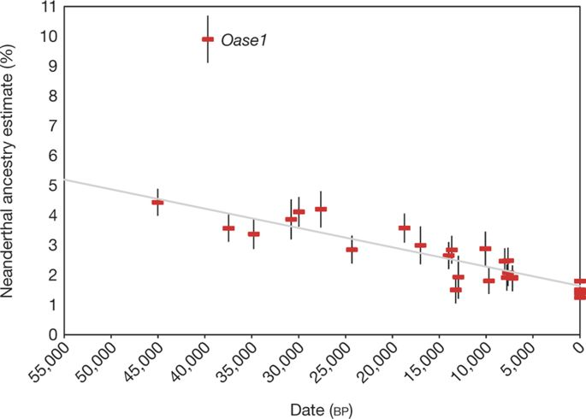
Neandertal ancestry
Fu et al. 2016

Slide 3
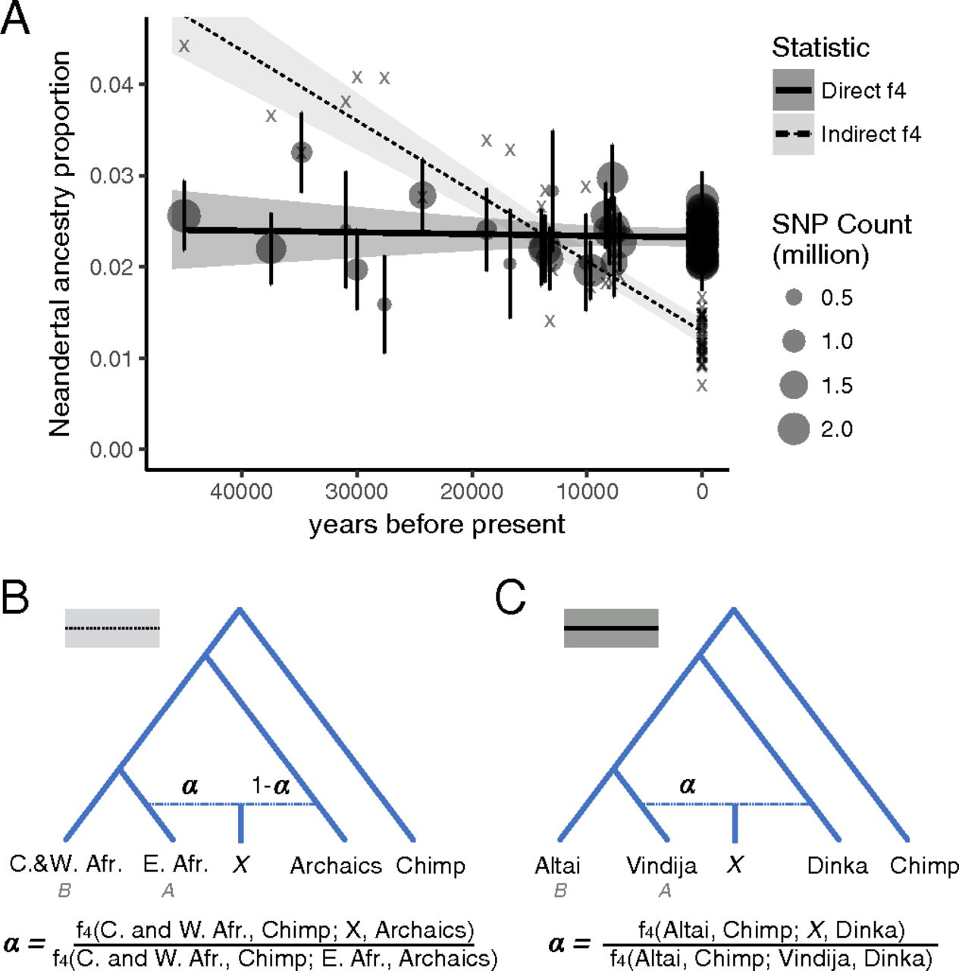
Petr et al. 2019

Slide 5
Admixture graphs

Slide 6
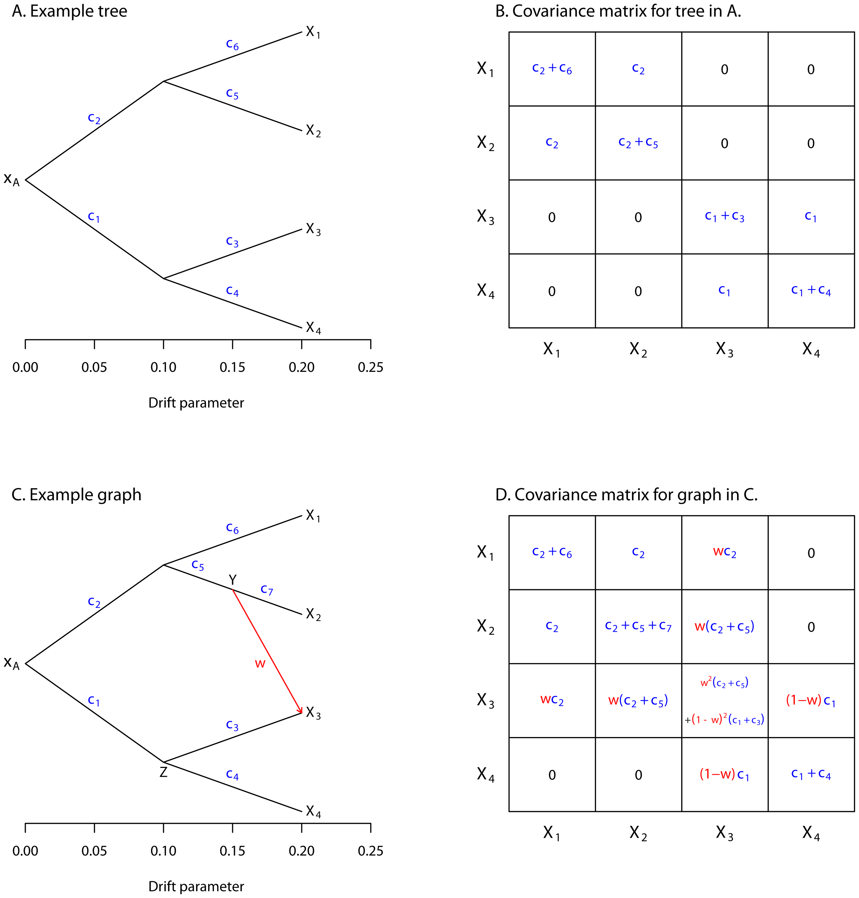

Slide 8
Population structure models

Slide 9
Using trees to describe
(human) population structure

Slide 10
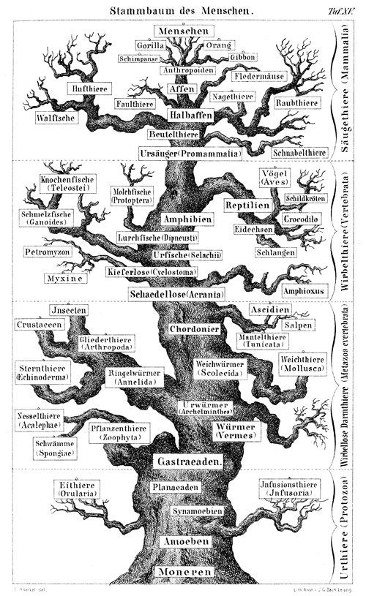

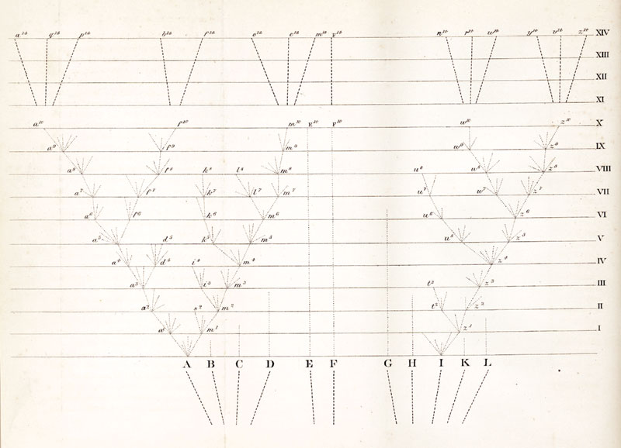
Trees are foundational to Systematics and Evolution
Wikipedia.org; Darwin 1859, Haeckel 1868

Slide 11
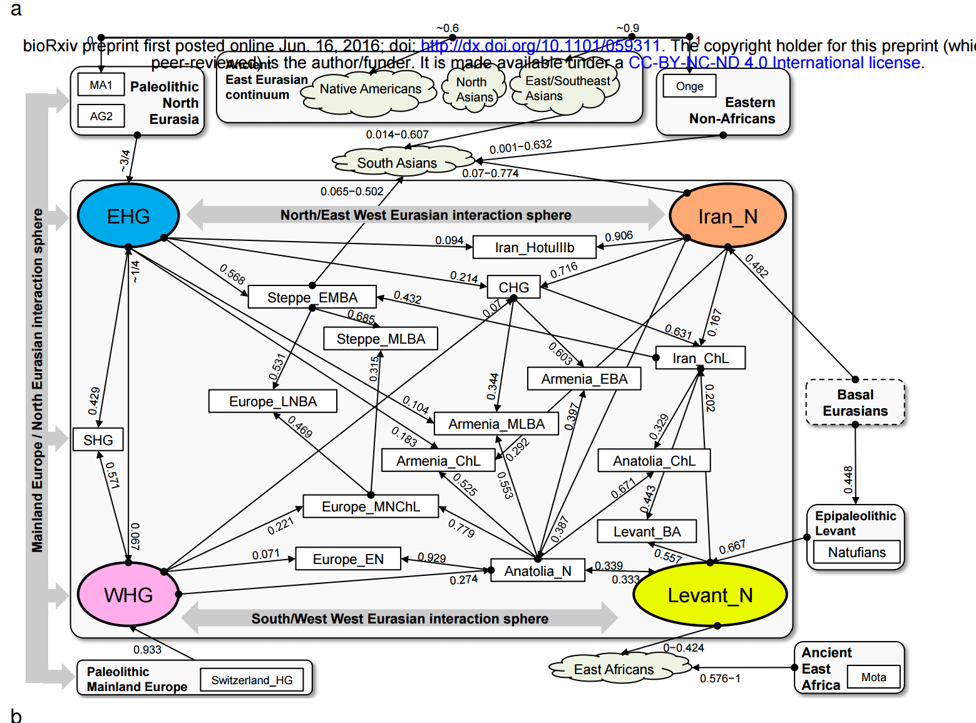
Or really complicated
Lazaridis et al. 2016, biorXiv

Slide 12
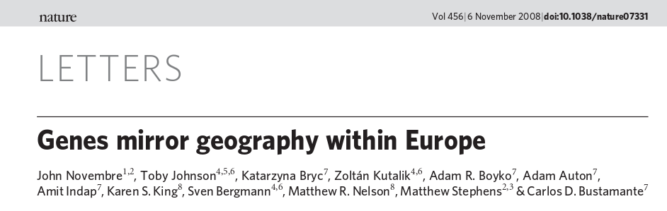
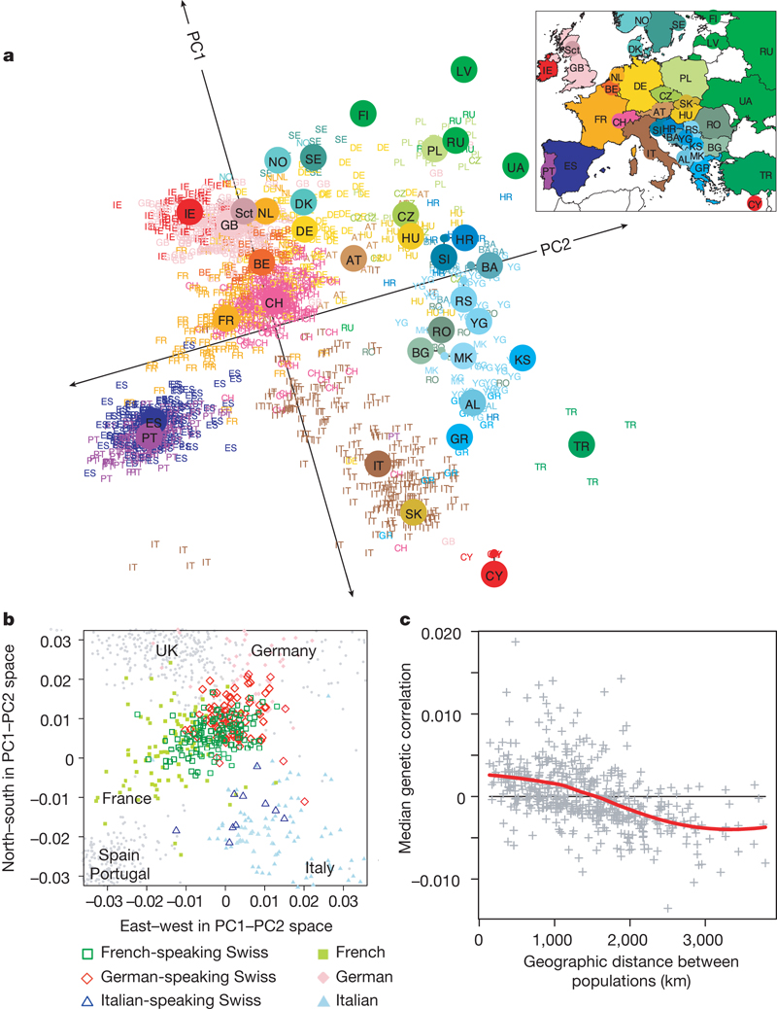
Or (nearly) continuous
Novembre et al. 2008, Nature

Slide 14
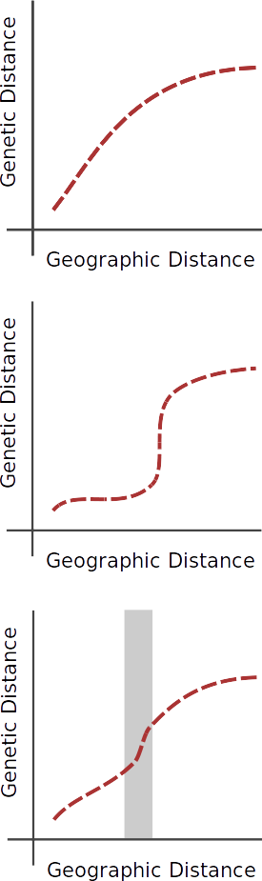
Continuous structure

Slide 15
Discrete structure

Slide 16
Inferring discontinuities

Slide 17
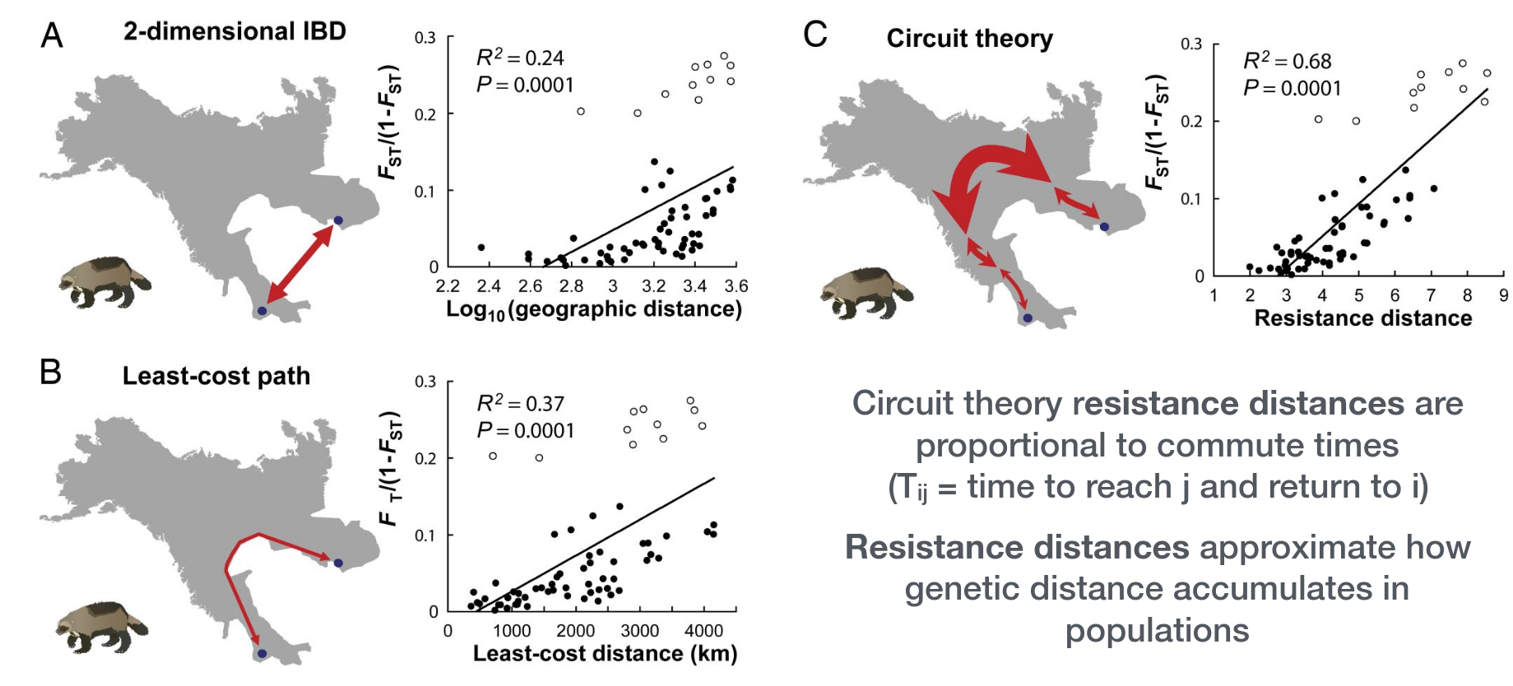
Where do individuals move?
Figure: McRae & Beier 2007

Slide 18
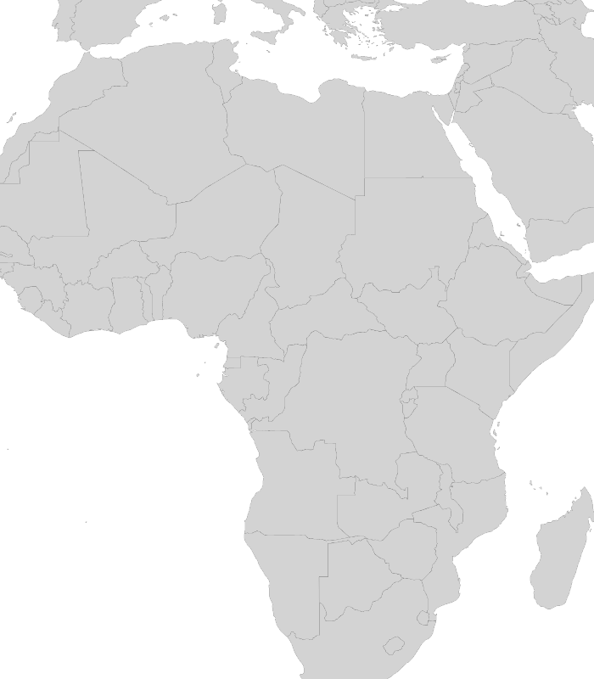

Slide 19
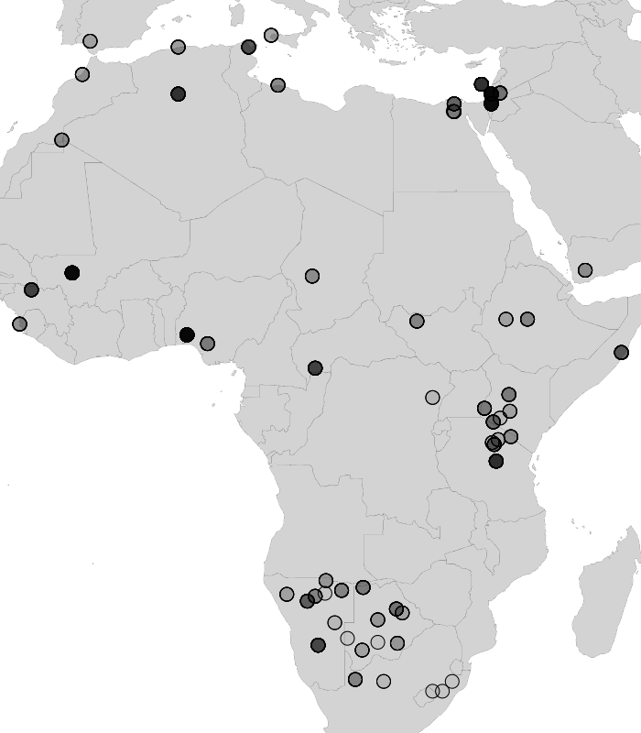

Slide 20
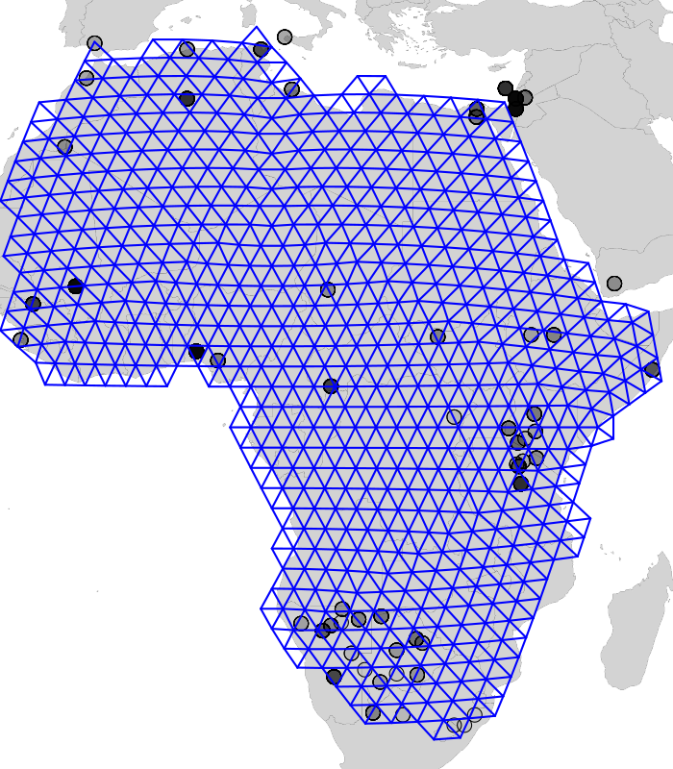

Slide 21
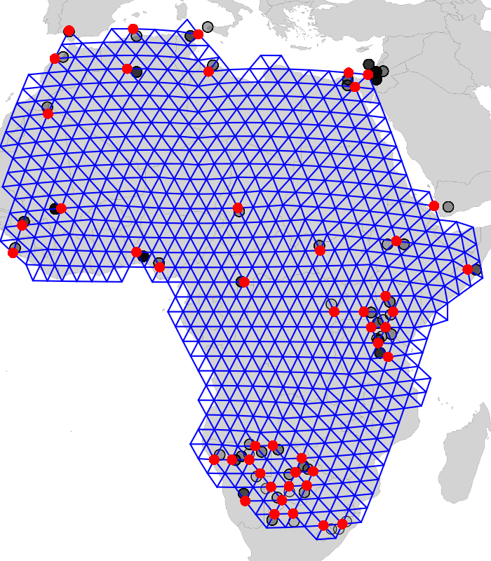

Slide 22
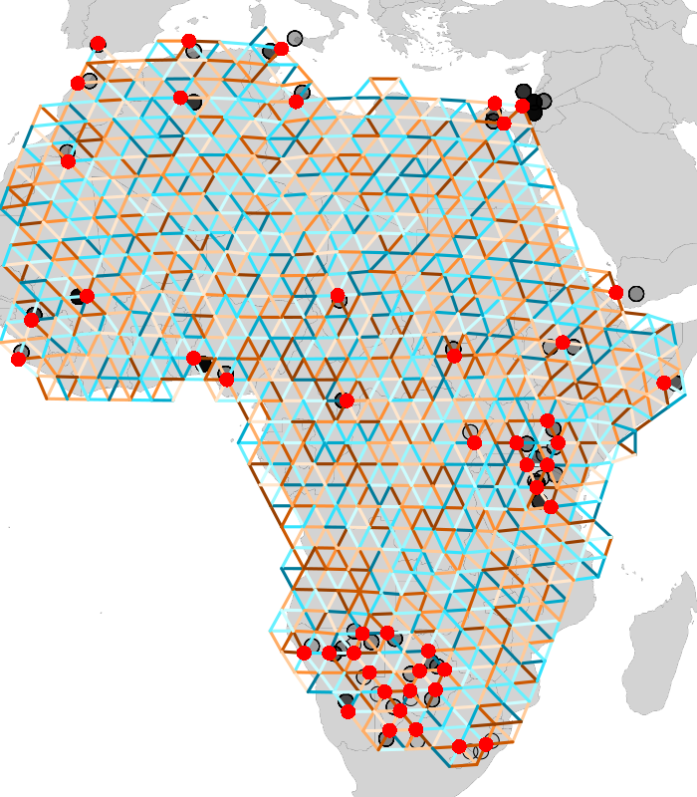
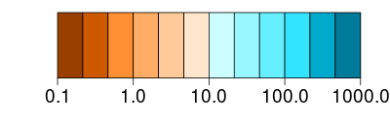
Migration Rate

Slide 23
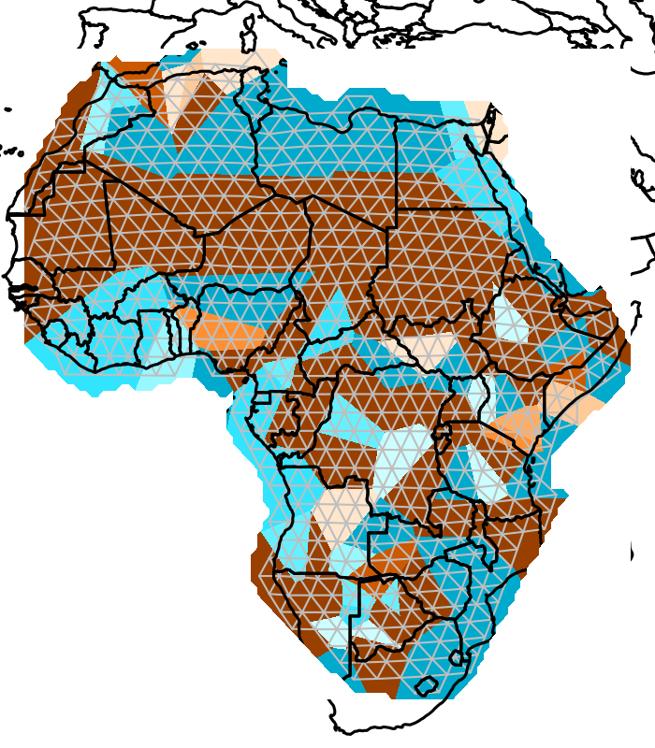
Migration Rate

Slide 24
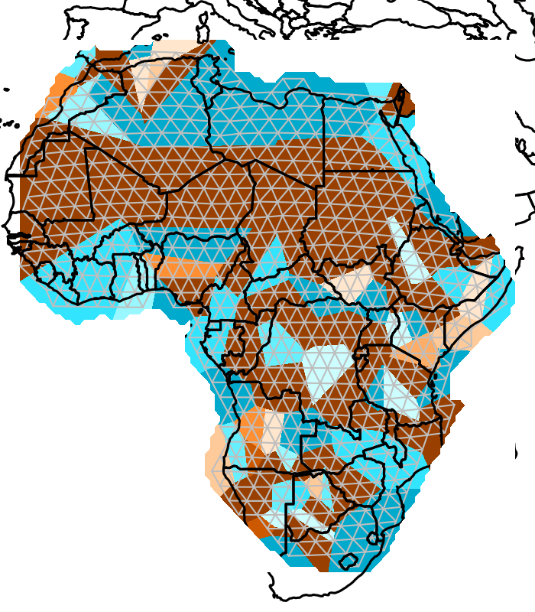
Migration Rate

Slide 25
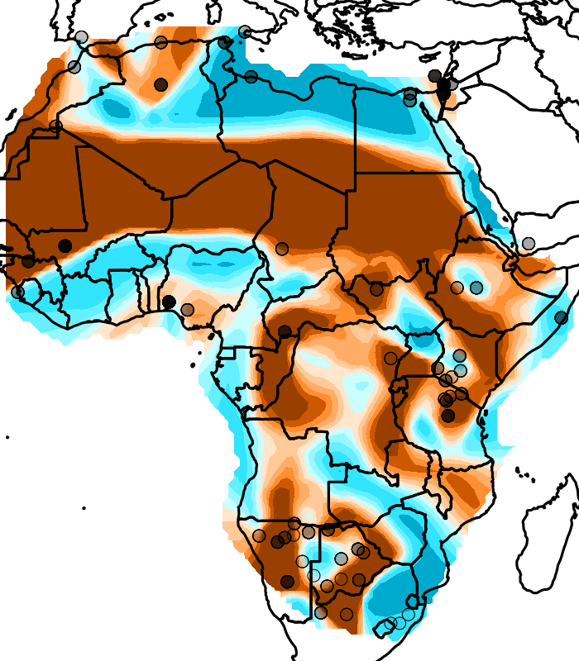
Migration Rate

Slide 26
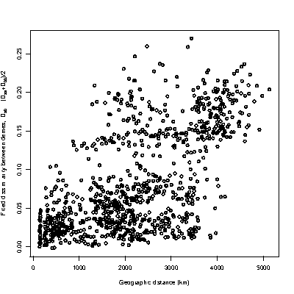
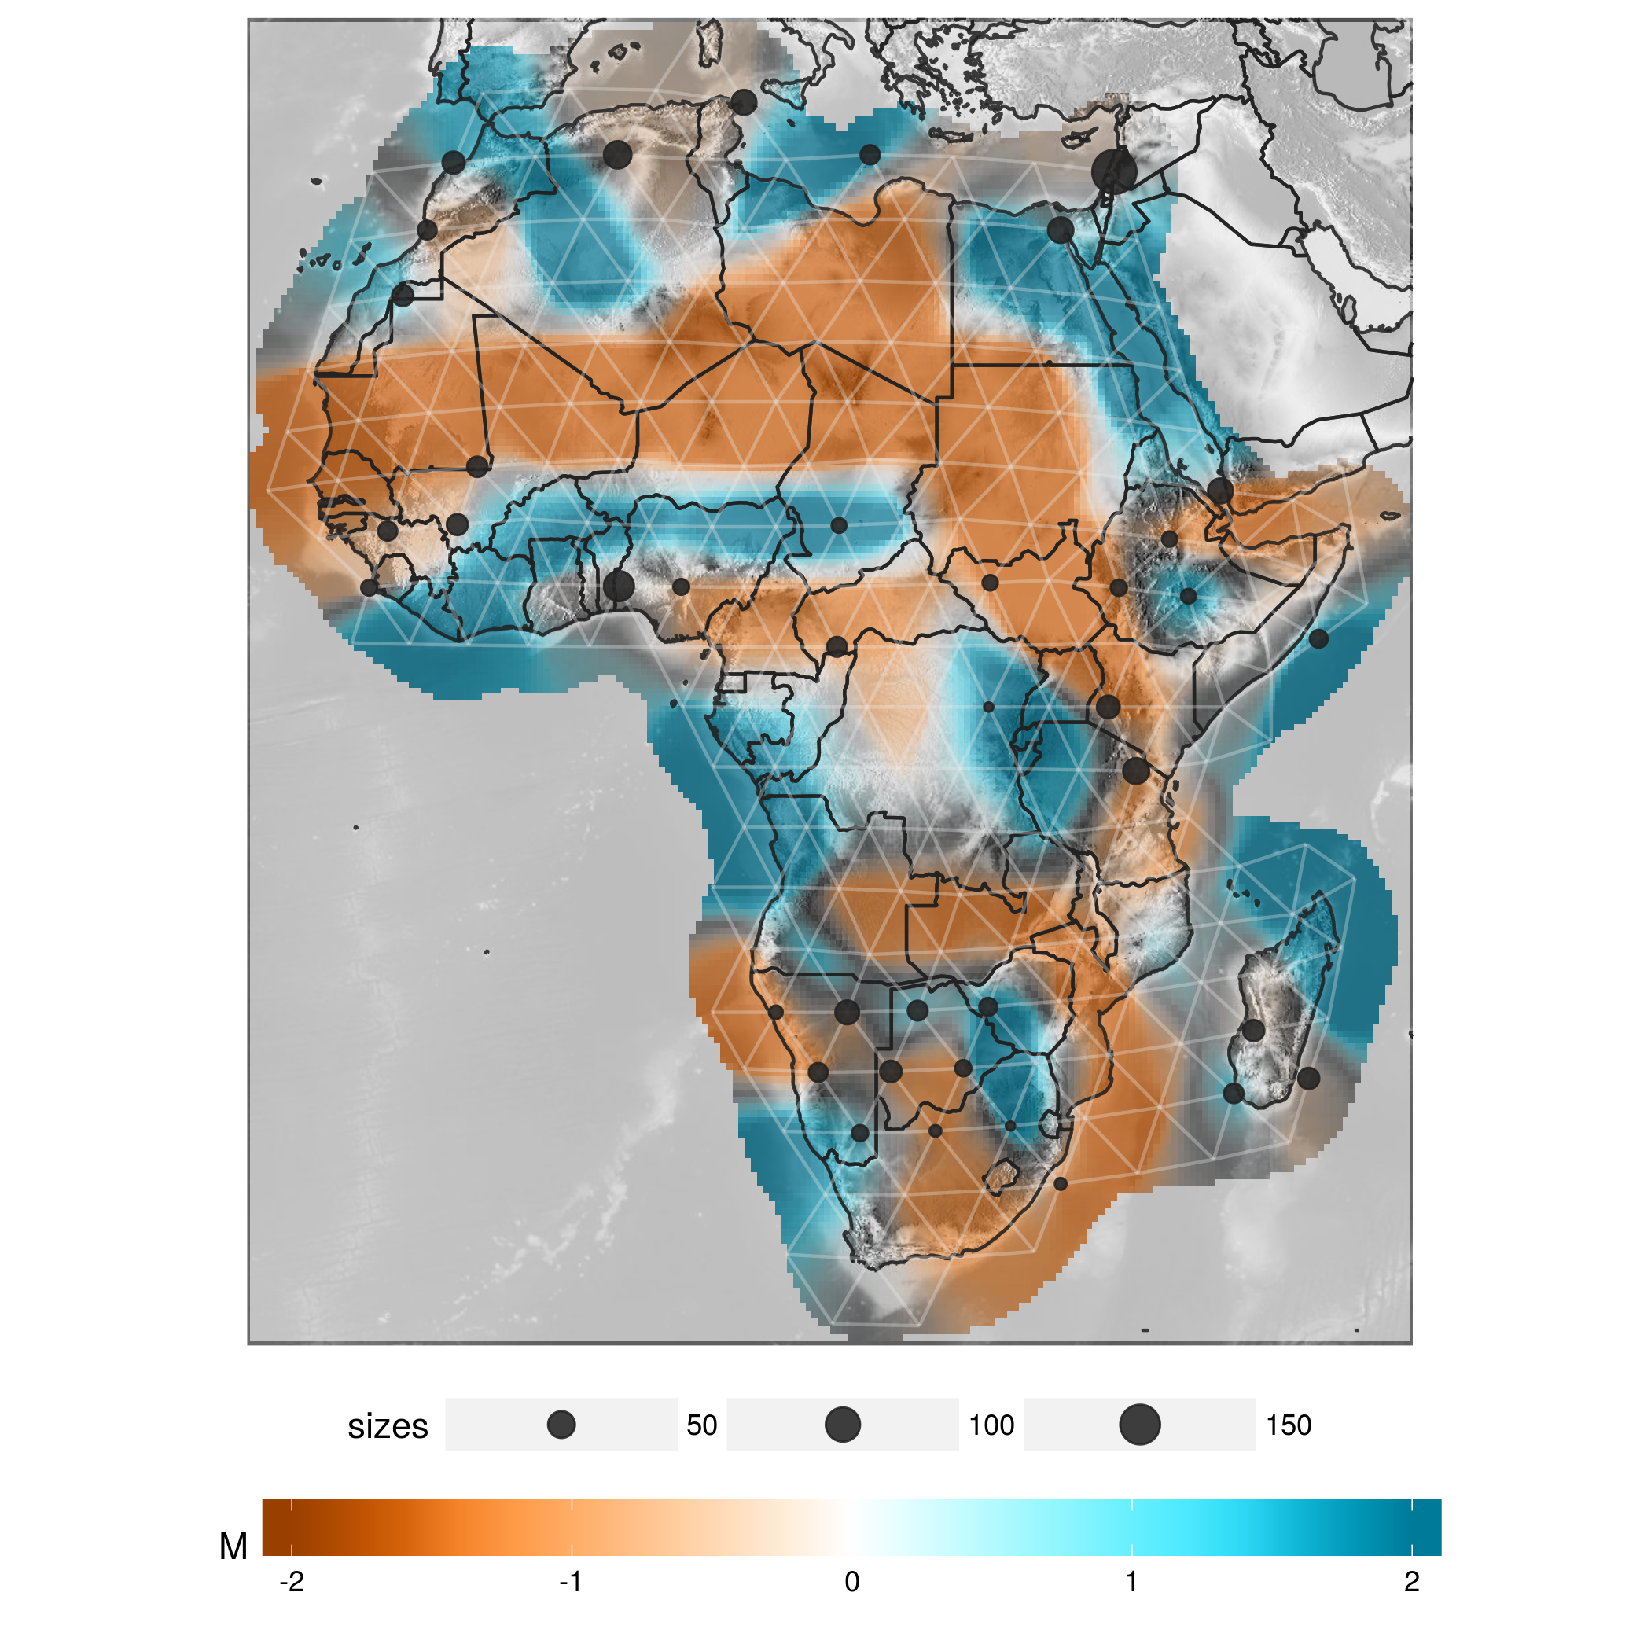
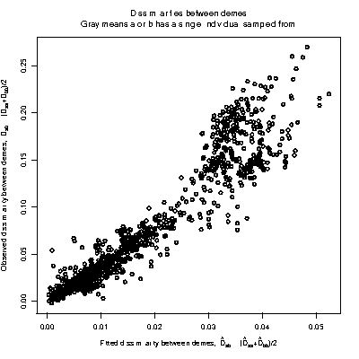
Genetic distance
Geographic distance
Genetic distance
Migration Rate
Fitted circuit distance
Fitted circuit distance

Slide 27
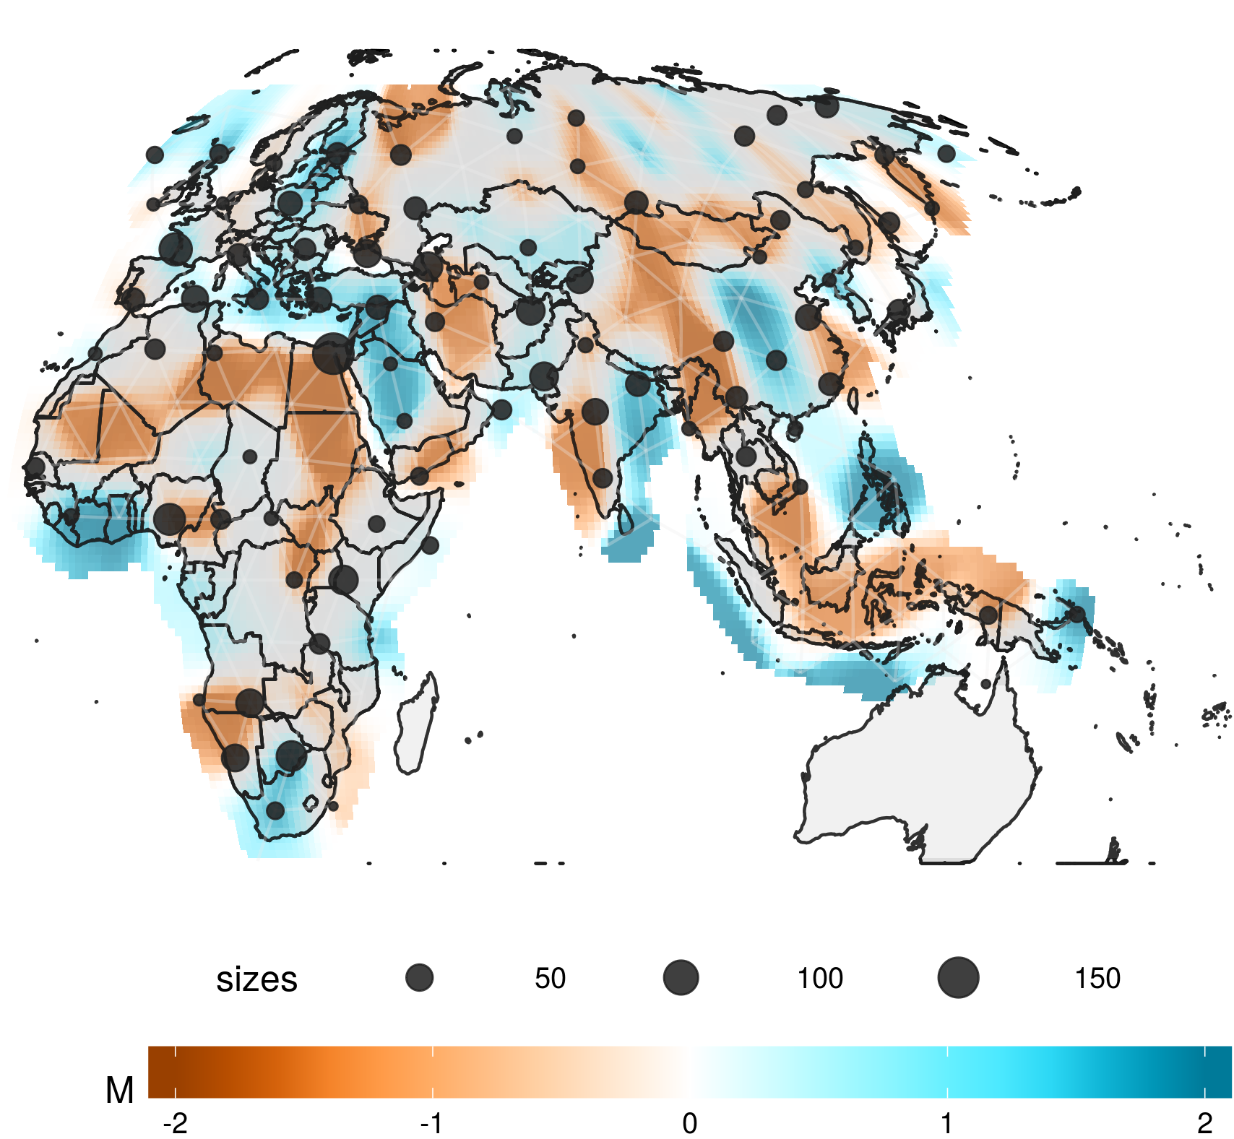
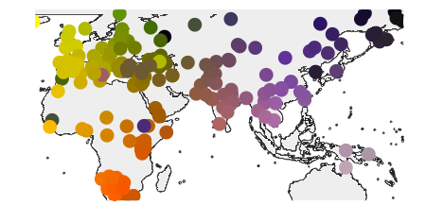
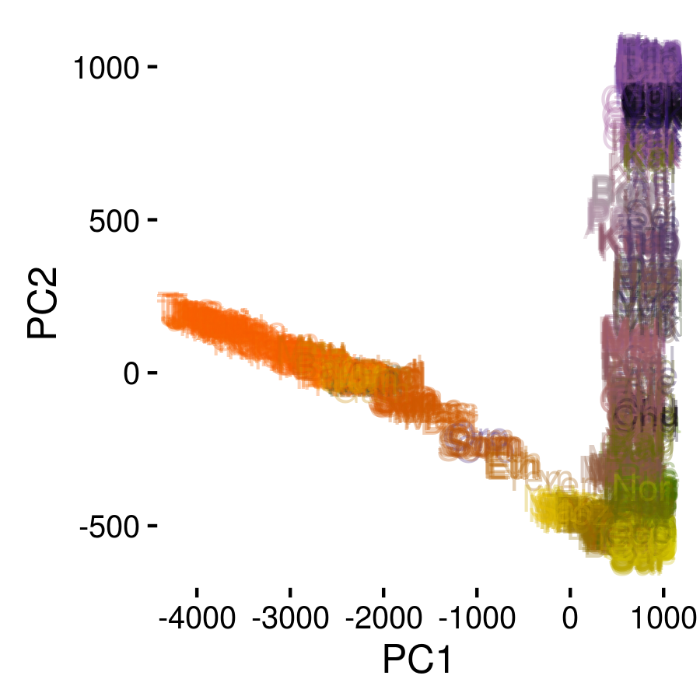
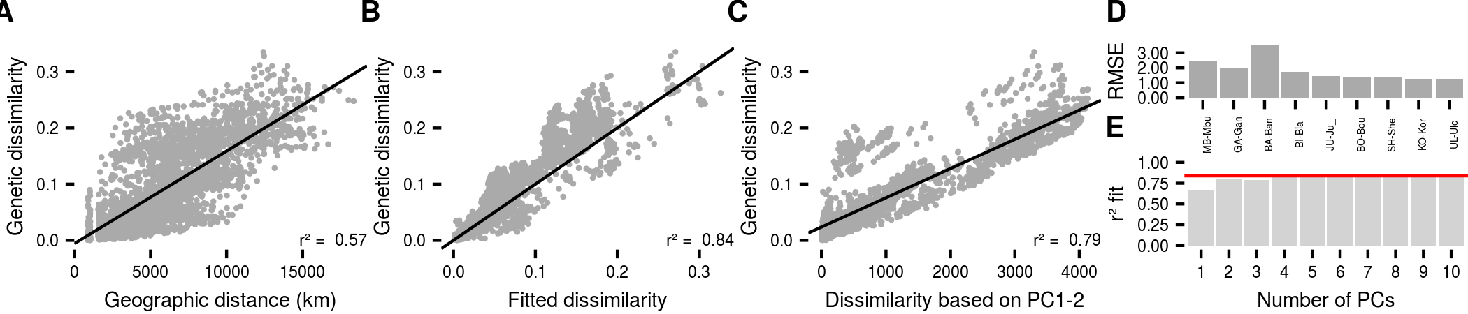
Global patterns

Slide 28
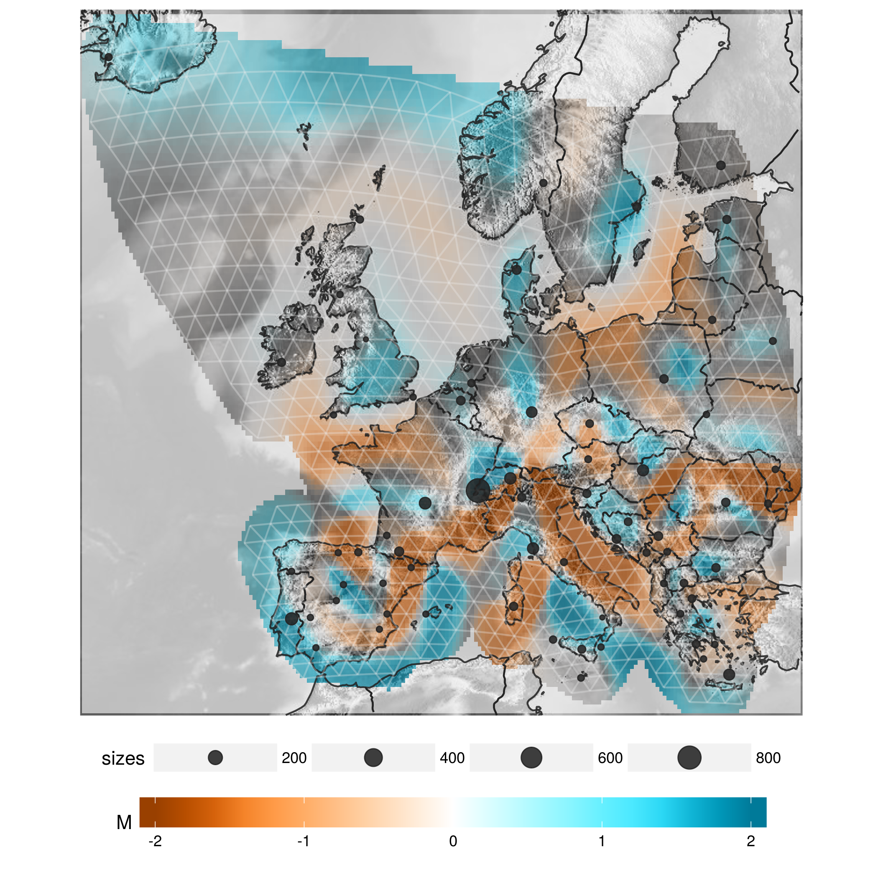
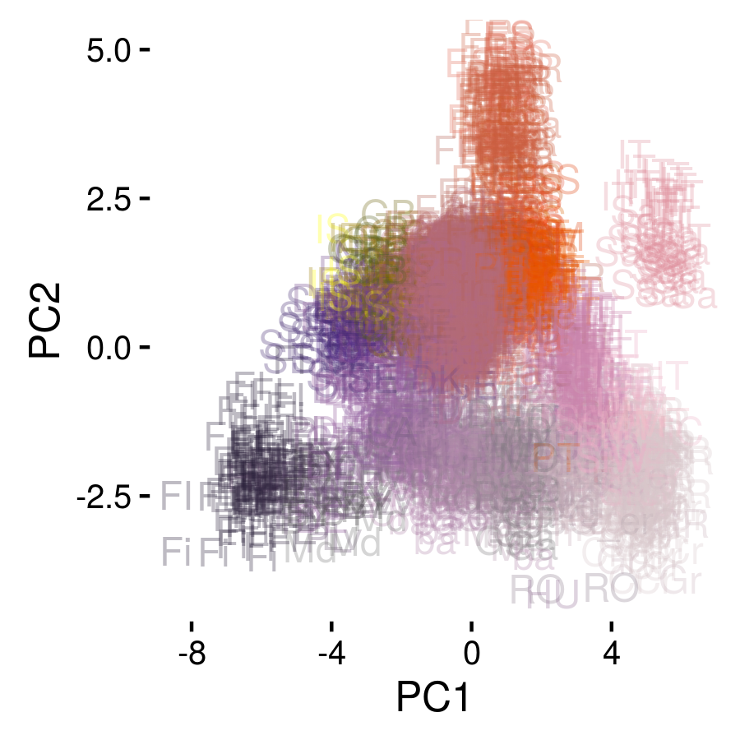
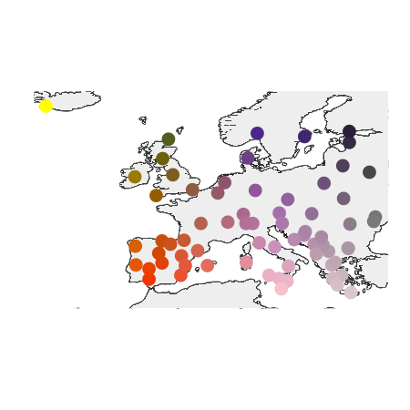
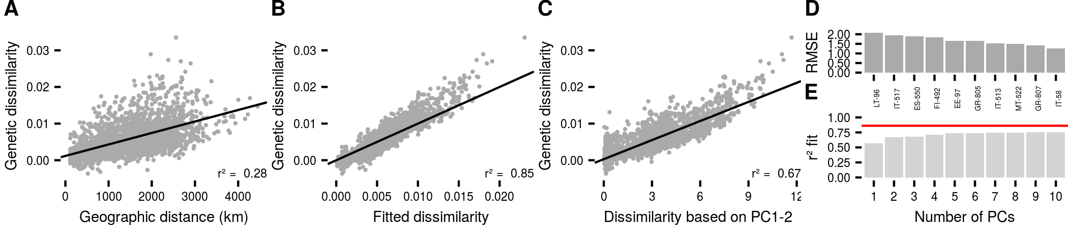
Europe

