Slide 1
F-statistics and Population Structure
Benjamin Peter, MPI for Evolutionary Anthropology

Slide 2
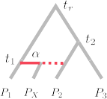
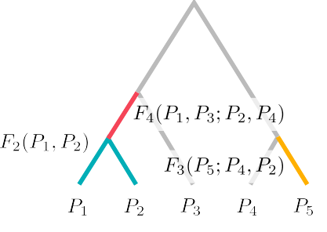
Recap

Slide 3
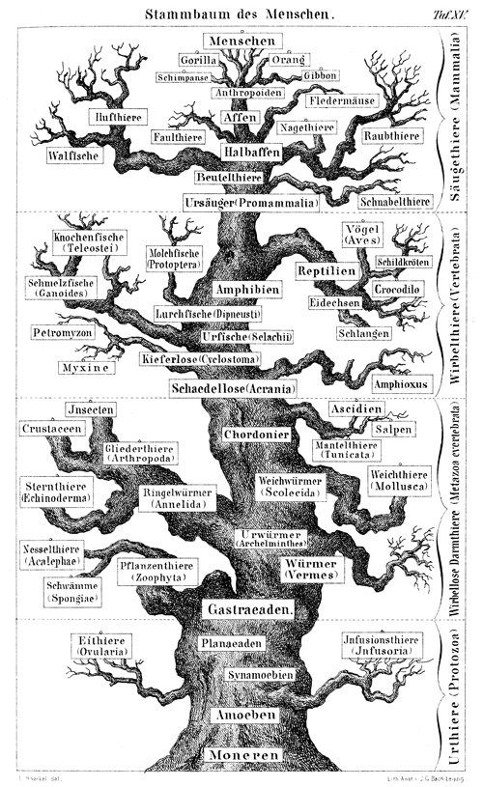
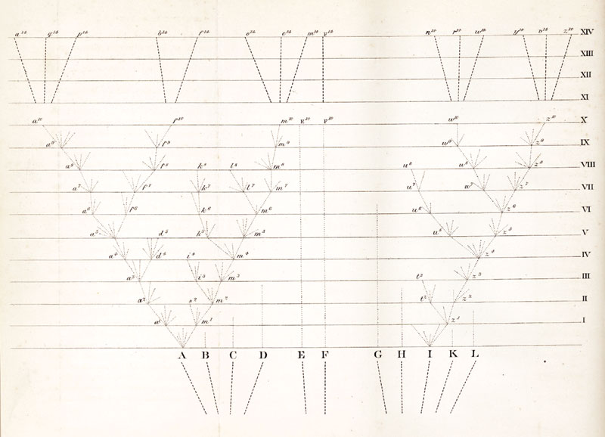
Trees are foundational to Systematics and Evolution
Wikipedia.org; Darwin 1859, Haeckel 1868

Slide 4
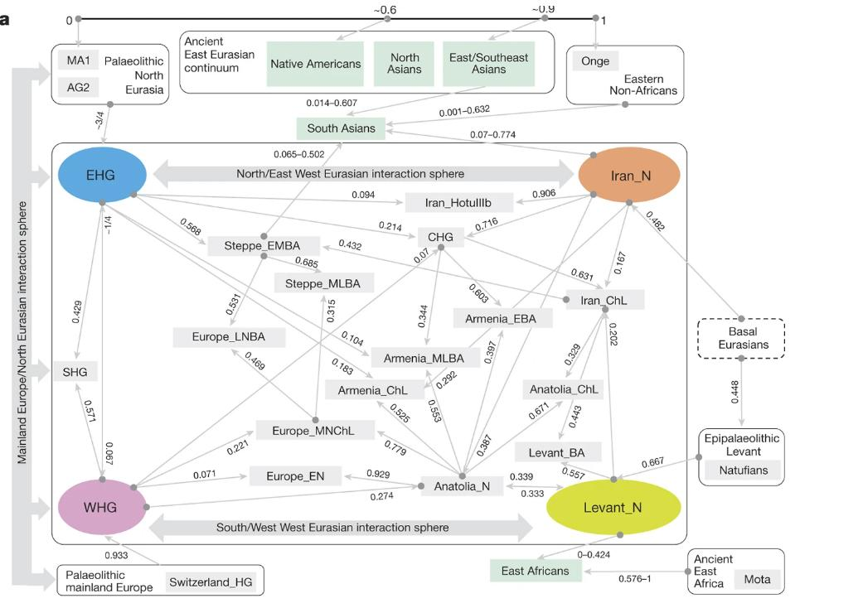
Or really complicated
Lazaridis et al. 2016, Nature

Slide 5
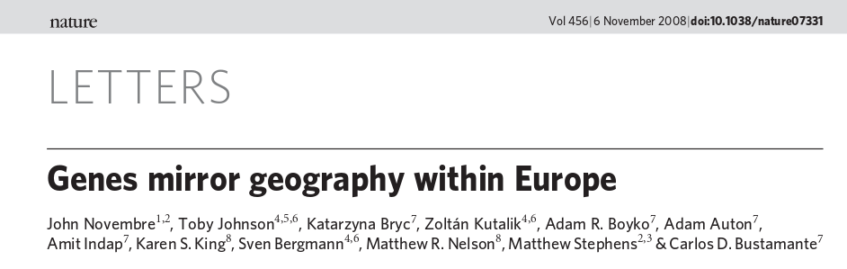
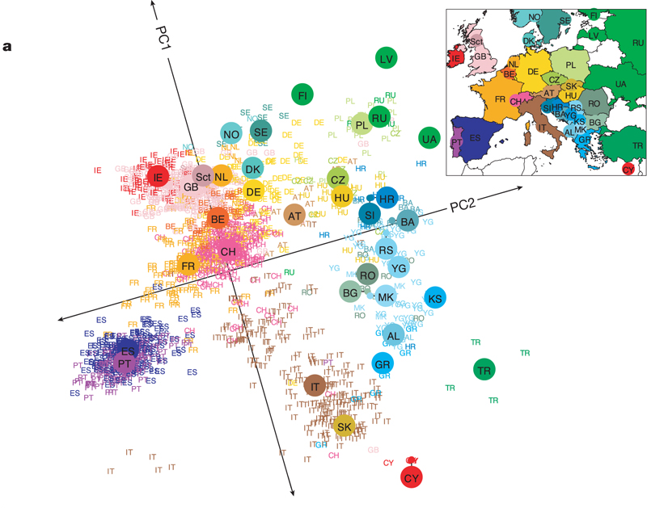
Or (nearly) continuous
Novembre et al. 2008, Nature

Slide 6
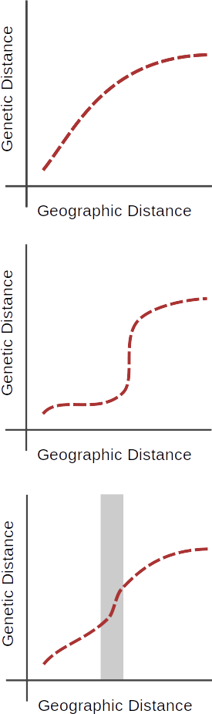
Continuous structure

Slide 7
Discrete structure

Slide 8
Inferring discontinuities

Slide 9
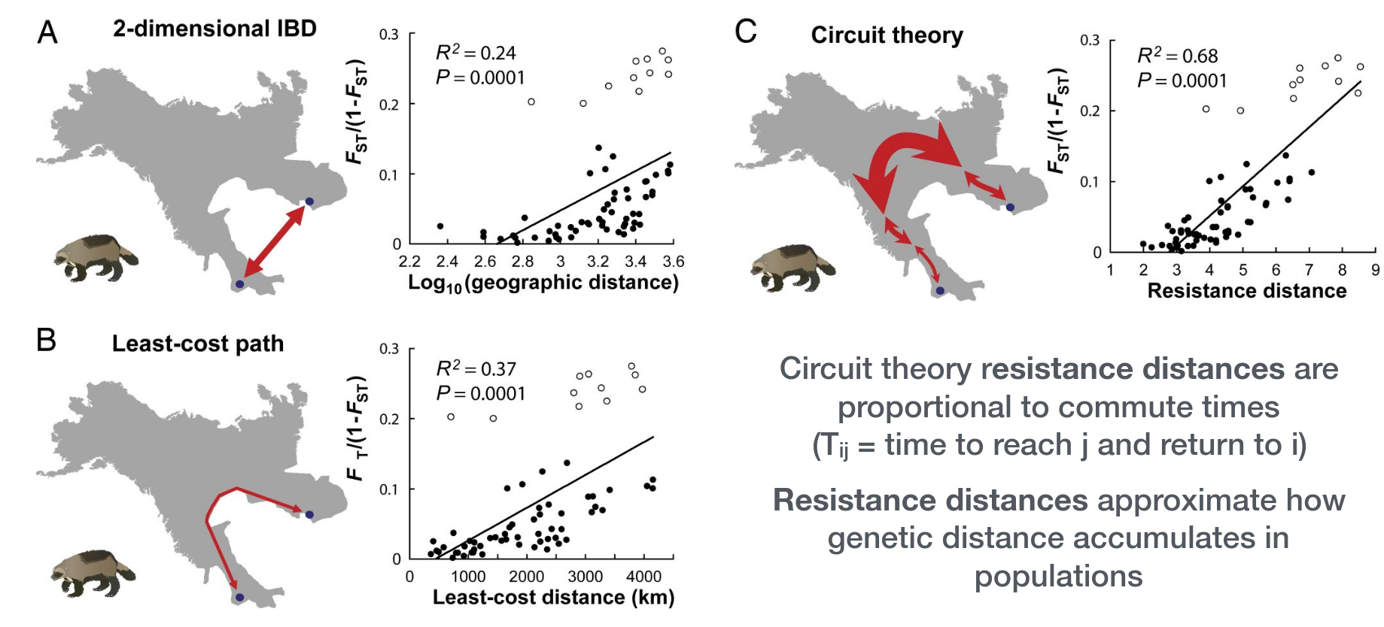
Where do individuals move?
Figure: McRae & Beier 2007

Slide 10


Slide 11
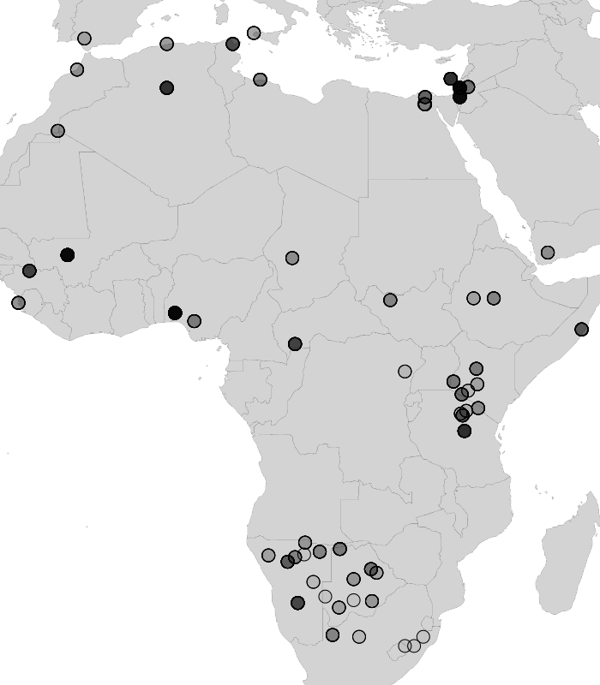
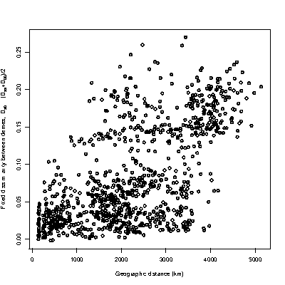
Genetic distance
Geographic distance

Slide 12
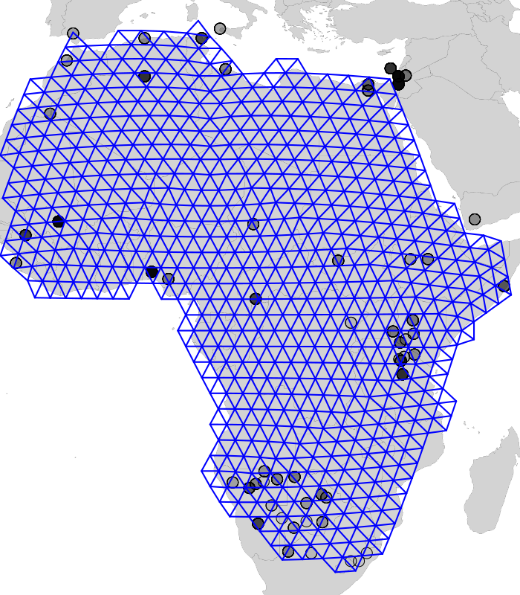

Slide 13
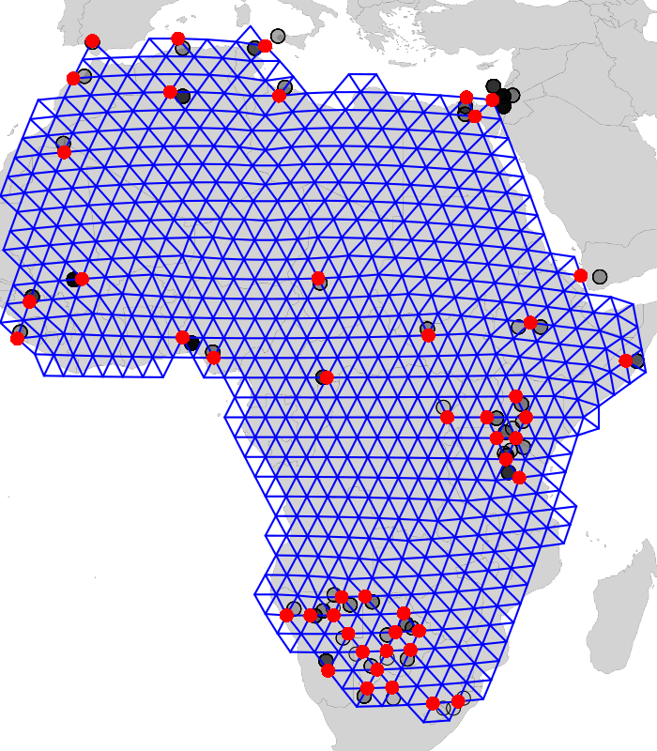

Slide 14
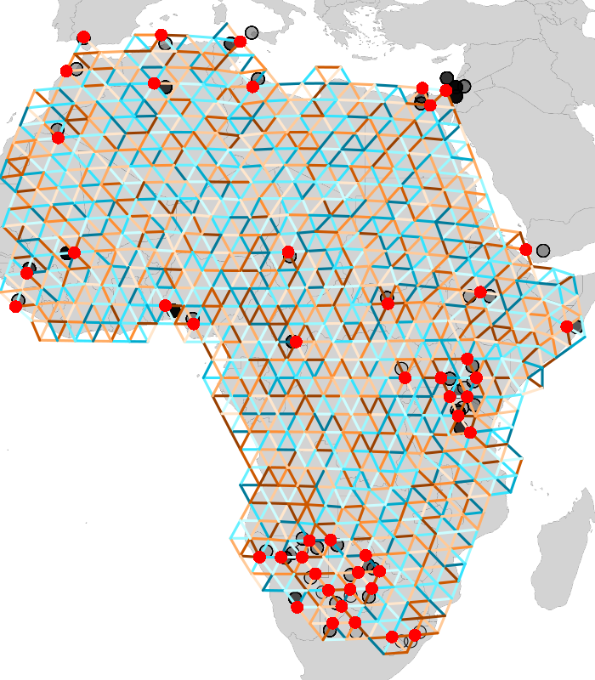
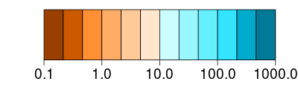
Migration Rate

Slide 15
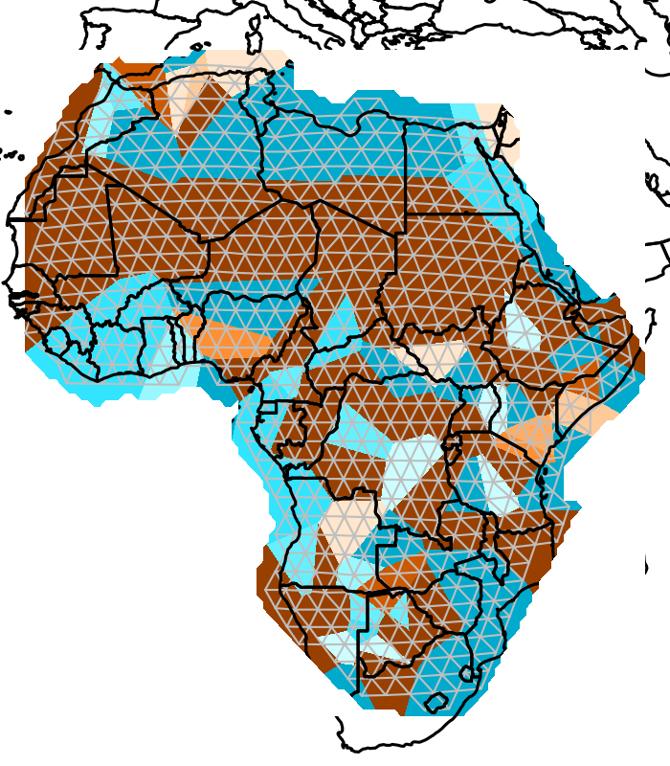
Migration Rate

Slide 16
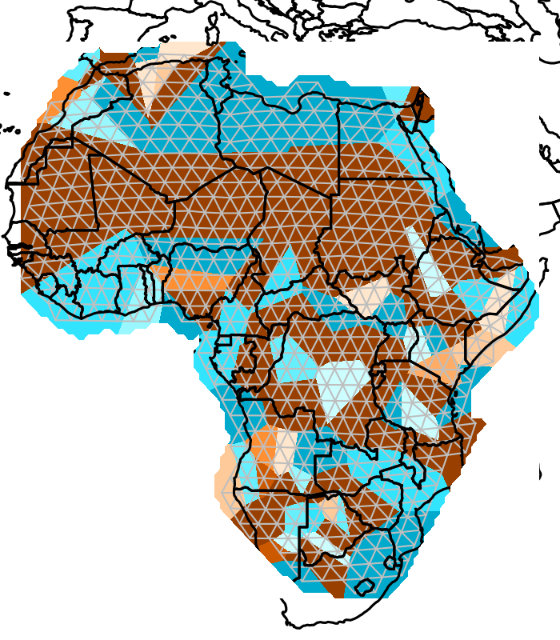
Migration Rate

Slide 17
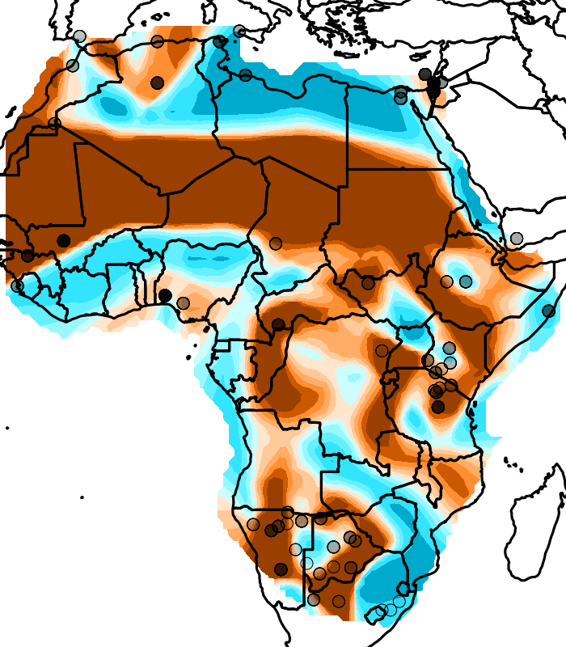
Migration Rate

Slide 18
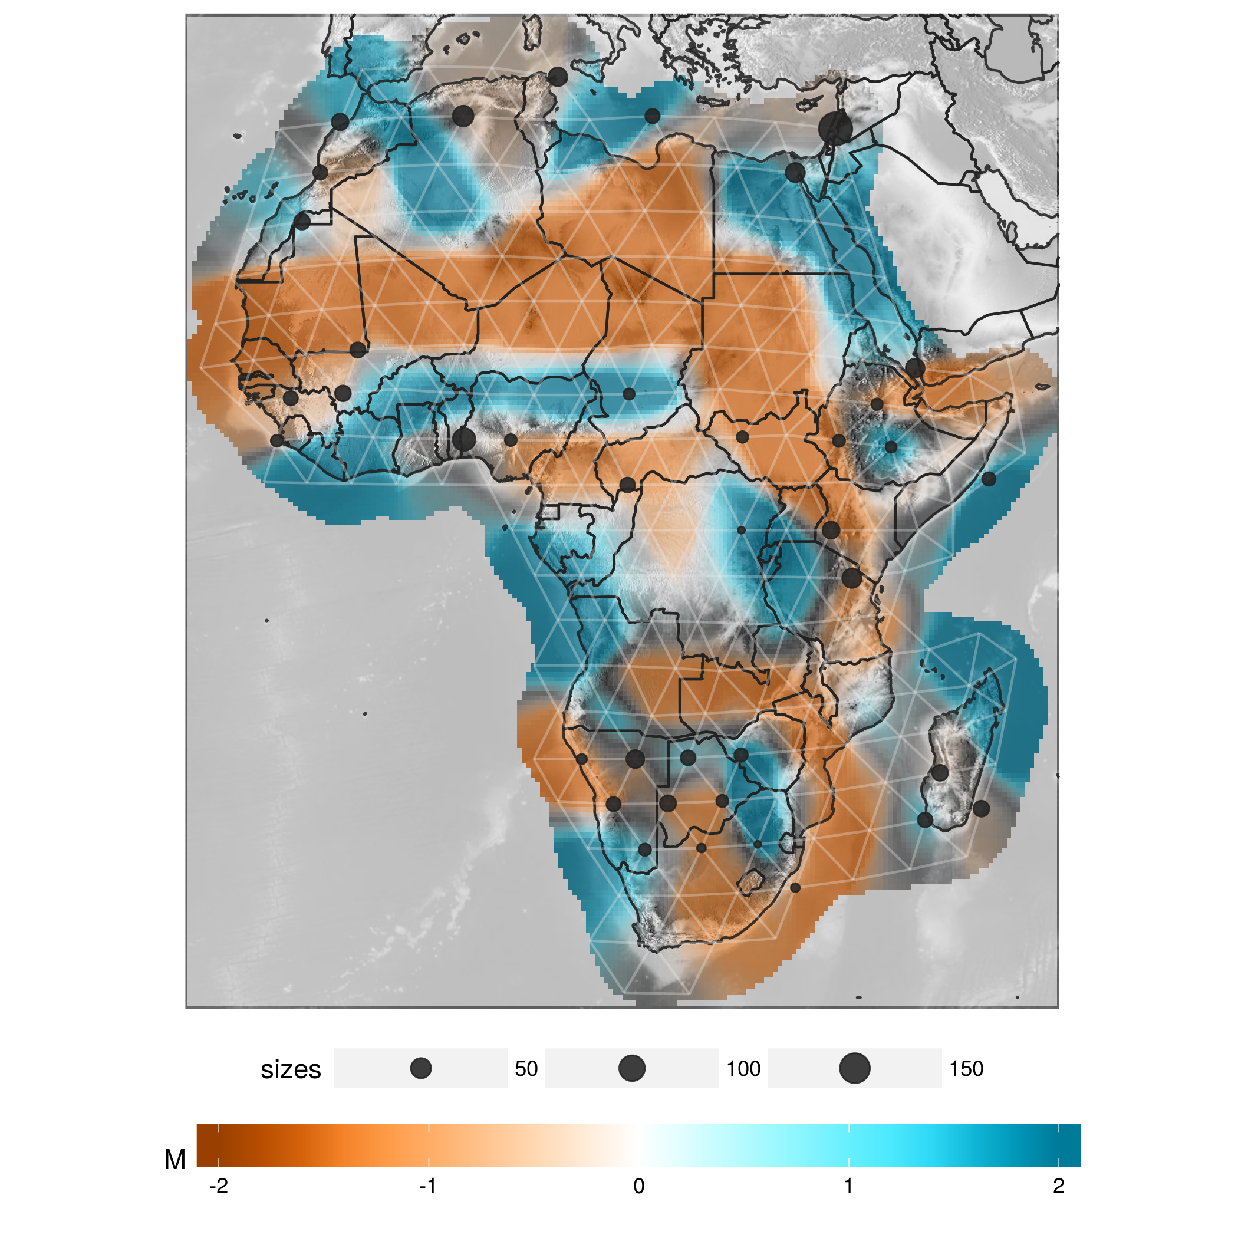
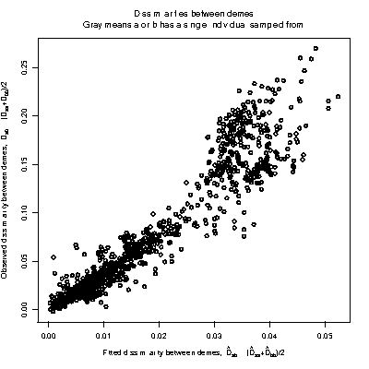
Genetic distance
Geographic distance
Fitted circuit distance
Fitted circuit distance

Slide 19
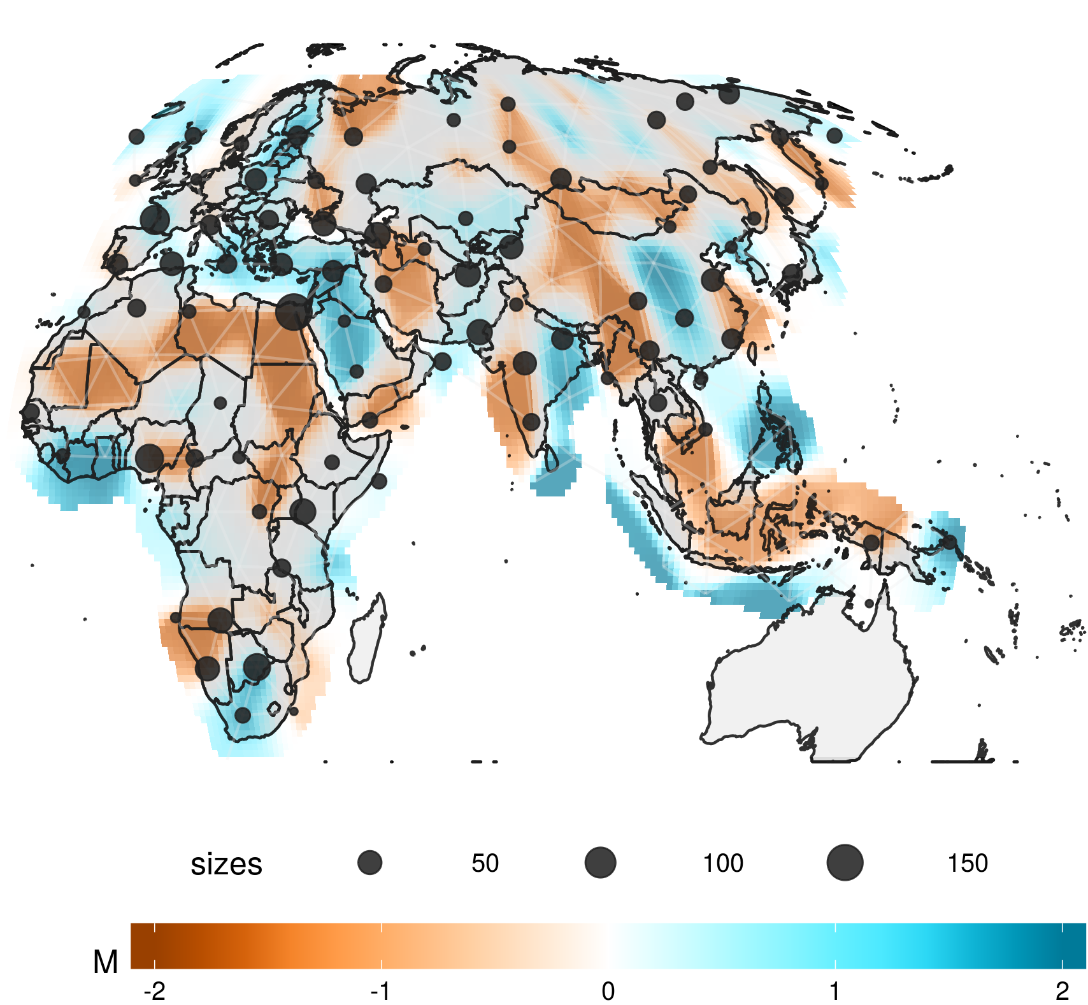
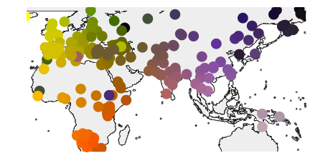
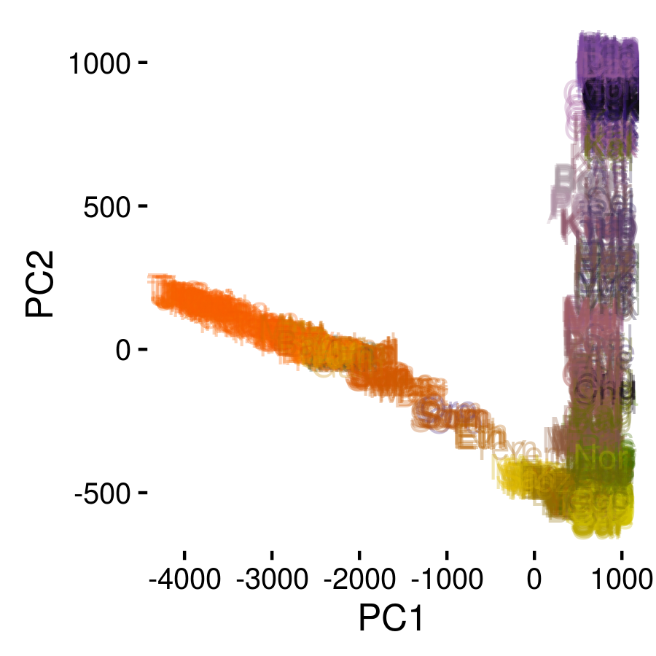
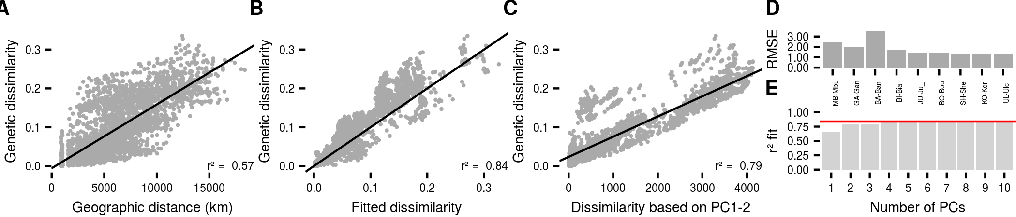
Peter, Petkova & Novembre (2020)

Slide 20
Models are starting points!
Discrete pops
Trees
Clustering
Admixture graphs
Continuous pops
PCA
Spatial methods

Slide 21

Recap: F-stats as branches on tree
F2 is pairwise distance
F3 is external branch
F4 is internal branch
Simple hypothesis tests involving 2,3 or four pops

Slide 22
Estimating Trees from F-stats
Calculate all F2-statistics
Treat them as distances
Estimate tree (fitting covariance, or standard algorithms such as neighbor-joining)

Slide 23
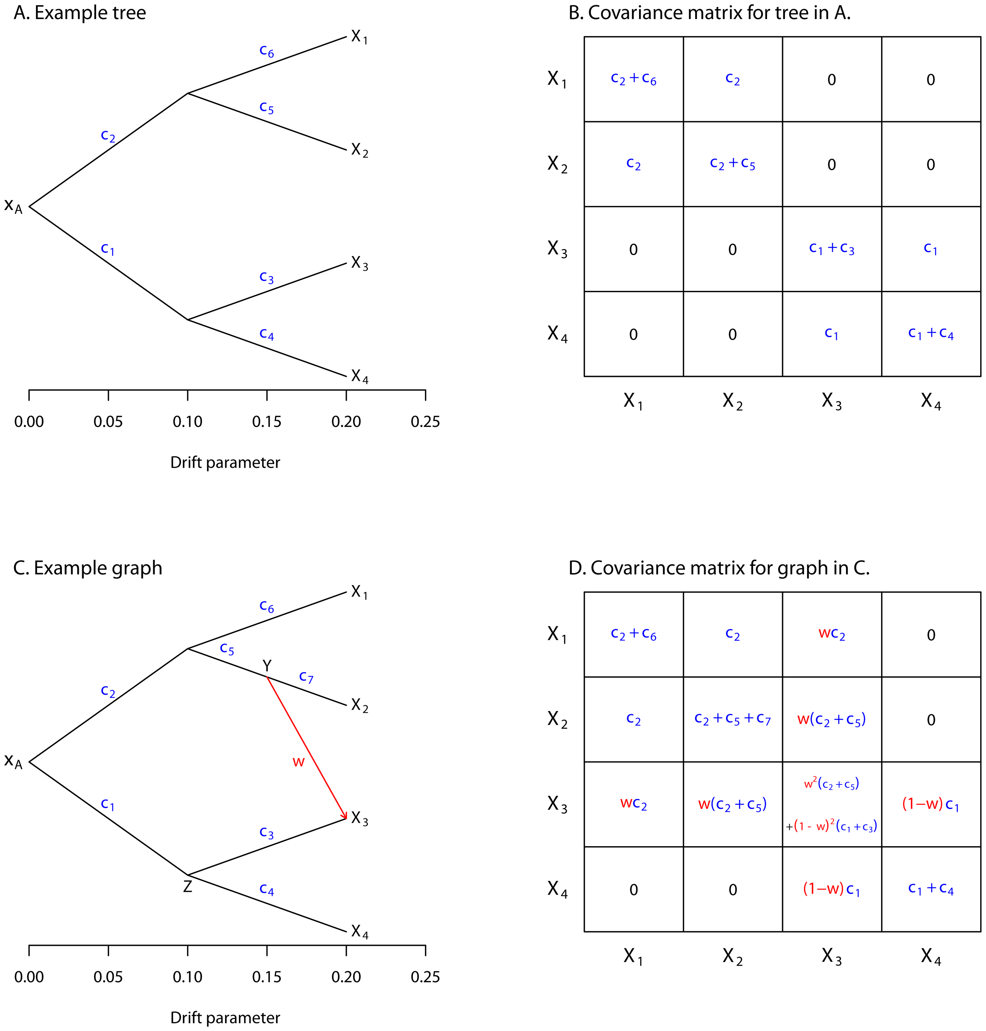
Covariance of a tree
F2(X, Y) = Var(X) + Var(Y) - 2Cov(X, Y)
Figure from Pickrell & Pritchard (2012)

Slide 24
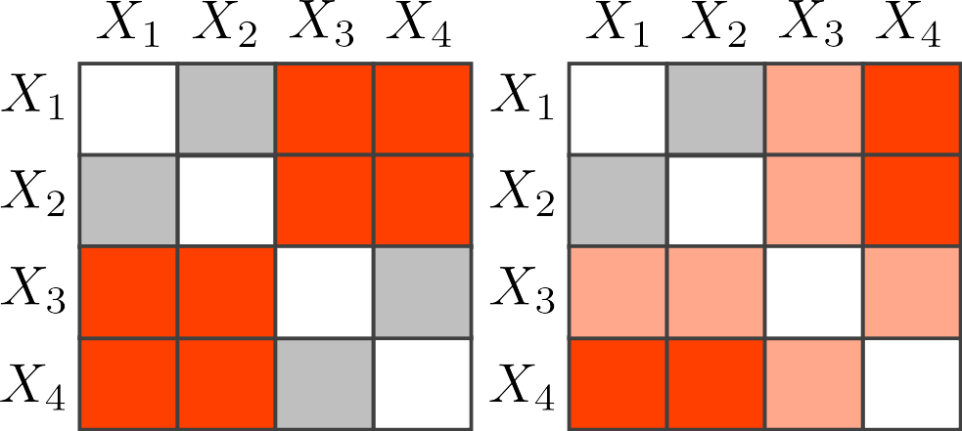
Distance matrix of a tree
F2(X, Y) = Var(X) + Var(Y) - 2Cov(X, Y)

Slide 25
Covariance of Admixture Graph

Slide 26
Distance matrix of Admixture Graph

Slide 27
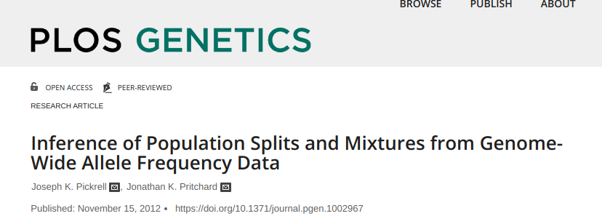

Applications
treemix
qpgraph (admixtools)

