Slide 1
Trees, Admixture graphs and population structure

Slide 2
Using trees to describe
(human) population structure

Slide 3
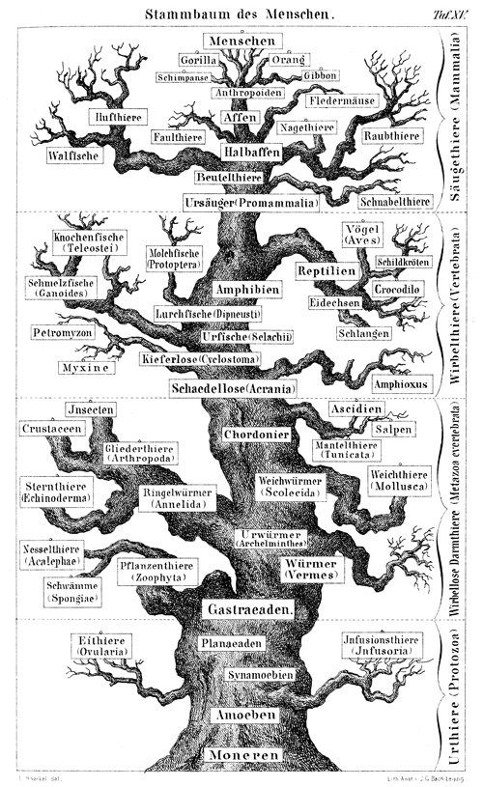
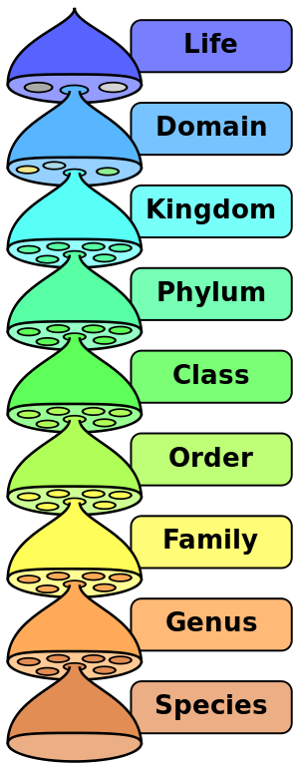
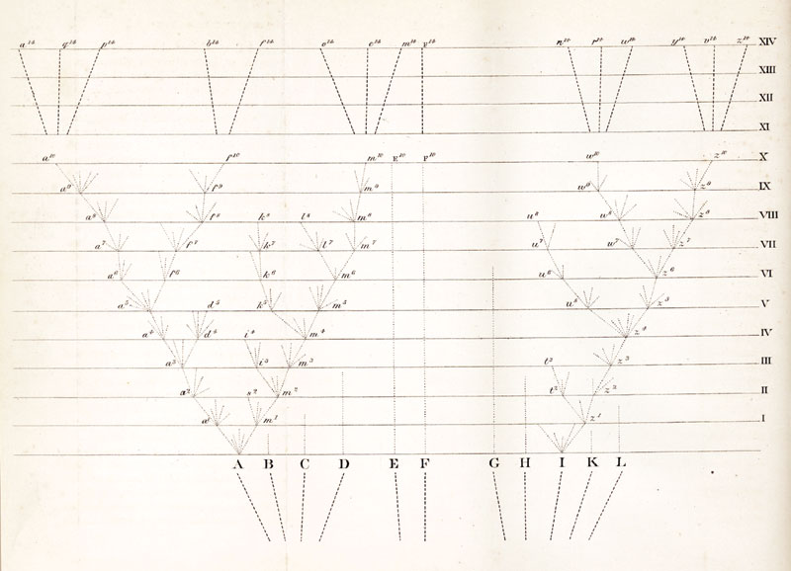
Trees are foundational to Systematics and Evolution
Wikipedia.org; Darwin 1859, Haeckel 1868

Slide 4
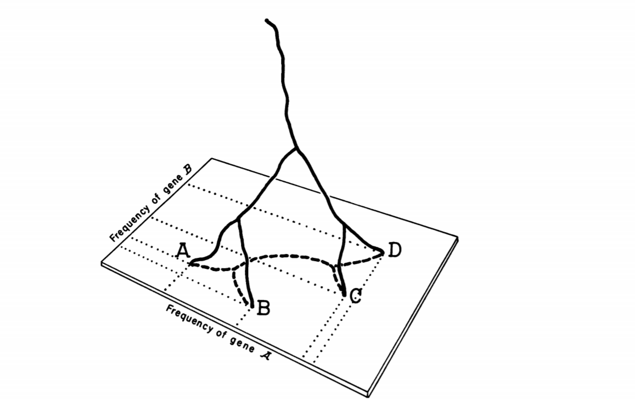
Where do trees come from?
Cavalli-Sforza & Edwards, 1967

Slide 5
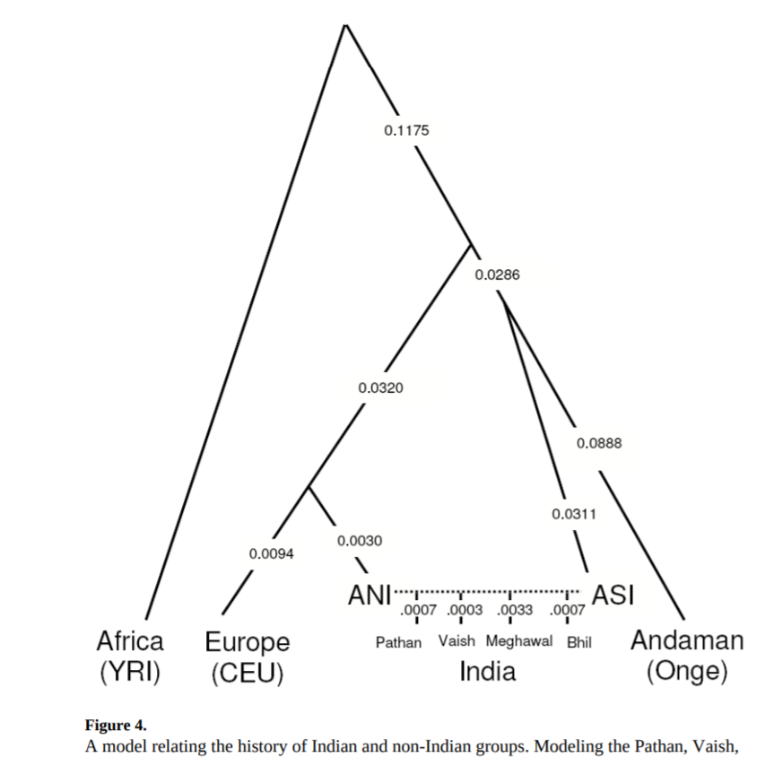
But when does this model break?
Reich et al. 2009

Slide 6
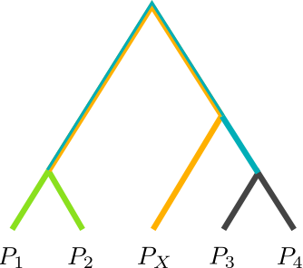
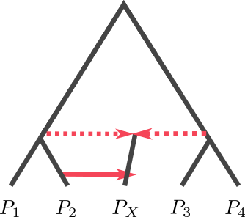
Trees and Admixture Graphs

Slide 7

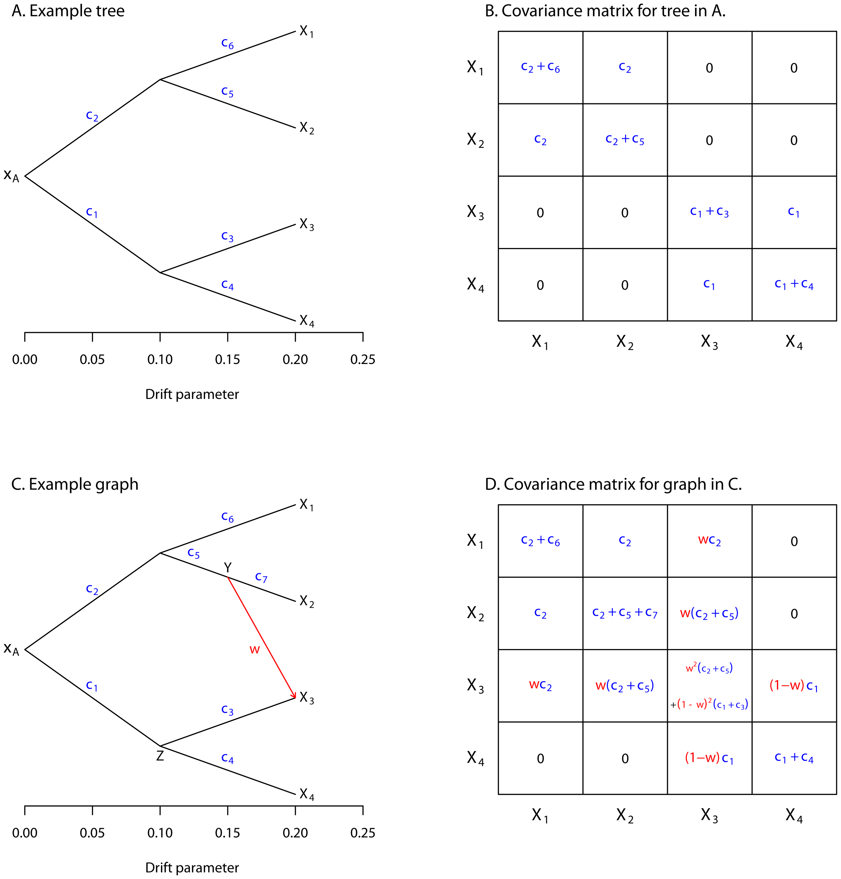

Slide 8
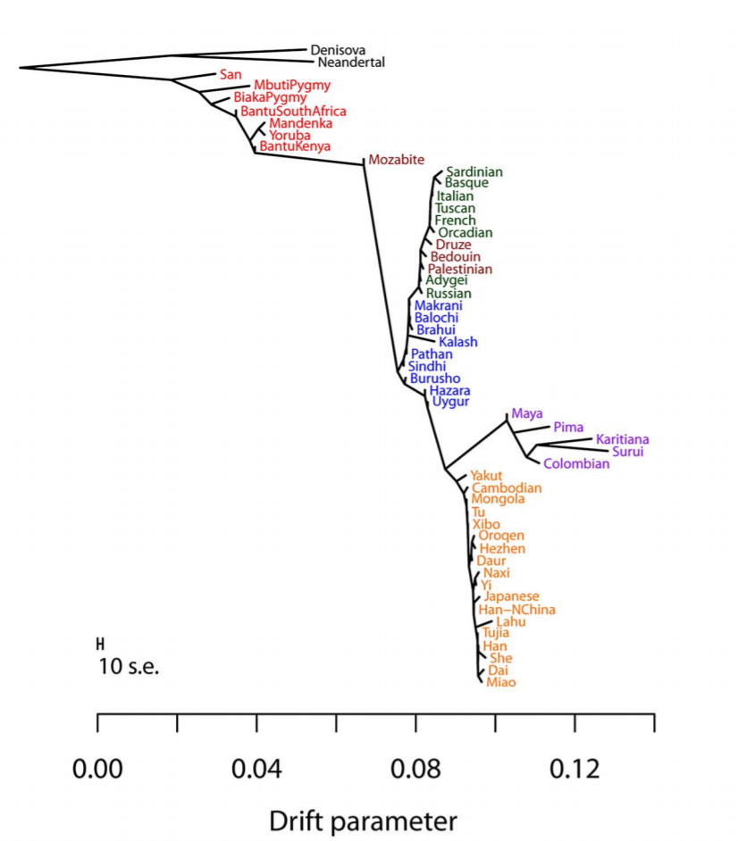
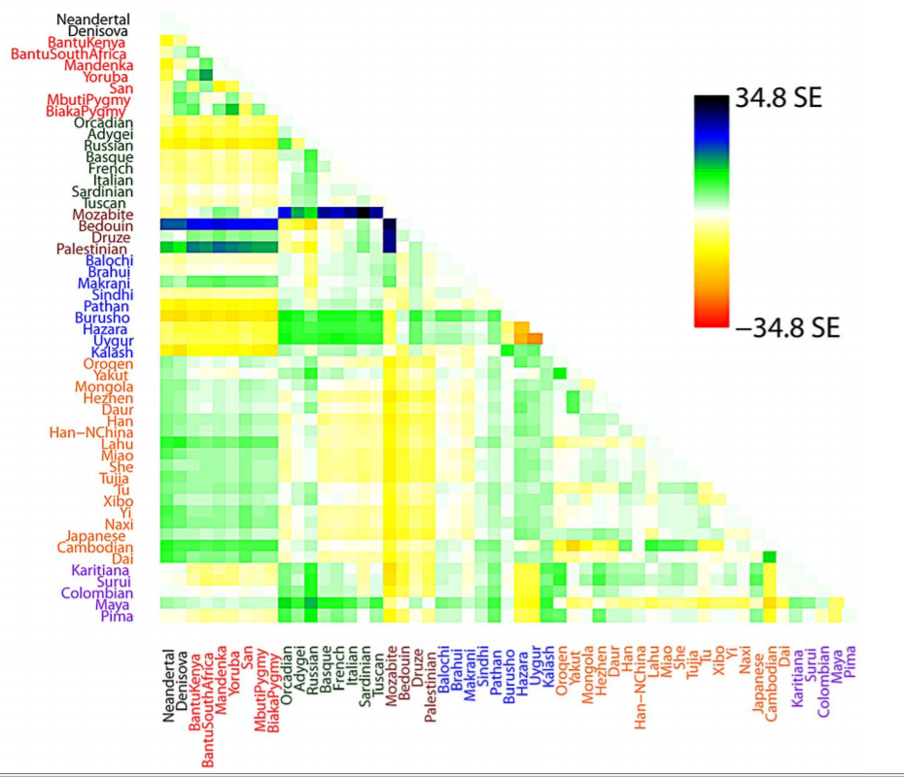

Slide 10
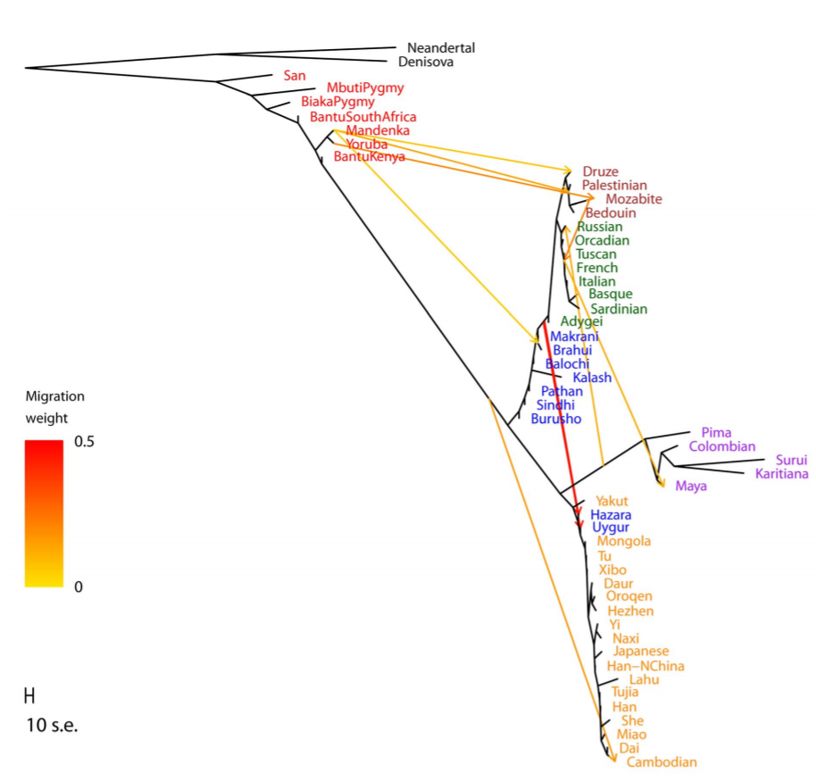

Slide 11
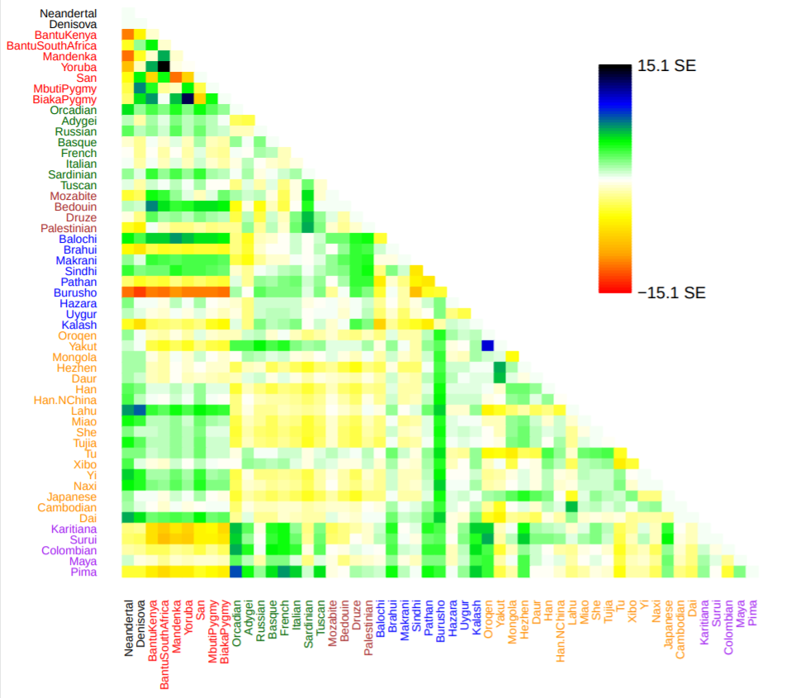

Slide 12
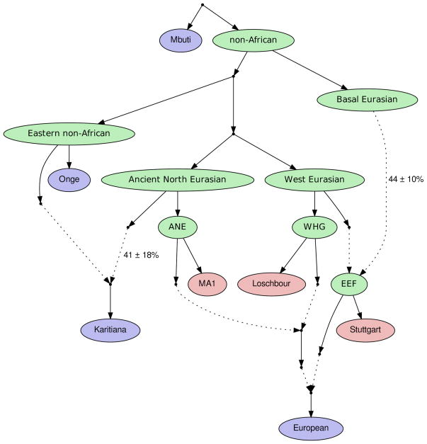
Admixture graphs
Lazaridis et al. 2014, Nature

Slide 13
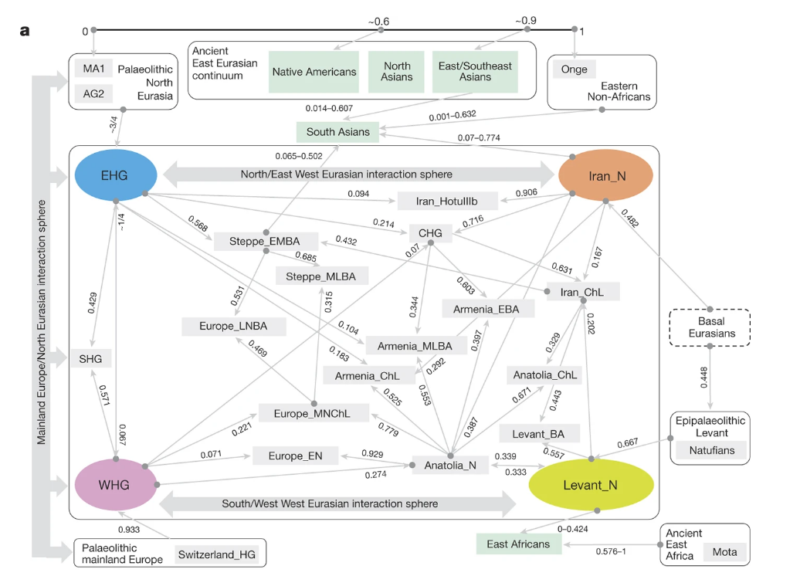
Over-the-top
Lazaridis et al. 2016, Nature

Slide 14
Population structure models
When should we use trees?

Slide 15
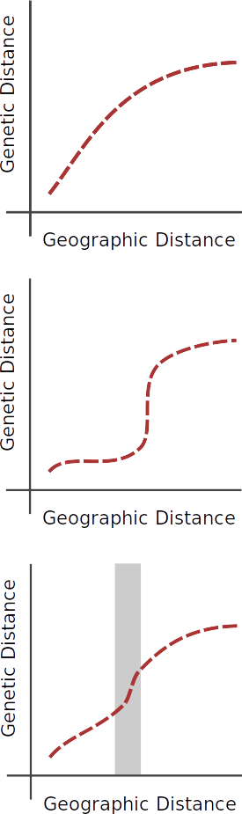
Continuous structure

Slide 16
Discrete structure

Slide 17
Inferring discontinuities

Slide 18
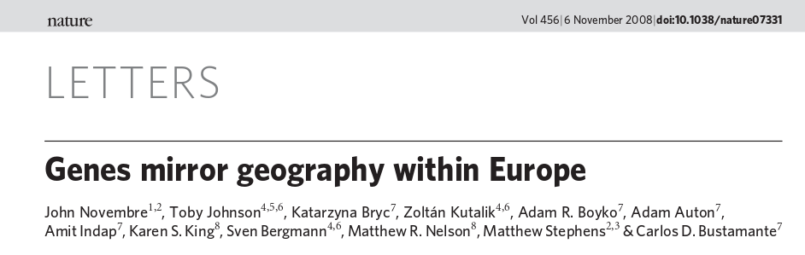
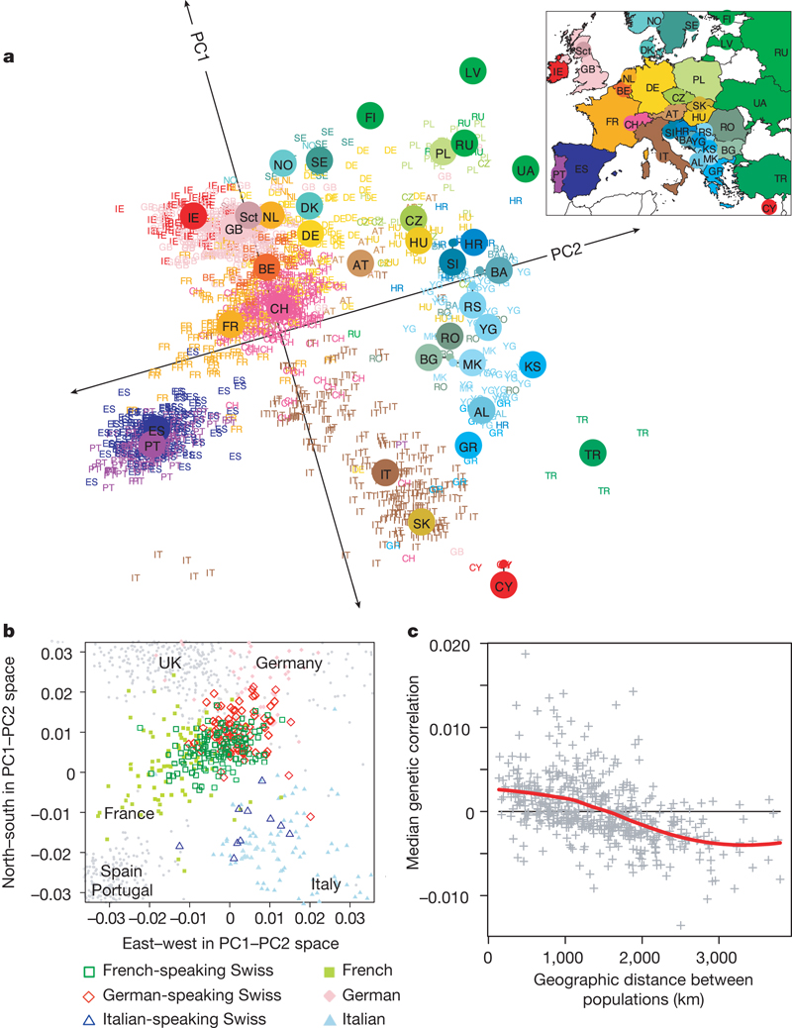
Or (nearly) continuous
Novembre et al. 2008, Nature

Slide 20
When should we use trees?
Trees / Admixture graph
Sparse structure / sampling
Large time scales
Non-spatial structure
Spatial models / EEMS
High-density sampling
Small time scales
Continuous structure

