Slide 1
F-statistics and Population Structure
Benjamin Peter, MPI for Evolutionary Anthropology

Slide 2
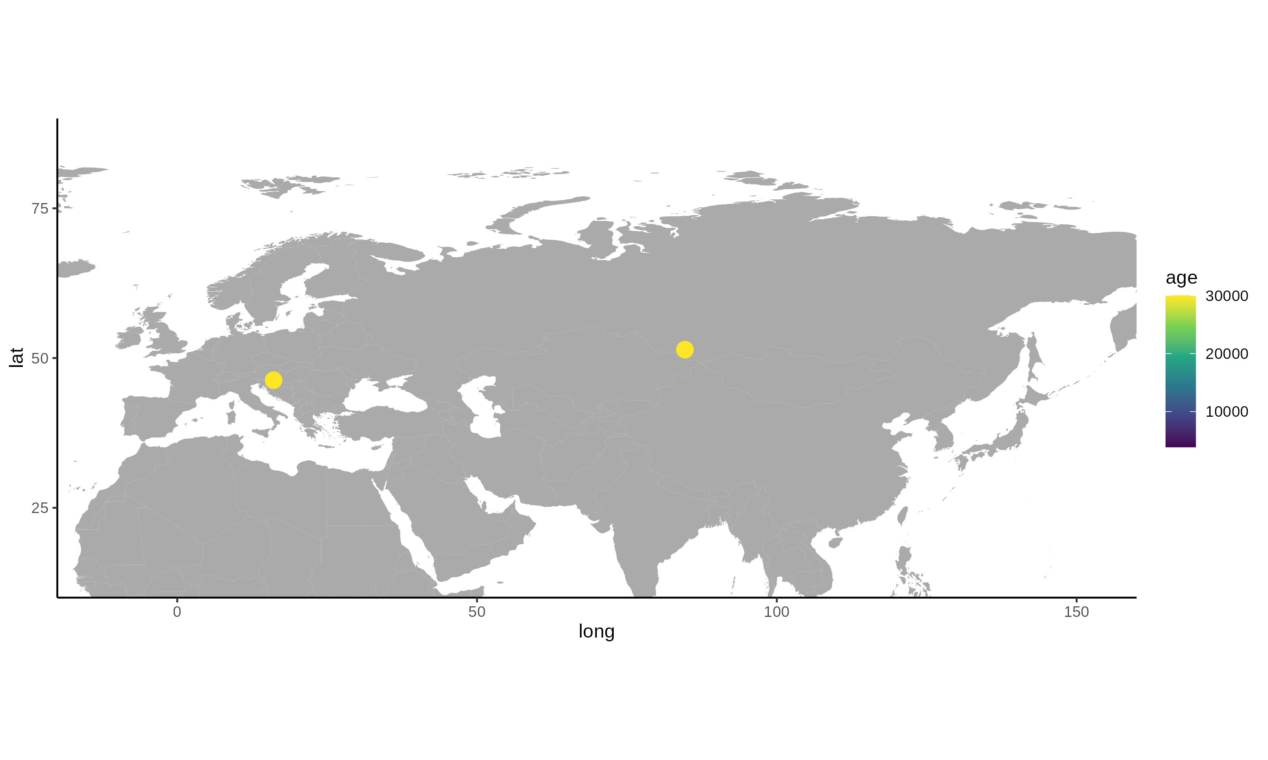
Hominin Ancient DNA (2010)
Data compiled by D. Reich et al.

Slide 3
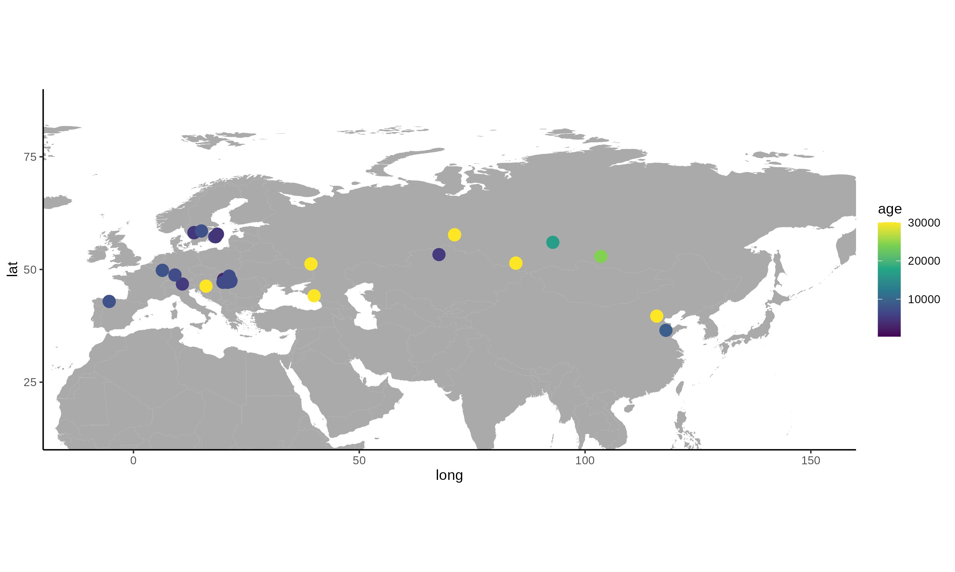
Hominin Ancient DNA (2014)
Data compiled by D. Reich et al.

Slide 4
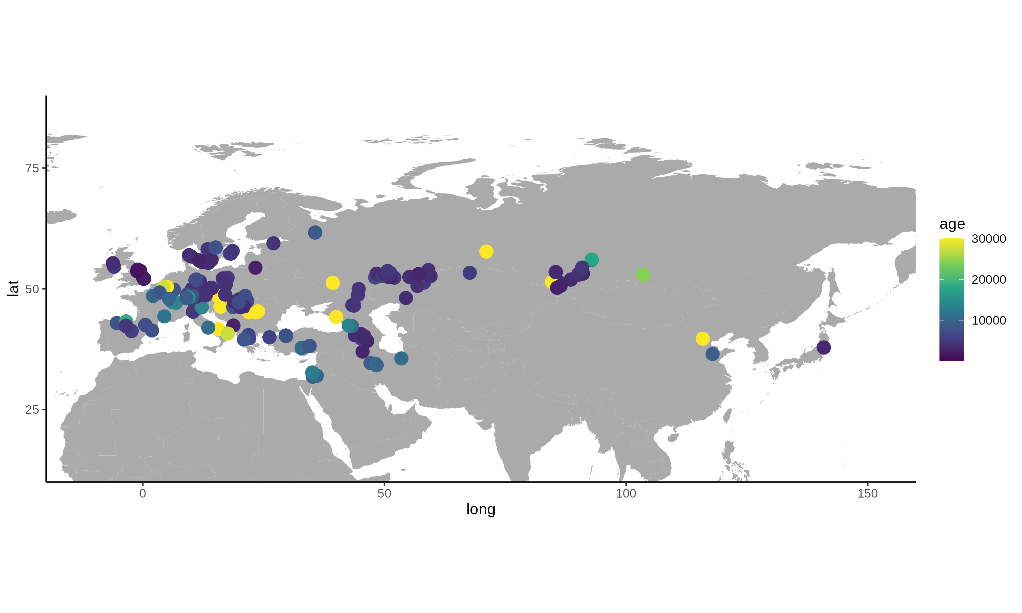
Hominin Ancient DNA (2016)
Data compiled by D. Reich et al.

Slide 5
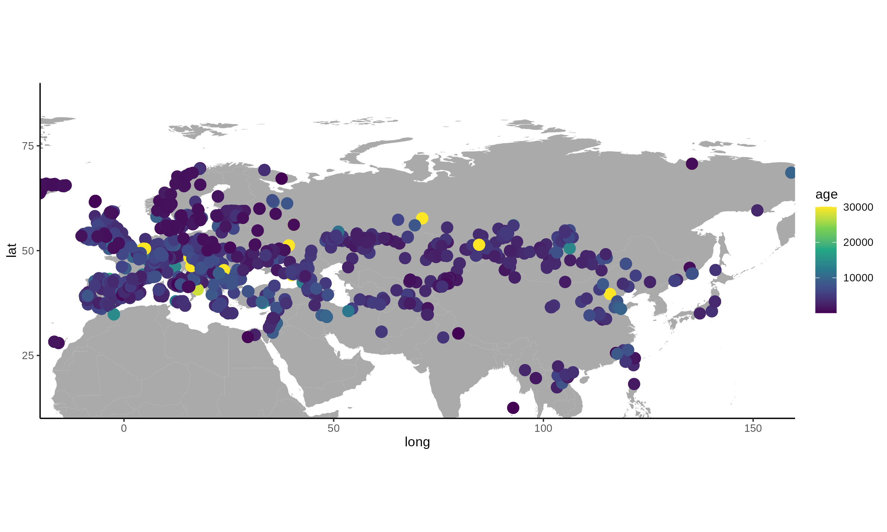
Hominin Ancient DNA (2020)
Data compiled by D. Reich et al.

Slide 6
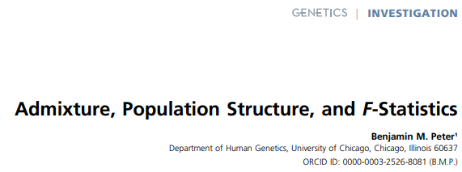
Main Reference
https://doi.org/10.1534/genetics.115.183913

Slide 7
Setup
Today: Theory of F-statistics and Computations
Tomorrow: Using F-statistics to build more complex models

Slide 8
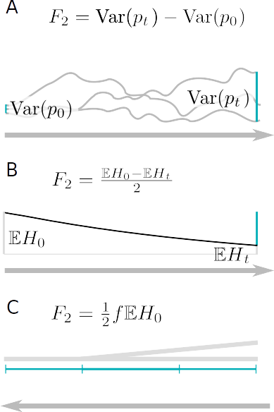
Measuring Genetic Drift
Change in Allele Frequency
Decay of Heterozygosity
Coalescence rates

Slide 9
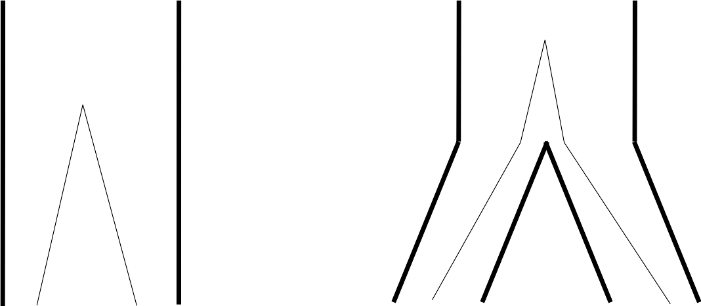
Pairwise differences

Slide 10
Fixation Index FST
FST is a correlation coefficient
Between 0 and 1
Hierarchical partitioning (AMOVA)
Many estimators exist
  Hudson (1991)
  Weir & Cockerham (1984)

Slide 11
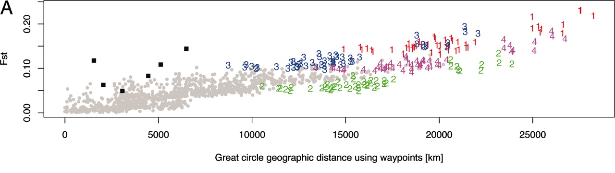
Fixation Index FST
Ramachandran et al. 2005

Slide 12
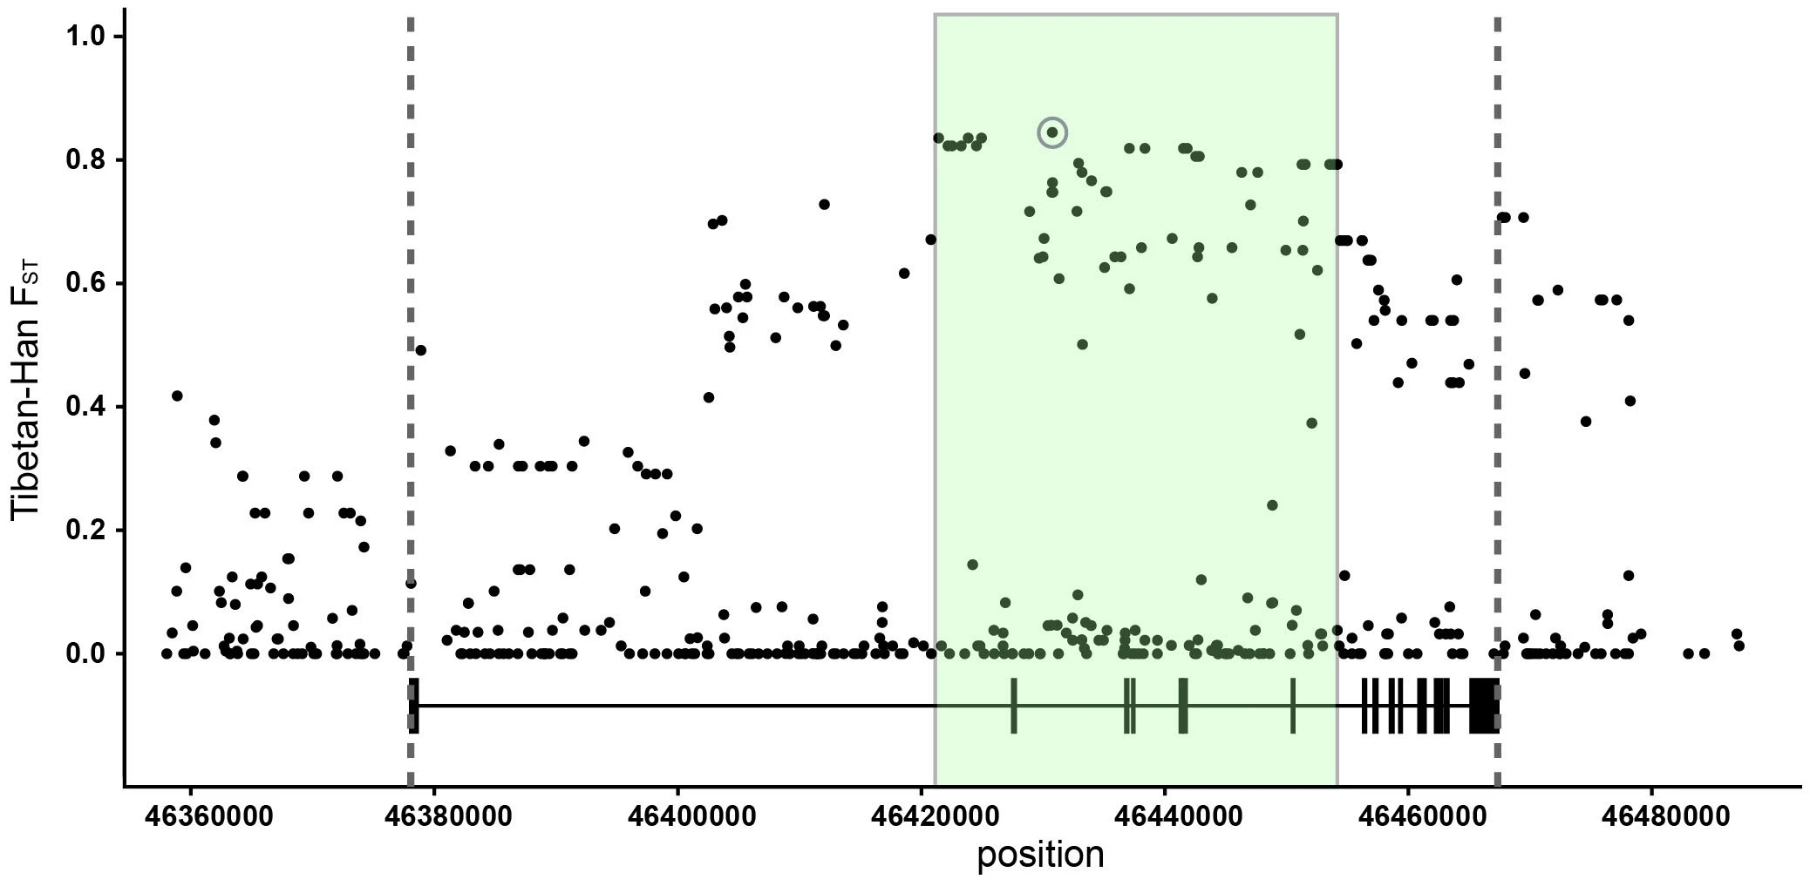
FST Outliers
Huerta-Sanchez et al. 2014

Slide 13
F2 -statistic
FST is a correlation coefficient
Between 0 and 1
Hierarchical partitioning (AMOVA)
Many estimators exist
  Hudson (1991)
  Weir & Cockerham (1984)
F2 is a covariance
Bigger than 0
Tree-additive
Testing for treeness

Slide 14
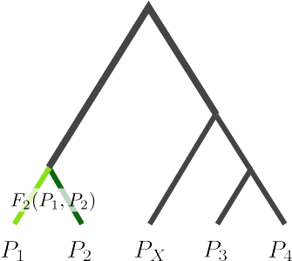
Tree-additive

Slide 15
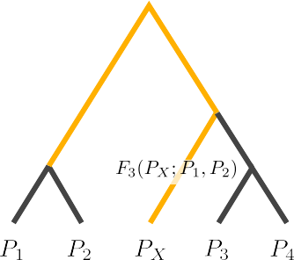
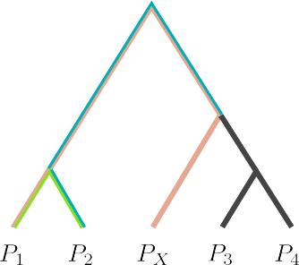
F3 -statistic
Given all F2-values, how can we calculate the yellow branch length?

Slide 16
F3 -statistic equations

Slide 17
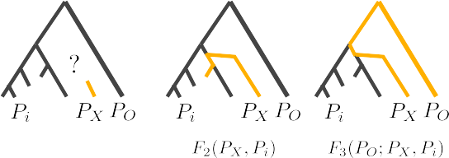
Outgroup-F3-statistic

Slide 18
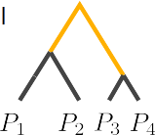
(Branch)-F4 -statistic
What if we reorder the arguments?

Slide 19
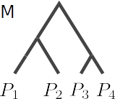
(Treeness)-F4 -statistic

Slide 20
F4 -statistic-equations

Slide 21
Testing Treeness
If data is generated from a tree:
Buneman 1974

Slide 22
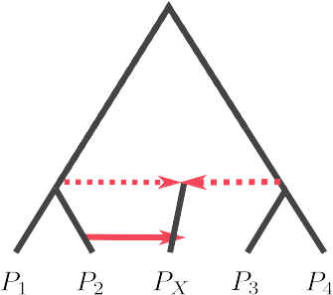
Admixture Graphs

Slide 23
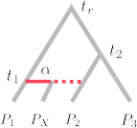
F3 in an admixture graph

Slide 24
F4 in an admixture graph

Slide 25



D-statistic
D-statistic and F4 are closely related
concordant
ABBA-genealogy
BABA-genealogy

Slide 26
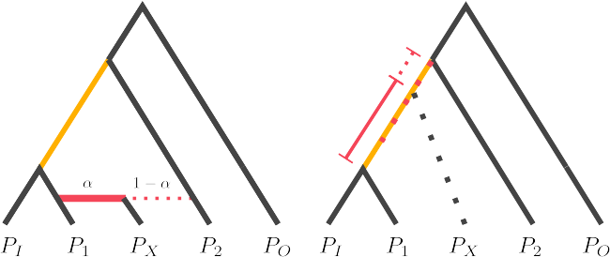
F4-ratio

Slide 27
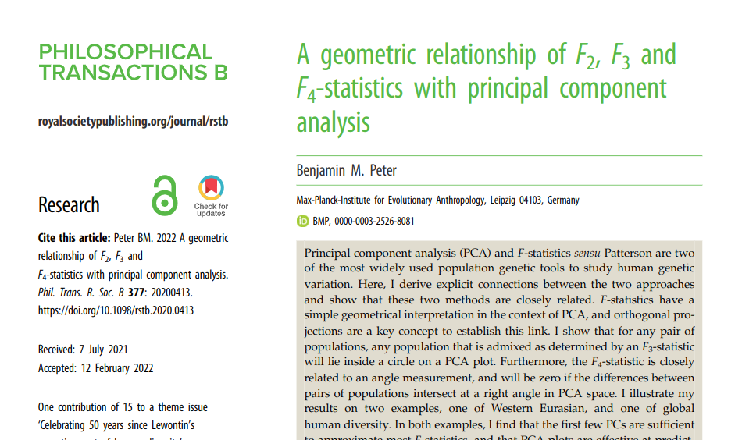
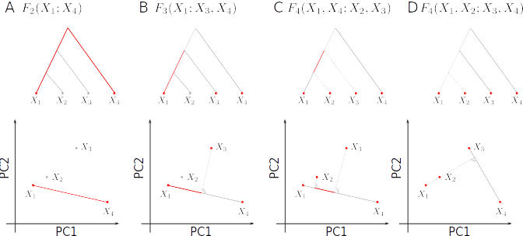
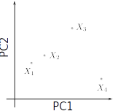
* true if all PCs are used, optimal approximation otherwise
Peter (2022): doi 10.1098/rstb.2020.0413

