Slide 1
F-statistics and Population Structure
Benjamin Peter, MPI for Evolutionary Anthropology

Slide 2
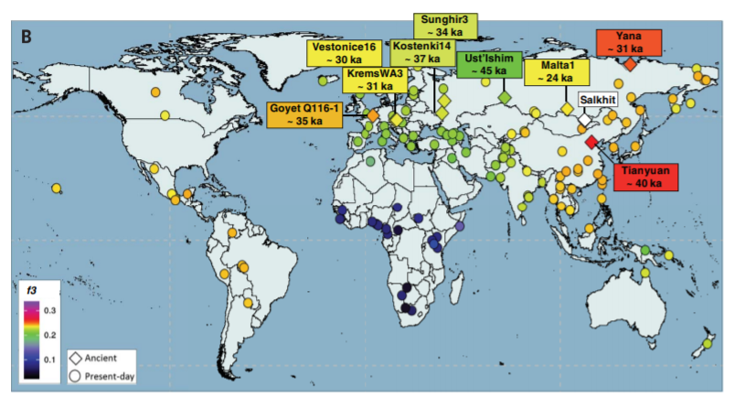
Motivation: Ancient DNA

Slide 3
Setup
Today: Theory of F-statistics and Computations
Tomorrow: Using F-statistics to build more complex models

Slide 4
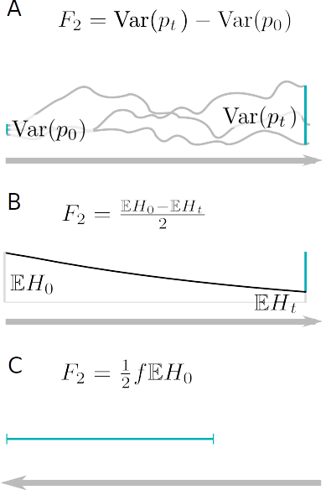
Measuring Genetic Drift
Change in Allele Frequency
Decay of Heterozygosity
Coalescence rates

Slide 5
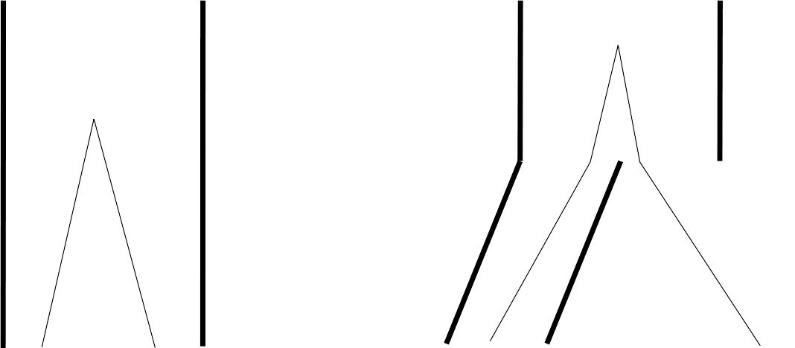
Pairwise differences

Slide 6
Fixation Index FST
FST is a correlation coefficient
Between 0 and 1
Hierarchical partitioning (AMOVA)
Many estimators exist
  Hudson (1991)
  Weir & Cockerham (1984)

Slide 7
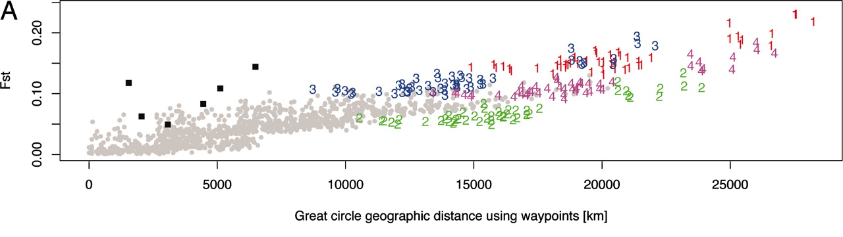
Fixation Index FST
Ramachandran et al. 2005

Slide 8
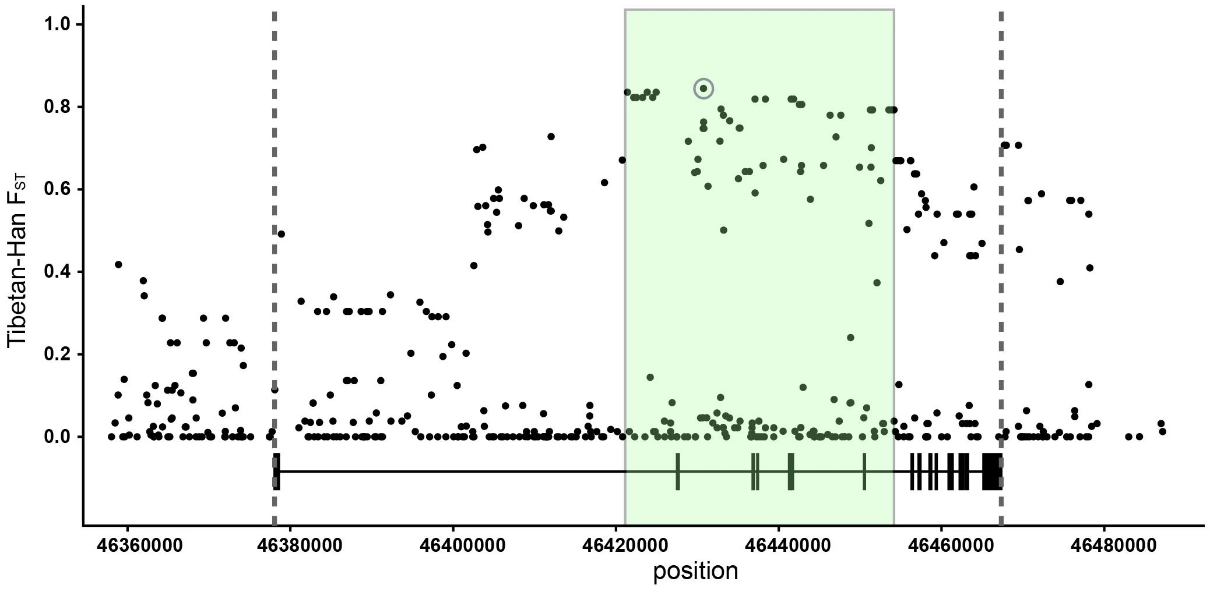
FST Outliers
Huerta-Sanchez et al. 2014

Slide 9
F2 -statistic
FST is a correlation coefficient
Between 0 and 1
Hierarchical partitioning (AMOVA)
Many estimators exist
  Hudson (1991)
  Weir & Cockerham (1984)
F2 is a covariance
Bigger than 0
Tree-additive
Testing for treeness

Slide 10
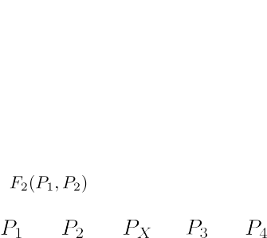
Tree-additive

Slide 11
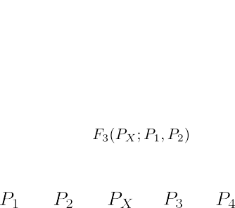
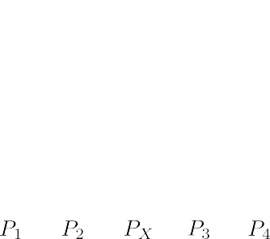
F3 -statistic
Given all F2-values, how can we calculate the yellow branch length?

Slide 12
F3 -statistic equations

Slide 13
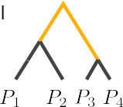
(Branch)-F4 -statistic
What if we reorder the arguments?

Slide 14
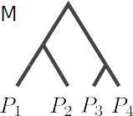
(Treeness)-F4 -statistic

Slide 15
F4 -statistic-equations

Slide 16
Testing Treeness
If data is generated from a tree:
Buneman 1974

Slide 17
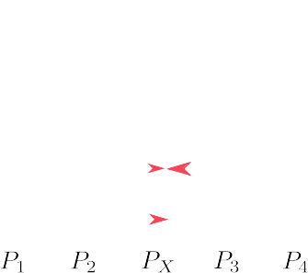
Admixture Graphs

Slide 18
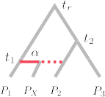
F3 in an admixture graph

Slide 19
F4 in an admixture graph

Slide 20



D-statistic
D-statistic and F4 are closely related
concordant
ABBA-genealogy
BABA-genealogy

Slide 21
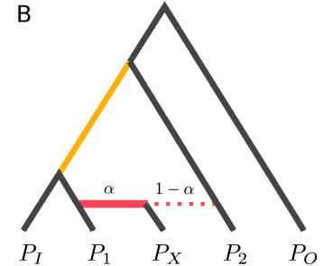
F4-ratio

