Slide 1

Tendency Towards Bias Scoring Application
Ben Moss
March, 2024
General Assembly: DSI 1211
Link: https://beastengine.streamlit.app

Slide 2
Introduction
How can bias and sentiment be identified from abstracts and headlines of news articles?
We present novel methods for determining bias within abstracts/headlines of online articles, label these articles based on relative bias levels, and harness these labels to train a neural network model capable of upscaling this labeling process.
The result was a Streamlit App with a Bias Estimator and Analyzer of Sentiment Tendency (BEAST) Engine, capable of scoring bias on a 0 to 1 scale and returning a sentiment score from -1 to 1.
Interested parties in this research include political party affiliates, media outlets, psychologists and sociologists, and others intrigued by the phenomenon of media influence upon societal thought processes.

Slide 3
Methods
Webscraping
Natural Language Processing Binary Classification Modeling
Labeling Functions with Proprietary Snorkel Functions
Long Short Term Memory (LSTM) Neural Network Categorical Model
Word2Vec: Continuous-Bag-Of-Words, and Skip-Gram word encoding algorithms
VADER sentiment analyzer
Streamlit App Services

Slide 4
Project Pipeline
Webscraping – articles from ‘United States’ as API keyword
Binary Classification – based on whether abstract/headline couplings originated from Opinion section of New York Times or other sections
Snorkel Labeling Functions and Linear Weighted Labeling Function Creation
Neural Networks and Word2Vec encoding Algorithms
Sentiment Analysis
Repeat steps 3 through 6
Streamlit App Deployment

Slide 5
Binary Classification Modeling
Preprocessed abstracts and headlines from NYT articles with Regular Expressions
Text strings were features
Opinion section labeled 1, non-Opinion labeled 0 were targets
GridSearchCV for multiple binary classification models to find optimal parameters with lowest error metrics, highest specificity, and balanced F1 Score
Pickled and exported for inclusion in Streamlit App

Slide 6


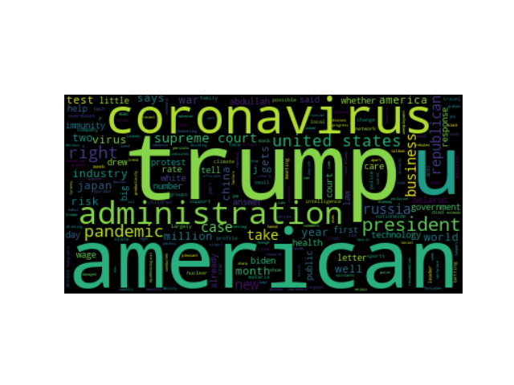
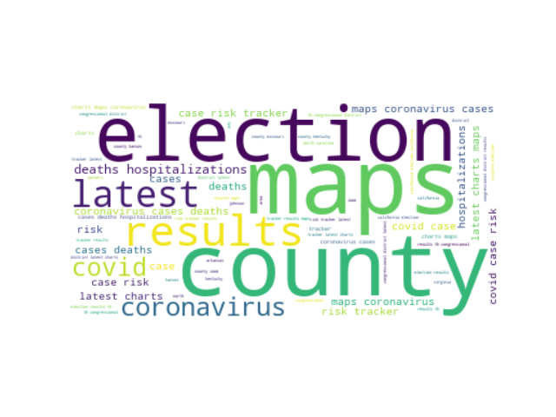
Labeling
Snorkel is a library with proprietary functions that is used to label data based on user input.
Regular Expressions label different abstract/headline couplings interpreted as having bias versus others which were interpreted to not have bias. (Hand labeled a training set).
Length functions and TextBlob polarity and sentiment analyzers included.
Snorkel metrics surveyed to inform decisions regarding more labeling function creation.
Notes:
Write Snorkel metrics and explanations in notes here: Polarity: The set of unique labels this LF outputs (excluding abstains). Coverage: The fraction of the dataset the LF labels. Overlaps: The fraction of the dataset where this LF and at least one other LF labels. Conflicts: The fraction of the dataset where this LF and at least one other LF label and disagree. Correct: The number of data points this LF labels correctly (if gold labels are provided). Incorrect: The number of data points this LF labels incorrectly (if gold labels are provided). Empirical Accuracy: The empirical accuracy of this LF (if gold labels are provided). Only Polarity, Coverage, Overlaps, and Conflicts were surveyed in this project as gold labels were not provided. Only UNBIASED (denoted 00) versus BIASED (denoted 01) were label returns; ABSTAIN was not included.

Slide 7
Linear Label Function with Weights
Electoral College Comparison
Return values between 0 and 1 and each had tiers.
Cohen Kappa Score – 1-1 correspondence – with Bias Score.
[0,0.2] represents not-to-slightly-biased.
(0.2,0.4] represents slightly-to-moderately biased.
(0.4,0.6] represents moderately-to-pretty-biased.
(0.6,0.8] represents pretty-to-mostly-biased.
(0.8,1.0] represents perfectly-biased.

Slide 8
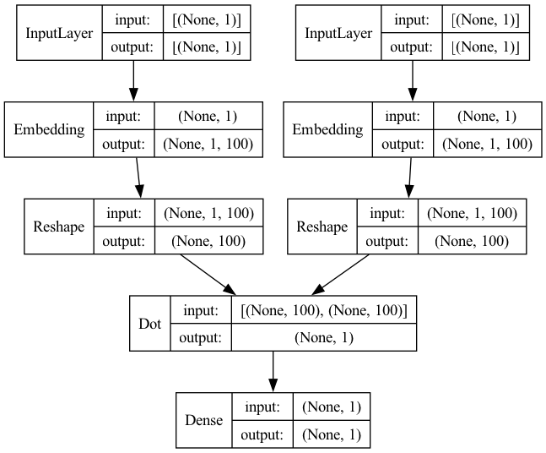
Neural Networks
Long Short Term Memory (LSTM) Categorical model with multiple layers.
Word2Vec Variants: Continuous Bag of Words and Skip Grams are word encoding algorithms with neural networks. (There are more but only these two were utilized here)
Interspersed were Cosine Similarity, Clustering, PCA.

Slide 9
Word2Vec Variant: Skip-Gram
One Variant of Word2Vec: The skip-gram variant takes a target word and tries to predict the surrounding context words.
This is particularly effective when using a keyword chosen to either labeled with either BIASED or UNBIASED tags and survey words around it to extrapolate full meaning or text string, delineate whether BIASED or UNBIASED.

Slide 10
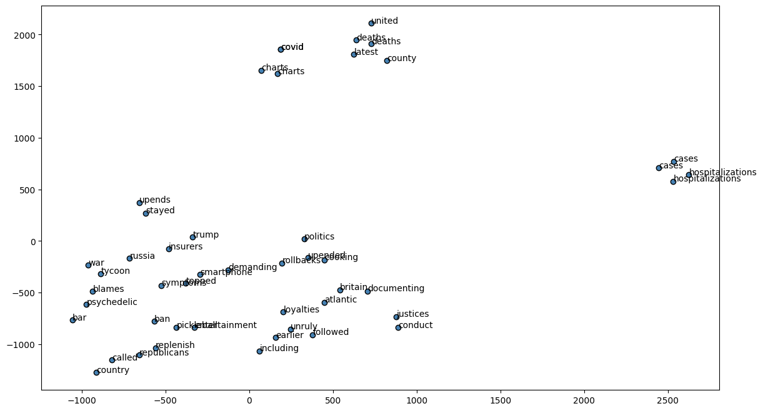
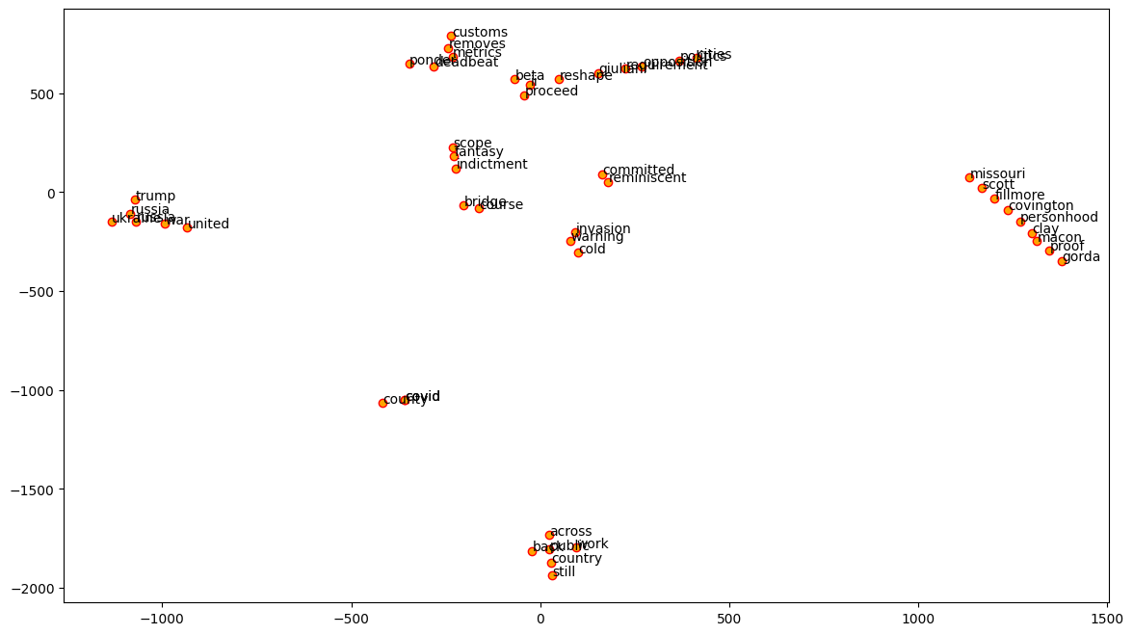
Skip-Gram Plots

Slide 11
Word2Vec Variant: Continuous-Bag-of-Words
One Variant of Word2Vec: The Continuous-Bag-Of-Words (CBOW) variant takes a set of context words and tries to predict a target word.
This is particularly effective when using commonly found string of words labeled with either BIASED or UNBIASED tags to pinpoint a characteristic word within a string that plays a big role in sentiment analysis and overall BIASED or UNBIASED text string label.

Slide 12
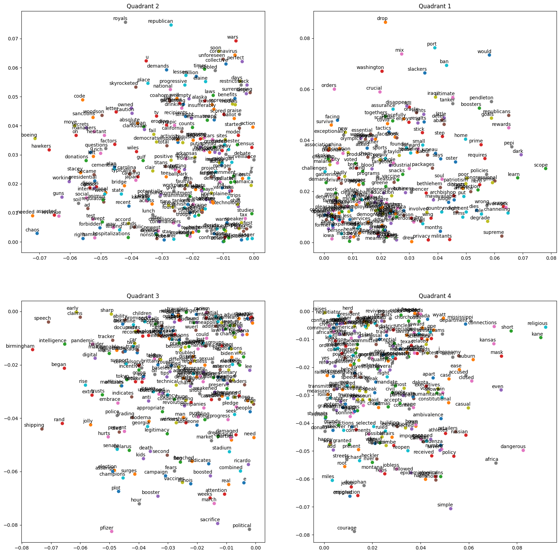
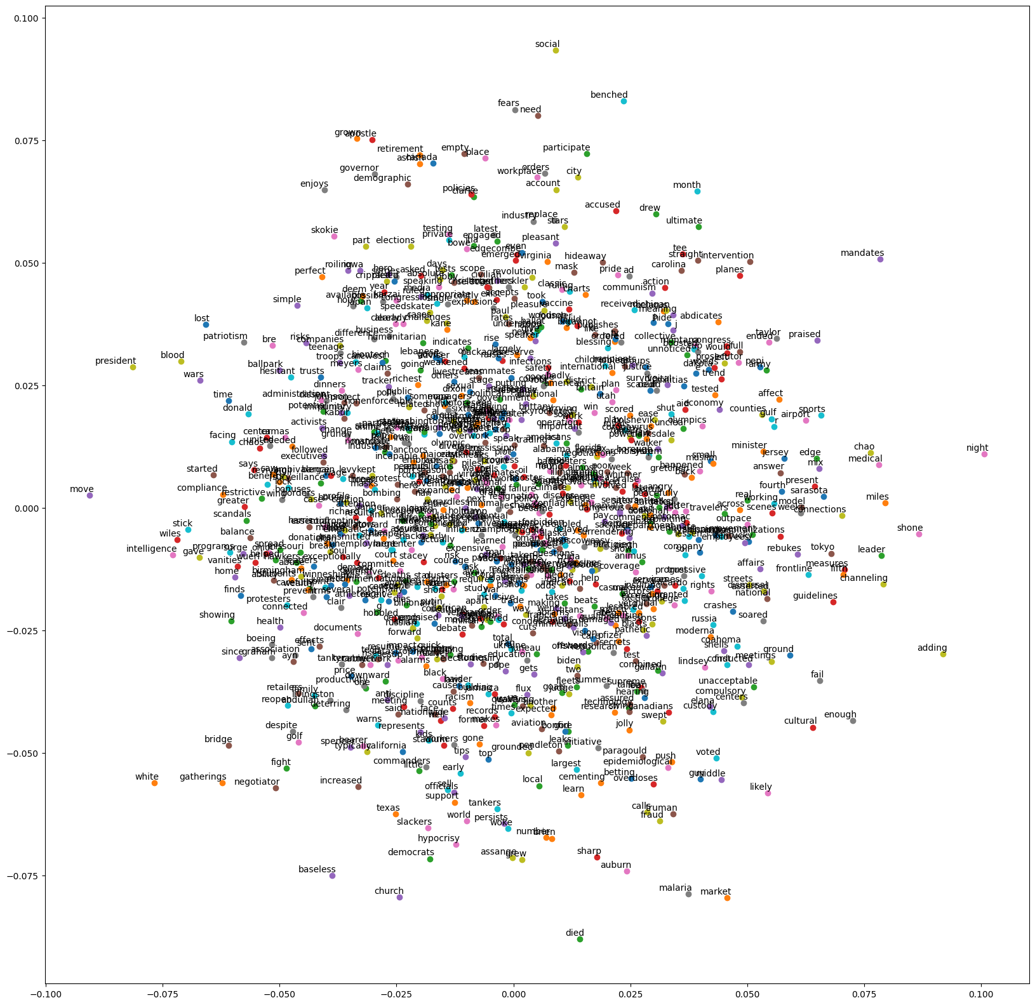
CBOW Plots

Slide 13
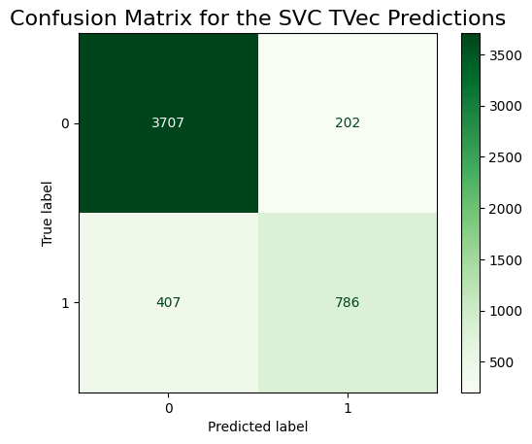
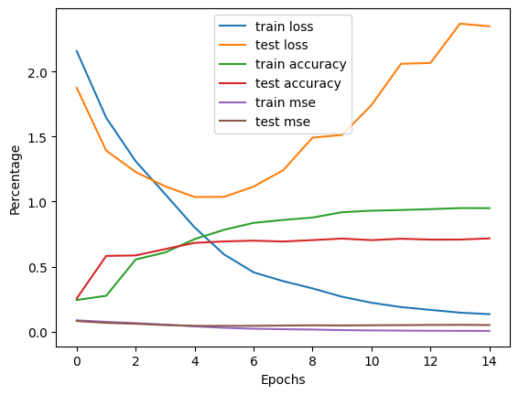
Summary of Results and Analysis
Performance of Binary Classification Model (Support Vector Machine with TfidfVectorizer)
1.0 Train | 0.88 Test | Sensitivity 0.66 | Specificity 0.95 | Accuracy 0.88 | Precision 0.800
Miscalculation Rate 0.12 | F1 Score 0.72
Performance of Neural Network Model:
Loss: 0.13 - Accuracy: 0.95 - MSE: 0.006
Validation Loss: 2.34 – Validation Accuracy: 0.72 – Validation MSE: 0.05
Tendency Towards Bias Scoring App runs on…
Bias Estimator and Analyzer of Sentiment Tendency
(BEAST) Engine

Slide 14
BEAST Performance
Compare performance of Sentiment Analyzer with VADER sentiment analyzer.
KDE Plots looking at absolute differences between NN model and LF function, BEAST and VADER sentiment analyzers
A/B Testing Results looking at absolute difference, BEAST and VADER sentiment scores individually.
Notes:
Kernel Density Estimation plots are the equivalent of a probability mass function except instead of discrete outputs they are used to visualize continuous outputs.

Slide 15
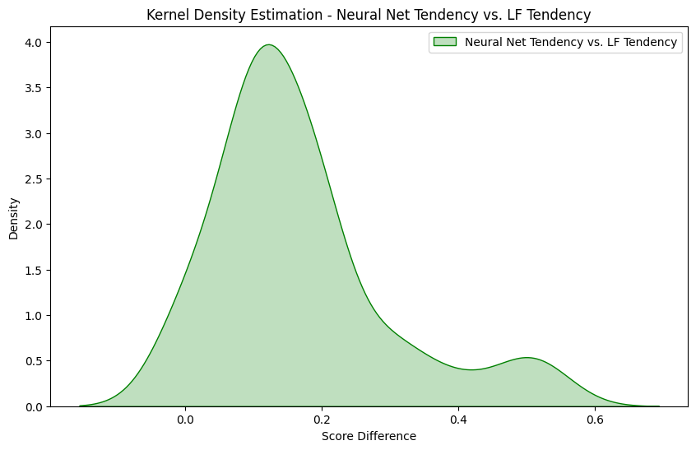
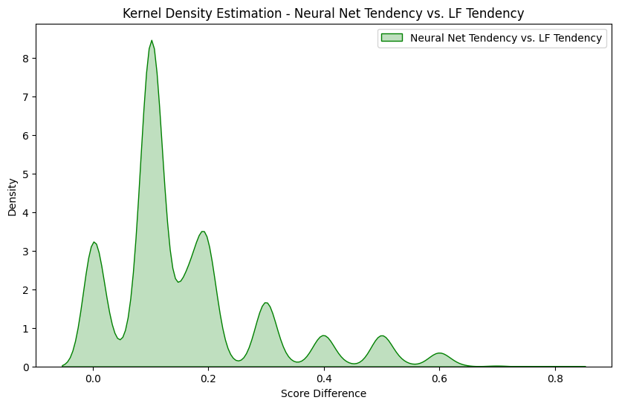
Kernel Density Plots – Neural Net Model versus Labeling Function
Notes:
Neural Net Tendency vs. LF Tendency: {0.1: 35, 0.2: 82, 0.3: 88, 0.4: 93, 0.5: 97, 0.6: 100, 0.7: 100, 0.8: 100, 0.9: 100, 1.0: 100}
Neural Net Tendency vs. LF Tendency: {0.1: 12632, 0.2: 20636, 0.3: 22773, 0.4: 23880, 0.5: 24871, 0.6: 25089, 0.7: 25506, 0.8: 25510, 0.9: 25510, 1.0: 25510}

Slide 16
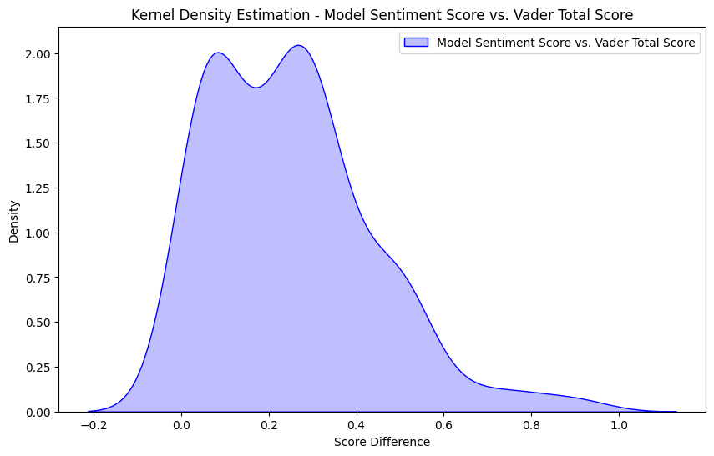
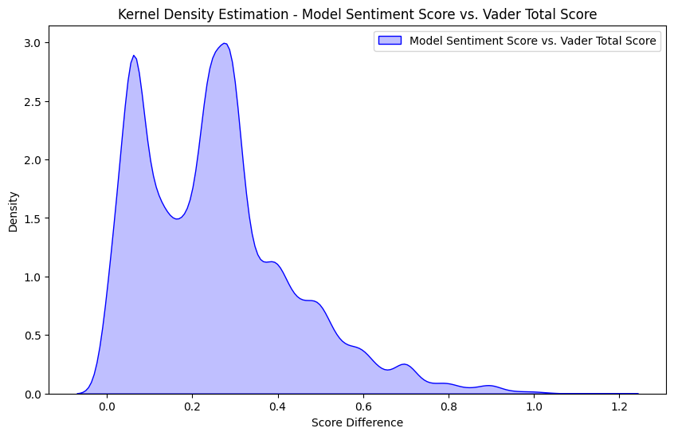
Kernel Density Plots – BEAST versus VADER
Notes:
Model Sentiment Score vs. Vader Total Score: {0.1: 31, 0.2: 42, 0.3: 72, 0.4: 83, 0.5: 91, 0.6: 96, 0.7: 97, 0.8: 98, 0.9: 99, 1.0: 100}
Model Sentiment Score vs. Vader Total Score: {0.1: 6137, 0.2: 10233, 0.3: 17876, 0.4: 20908, 0.5: 23133, 0.6: 24317, 0.7: 25010, 0.8: 25264, 0.9: 25437, 1.0: 25497}

Slide 17
A/B Testing On Sentiment Analysis
Mann-Whitney U test instead of t-test as these values are not normally distributed
BEAST Sentiment Analyzer to tell different between Opinion versus non-opinion section with only a 10 % chance of being incorrect… (α= 0.1).
P-value: 0.947 Fail to reject the null hypothesis. There is no significant difference between Opinion and non-Opinion groups.
Vader Sentiment Analyzer to tell different between Opinion versus non-opinion section with only a 10 % chance of being incorrect… (α= 0.1).
P-value: 0.520
Look at absolute difference between BEAST and VADER sentiment levels…
P-value: 0.0976
Reject the null hypothesis. There is a significant difference. Thus, by looking at BEAST and VADER absolute sentiment level differences we may distinguish between Opinion section articles and non-Opinion section articles with under a 10% chance of being incorrect, less than our binary classification model!
Notes:
# To Summarize:
1. Objective: We aimed to compare the absolute sentiment difference between your model and VADER's analyzer for articles in the Opinion versus non-Opinion sections.
2. Method: We computed the absolute differences between `model_sentiment_score` and `vader_total_score` for each article. Then, we divided the dataset into `Opinion` and `non-Opinion` categories.
3. Statistical Test: We conducted a Mann-Whitney U test to compare the distributions of these absolute differences between `Opinion` and `non-Opinion` categories.
4. Result: The p-value obtained from the test was $0.0976$, which is less than our chosen $\alpha$ significance level of $0.1$.
5. Conclusion: With a p-value less than $\alpha$, we rejected the null hypothesis. This implies that there was a statistically significant difference in the absolute sentiment differences of BEAST's and VADER's analyzer for distinguishing between `Opinion` versus `non-Opinion` sections.
6. This conclusion suggests that there is evidence to support that the absolute differences between our model and VADER's analyzer vary significantly depending on whether the articles are from the `Opinion` or `non-Opinion` sections. In this way we can determine if the article came from an `Opinion` section versus `non-Opinion` section based on absolute differences between analyzers alone. However, we may also utilize our binary classification model without having to rely upon sentiment information.
7. Done individually, these scores ALONE provided no statistically significant information regarding whether, based on score alone from either analyzer, a given abstract/headline originated from an article in the `Opinion` section nor an article from the `non-Opinion` section.
Moreover, paired with one of our classification models, depending on which one was chosen, there would be a $95\%$ specificity rate and you would be able to distinguish which category these abstracts/headlines came from with only a $\sim 10\%$ of being incorrect (the current misclassification rate). When we put all of these classification models, neural network models, and sentiment analyzers together the results are incredibly promising as we begin to understand how tendency towards bias may be understood.

Slide 18
Recommendations and Guidance
Develop labeling functions and other word encoding algorithms for further optimization.
Hand Label a greater expanse of samples to acquire more detailed and meaningful Snorkel summary statistics.
Continue to advance hardware capabilities to develop Neural Network models further.
Switch to Microsoft and NVIDIA GPU.
Apply these labeling functions to other well-defined problems such as customer service evaluations, prescription drug side-effect forms, crowd surfing surveys, etc.

Slide 19
Peering Into the Future
Instead of binary Word2Vec labeling, qubits (0 or 1 quantum superposition principle) exhibit entanglement and calculate BIASED or UNBIASED labels in effective real-time response.

Slide 20
Conclusion
We use labeling functions in our everyday lives!
When we harness multiple powerful modeling techniques with these relatively simple primitive fundamental forms, complex and daunting language processing challenges become simpler and more realistic to understand.
We successfully utilized many of these NLP and NN modeling techniques and created a Bias Estimator and Analyzer of Sentiment Tendency (BEAST) Engine capable of generating a bias score and sentiment levels comparable to that of VADER’s sentiment analyzer.
Stakeholders interested in this research include product managers, app developers, customer service leads, etc.

Slide 21
References
`API` Documentation from `NYT`: https://developer.nytimes.com/apis
Code for Webscraping adapted from fellow coursemate's group project, with their permission this code was included in the pipeline for this project.
Snorkel documentation for Cohen Kappa Score labeling: https://www.snorkel.org
Pew Center Article on Bias: https://www.pewresearch.org/internet/2017/10/19/the-future-of-truth-and-misinformation-online
VADER Documentation: https://vadersentiment.readthedocs.io
Kaggle GPU Documentation: https://www.kaggle.com/code/dansbecker/running-kaggle-kernels-with-a-gpu
CBOW/Skip Gram: https://towardsdatascience.com/understanding-feature-engineering-part-4-deep-learning-methods-for-text-data-96c44370bbfa
CBOW/SKip Gram: https://medium.com/@dube.aditya8/word2vec-skip-gram-cbow-b5e802b00390
KDE Plot Documentation: https://seaborn.pydata.org/generated/seaborn.kdeplot.html
Quantum Neural Networks: https://openreview.net/pdf?id=ZLKaNvYFfjd

