Slide 1

Tendency Towards Bias Scoring Application
Ben Moss
March, 2024
General Assembly: DSI 1211
Link: https://beastengine.streamlit.app

Slide 2
Introduction
How can bias and sentiment be identified from abstracts and headlines of news articles?
We present novel methods for determining bias within abstracts/headlines of online articles, label these articles based on relative bias levels, and harness these labels to train a neural network model capable of upscaling this labeling process.
The result was a Streamlit App with a Bias Estimator and Analyzer of Sentiment Tendency (BEAST) Engine, capable of scoring bias on a 0 to 1 scale and returning a sentiment score from -1 to 1.
Interested parties in this research include political party affiliates, media outlets, psychologists and sociologists, and others intrigued by the phenomenon of media influence upon societal thought processes.

Slide 3
Methods
Webscraping
Natural Language Processing Binary Classification Modeling
Labeling Functions with Proprietary Snorkel Functions
Long Short Term Memory (LSTM) Neural Network Categorical Model
Word2Vec: Continuous-Bag-Of-Words, and Skip-Gram word encoding algorithms
VADER sentiment analyzer
Streamlit App Services

Slide 4
Project Pipeline
Webscraping – articles from ‘United States’ as API keyword
Binary Classification – based on whether abstract/headline couplings originated from Opinion section of New York Times or other sections
Snorkel Labeling Functions and Linear Weighted Labeling Function Creation
Neural Networks and Word2Vec encoding Algorithms
Sentiment Analysis
Repeat steps 3 through 6
Streamlit App Deployment

Slide 5
Binary Classification Modeling
Preprocessed abstracts and headlines from NYT articles with Regular Expressions
Text strings were features
Opinion section labeled 1, non-Opinion labeled 0 were targets
GridSearchCV for multiple binary classification models to find optimal parameters with lowest error metrics, highest specificity, and balanced F1 Score
Pickled and exported for inclusion in Streamlit App

Slide 6


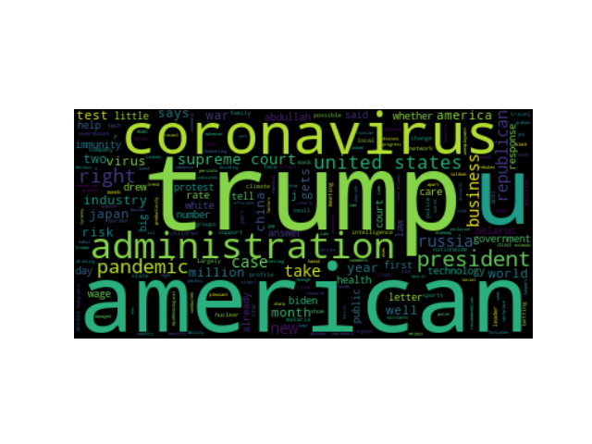
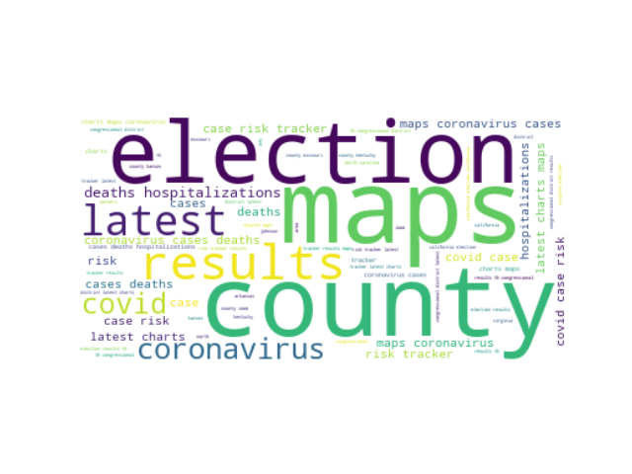
Labeling
Snorkel is a library with proprietary functions that is used to label data based on user input.
Regular Expressions label different abstract/headline couplings interpreted as having bias versus others which were interpreted to not have bias. (Hand labeled a training set).
Length functions and TextBlob polarity and sentiment analyzers included.
Snorkel metrics surveyed to inform decisions regarding more labeling function creation.
Notes:
Write Snorkel metrics and explanations in notes here: Polarity: The set of unique labels this LF outputs (excluding abstains). CoverageCoverage: The fraction of the dataset the LF labels. OverlapsOverlaps: The fraction of the dataset where this LF and at least one other LF labels. ConflictsConflicts: The fraction of the dataset where this LF and at least one other LF label and disagree. CorrectCorrect: The number of data points this LF labels correctly (if gold labels are provided). IncorrectIncorrect: The number of data points this LF labels incorrectly (if gold labels are provided). Empirical AccuracyEmpirical Accuracy: The empirical accuracy of this LF (if gold labels are provided). Only Polarity, Coverage, Overlaps, and Conflicts were surveyed in this project as gold labels were not provided. Only UNBIASED (denoted 00) versus BIASED (denoted 11) were label returns; ABSTAIN was not included.

Slide 7
Linear Label Function with Weights
Electoral College Comparison
Return values between 0 and 1 and each had tiers.
Cohen Kappa Score – 1-1 correspondence – with Bias Score.
[0,0.2] represents not-to-slightly-biased.
(0.2,0.4] represents slightly-to-moderately biased.
(0.4,0.6] represents moderately-to-pretty-biased.
(0.6,0.8] represents pretty-to-mostly-biased.
(0.8,1.0] represents perfectly-biased.

Slide 8
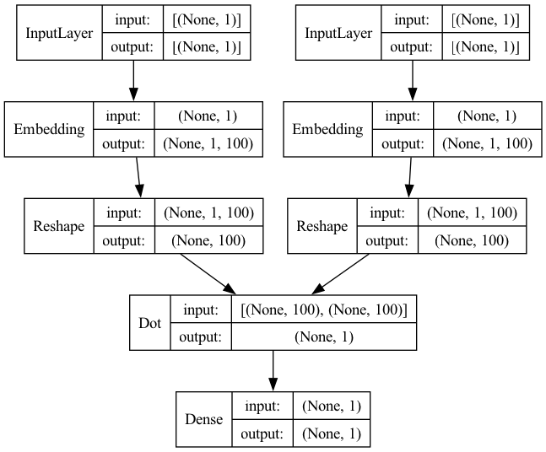
Neural Networks
Long Short Term Memory (LSTM) Categorical model with multiple layers.
Word2Vec Variants: Continuous Bag of Words and Skip Grams are word encoding algorithms with neural networks. (There are more but only these two were utilized here)
Interspersed were Cosine Similarity, Clustering, PCA.

Slide 9
Word2Vec Variant: Skip-Gram
One Variant of Word2Vec: The skip-gram variant takes a target word and tries to predict the surrounding context words.
This is particularly effective when using a keyword chosen to either labeled with either BIASED or UNBIASED tags and survey words around it to extrapolate full meaning or text string, delineate whether BIASED or UNBIASED.

Slide 10
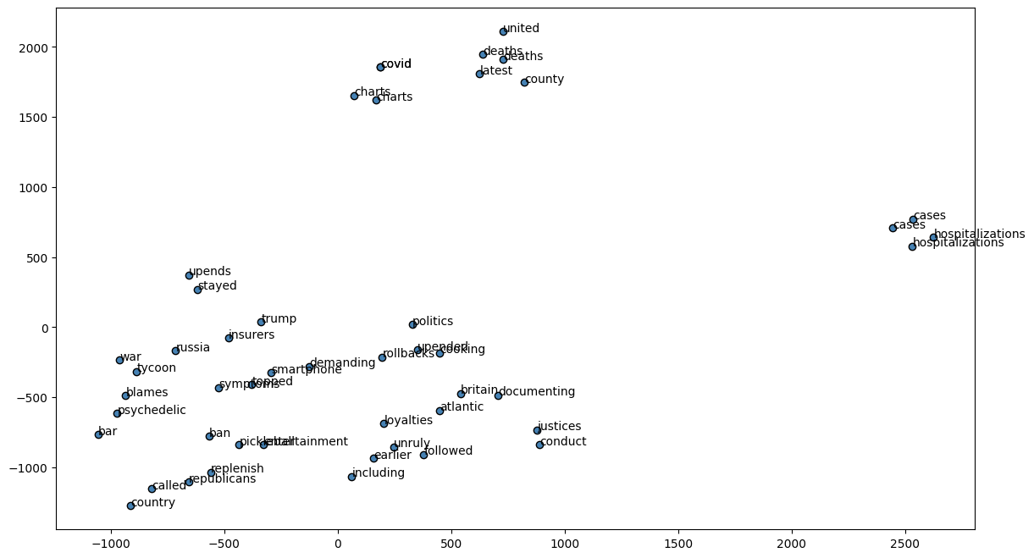
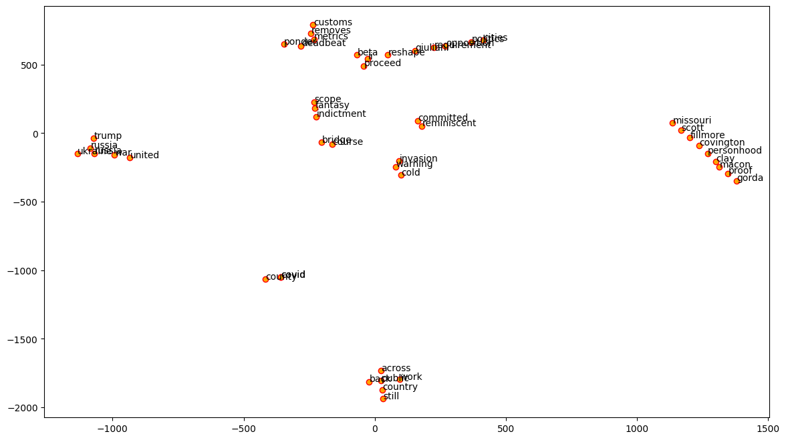
Skip-Gram Plots

Slide 11
Word2Vec Variant: Continuous-Bag-of-Words
One Variant of Word2Vec: The Continuous-Bag-Of-Words (CBOW) variant takes a set of context words and tries to predict a target word.
This is particularly effective when using commonly found string of words labeled with either BIASED or UNBIASED tags to pinpoint a characteristic word within a string that plays a big role in sentiment analysis and overall BIASED or UNBIASED text string label.

Slide 12
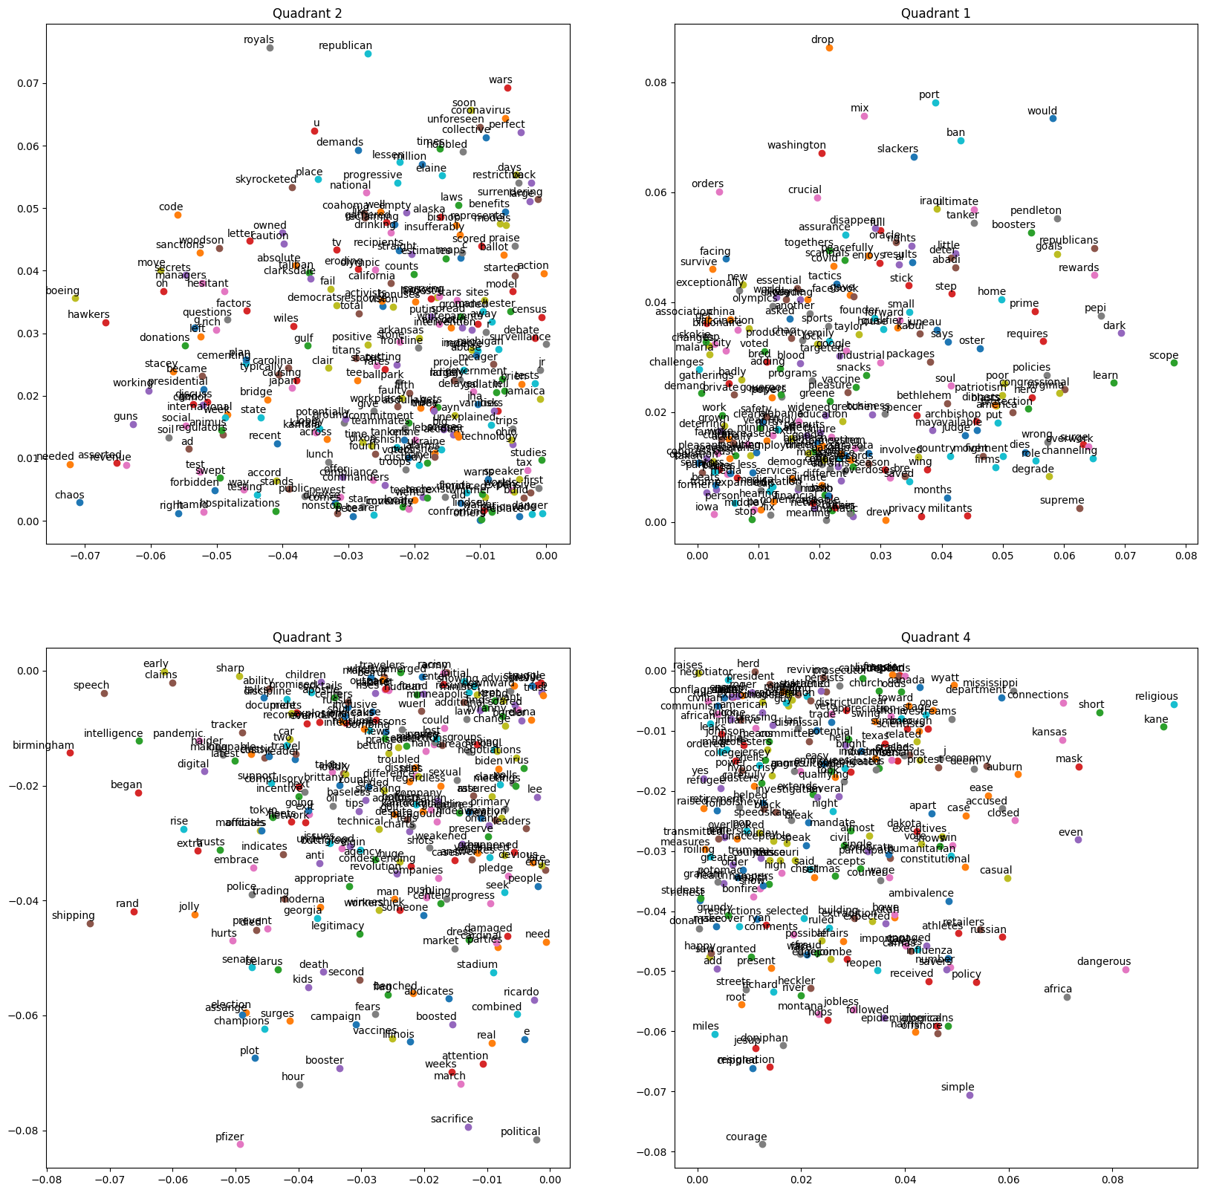
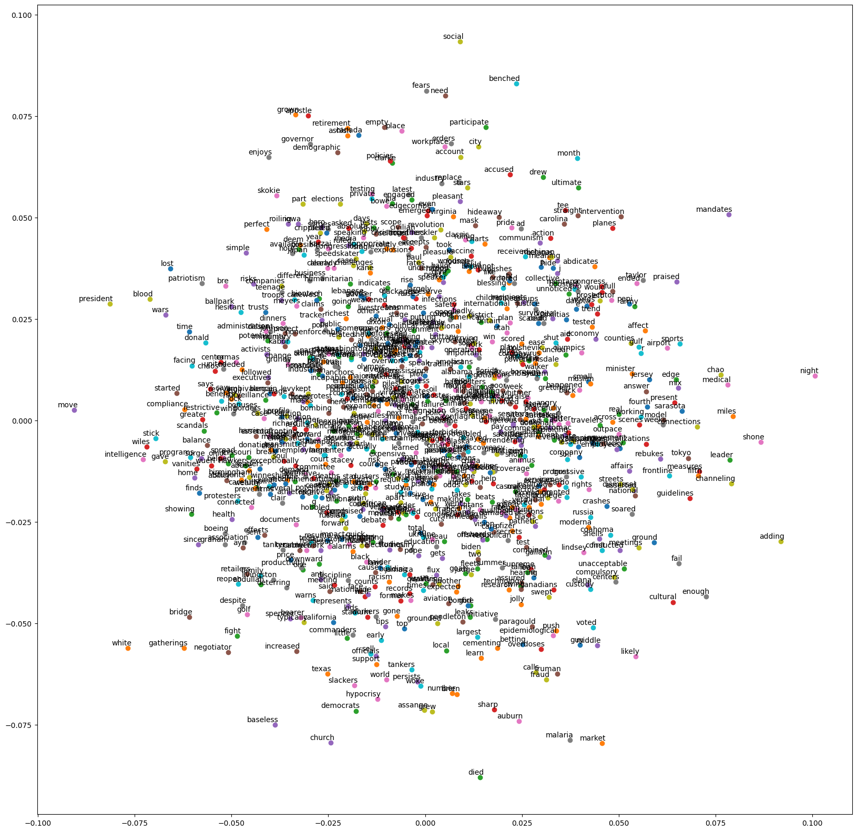
CBOW Plots

Slide 13
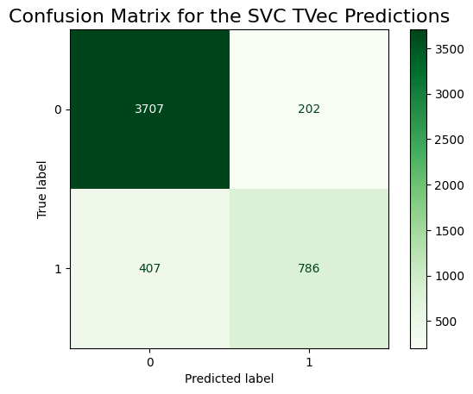
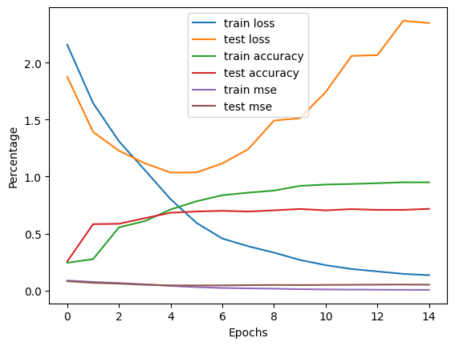
Summary of Results and Analysis
Performance of Binary Classification Model (Support Vector Machine with TfidfVectorizer)
1.0 Train | 0.88 Test | Sensitivity 0.66 | Specificity 0.95 | Accuracy 0.88 | Precision 0.800
Miscalculation Rate 0.12 | F1 Score 0.72
Performance of Neural Network Model:
Loss: 0.13 - Accuracy: 0.95 - MSE: 0.006
Validation Loss: 2.34 – Validation Accuracy: 0.72 – Validation MSE: 0.05
Tendency Towards Bias Scoring App runs on…
Bias Estimator and Analyzer of Sentiment Tendency
(BEAST) Engine

Slide 14
BEAST Performance
Compare performance of Sentiment Analyzer with VADER sentiment analyzer.
KDE Plots, A/B Testing Results
Notes:
Kernel Density Estimation plots are the equivalent of a probability mass function except instead of discrete outputs they are used to visualize continuous outputs.

Slide 15
Recommendations and Guidance
Develop labeling functions and other word encoding algorithms for further optimization.
Hand Label a greater expanse of samples to acquire more detailed and meaningful Snorkel summary statistics.
Continue to advance hardware capabilities to develop Neural Network models further.
Switch to Microsoft and NVIDIA GPU.
Apply these labeling functions to other well-defined problems such as customer service evaluations, prescription drug side-effect forms, crowd surfing surveys, etc.

Slide 16
Peering Into the Future
Instead of binary Word2Vec labeling, qubits (0 or 1 quantum superposition principle) exhibit entanglement and calculate BIASED or UNBIASED labels in effective real-time response.

Slide 17
Conclusion
We use labeling functions in our everyday lives!
When we harness multiple powerful modeling techniques with these relatively simple primitive fundamental forms, complex and daunting language processing challenges become simpler and more realistic to understand.
We successfully utilized many of these NLP and NN modeling techniques and created a Bias Estimator and Analyzer of Sentiment Tendency (BEAST) Engine capable of generating a bias score and sentiment levels comparable to that of VADER’s sentiment analyzer.
Stakeholders interested in this research include product managers, app developers, customer service leads, etc.

Slide 18
References
`API` Documentation from `NYT`: https://developer.nytimes.com/apis
Code for Webscraping adapted from fellow coursemate's group project, with their permission this code was included in the pipeline for this project.
Snorkel documentation for Cohen Kappa Score labeling: https://www.snorkel.org
Pew Center Article on Bias: https://www.pewresearch.org/internet/2017/10/19/the-future-of-truth-and-misinformation-online
VADER Documentation: https://vadersentiment.readthedocs.io
Kaggle GPU Documentation: https://www.kaggle.com/code/dansbecker/running-kaggle-kernels-with-a-gpu
CBOW/Skip Gram: https://towardsdatascience.com/understanding-feature-engineering-part-4-deep-learning-methods-for-text-data-96c44370bbfa
CBOW/SKip Gram: https://medium.com/@dube.aditya8/word2vec-skip-gram-cbow-b5e802b00390
KDE Plot Documentation: https://seaborn.pydata.org/generated/seaborn.kdeplot.html
Quantum Neural Networks: https://openreview.net/pdf?id=ZLKaNvYFfjd

