Slide 1
Negative Correlation Between Participation Rates and Test Scores in the 2017-2019 SAT
Ben Moss
General Assembly
January, 2024

Slide 2
Objective
Analyze trends in SAT scores among test takers from 2017 to 2019.
In general, although participation levels increased in the SATs from 2017 to 2019, test scores decreased slightly across these years in all areas. T
These two variables were negatively correlated and a linear regression line may be observed across these years.
Additionally, we observe trends in 2019 scores among intended majors and perform statistical analysis methods to to analyze various features of these scores.
Those in intended majors relevant to test subjects performed better in those areas.
Those with non-academic intended majors, in general, performed under the average of 2019 general SAT standards.

Slide 3
Data
Discussing the layout of the CSV Files.

Slide 4
Analysis
Discussing significant figures.

Slide 5
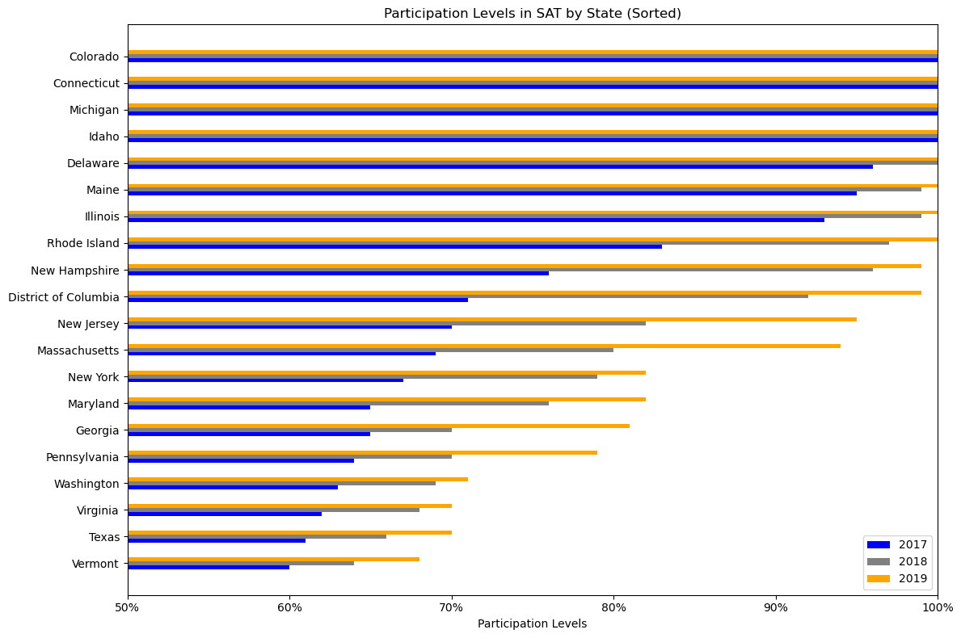
Figures

Slide 6
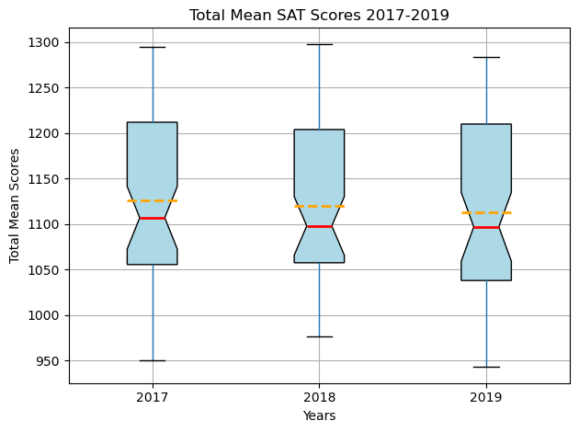

Slide 7
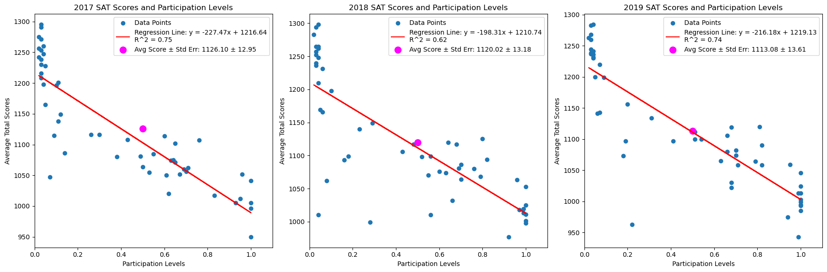

Slide 8
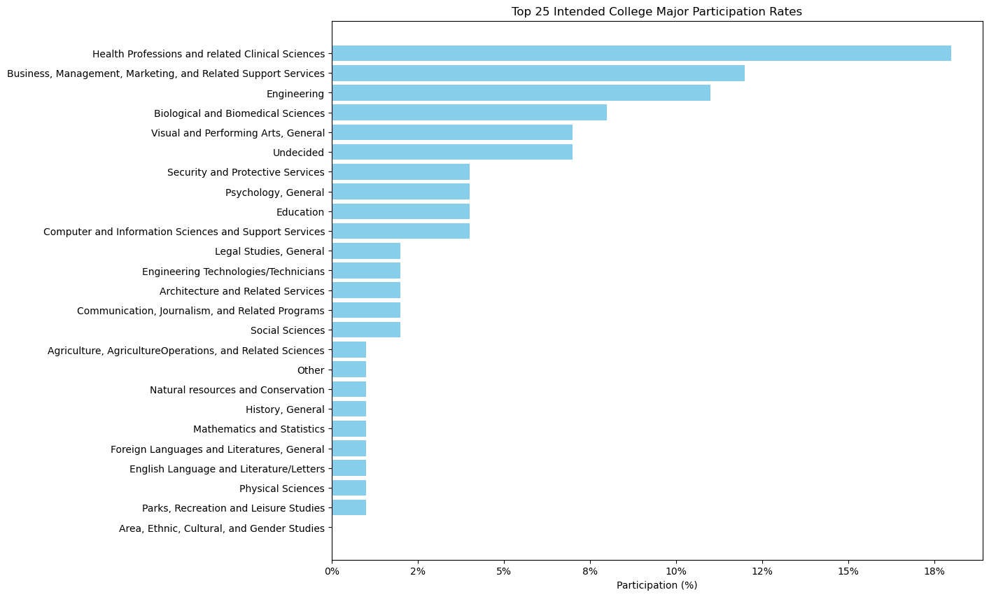

Slide 9
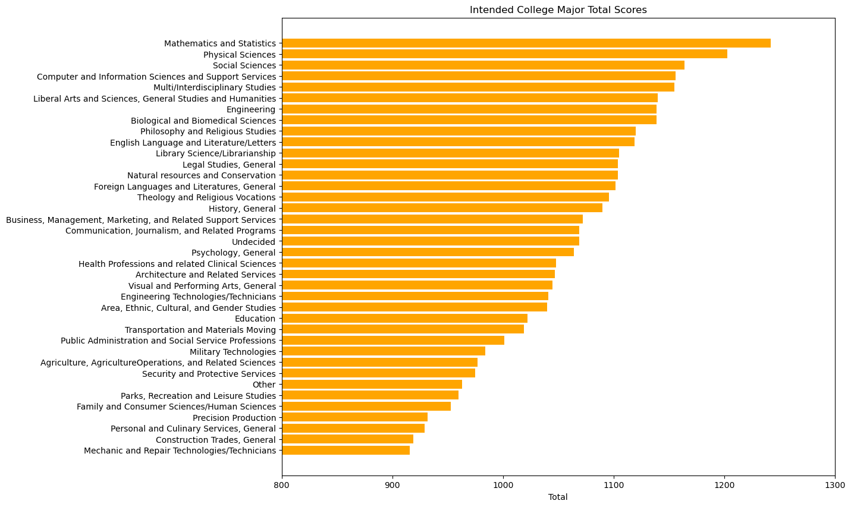

Slide 10
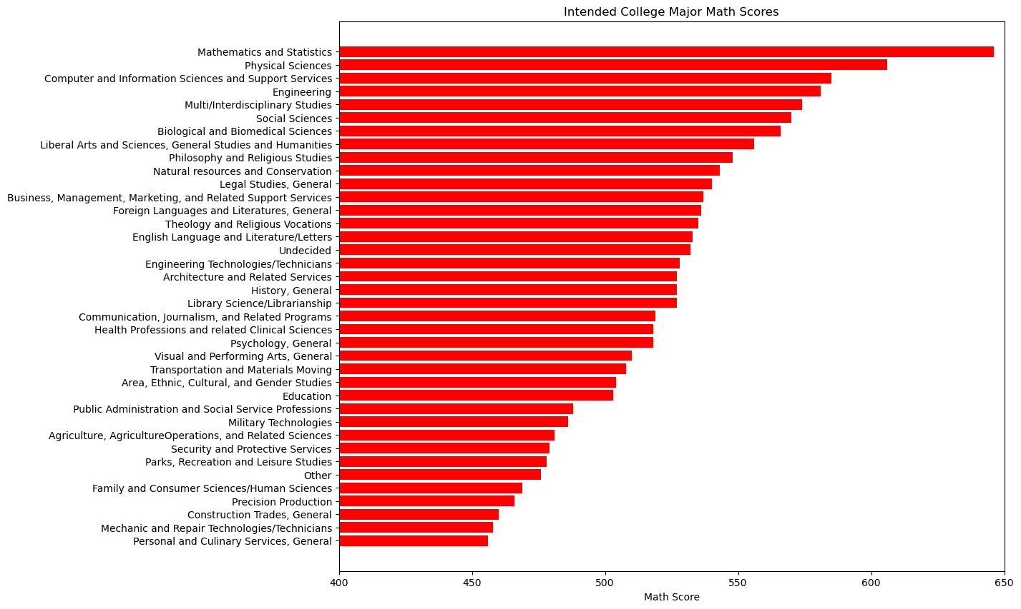

Slide 11
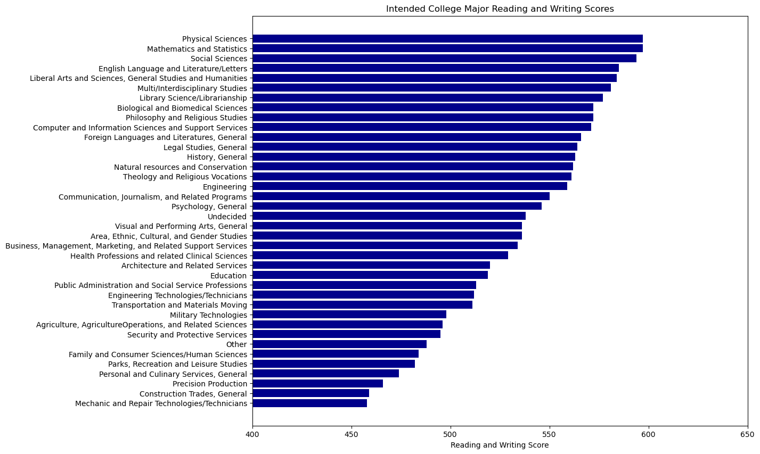

Slide 12
Conclusion
We examined trends in SAT scores and participation rates from 2017 through 2019.
We looked at trends in intended major SAT scores and participation in 2019.
We found that, although participation increased in these years, SAT scores declined slightly as a result of new test takers entering the pool, i.e. participation did not lead to preparedness and these variables were negatively correlated.
Intended majors performed better in their areas of expertise compared with those not in that area.
Those in the sciences performed better overall, most likely due to objectivity of mathematics questions / multi-interpretability of reading and writing questions, as well as cultural factors and disparities in resources.

Slide 13
Thank You!

