Slide 1
CO₂ Emissions and Energy Sources
Ben Moss
Dominic Martorano
Daniel Kim
DSI 1211 February 2024

Slide 2
Problem Statement
Communities across the United States are facing the dangers of climate change and air pollution. To address the issue, we are surveying air pollution and renewable energy datasets to create predictive models that can be utilized by policymakers, economists, and civil society organizations. The goal of this research is to better aid our understanding on how air pollution is affecting our society as a whole. The model will be capable of predicting air pollution levels as a function of changes in renewable energy and fossil fuel productions.

Slide 3
Data Cleaning And Exploratory Data Analysis
Import Data in from sources
For all datasets - Set Date column as index
In some cases (EIA datasets) utilize `melt` function to reformat the data
Kaggle Datasets - Graph data to observe trends prior to modeling
Commence Modeling

Slide 4
Regression Modeling
Most Successful Regression Models
Third Place: Linear Regression
Second Place: K-Nearest Neighbors
First Place: Bagging Tree Regressor
Regression Models | R² |  | RMSE
 | Train | Test | Train | Test
Bagging Tree | 0.9989 | 0.9953 | 0.5586 | 1.2230
KNN | 1.0 | 0.99476 | 0.0 | 1.2920
Linear | 0.9956 | 0.9941 | 1.1213 | 1.371

Slide 5
Time Series Modeling
ARIMA
SARIMA (Small Sample Size)
TS Models | AIC | RMSE
ARIMA | 89.124 | 3.330
SARIMA | 36.0 | 0.4773

Slide 6
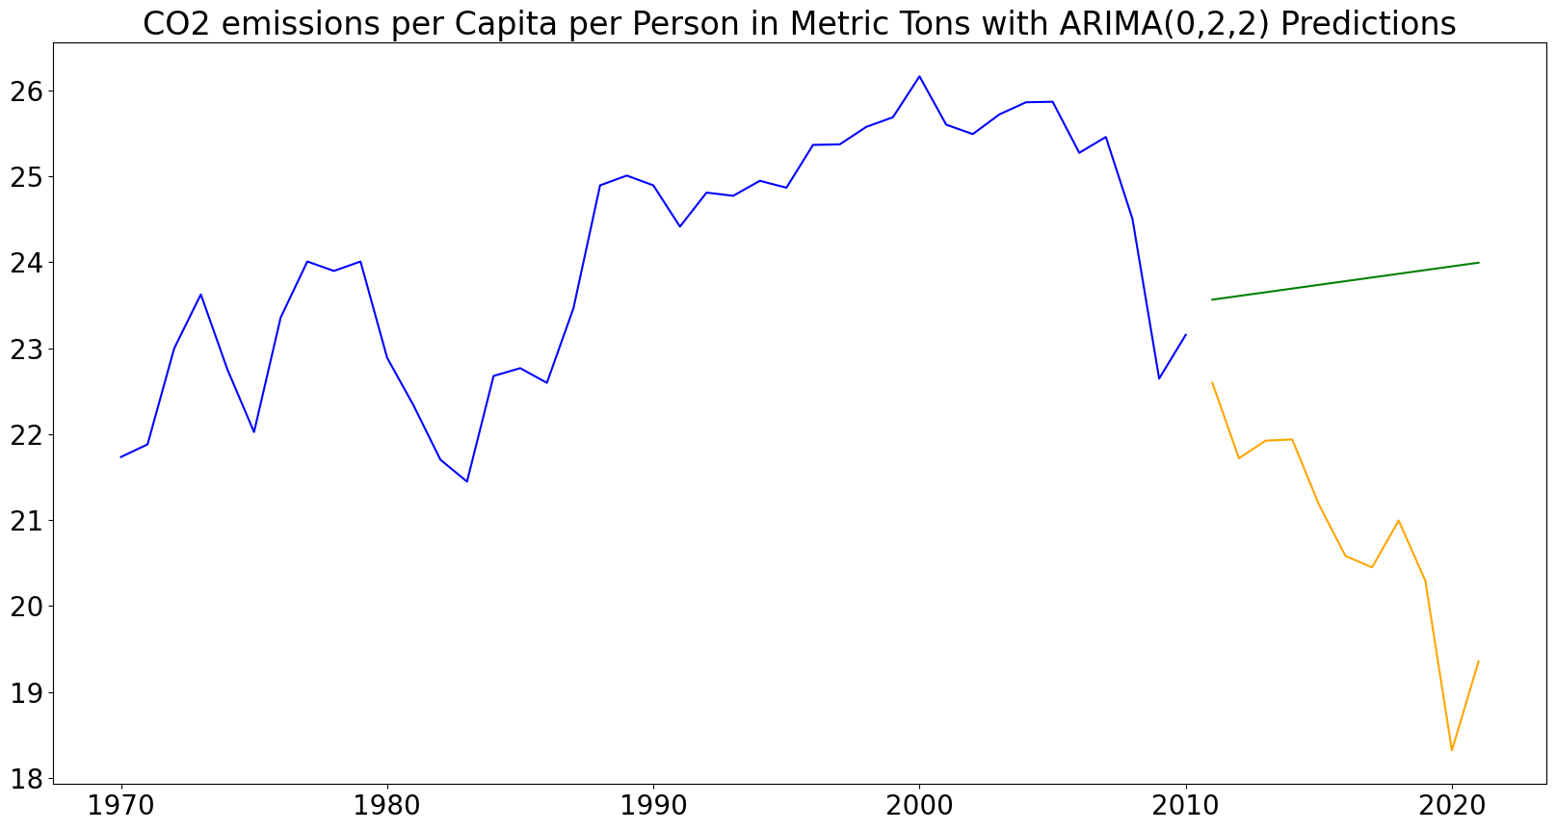
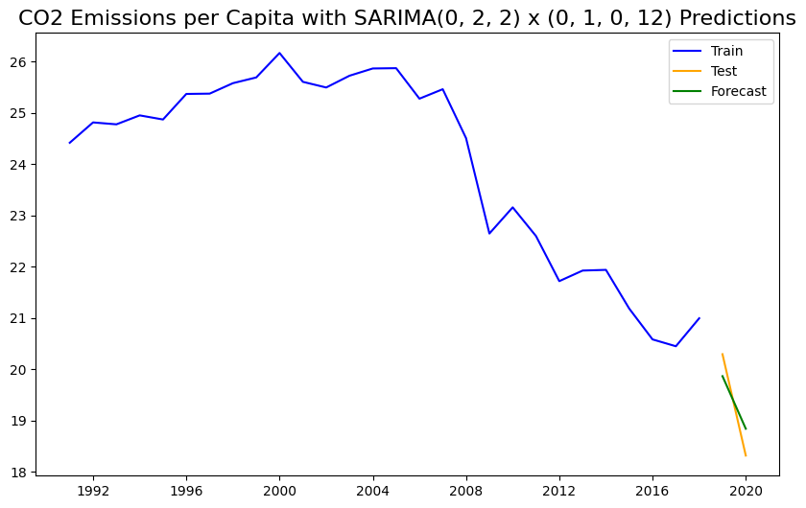
Time Series Plots

Slide 7
Linear Time Series Model Set-Up
Year column as index
Convert Year to DateTime Index
CO2 Value as the target variable
All energy values as features
Test size as 20 percent and Shuffle to False

Slide 8
Model’s Summary
AIC Score: 5.955
R-squared: 0.976
RMSE: 0.874
R2 score of test data: 0.455

Slide 9
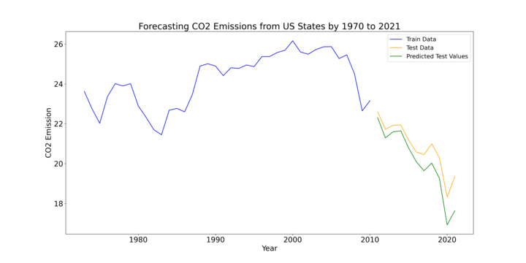

Slide 10
Dom’s Slides

Slide 11
Data Sources
https://www.kaggle.com/datasets/sogun3/uspollution
https://www.kaggle.com/datasets/anshtanwar/global-data-on-sustainable-energy
https://www.eia.gov/state/seds/seds-data-complete.php
https://www.eia.gov/electricity/data/state/

