Slide 1
School Project

Slide 2
Our tasks
Create a small diagram for project overview
Create a trello board with all tasks
Prioritize tasks
Assign tasks to all team members
Start working on the fundamental tasks

Slide 3
Fundamental tasks
Be able to create new teachers, students, classes, subjects and schools
Be able to print grades for one student
Create a grading system for the students
Create a schedule plan and be able to print it
Create a function to print the homework for a specific class and subject

Slide 4
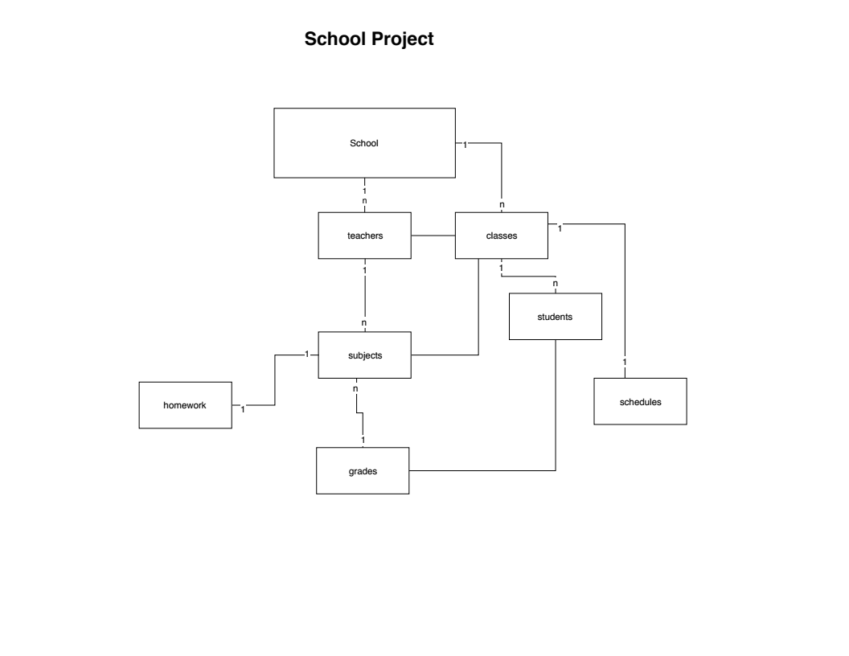
ER-Diagram

Slide 5
Format schedule plan for class
Monday | Tuesday | Wednesday | Thursday | Friday
xxxxx | xxxxx | xxxxx | xxxxx | xxxxx
xxxxx | xxxxx | xxxxx | xxxxx | xxxxx
xxxxx | xxxxx | xxxxx | xxxxx | xxxxx
xxxxx | xxxxx | xxxxx | xxxxx | xxxxx
xxxxx | xxxxx | xxxxx | xxxxx | xxxxx

