Slide 1
Team 2
23166 Victor CAZAUX
23163 Théo UNDERWOOD
23167 Nicolas GONCALVES
23206 Benjamin TOUBIANA
23178 Foucauld BONNEFONT
23174 Thomas CULINO
GitHub : https://github.com/BenjaminTOUD/dorset-college-oop-group-2

Slide 2
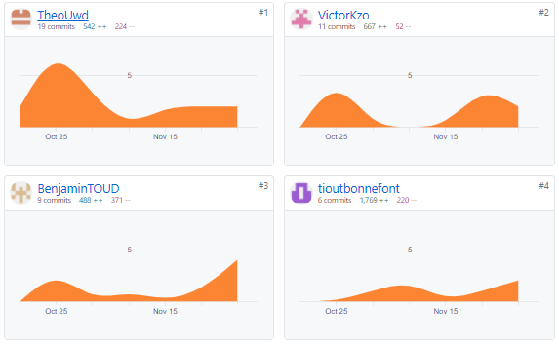
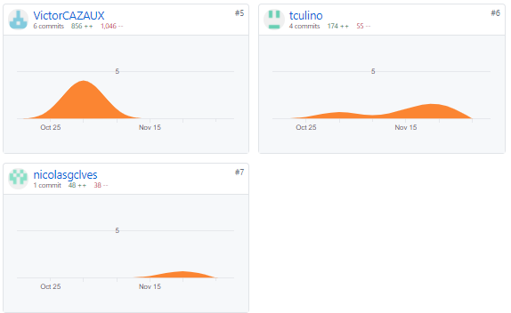
GitHub commits

Slide 3
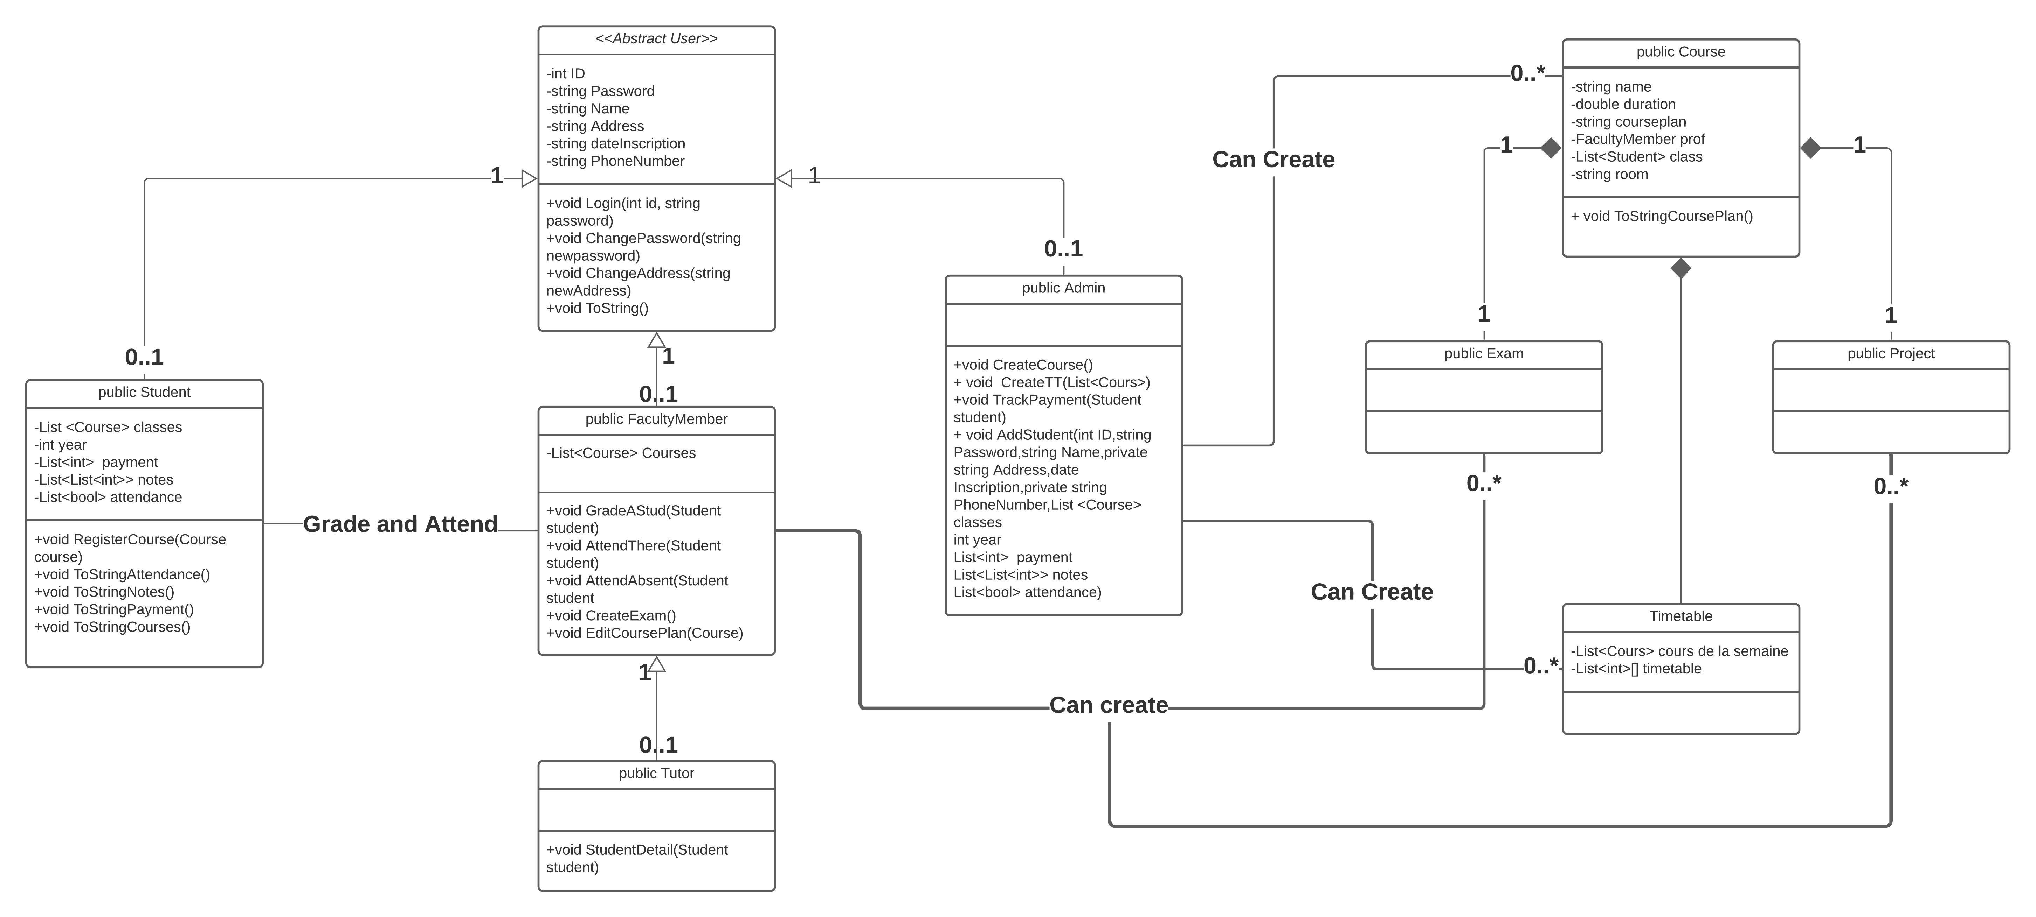
UML

Slide 4
Key topics
Manage Exams, Assignments and Results
Manage Student Attendance
Manage Course Lesson Plan
Manage Timetable
Management of fees paid

Slide 5
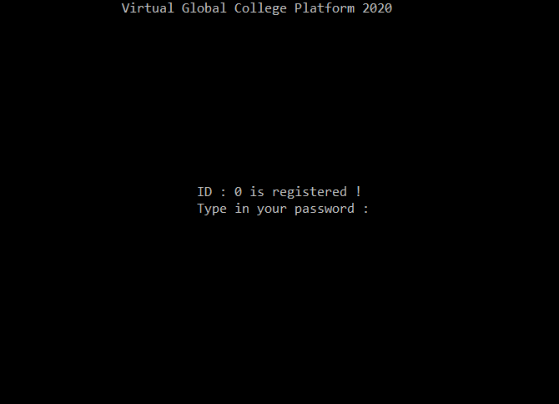
Home page

Slide 6
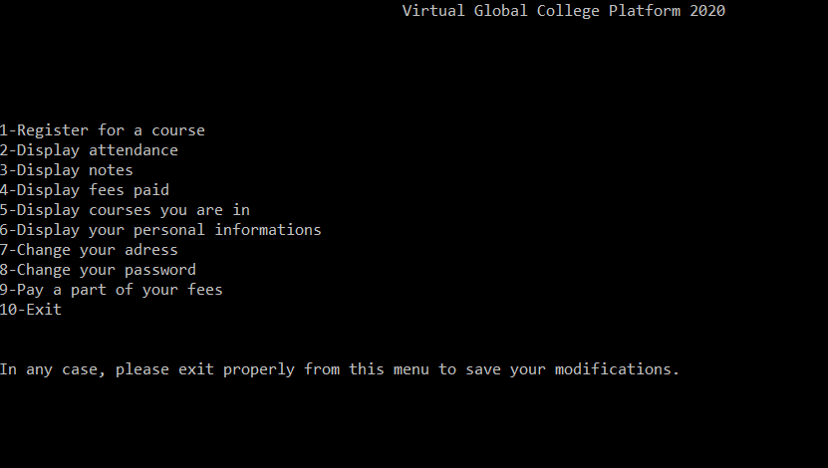
Logged in as a Student

Slide 7
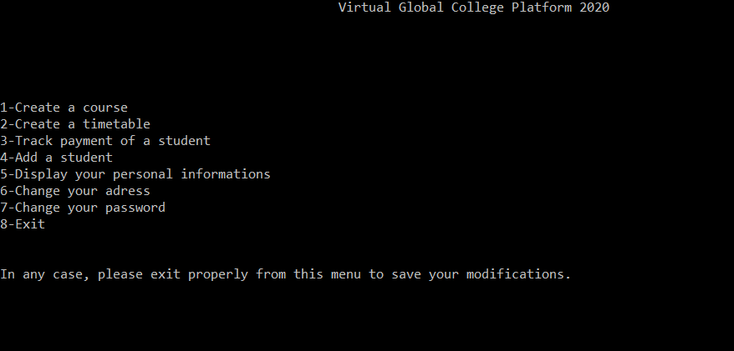
Logged in as an Admin

Slide 8
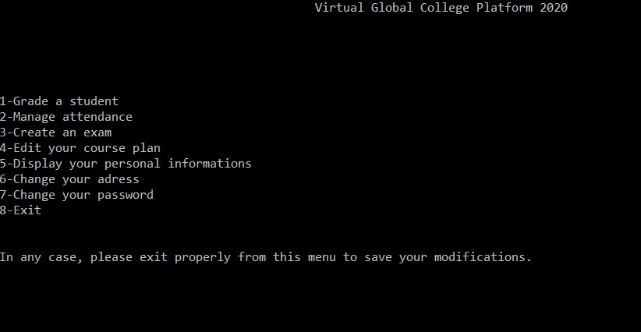
Logged in as a Faculty Member

Slide 9
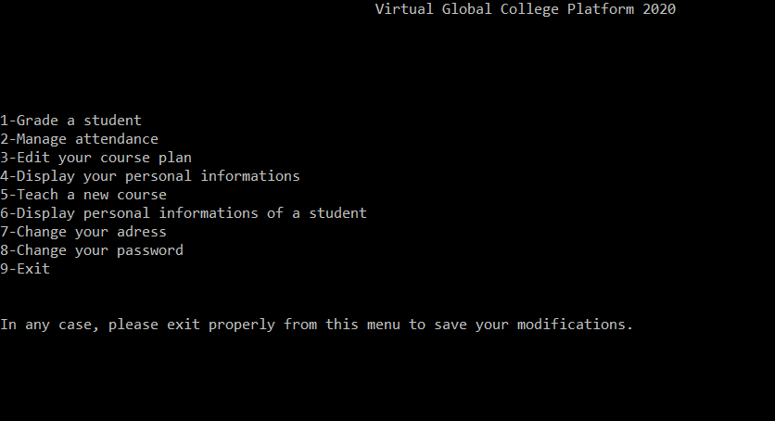
Logged in as a Tutor

Slide 10
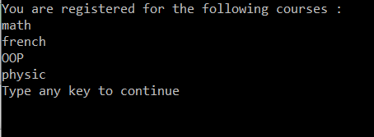
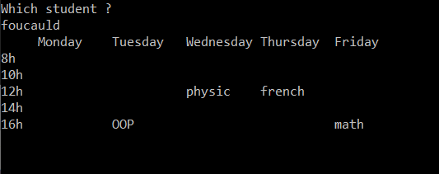
Create a timetable
Courses chosen by the student
Final timetable

Slide 11
What we learned from doing this projet

