Slide 1








Useful components
$$y$$
$$y$$
$$0$$
$$x$$
$$0$$
$$x$$
$$x$$
$$0$$

Slide 2















$$\vec{F}$$
$$A$$
$${\vec{F}}_{container}$$
$$y$$
$$y$$
$$P_{1}$$
$$\vec{g}$$
$$P+dP$$
$$h$$
$$\vec{g}$$
$$A$$
$$dm$$
$$dy$$
$$P_{2}$$
$$P$$

Slide 3








$$A$$
$$B$$
$$C$$
$$h$$
$$N$$
$$wind$$
$$sail$$
$$sailboat$$

Slide 4









$$P_{0} (atmospheric)$$
$$P (to be measured)$$
$$M$$
$$\vec{F}$$
$$h$$
$$A$$
$$B$$
$$D$$
$$\frac{D}{2}$$

Slide 5













$$P_{1}$$
$$P_{1}$$
$$P=0$$
$$P=0$$
$$P_{0}$$
$$h$$
$$A$$
$$B$$
$$h$$
$$h$$
$$A$$
$$B$$
$$P_{0}$$

Slide 6
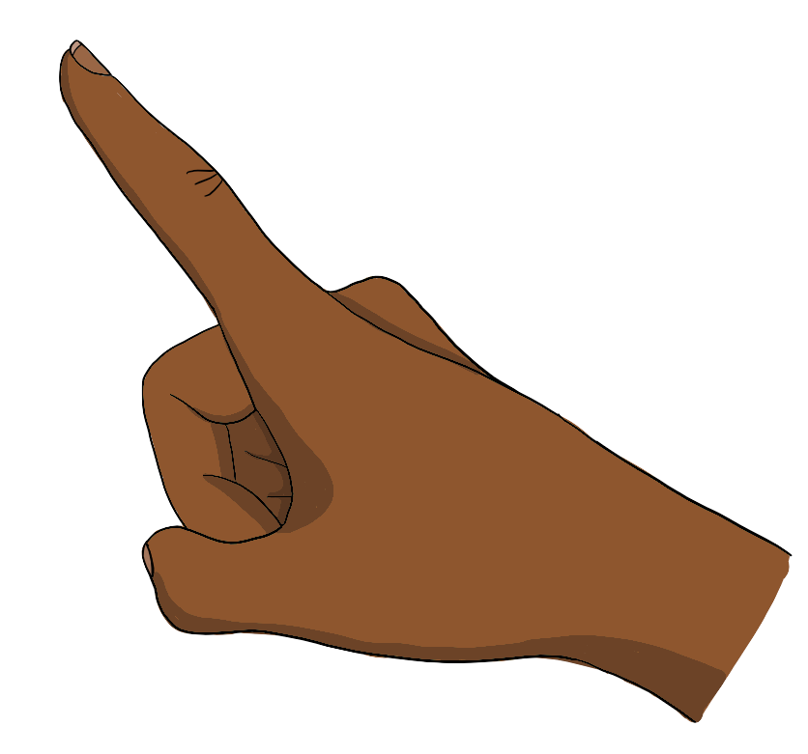





$${\vec{F}}_{B}$$
$${\vec{F}}_{B}$$
$$V$$
$${\vec{F}}_{g}$$
$$V$$

Slide 7
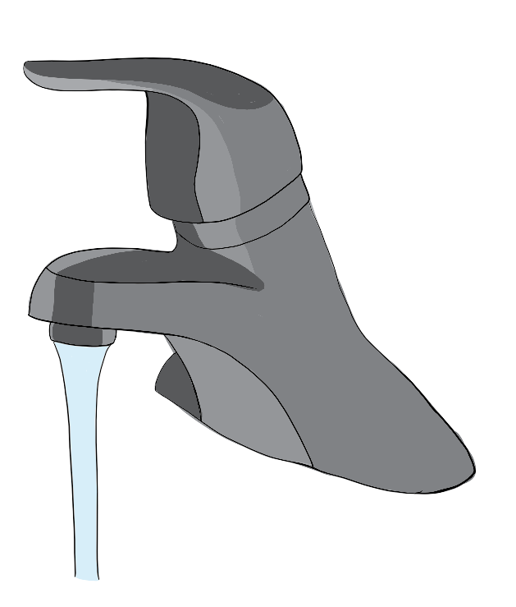






$$Laminar flow$$
$$Turbulent flow$$
$$A_{1}$$
$$A_{2}$$
$$v_{1}$$
$$v_{2}$$

Slide 8
















$$F_{2}=P_{2}A_{2}$$
$$y_{2}$$
$$P_{2}, A_{2}$$
$$v_{2}$$
$$F_{1}=P_{1}A_{1}$$
$$v_{2}Δt$$
$$y_{1}$$
$$t=0$$
$$v_{1}$$
$$P_{1}, A_{1}$$
$$P_{2}, A_{2}$$
$$v_{2}$$
$$v_{1}Δt$$
$$t=Δt$$
$$P_{1}, A_{1}$$
$$v_{1}$$

Slide 9


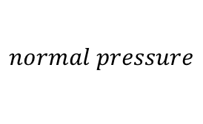

$$low pressure$$
$$low pressure$$
$$low pressure$$
$$normal pressure$$

Slide 10
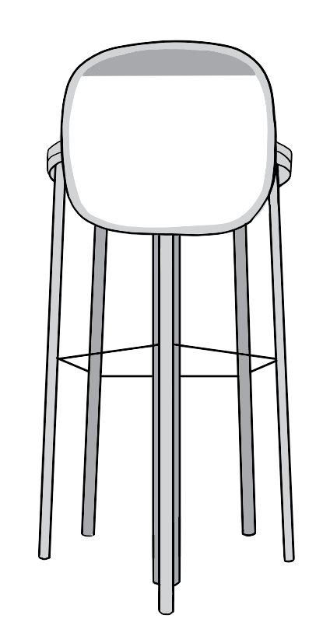


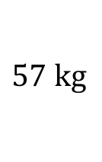
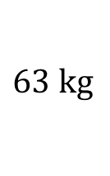












$$Rebeka$$
$$Josh$$
$$57 \text{kg}$$
$$63 \text{kg}$$
$$h_{1}$$
$$door$$
$$0.12 \text{m}$$
$$1 \text{m}$$
$$ocean$$
$$h_{2}$$
$$y$$
$${\vec{F}}_{B}$$
$$0$$
$$x$$
$$d$$
$${\vec{F}}_{g}^{door}$$
$${\vec{F}}_{g}^{people}$$

Slide 11








$$\vec{v}$$
$$bank$$
$$\vec{F}$$
$$river$$
$$v$$
$$l$$
$$v=0$$
$$bank$$

Slide 12



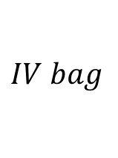









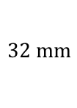
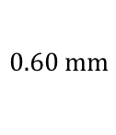
$$y$$
$$y_{0}$$
$$house 1$$
$$R_{1}$$
$$main$$
$$main$$
$$ΔP$$
$$y_{1}=0$$
$$R_{2}$$
$$IV bag$$
$$house 2$$
$$0.60 \text{mm}$$
$$32 \text{mm}$$
$$tube$$
$$needle$$

