Slide 1








Useful components
$$y$$
$$y$$
$$0$$
$$x$$
$$0$$
$$x$$
$$x$$
$$0$$

Slide 2
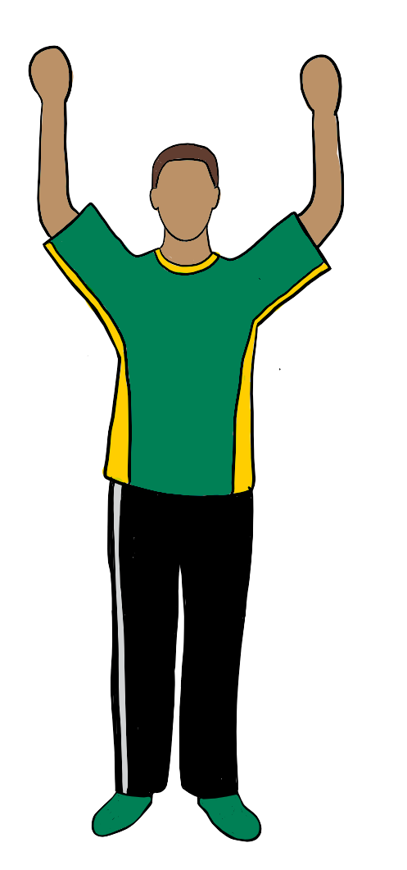
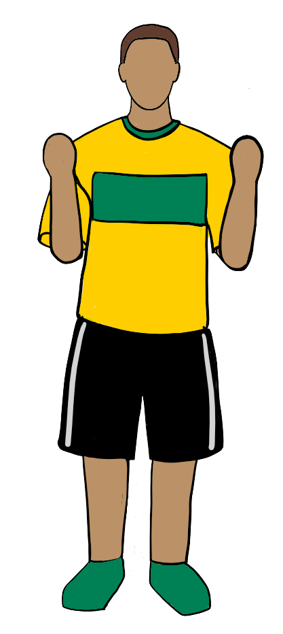
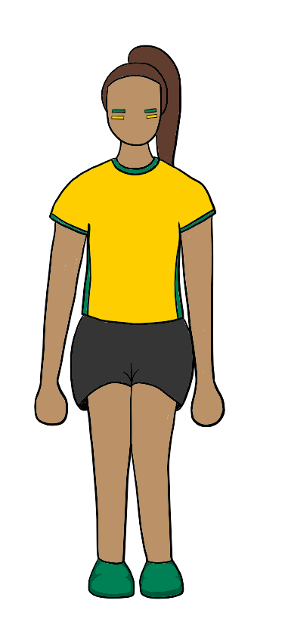
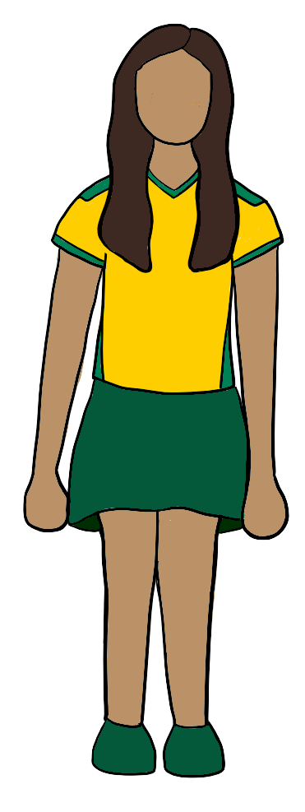


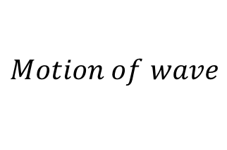
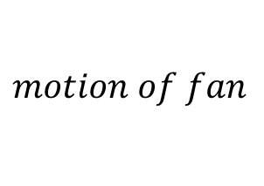


$$Motion of wave$$
$$motion of fan$$
$$Motion of wave$$
$$motion of water molecule$$
$$Top view$$
$$Side view$$

Slide 3
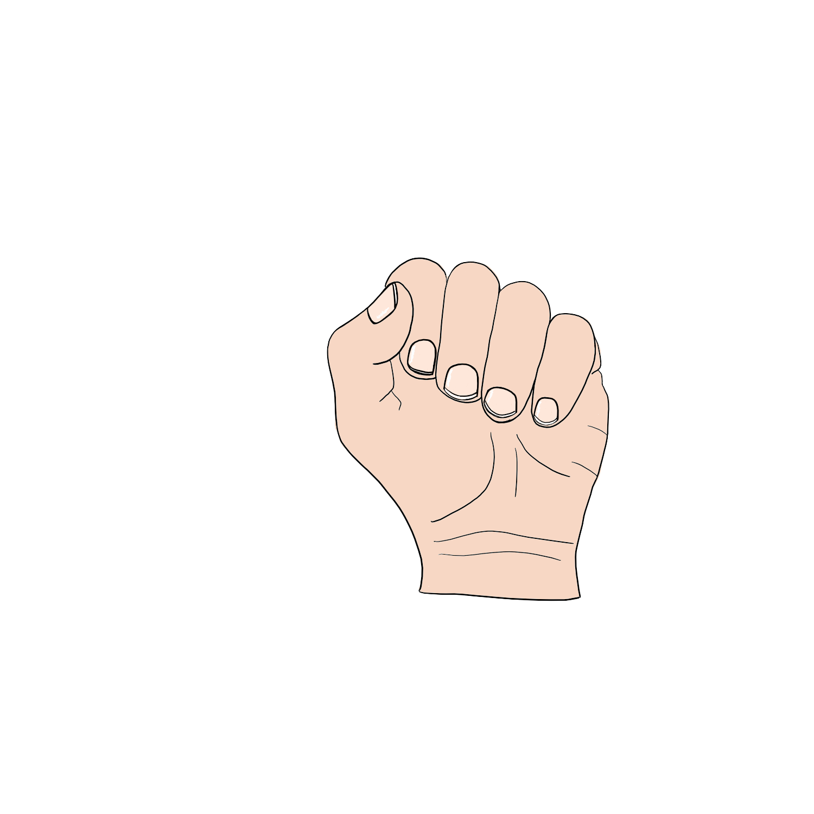
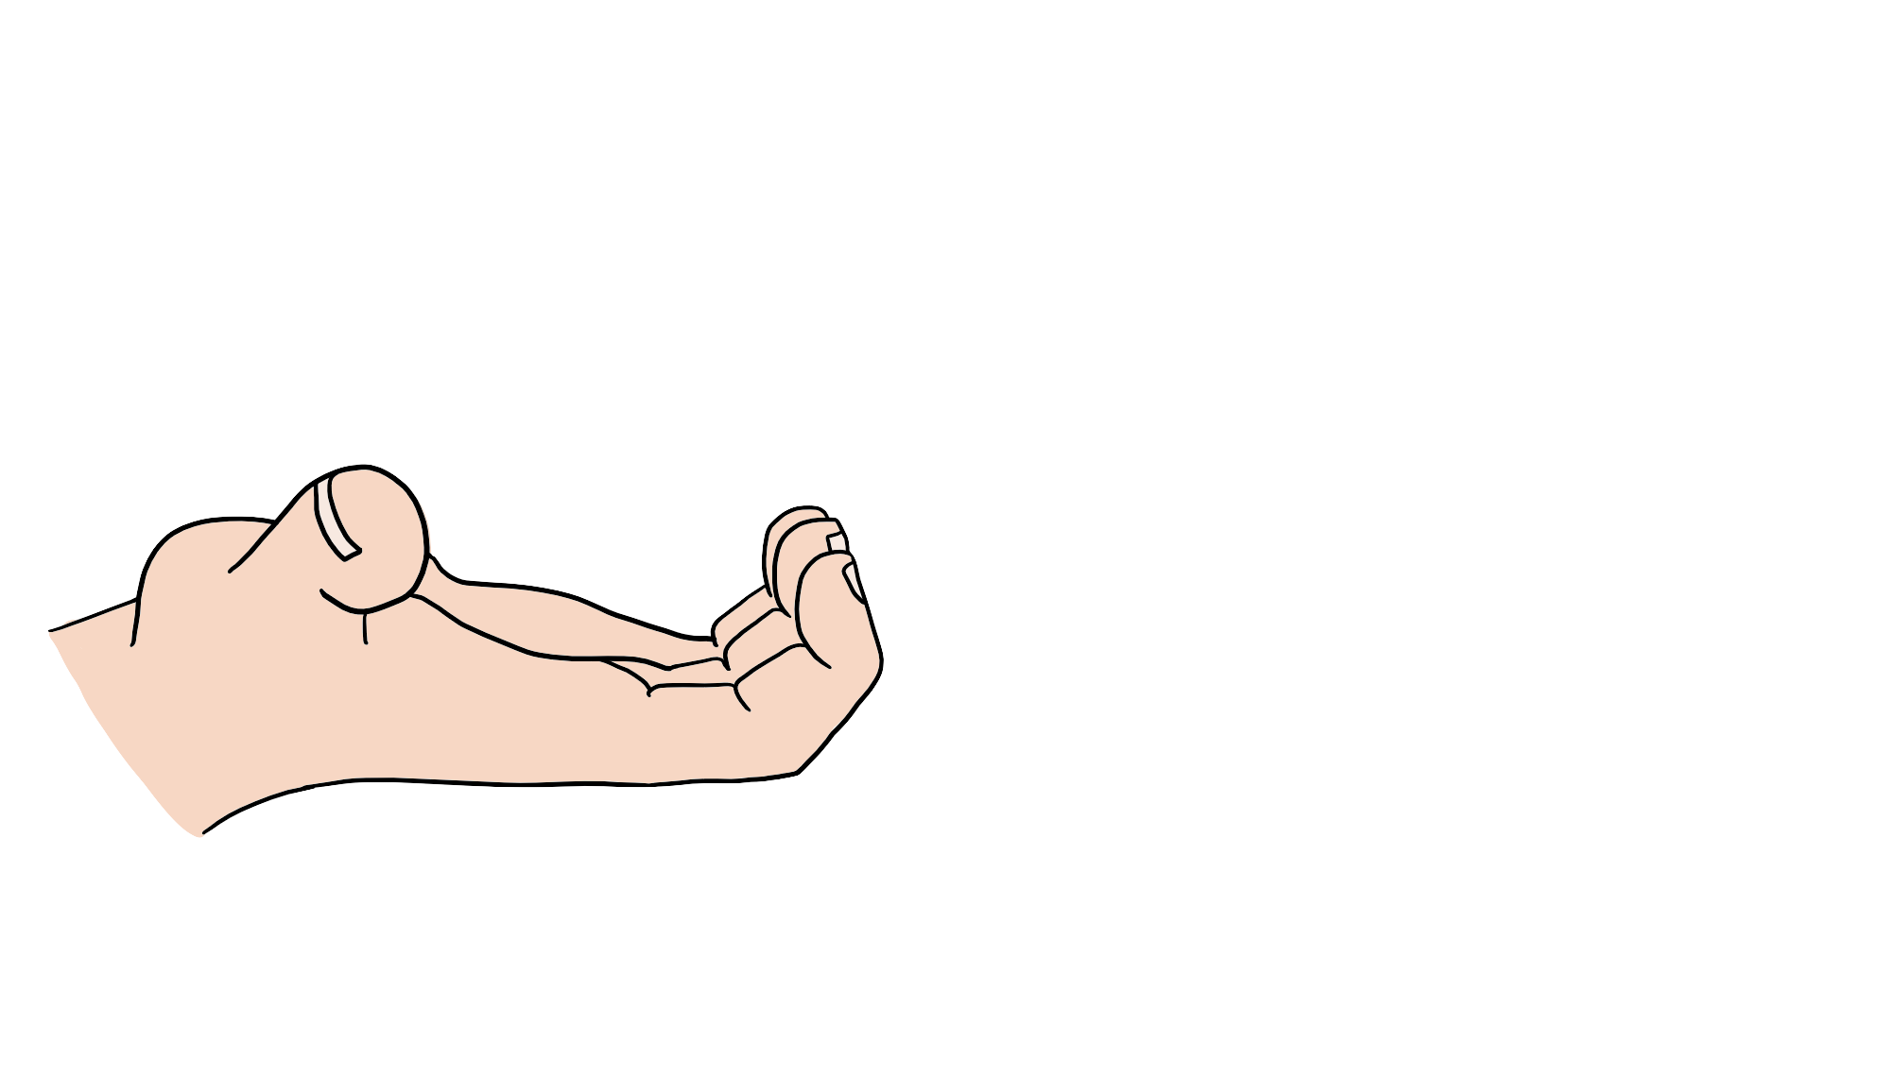
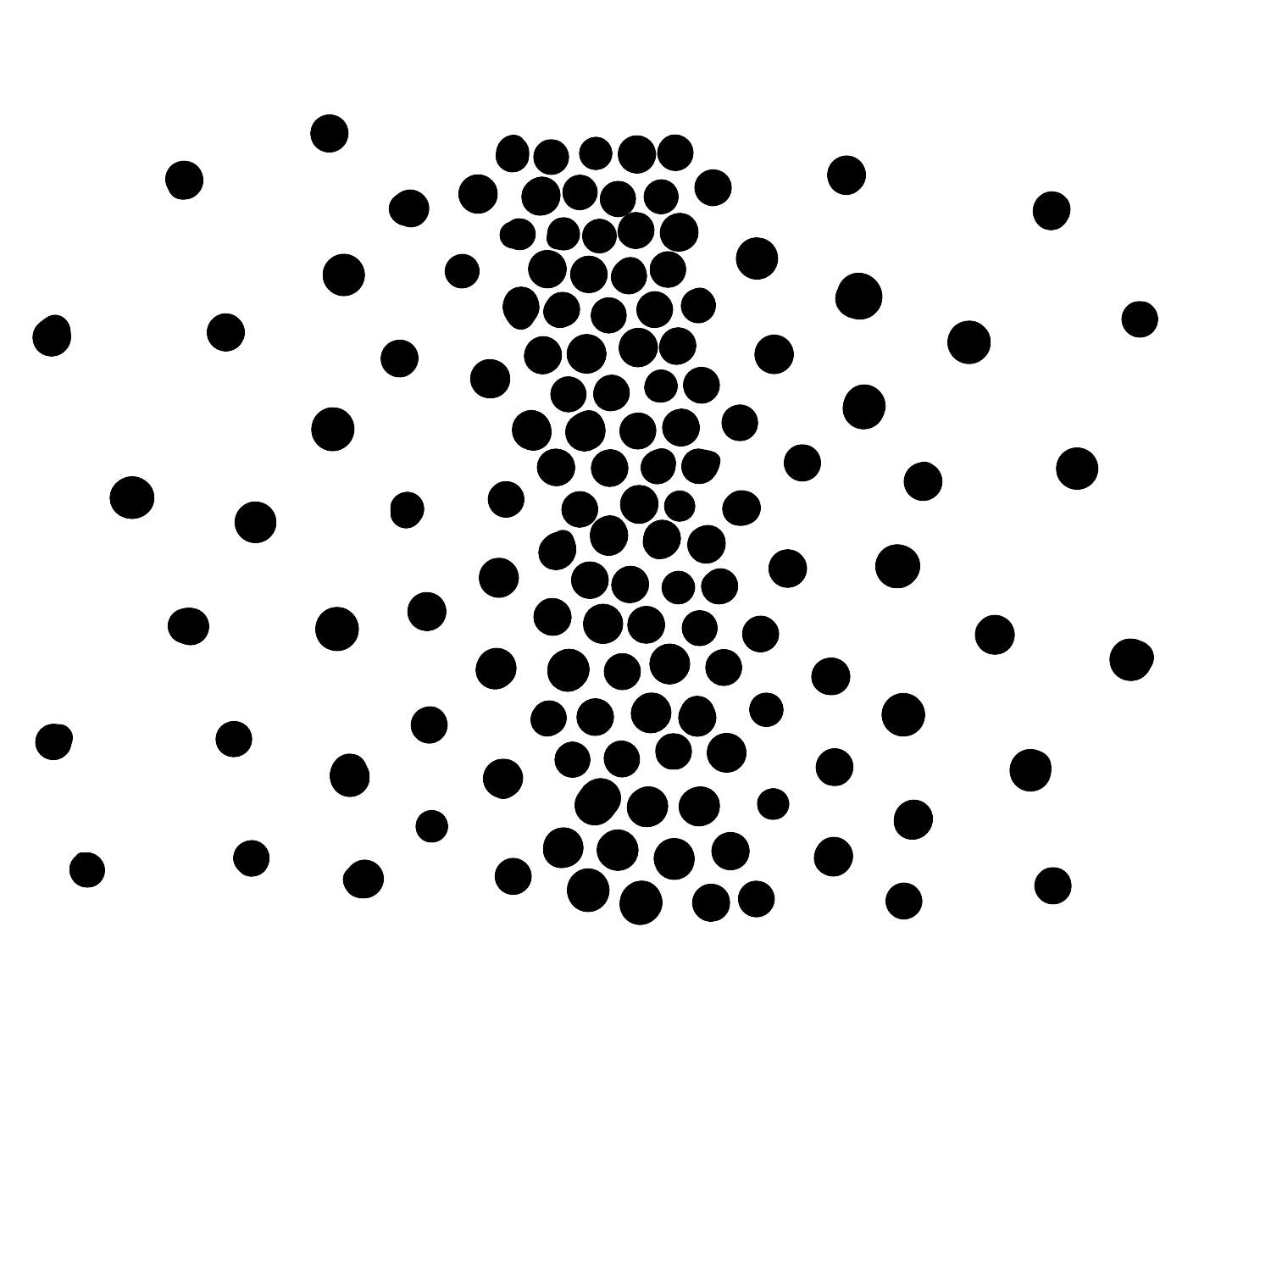
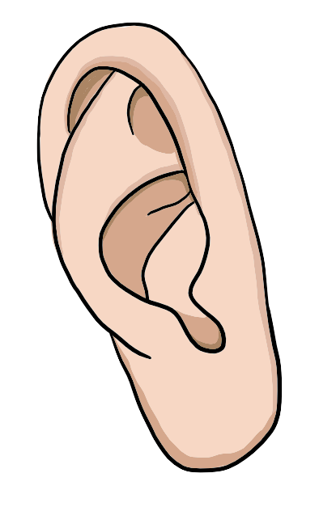
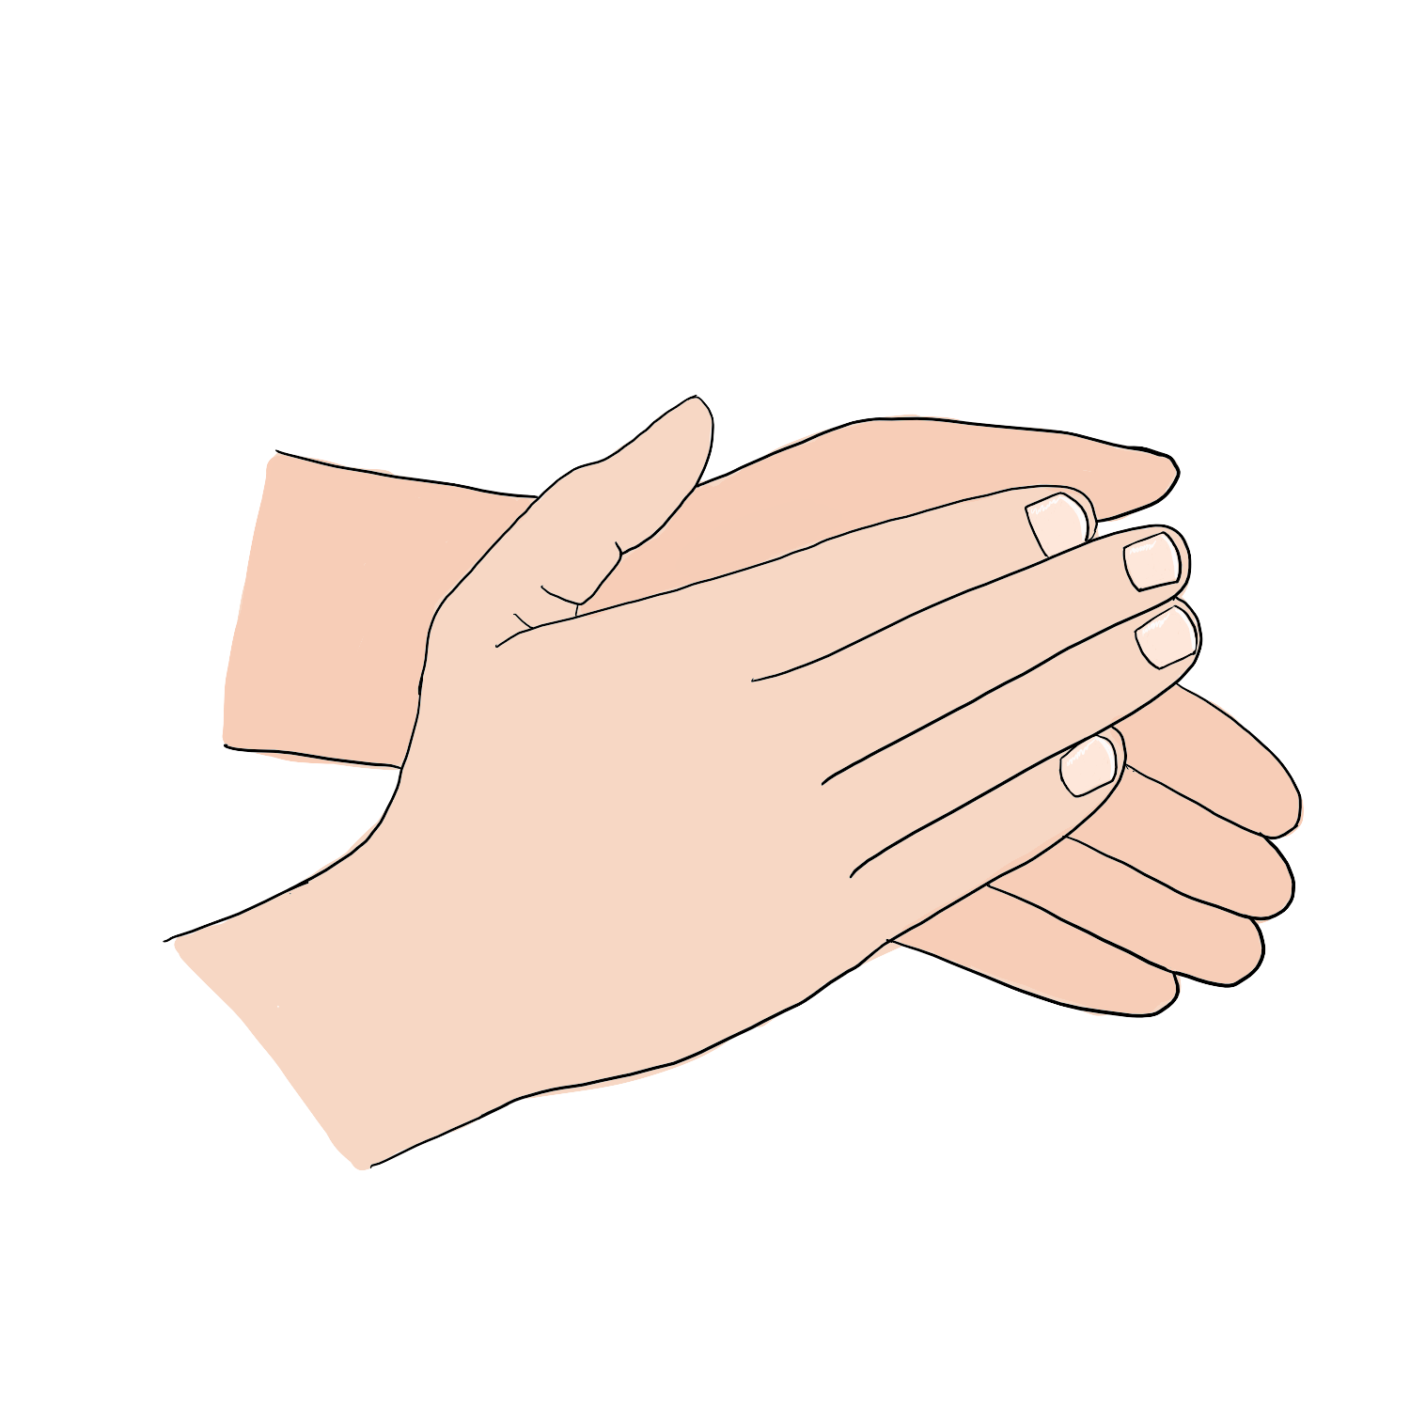


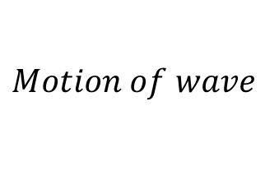
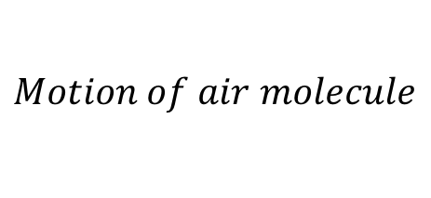
$$Motion of wave$$
$$Motion of rope section$$
$$Motion of wave$$
$$Motion of air molecule$$

Slide 4
















$$\vec{v}$$
$$λ$$
$$A$$
$${\vec{F}}^{net}$$
$$\vec{F}$$
$$\vec{F}$$
$$\vec{v}$$
$$\vec{v}′$$
$${\vec{F}}_{T}$$
$$A$$
$$v^{′}t$$
$$\vec{v}$$
$$C$$
$$vt$$
$$B$$
$${\vec{F}}_{T}$$
$$y$$
$$0$$
$$x$$

Slide 5






$${\vec{F}}_{from rope}$$
$$reflected$$
$$original$$
$${\vec{F}}_{from wall}$$
$$original$$
$$reflected$$

Slide 6










$$\vec{v}$$
$$D$$
$$0$$
$$x$$
$${\vec{F}}_{T2}$$
$$dx$$
$$θ_{2}$$
$$θ_{1}$$
$${\vec{F}}_{T1}$$
$$D(x,t)$$
$$y$$
$$0$$
$$x$$

Slide 7
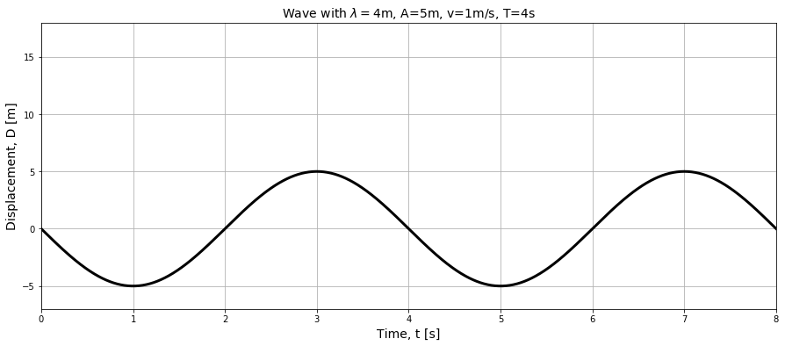

Slide 8
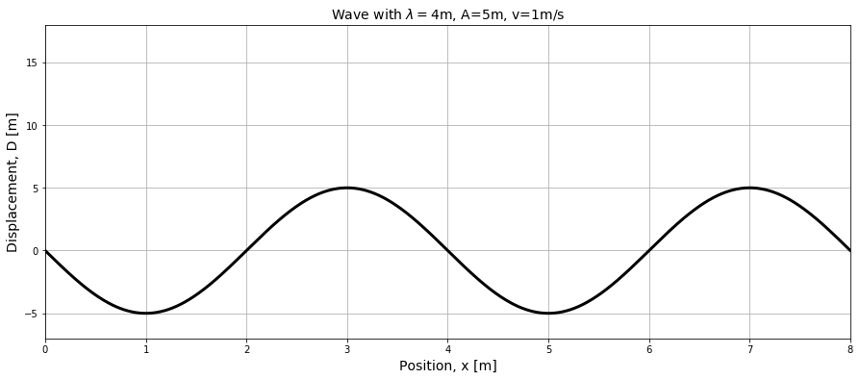

Slide 9

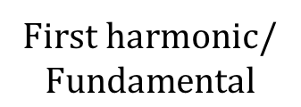
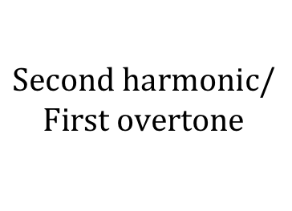
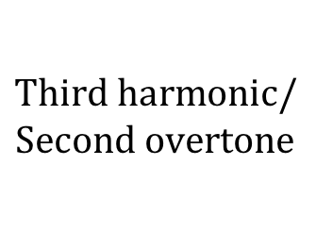


First harmonic/
$$\text{Fundamental}$$
$$\text{Second} \text{harmonic}\text{/}$$
$$\text{First} \text{overtone}$$
$$Antinode$$
$$\text{Third} \text{harmonic}\text{/}$$
$$\text{Second} \text{overtone}$$
$$Node$$

Slide 10


$$\text{W}\text{ave} \text{Front}$$
$$\text{M}\text{embrane}$$

Slide 11
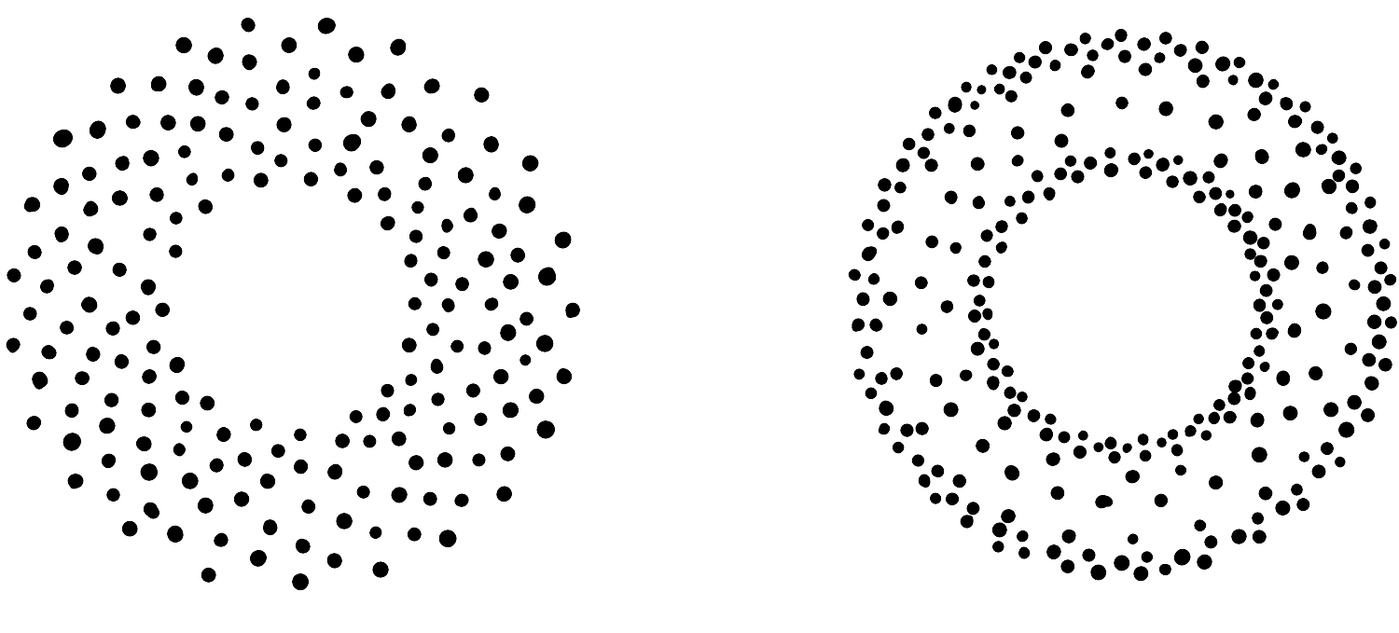

Slide 12




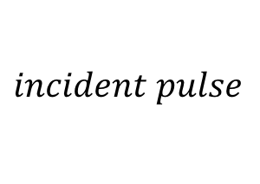








$$y$$
$$incident pulse$$
$$r$$
$$μ_{1}$$
$$dr$$
$$μ_{2}$$
$$x=0$$
$$x$$
$$reflection$$
$$transmission$$
$$F_{T}$$
$$θ_{2}$$
$$θ_{1}$$
$$F_{T}$$
$$y$$
$$0$$
$$x$$

Slide 13





$$original$$
$$original$$
$$reflected$$
$$transmitted$$
$$reflected$$
$$transmitted$$

Slide 14

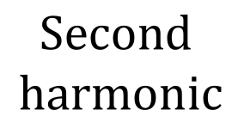
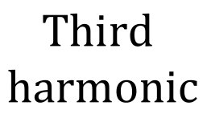

$${\vec{v}}_{1}$$
First
harmonic
$${\vec{v}}_{2}$$
$$\text{Second}$$
$$\text{harmonic}$$
$$\text{Third}$$
$$\text{harmonic}$$

Slide 15


$$air$$
$$L$$

