Slide 1








Useful components
$$y$$
$$y$$
$$0$$
$$x$$
$$0$$
$$x$$
$$x$$
$$0$$

Slide 2






$$Motion of wave$$
$$motion of fan$$
$$Motion of wave$$
$$motion of water molecule$$
$$Top view$$
$$Side view$$

Slide 3


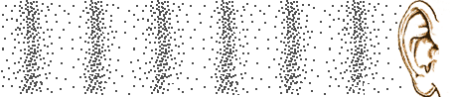




$$Motion of wave$$
$$Motion of rope section$$
$$Motion of wave$$
$$Motion of air molecule$$

Slide 4



$$\vec{v}$$
$$λ$$
$$A$$

Slide 5
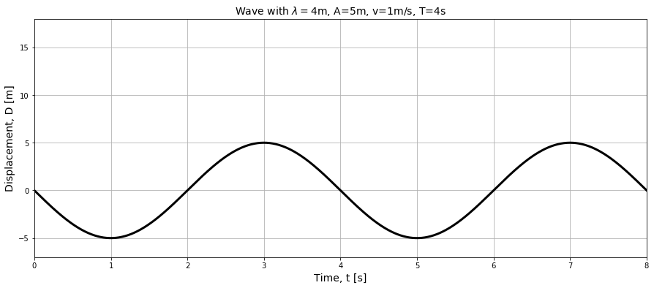

Slide 6
