Slide 1
Thermo-Hydraulics (THM) MOOSE Module Utah Forge Simulation One Fracture Model
Intern: Benjamin Willis
Mentor: Robert Podgorney

Slide 2
(0,0,0)
(1,0,0)
I.D = 0.18 m
Perf diameter = 3/8 in = 0.009525 m
(1,0,-1957)
(0,0,-2057)
(1122.4,0,-2531.9)
I.D = 0.076 m for 10 perfs
I.D = 1 m
I.D = 0.076 m for 10 perfs
(1122.6,0,-2632.1)

Slide 3
inlet
outlet
fracture3 injection well distance ~= 3317 m ~= 10887 ft
injection_pipe
production_pipe
jct8
pipe7
pipe6
jct7
jct6
pipe5
jct5
jct1
fracture3_perf2
Jct_fracture3_perf2
pipe2
fracture3
jct2
Jct_fracture3_perf1
pipe3
fracture3_perf1
jct3
pipe4
jct4

Slide 4
Model Pipe Lengths (all approximated)
fracture3 injection well distance ~= 3317 m ~= 10887 ft
1957 m
2057 m
1 m
98 m
1030 m
1 m
134 m
96 m

Slide 5
Parameters
Component Name | Parameters Used
inlet | m_dot = 5 kg/s T_in = 25°C
outlet | p = 2 MPa (~= 145 PSI)
Perforations | Diameter = 0.009525 m, 10 perfs assumed → Diameter = 0.09525 m Length = 1 m
Fractures | Diameter = 2 m Length = 98 m
All pipes | # of elements = 200 custom_closures used (f = 0.0167, Hw = 2000)
Temperature with Elevation | Linear interpolation between 25°C at z = 0 m 196°C at z = -2800 m
Pressure with Elevation | Linear interpolation between 101.325 kPa at z = 0 m 25.1865e3 kPa at z = -2800 m

Slide 6
Fluid Properties Used
Modules/FluidProperties Name | Parameters Used
water | type = StiffenedGasFluidProperties gamma = 2.35 (heat capacity ratio) cv = 1816 (Constant volume specific heat) q = -1.167e6 (defines zero point of internal energy) p_inf = 1e9 (stiffness parameter) mu = 1e-4 Pa*s (Dynamic viscosity) q_prime = 0 (Default)

Slide 7
Heat Structure Materials
HeatStructureMaterials Name | Parameters Used
mild_steel (used for pipe wall) | rho = 7850 kg/m³ cp = 510.8 J/(kg*K) k = 60 W/(m*K)
cement | rho = 2400 kg/m³ cp = 920 J/(kg*K) k = 0.29 W/(m*K)
rock | rho = 2750 kg/m³ cp = 830 J/(kg*K) k = 3 W/(m*K)

Slide 8
Preconditioning Used
Preconditioner Name | Parameters Used
pc | type = SMP full = true

Slide 9
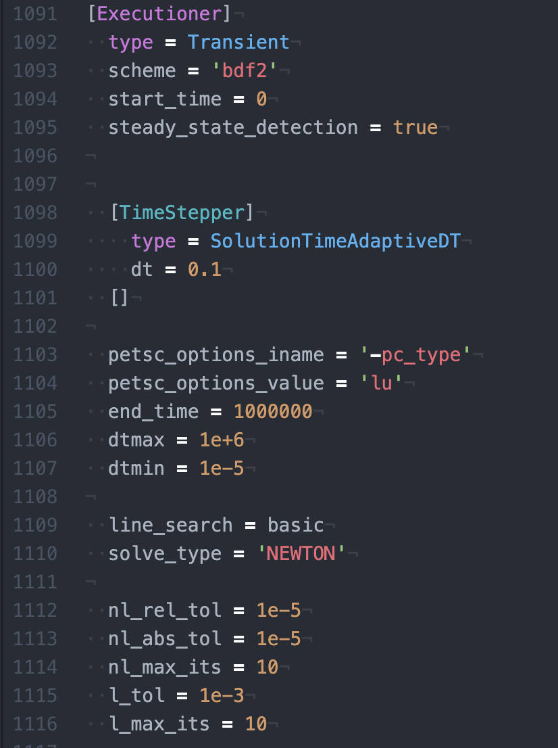
Executioner Used

Slide 10
Heat Structures for pipes
INNER_RADIUS = 0.09 m = pipe radius
R = 50 m
Temperature BCs: based on Temperature with Elevation
pipe
pipe wall
cement
rock
Width pipe wall = 0.00635 m
Width cement = 0.0051 m
Width rock = 49.95 m

Slide 11
Heat Structures for fractures
INNER_RADIUS = 0.5 m or 1 m = fracture radius
R = 50 m
Temperature BCs: based on Temperature with Elevation
fracture (treated as a pipe)
rock
Width rock = 50 m

Slide 12
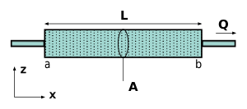
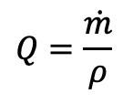
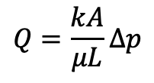
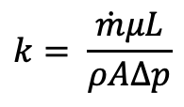
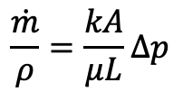
Calculating Fracture Permeability Using Darcy’s Law
$$Q=\frac{kA}{μL}∆p$$
Equation 1
$$Q=\frac{\dot{m}}{ρ}$$
Equation 2
$$\frac{\dot{m}}{ρ}=\frac{kA}{μL}∆p$$
Equations 1 and 2
$$k= \frac{\dot{m}μL}{ρA∆p}$$
Solve for k
Use $μ,$ $ρ$, and $\dot{m}$ at inlet and outlet of fracture and compare value

Slide 13
1 Fracture Study
Done With both Inlet and Exit Perforations
5 kg/s
Fracture diameter = 2 m
10 inlet and exit perforations

Slide 14
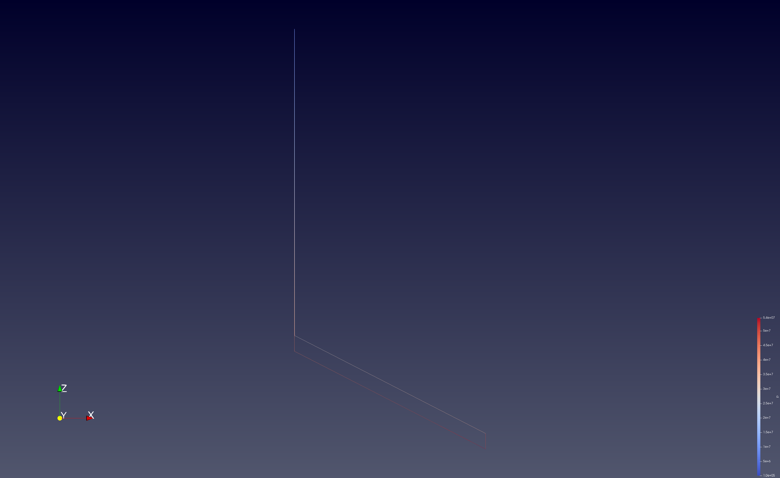
Paraview at ~= 60,000s

Slide 15
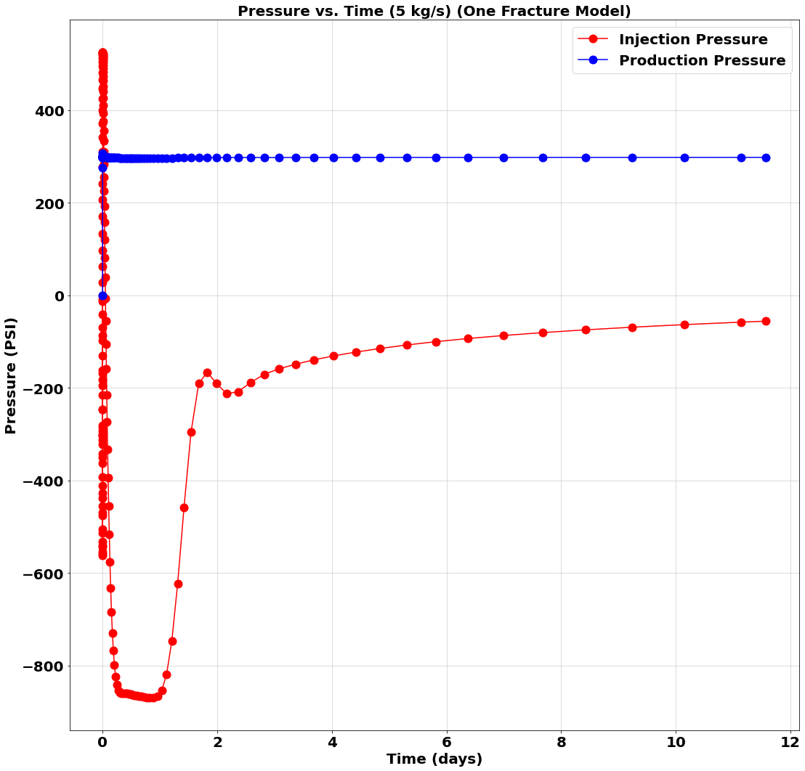
Pressure at Injection and Production Points

Slide 16
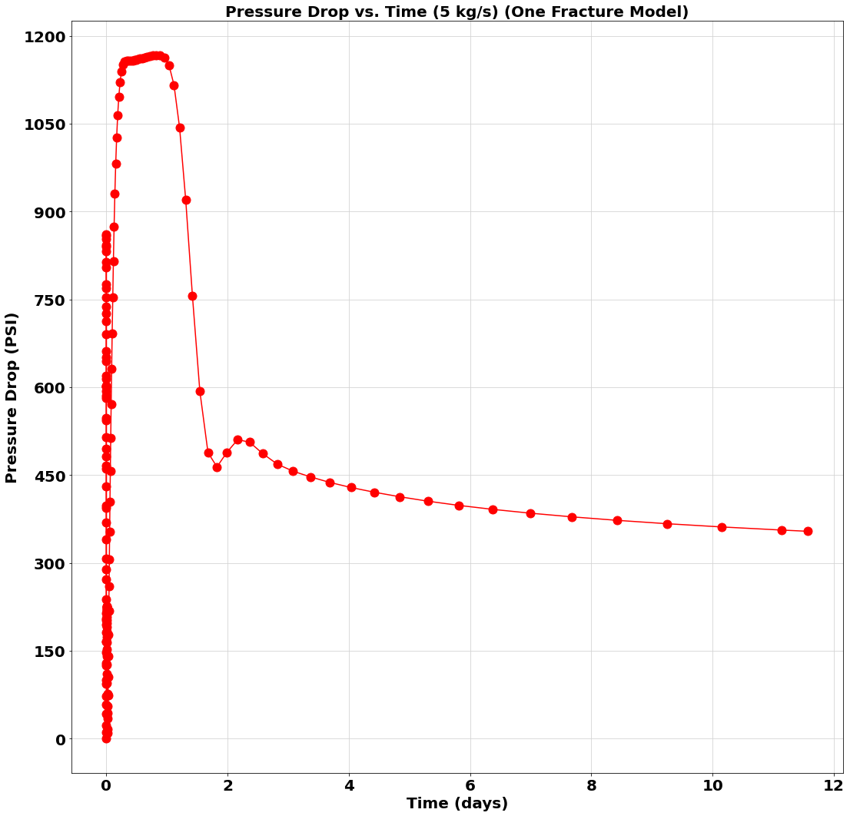
Pressure Drop Across EGS

Slide 17
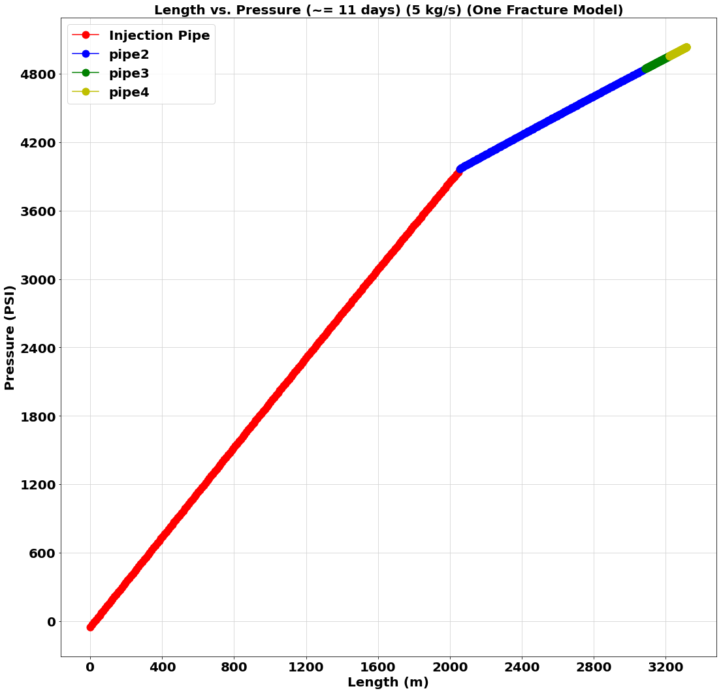
Pressure Drop Across EGS

Slide 18
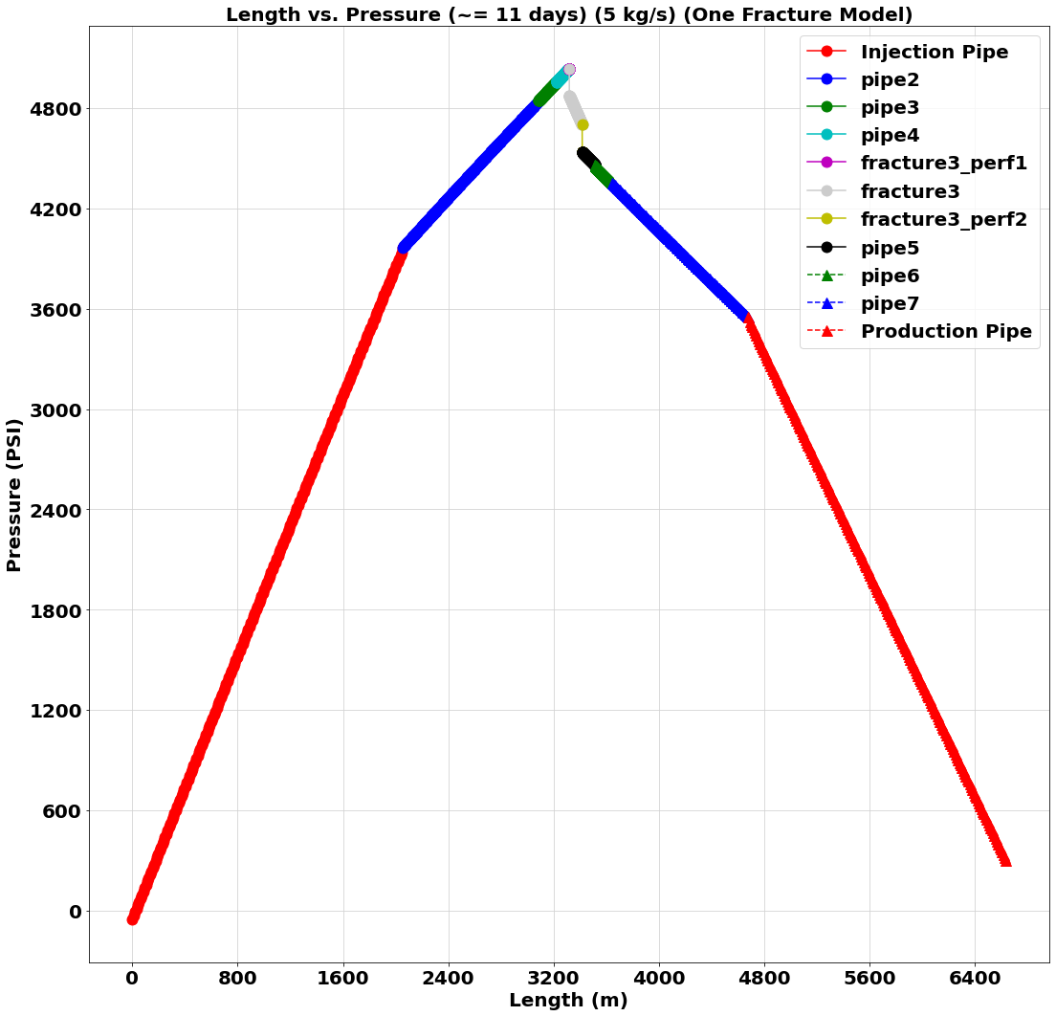
Pressure Across EGS

Slide 19
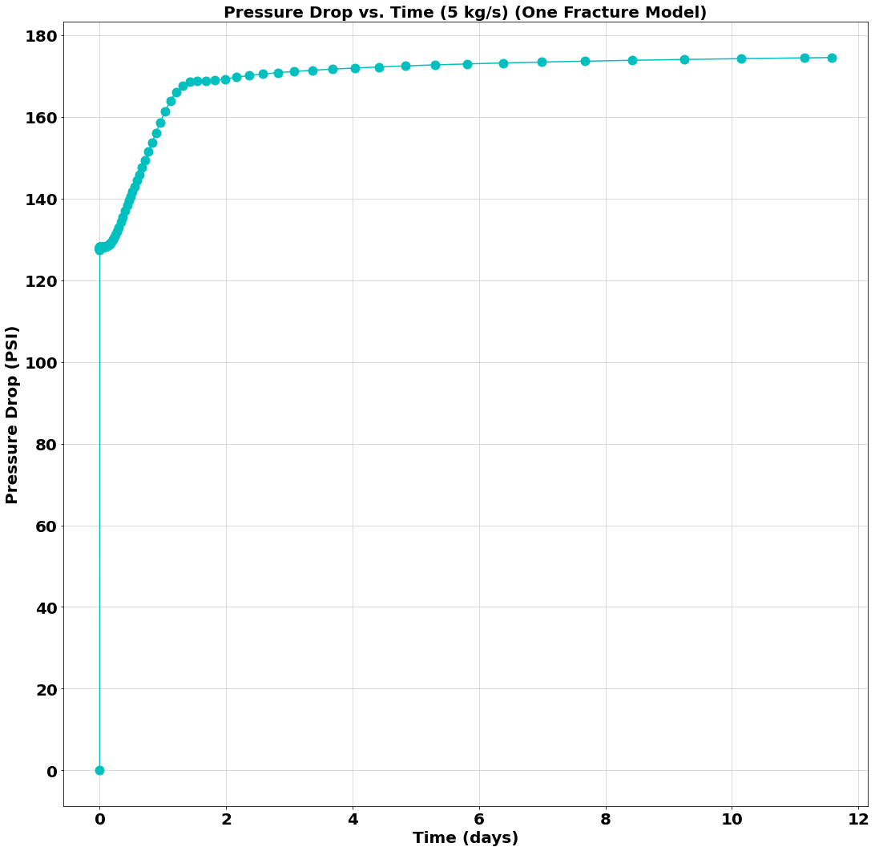
Pressure Across Fracture

Slide 20
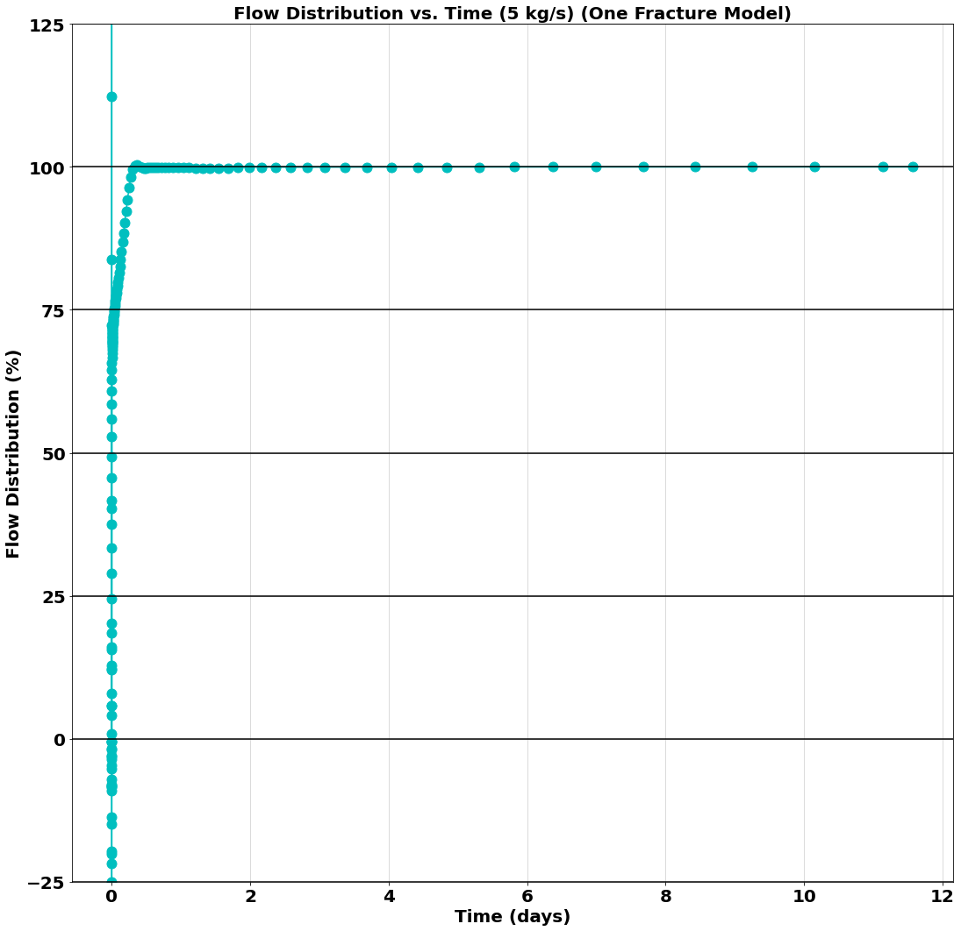
Flow Distribution

Slide 21
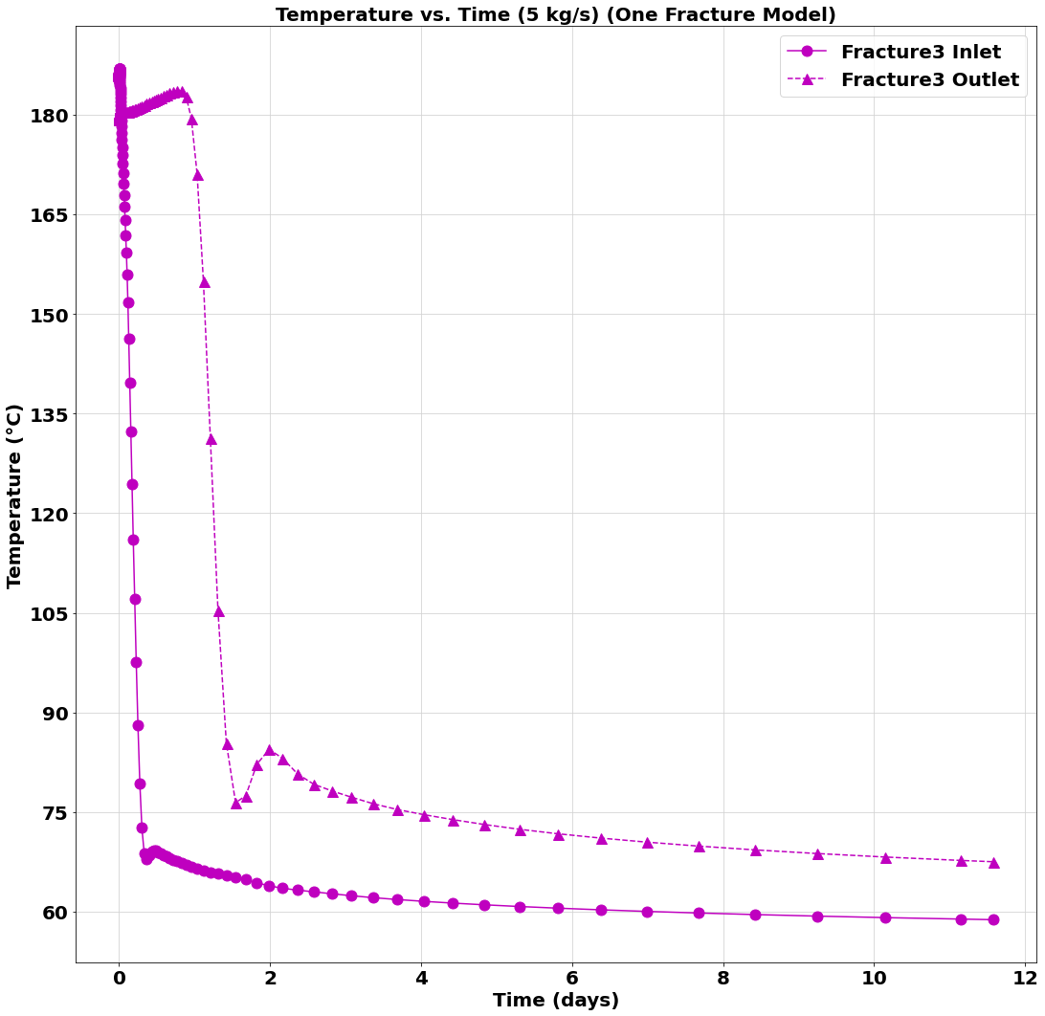
Fracture Inlet vs Outlet Temperature

Slide 22
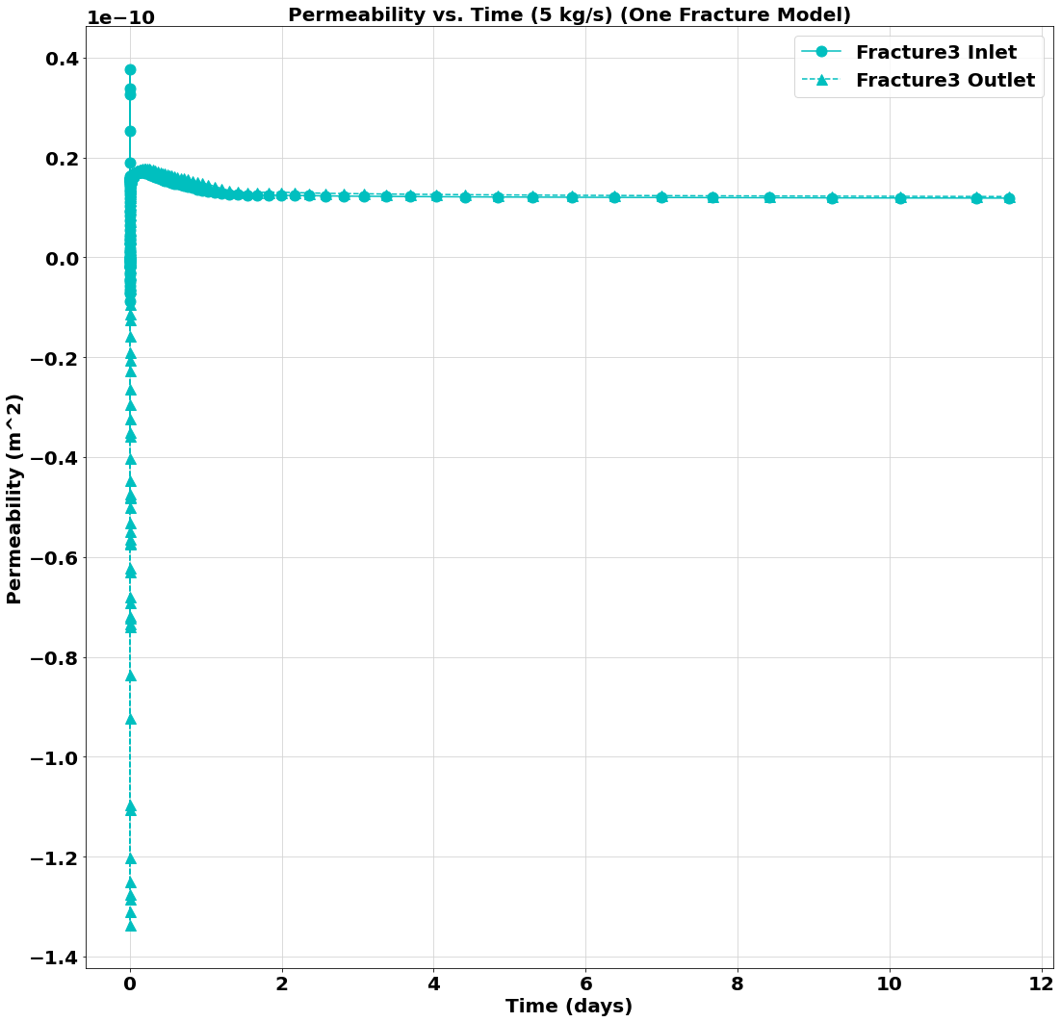
Fracture Permeability

