Slide 1
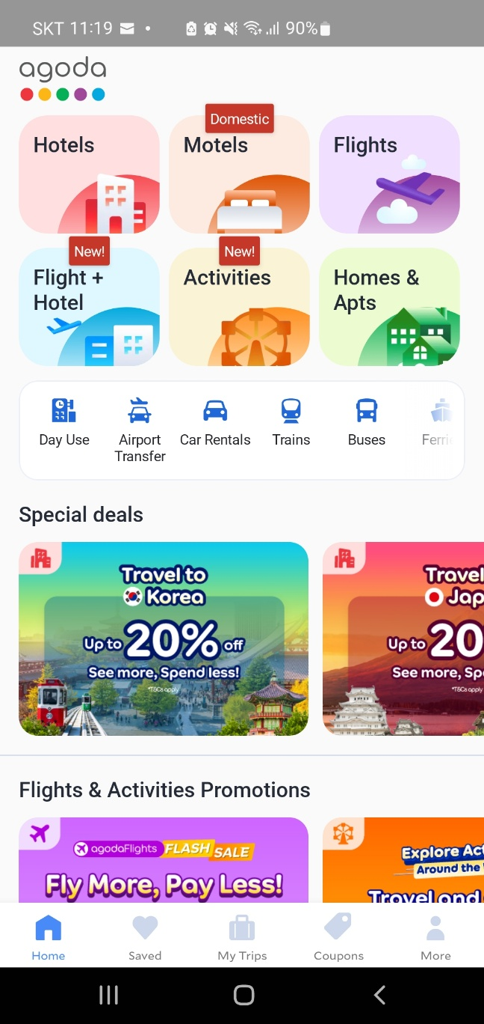
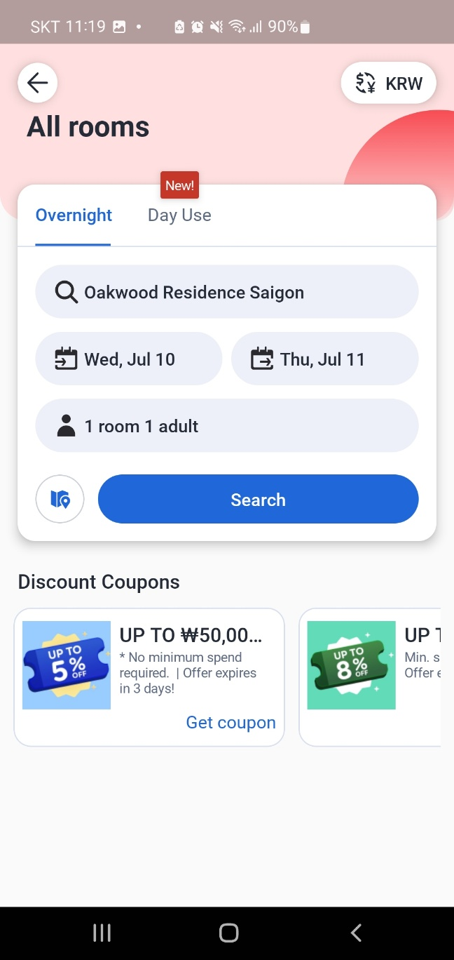
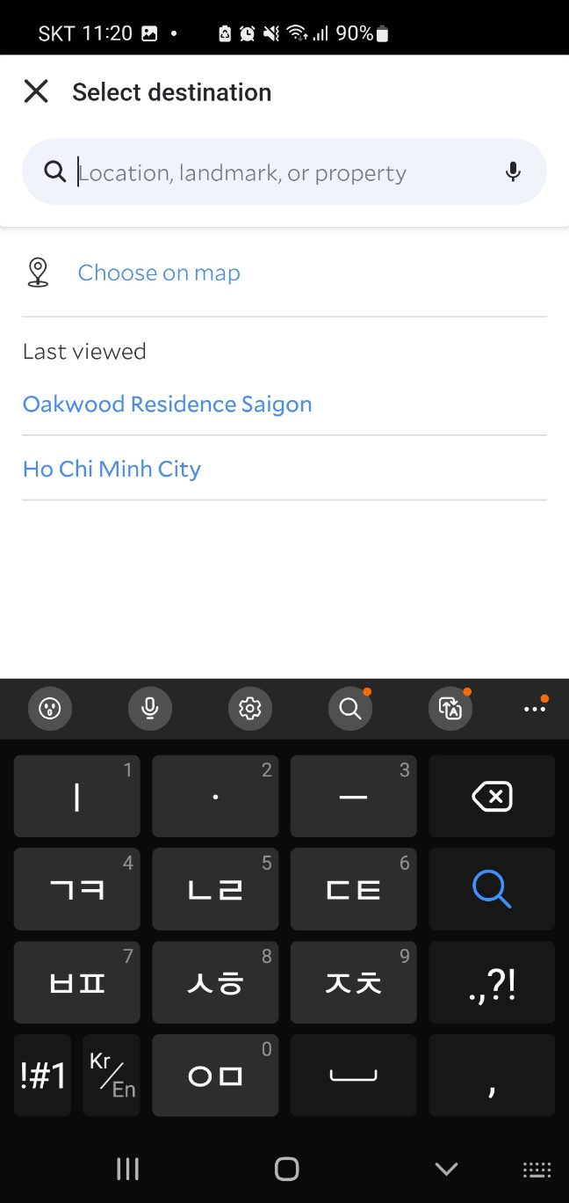
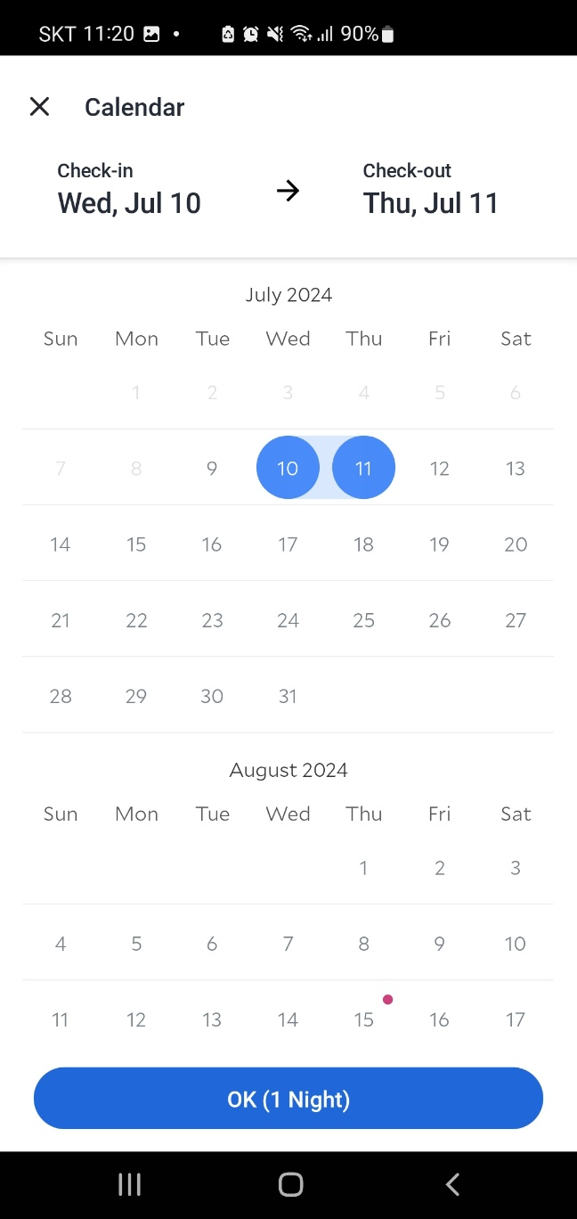
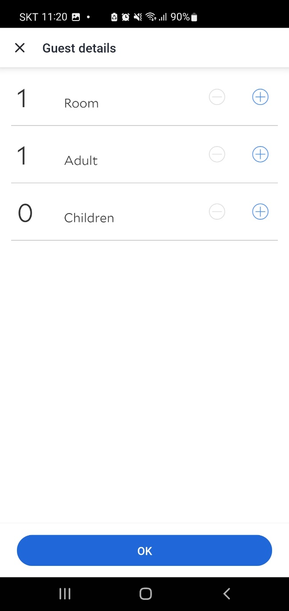
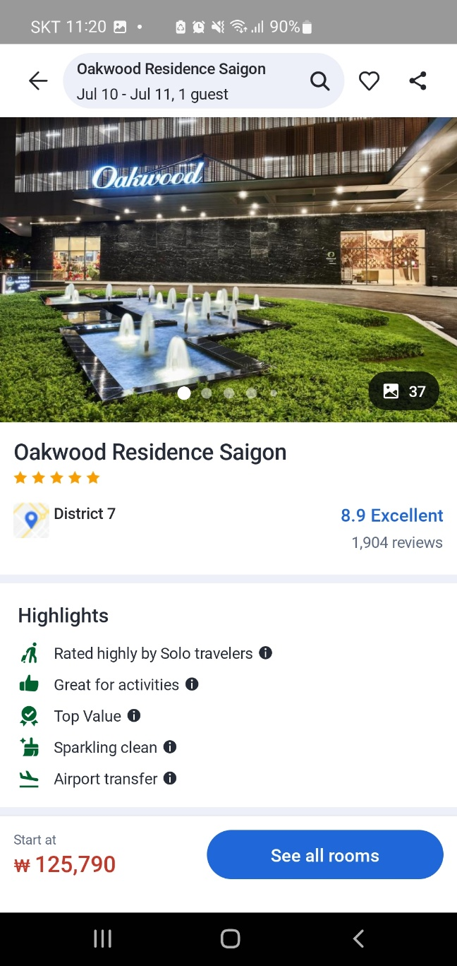
Agoda
Destination
Date
Guest
Search

Slide 3
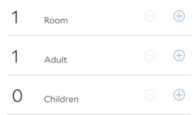
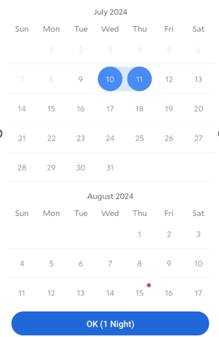
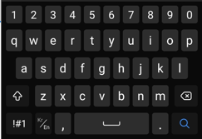
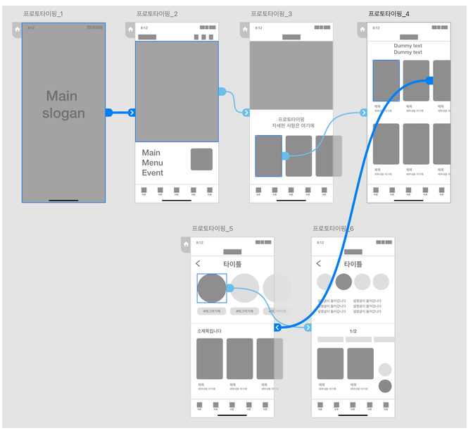
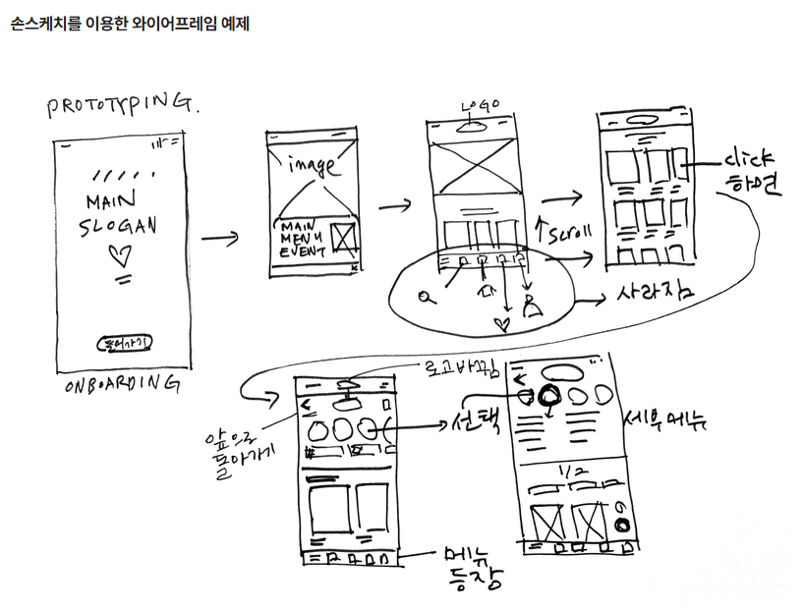
Agoda
Hotel
Agoda
Agoda
Agoda
Agoda
Select destination
Calendar
Guest details
Destination
Location, landmark
Check-in -> Check-out
Date
Guest
Enter
Search
Event
Menu
Agoda
Agoda
Agoda
Pictures
Information
Information in detail
Pictures
Menu
Menu
Menu

Slide 4
Agoda
Hotel
Agoda
Agoda
Agoda
Agoda
Select destination
Calendar
Guest details
Destination
Location, landmark
Check-in -> Check-out
Date
Guest
Enter
Event
Menu
Agoda
Agoda
Agoda
Pictures
Information
Information in detail
Pictures
Menu
Menu
Menu

Slide 5
적용
https://marvelapp.com/prototype/7fie12j

