Slide 1

Introduction to Computer Architecture Research
Tamara Silbergleit Lehman
November 2024
Latin America gem5 Bootcamp
Buenos Aires, Argentina

Slide 2
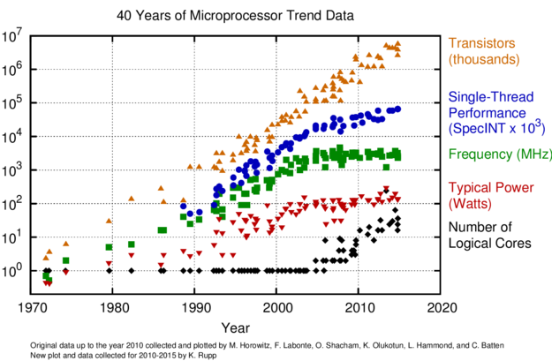
Computing Trends

Slide 3
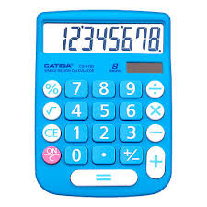

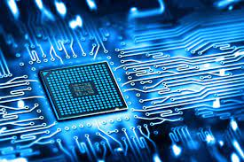
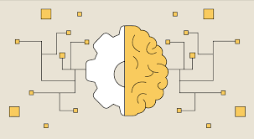

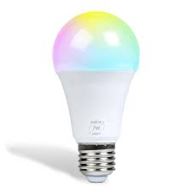

Computing Applications
Applications are changing rapidly
Original applications were mostly calculator focused
Today, wide range of applications
General desktop computing
Machine learning
Autonomous systems
Embedded devices
Accelerators
Etc.

Slide 4
Computing Goals
Goals change often as well
Original goal more data (only 4 bits of data)
Then performance
More transistors and increasing clock frequency in the early 2000s
Then energy efficiency
Can you guess percentage of power globally datacenters consume today?
Today, all of these plus security
Spectre and Meltdown
3% of all electricity generated worldwide (416 terawatts)
(by Ali Marashi, Vxchnge, Feb 2020)

Slide 5


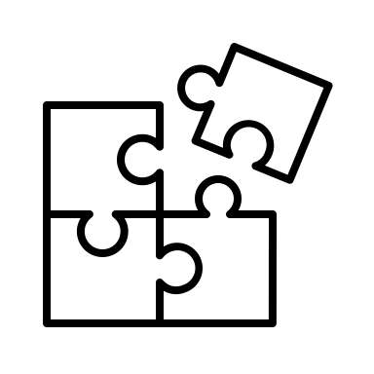

Big Picture
Computer Architecture Research
Applications
Trends
Goals

Slide 6
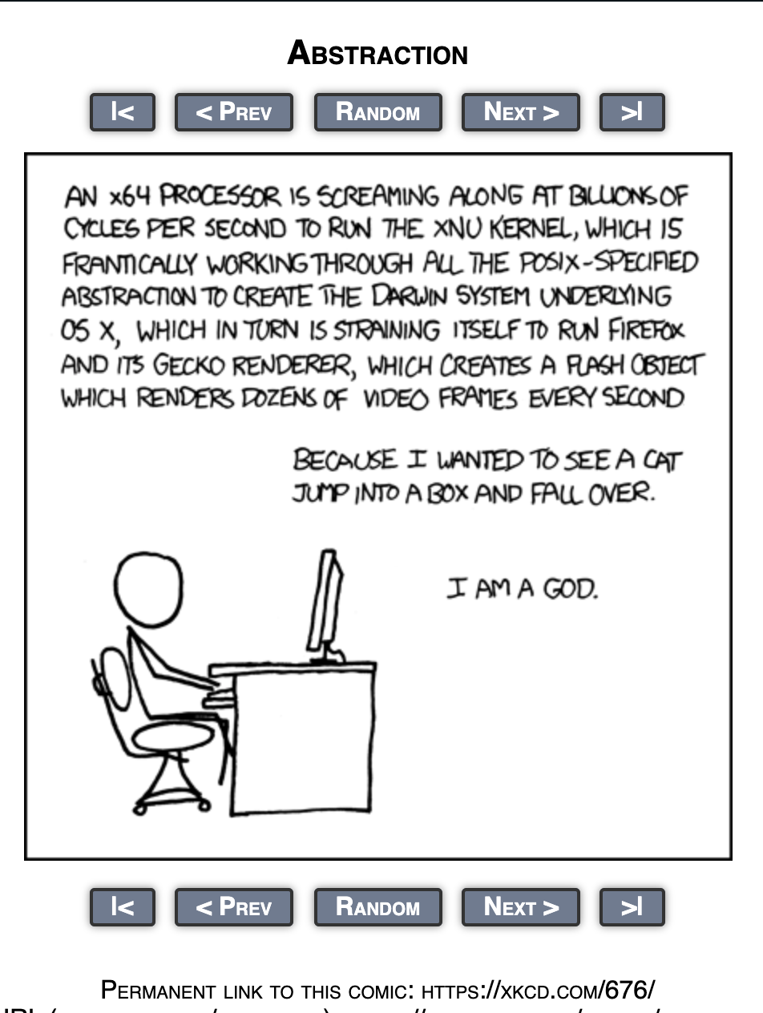
Abstraction is the Key to Computing Research
What is abstraction?
Divide interface from implementation
Interface: how it is used
Implementation: how does it do it
Build larger components from smaller ones
Larger ones use interface of smaller ones to do tasks
Abstraction helps to divide the work
Engineer A makes piece xyz that does abc and engineer B uses it to make piece xkcd
Latin America gem5 Bootcamp

Slide 7
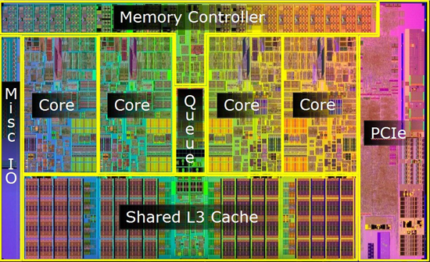
Levels of Abstraction (Processor Building)
Transistor: ”electrical switch”
Gates: a few transistors
Logic elements: a handful of gates
Functional elements (stages, units): combination of logic elements
Core: multiple functional elements
Chip: multiple cores
I
O
F
D
E
M
W
Reg File
Latin America gem5 Bootcamp

Slide 8










Levels of Abstraction (Processor Using)
User Applications
System Software: Operating system, compilers
Computer Architecture: ISA, microarchitecture
Hardware Realization: Transistors, circuits
Architects must be aware of what is “above” and “beneath” them in this stack. Good architects design processors that are hardware-aware and software-aware.
Latin America gem5 Bootcamp

Slide 9
Architecture vs. Microarchitecture
Processor Architecture (x86, RISC-V, ARM V8, etc)
Functional appearance to software
Opcodes, addressing modes, architected registers
Processor Microarchitecture (Intel Core i9, AMD Epyc, etc.)
Logical structure that implements the architecture
Pipelining, functional units, caches, physical registers
Note: many people loosely use the word “architecture” to refer to both concepts
Latin America gem5 Bootcamp

Slide 10
The Von Neumann Model
Published by John Von Neuman in 1945
Implicit model of all modern ISAs (sequential)
Basic feature: program counter (PC)
Currently executing instructions at Memory[PC]
Defines total order on dynamic instructions (program order)
Next PC is PC++ unless current instruction says otherwise
Order and named storage define computation
Value flows from instruction X to Y via storage A
A=X’s output, Y after X in program order
No interceding instruction Z where A=Z’s output
Processor logically executes loop on the left
Sometimes shortened to fetch-decode-execute
“Atomicity”: instruction X finishes before instruction X+1 starts
Important thing is appearance of atomicity
Fetch
Decode
Read Inputs
Execute
Write Output
Next PC
Latin America gem5 Bootcamp

Slide 11
Simple In-Order Pipelined Processor
+4
Register File
PC
Instr Mem
F/D
D/X
X/M
M/W
D$
Canonical 5-Stage pipeline (one cycle per stage)
Fetch, Decode, Execute, Memory, Writeback. Use latches to hold value until next cycle
Read input registers in decode stage
Read/write memory in the memory stage
Write to registers in the last stage, writeback
Latin America gem5 Bootcamp

Slide 12
Out-of-Order Pipeline Processor
Reorder Buffer (ROB)
+4
Register File
Commit
PC
Instr Mem
F/D
D/X
X/C
D$
stores
stores
loads
Memory Ordering Buffer (MOB)
In-order pipeline limitations: structural hazards, one instruction per stage
Out of order execution:
reduces stalls,
improves functional unit utilization,
enables parallel execution (more instruction level parallelism)
Latin America gem5 Bootcamp
Notes:
Need to ask Jason how to align this slide to gem5 structures. Is dispatch rename and issue is issue/execute/writeback?
Look at one of the old m5 papers

Slide 13
Out of Order Execution
Reorder Buffer (ROB)
+4
Register File
Commit
PC
Instr Mem
F/D
D/X
X/C
D$
stores
stores
loads
Memory Ordering Buffer (MOB)
In-Order
Decode (in-order)
Out-of-Order (OOO)
In-Order
Decode split into two: decode and rename
Latin America gem5 Bootcamp

Slide 14
Out of Order Execution
Reorder Buffer (ROB)
+4
Register File
Commit
PC
Instr Mem
F/D
D/X
X/C
Rename (ooo)
D$
stores
stores
loads
Memory Ordering Buffer (MOB)
In-Order
Out-of-Order (OOO)
In-Order
Decode split into two: decode and rename
Latin America gem5 Bootcamp

Slide 15
Out of Order Execution
Reorder Buffer (ROB)
+4
Register File
Commit
Writeback (ooo)
PC
Instr Mem
F/D
D/X
X/C
D$
stores
stores
loads
Memory Ordering Buffer (MOB)
In-Order
Out-of-Order (OOO)
In-Order
Decode split into two: decode and rename
Writeback split into two: writeback and commit
Latin America gem5 Bootcamp

Slide 16
Out of Order Execution
Reorder Buffer (ROB)
+4
Register File
Commit
PC
Instr Mem
F/D
D/X
X/C
D$
stores
stores
loads
Memory Ordering Buffer (MOB)
In-Order
Out-of-Order (OOO)
In-Order
Decode split into two: decode and rename
Writeback split into two: writeback and commit
Latin America gem5 Bootcamp

Slide 17
Out of Order Execution
Reorder Buffer (ROB)
+4
Register File
Commit
PC
Instr Mem
F/D
D/X
X/C
D$
stores
stores
loads
Memory Ordering Buffer (MOB)
In-Order
Out-of-Order (OOO)
In-Order
Decode split into two: decode and rename
Writeback split into two: writeback and commit
ROB writes to register file in order
Latin America gem5 Bootcamp

Slide 18
Memory Ordering Buffer
Reorder Buffer (ROB)
+4
Register File
Commit
PC
Instr Mem
F/D
D/X
X/C
D$
stores
stores
loads
Memory Ordering Buffer (MOB)
In-Order
Out-of-Order (OOO)
In-Order
Read and write to memory in order?
Memory ordering buffer (MOB), orders memory instructions
Takes care of address aliasing
Load to an address that has a store that still in-flight
Latin America gem5 Bootcamp

Slide 19
Memory System
Reorder Buffer (ROB)
+4
Register File
Commit
PC
Instr Mem
F/D
D/X
X/C
D$
stores
stores
loads
Memory Ordering Buffer (MOB)
In-Order
Out-of-Order (OOO)
In-Order
Memory system is also part of the microarchitecture
We can also design it intentionally to optimize some metric (performance, energy, etc)
Latin America gem5 Bootcamp

Slide 20
Canonical Memory System
Processor Package
Core
Core
L1 Data Cache
L1 Instr Cache
L1 Data Cache
L1 Instr Cache
Last Level Cache
L1 Data Cache
L1 Instr Cache
L1 Data Cache
L1 Instr Cache
Core
Core
Memory Controller
Main Memory
(i.e. DRAM)
Latin America gem5 Bootcamp
Notes:
This diagram represents a simplified version of some of the components inside an integrated system. Throughout this talk I will highlight the components that are affected by the vulnerability under discussion.

Slide 21
How did we get here?
Answer: research across many domains including computer architecture

Slide 22
Computer Architecture Research
Research: Investigate innovative ways of building processors
Processor design opportunities: how many cores to use? Should they be all the same? Can we instrument the hardware to do more complex functions? Can we accelerate certain operations? etc.
Memory design opportunities: which technology to use? How should the cache architecture look like? How about the hierarchy? Etc.
Overall system design opportunities: how should cores communicate? How should the network architecture look like? Should chips be able to share data? If so how? And how about consistency and coherence? etc.
Latin America gem5 Bootcamp
Notes:
Topics to investigate: virtualization, accelerators, security, simulation, compilers, reliability, microarchitecture (CPU and GPU), hardware design tools, memory technologies, synchronization and concurrency, quantum, networks, and many more!

Slide 23
Evaluation Methodologies
When working on all of these, we need a way to evaluate new designs
Cannot run tests on our laptops→ hardware does not exist yet
Typical evaluation frameworks:
FPGA prototypes: high barrier of entry, complex process
Small toy models of the target system: too minimalistic, does not consider realistic systems
Full system Cycle accurate Processor simulators (i.e. gem5): closer to real systems, easier interface

Slide 24
One Example: Secure Memory
One possible study is to implement security at the architectural level to protect data in memory
Why? Because software systems alone cannot defend against cyber-attacks
Computers need software and hardware security solutions
This model has been around for over 2 decades (started with IBM)
Latin America gem5 Bootcamp

Slide 25
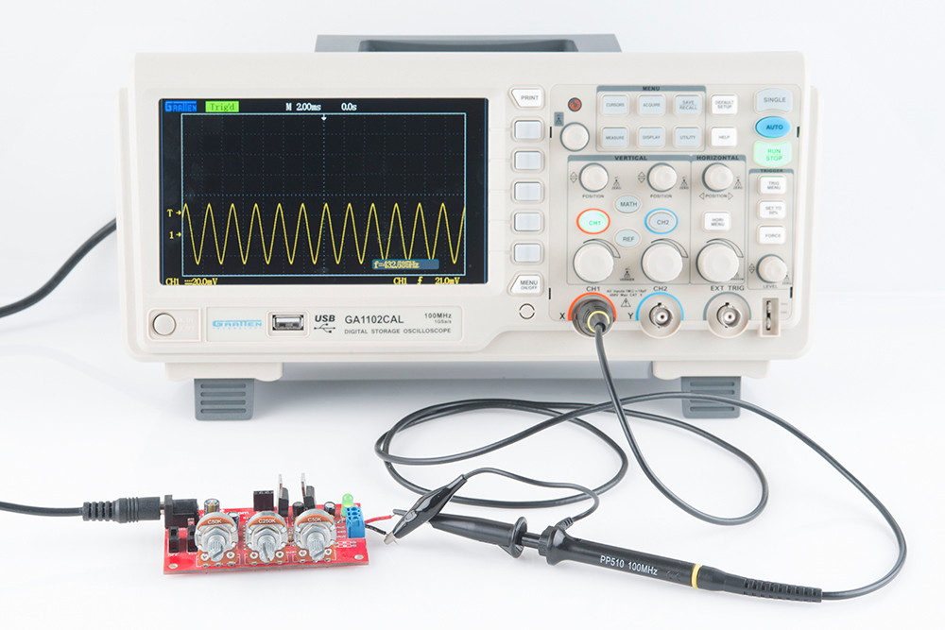
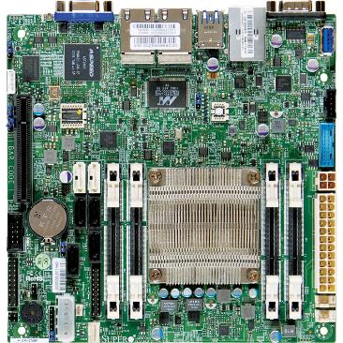
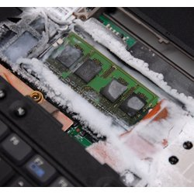
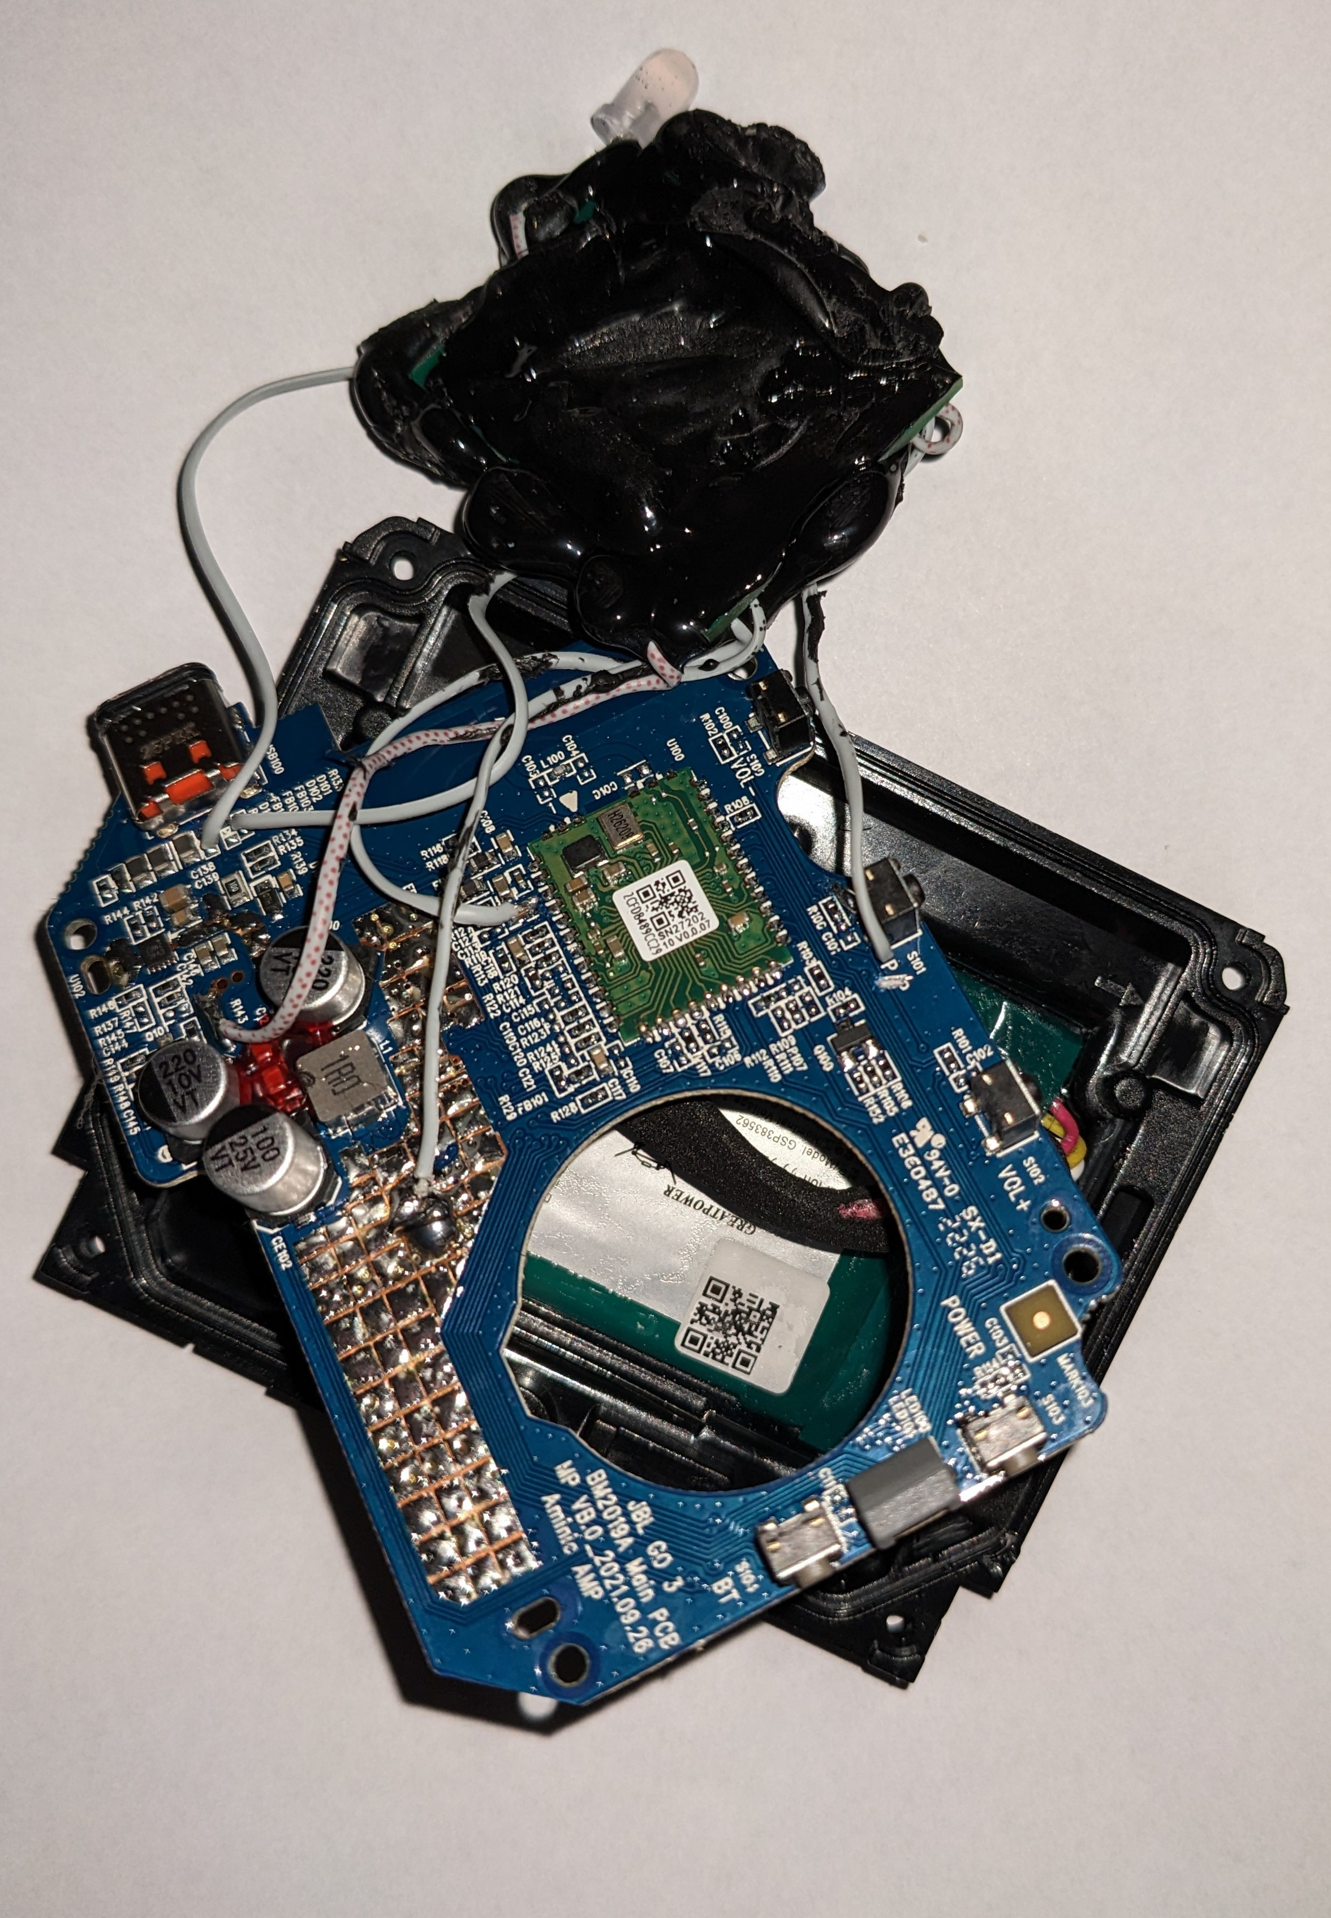
Threat Model
On-Device: physical control of the device (replay, splicing and spoofing attacks, cold boot attack)
Off-device: illegal remote access (Rowhammer attack, illegal malicious applications)
Solution: secure memory
Secure off-chip data
Trust only data on-chip
Trusted
Notes:
A physical attack can have many forms.
There can be passive attacks in which the attacker reads values in memory. An example of this type of attack is a cold boot attack.
Another form of physical attacks is an active attack, in which the an unauthorized party modifies the values in memory.
The solution to protect against physical attacks is secure memory.

Slide 26
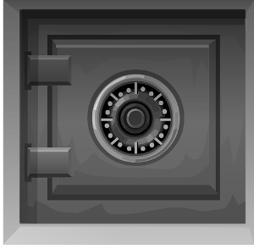

Secure Memory Requirements
Confidentiality
Data Integrity
Encryption
Hashes
Notes:
To detect and prevent physical attacks, data in memory should have confidentiality. An attacker should not be able to read the values that are crossing the communication bus between the processor and the memory. And that is what confidentiality does, it prevents sensitive data from being disclosed.
But confidentiality alone does not prevent an active attack, in which the attacker modifies the values in memory to control the behavior of the program. And for that, a secure system should also provide data integrity, the property that ensures that no data is modified in an unauthorized way.

Slide 27
Secure Memory Implementation
Metadata for security
Initiate memory accesses to fetch metadata for each last-level-cache miss
STORED IN MEMORY
RAM
CPU
Integrity metadata
Metadata includes counters and hashes
Notes:
METADATA IS GENERAL---- will explain in a few slides – Meta. (in Greek means beyond) data
Secure memory is expensive. Both for delay and energy.
For every memory access a counter is needed to decrypt the data.
And we also need metadata for the integrity verification.
All these pieces of metadata are stored in memory, since they are too big to be stored on-chip. Both energy and delay increase.
This means that for every LLC miss, there are an additional 9 memory accesses, a 9X overhead for both delay and energy.

Slide 28
Counter-Mode Encryption
Parallelize encryption and memory load
Trusted Processor
Memory Controller
AES
Counter B
OTP
Memory
40 cycles
XOR
To core
Ciphertext B
Plaintext B
Ciphertext B
1 Cycle
200 cycles
Notes:
To protect against snooping, secure memory uses counter-mode encryption.
Counter mode works well for secure memory because it is able to hide the slow part of the encryption process while the memory controller fetches the data from memory.
AES Engine can be pipelined to withstand high throughput of memory

Slide 29
Data Integrity with Hashes
Trusted Processor
Memory
Memory Controller
Ciphertext B
To core
Ciphertext B
HASH
Current
HMAC B
Compare
✔
HMAC B
HMAC B
Notes:
When storing data to memory compute hash. When fetching data from memory verify the hash.

Slide 30

Replay Attacks
Trusted Processor
Memory
Memory Controller
Ciphertext B
Old Ciphertext B
Old
Ciphertext B
To core
Old
Ciphertext B
HASH
Current
HMAC B
✔
Compare
Old
HMAC B
Old
HMAC B
HMAC B
Notes:
Attacker replays both old hash and old encrypted value
E.g. old plaintext = old password, unauthorized access

Slide 31
Data Integrity with Integrity Trees
Hash tree of memory, Bonsai Merkle Tree [Merkle 1980, Gassend ’03, Rogers ‘07]
Root On chip
Root
Tree C_{A}C_{B}C_{C}C_{D}
Integrity
L1
Tree C_{A}C_{B}
Tree C_{C}C_{D}
L0
Tree C_{A}
Tree C_{B}
Tree C_{C}
Tree C_{D}
Counter A
Counter B
Counter C
Counter D
Data A
Data B
Data C
Data D
Hash A
Hash B
Hash C
Hash D
Notes:
(make sure I say this is prior work)
To provide detection and protection against replay attacks, secure memory uses Bonsai Merkle trees which is a structure proposed by Rogers in 2007

Slide 32
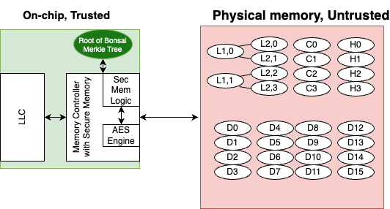
Secure Memory System

Slide 33
Secure Memory Evaluation
Need to understand the overhead incurred with secure memory
Could implement the overarching idea on a processor simulator
No need to model the encryption and hashing in detail (only its latency)
Once we understand the overhead we can start to think of ways to improve
And this is what we will do during this week
Latin America gem5 Bootcamp

Slide 34
Questions?

