Slide 1

PBT205 – Project-Based Technology
AI in NLP/Text/Speech
LanguageLearned
By Max Presley

Slide 2





Problem - What is the problem?
Goal
Help Korean students learn English thru NLP techniques
English is mandatory subject in Korea - increase results
Students struggle learning new languages - Let's make this easier
What is the need to learn English?
Help bridge the language gap
Korea is technologically and socially very impactful!
Culture exchange, learning more about each other
Everyday conversation
Education and Research Collaboration, Tourism, Diplomacy and International Relations and Globalization and Innovation.

Slide 3
Problem - What is the problem?
Without being able to communicate in a natural human way we miss out on so much that can improve our lives.

Slide 4
4 Module Approach
Conversation - Using a large language model, a mockup casual conversation will take place.
Quiz - Q&A style. The user must answer English related questions.
Translation - Provides a 1-1 translation.
Learn More - Delve deeper into English words and learn more about them.

Slide 5


Models
The large language model of Gemini by Google.
Was previously called Google Bard
Used for conversation module and quiz
Advantages
Easy to set up
Fairly fast, takes within 2 seconds to get a response
Good at responding to a user for conversations due to it being able to talk about anything (mostly)
Disadvantages
You don’t know what you are going to get as a response
Doesn’t always work with quizzes

Slide 6
Models - deep-translator
Deep-translator can be used to provide accurate translations very quickly.
Auto detect language
Translate to Korean or to English
Will be used in translation module

Slide 7
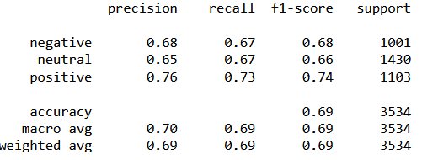
Models - Sentiment analysis + POS tagging
Using sklearn and a Kaggle dataset a model will be trained
This will give better understand to the sentence or word inputted
Not always accurate in certain situations however mostly good
POS tagging can give understand to words that may be ambiguous
Nltk is great for this

Slide 8
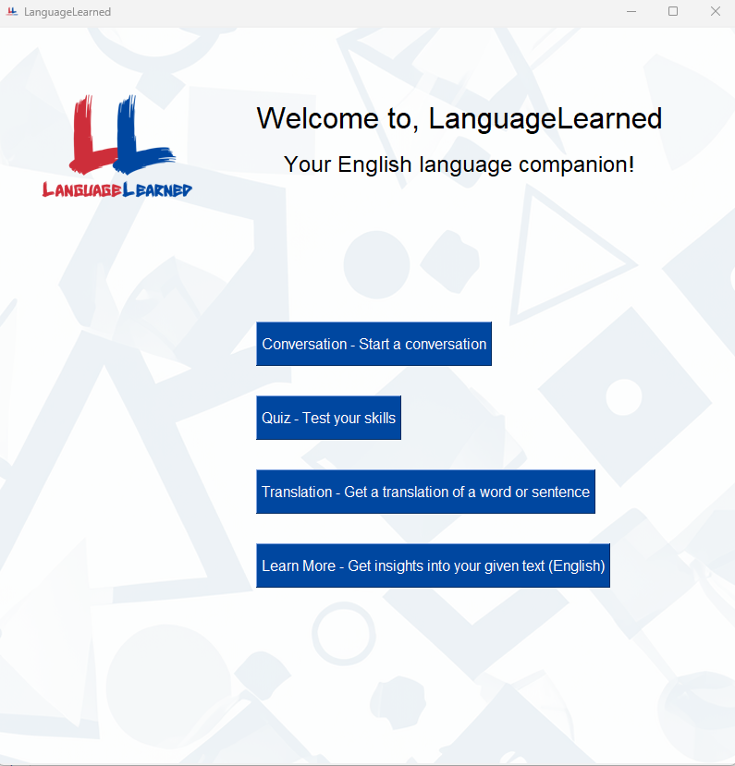
GUI & Prototype
The main window opens once you run the code
4 modules presented to the user
Logo/background made in photoshop

Slide 9
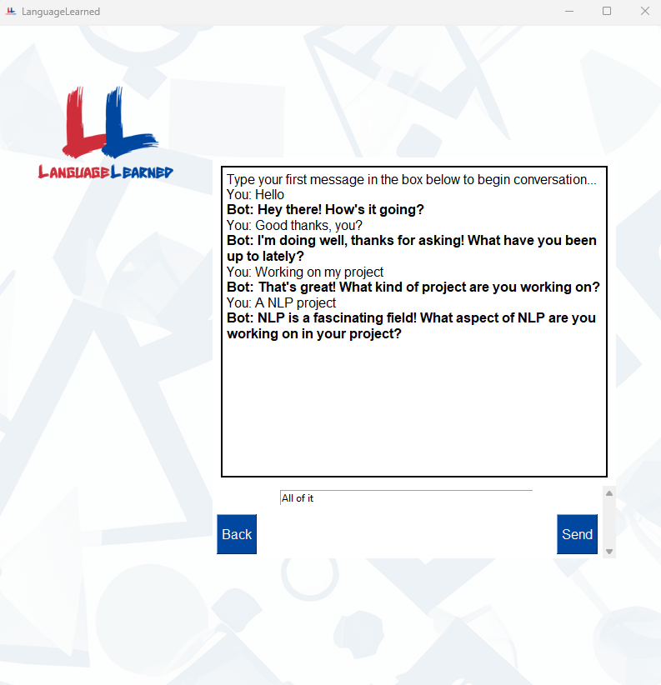
GUI & Prototype
Conversation mode
An auto scrolling text box
Bot text in bold
Send this to Gemini model: "You are currently in conversation mode where you are going to have a casual conversation, do your best to reply like a human would. Keep your message short. The following message is a message to you: " + response

Slide 10
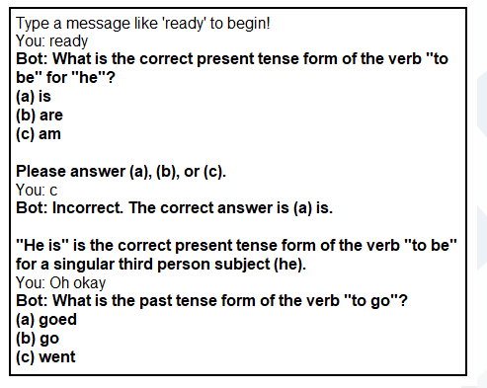
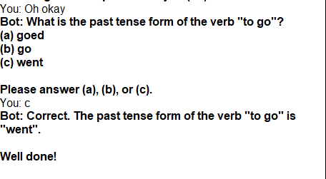
GUI & Prototype
Quiz mode
An auto scrolling text box
Bot text in bold
Send this to Gemini model: "be a helpful bot that gives quiz/questions for korean students to learn english (make your message short).only do one question at a time. Make sure the student is correct or wrong and tell them. The following message is from a korean student: " + response
Same GUI interface

Slide 11
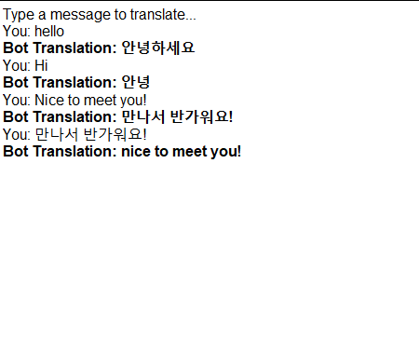
GUI & Prototype
Translation mode
An auto scrolling text box
Bot text in bold
Translations were accurate
Same GUI interface
Language detections with if statement

Slide 12
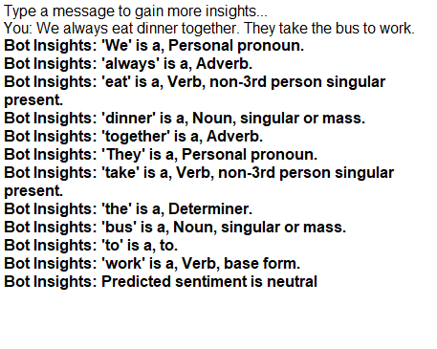
GUI & Prototype
Learn More mode
An auto scrolling text box
Bot text in bold
Gives the POS tagging data from nltk
Same GUI interface
Gives predicted sentiment
Uses the trained model to determine the sentiment of users message
sklearn

Slide 13
Conclusion
This solution can help students learn with 4 different way
Each module has its own value and uniqueness
A range of NLP techniques were used
Through use of a dataset sentiments can be analysis
GUI makes using the system easy
Can expand to include speak recognition and better quiz system with more targeted feedback

Slide 14
Q&A - Any questions?

