Slide 1
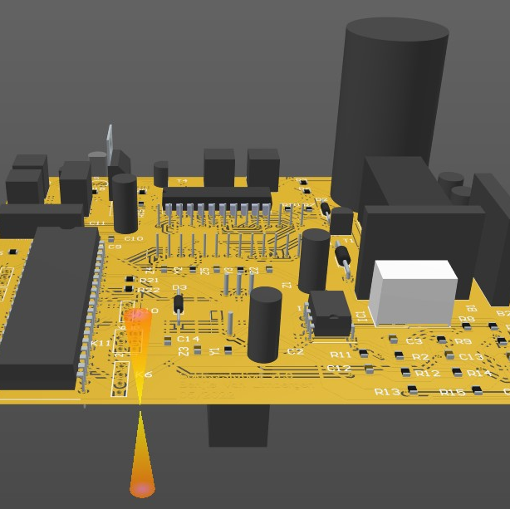
Soldering station
Design and fabrication
Benjie Van Limbergen
Notes:
Good afternoon, I am Benjie Van Limbergen and I am glad to show you my project in this presentation.

Slide 2
Contents
Why?
What I made
Process feedback
Notes:
What does a student in electronics or a future electronical engineer need? ...
Besides a great motivation and good grades.
It needs A good and reliable Soldering Station. At least that is what I really needed. I have not done much soldering before starting this course.
I'm going to show you
- Why I made a soldering station?
- What I made
- How the process went and what I learned.

Slide 3
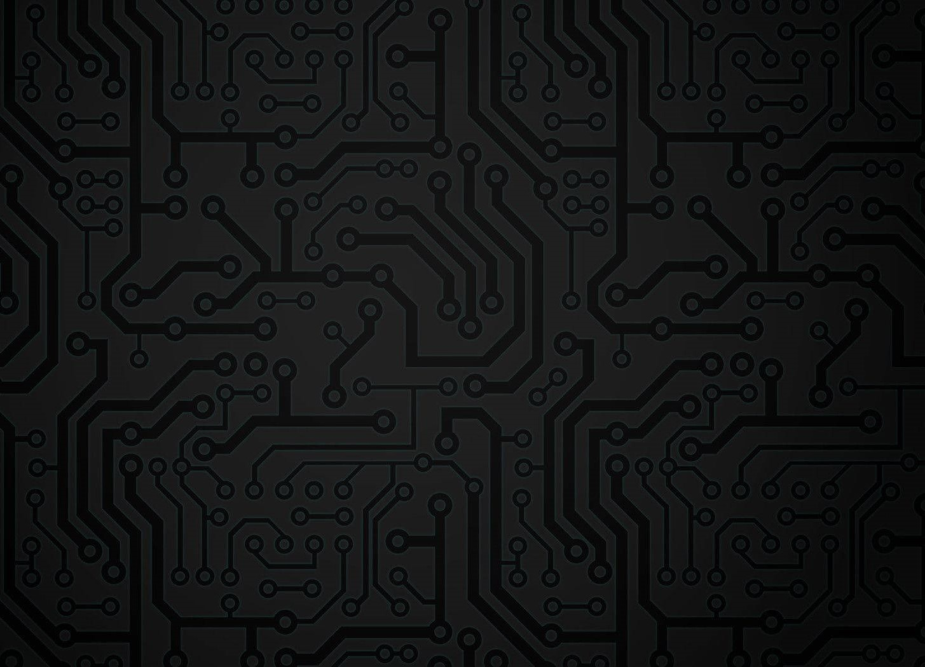
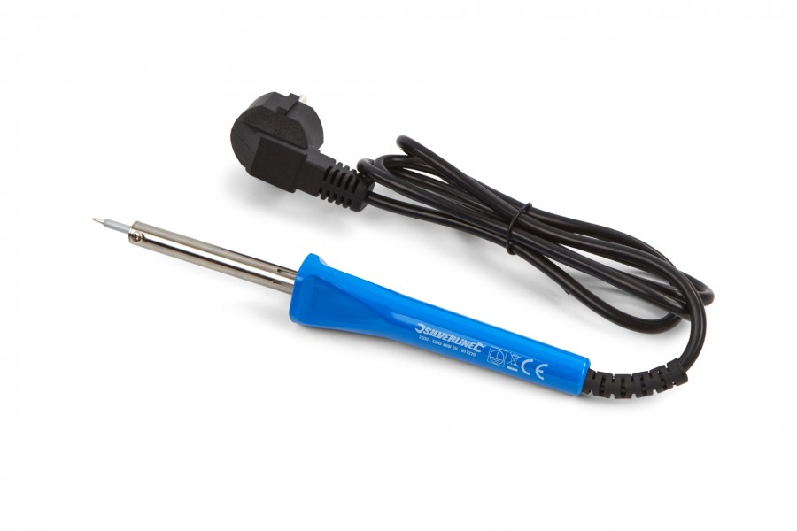


Why a soldering station?
No good alternative
Elektor article
Collaboration
Notes:
Why?: (did i chose a soldering station)
- The only soldering i did was with a cheap soldering iron like this. Temperature cannot be set on this one.
- One other reason was the detailed article in Elector instructing how to make a soldering station.
- Since all students chose this project it resulted in a helpfull exchange of knowledge. For example: were to find components, ordering together, sharing mistakes.

Slide 4
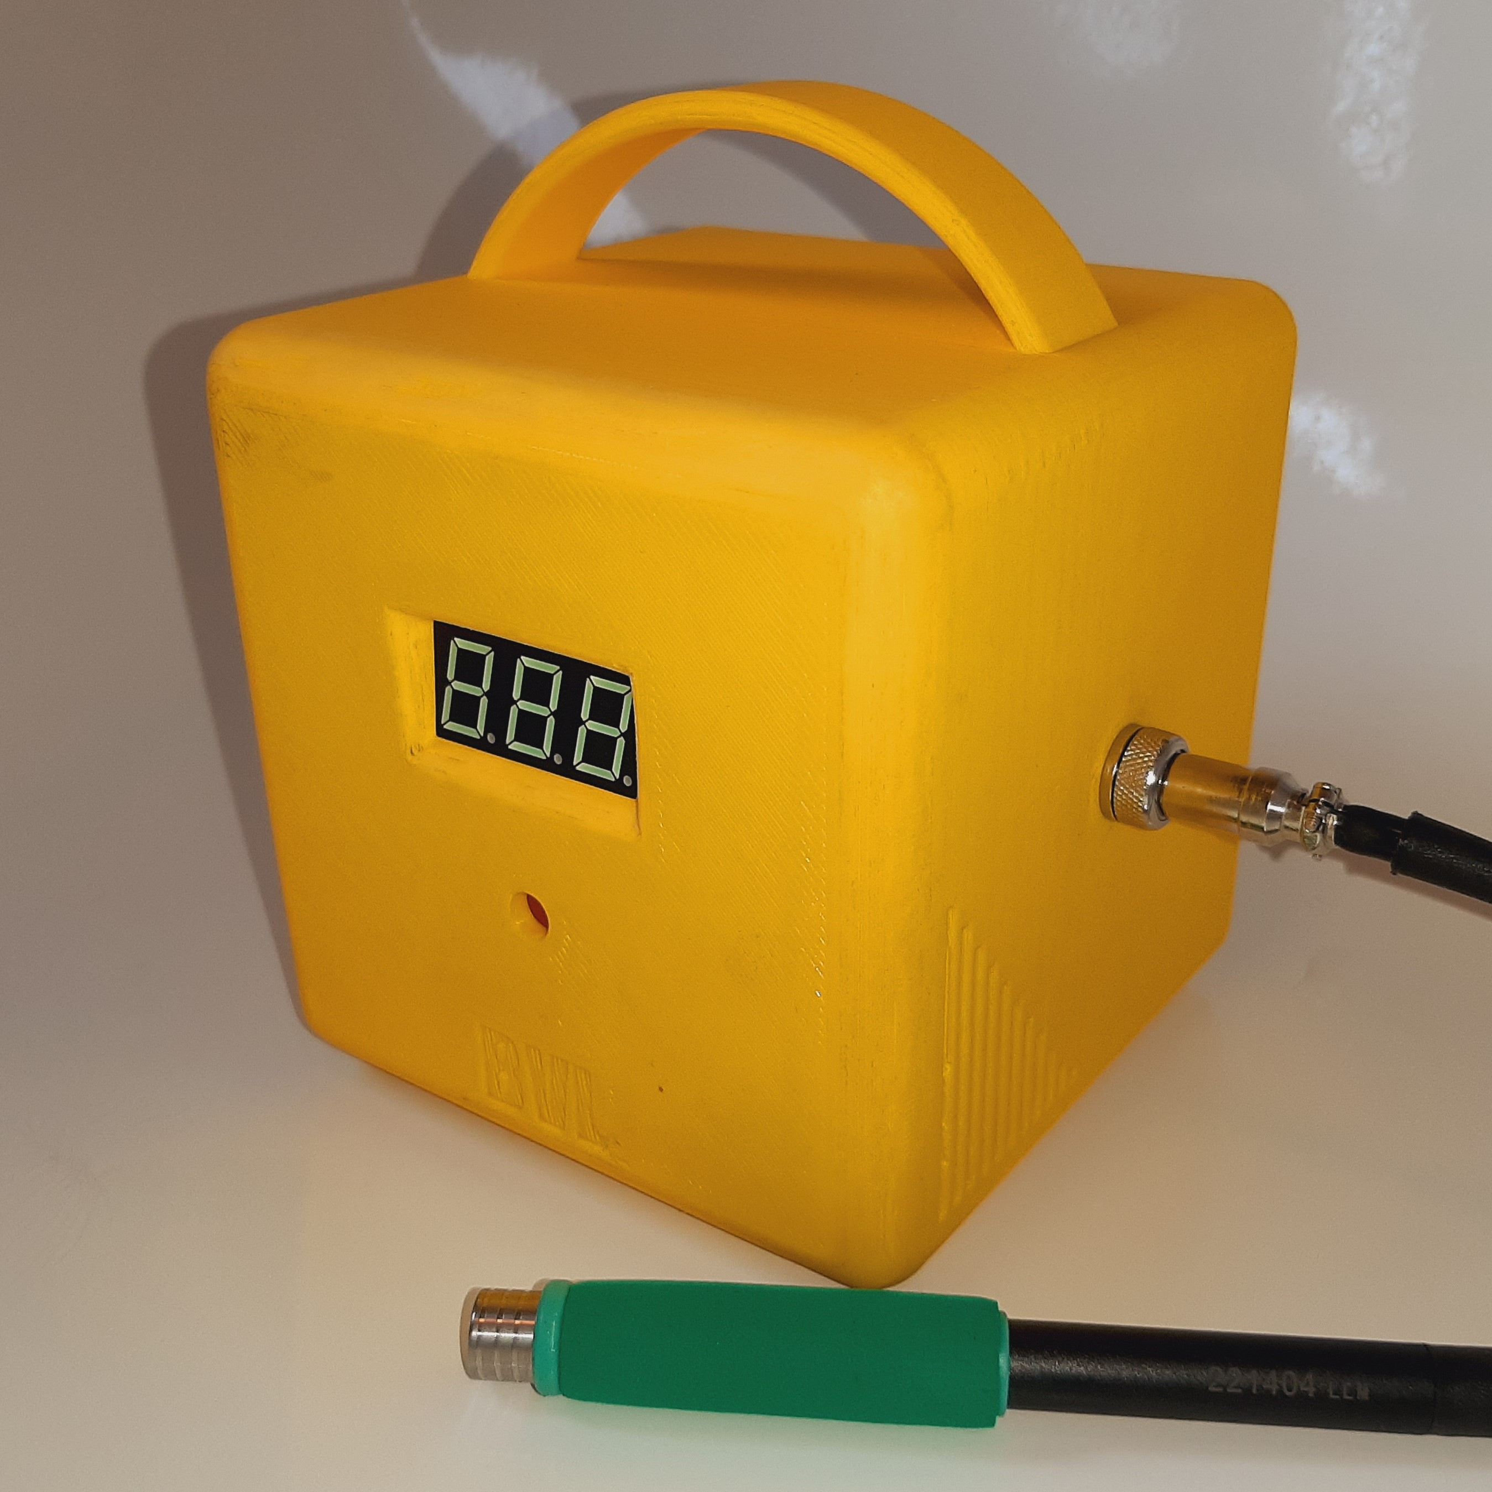
What?
Soldering station with a display and temperature control.
It supports 3 kinds of soldering irons.
All components on 1 PCB.
Easy operation.
Functional and minimalistic design.
Notes:
- I designed a Soldering station with a 7-segment 3-digit display and temperature control.
- It supports 3 kinds of soldering irons: Hakko FX8801, Weller RT and the JBC T245. I chose to provide it with a JBC T245 compatible soldering iron because his one is cheaper than the big brands.
- Operation is easy. Turn the rotary encoder to set the desired temperature. After 5 seconds it will save the set value and heat the solder iron. To indicate its heating, the left decimal point will blink.
- To lower complexity I chose to place all components on 1 PCB. The display and rotary encoder are placed on the bottom side of the PCB.
- I wanted the case to be functional and minimalistic and i'm glad about the result.
The gaps on the side and holes in the bottom increase the airflow to prevent overheating of components.
The handle on top make sure you can move it easily with one hand.
The four rubber studs at the bottom make sure it stays put.

Slide 5
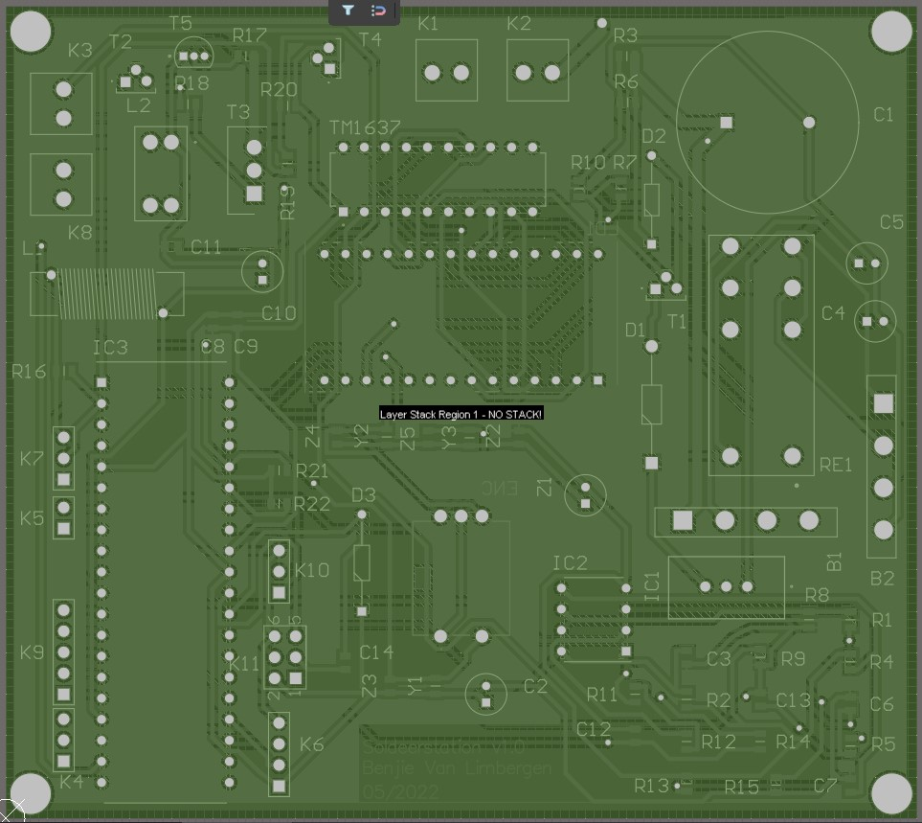




Process feedback: PCB
Altium Designer
Component Library
Schematic design
PCB design
Ordering materials
Notes:
The detailed fabrication process can be found in my Application Note.
- For designing the PCB we used Altium Designer. Its very decent but rather complex, It takes some time to get used to.
- The process of searching the right components with the right footprints and at the right price was the hardest part and took a lot of time. I learned that a good documented component library is half the work. This can avoid a lot of mistakes.
- I recreated the schematics from the Elektor article and Altium validated them.
Using the Schematics, Altium can Autoroute the layout of the PCB. Some corrections always must be made by hand.
I ordered free samples from WE and bought most of the components from Mouser. For the PCB production we chose JLCPCB. To lower shipping costs we also combined orders from other students.
- When you have all components the soldering can begin. First the SMD components have to get baked in a special oven. Next I soldered the THT components by hand.

Slide 6

Process feedback: Case design
Autodesk Fusion 360
3D printing
Assembly
Notes:
As an absolute beginner in 3D design, I really liked working with Autodesk Fusion 360. The learning curve is steep thus results come fast.
The main downside of my design is the excessive 3D printed support that was needed. Printing that much unnecessary plastic is not sustainable and removing it was not always easy. For example, the screw sockets for the back cover were accidentally removed while removing the 3D printed support. I fixed this with a glue gun and bolts.
- The fun part is assembling all parts and creating seeing the end result.

Slide 7
Conclusion
Challenging but motivating project.
I learned a lot!
Notes:
To sum up:
- I really liked creating a device like this from scratch. I was motivated to deliver a decent device and it did not feel like "hard work". After doing all these things I have never done before it feels like a whole new world opened up for me. A world of unlimited electronical possibilities.
I learned a lot and I look forward to making next projects with the help of my own soldering station!
I’m glad to answer any questions.

