Slide 1

High-Performance Arithmetic System
Project 2
Madison Gage & Benjamin Niccum

Slide 2

Introduction
Functional Requirements
Distributed Input Processing
Parallel Arithmetic Operations
Fault-Tolerant Communication
Synchronous Result Aggregation
Performance Monitoring and Analytics
Scalable Container Orchestration
Non-Functional Requirements
Scalability

Slide 3

Distributed Input Processing
The system shall accept computational requests through both interactive CLI and batch CSV processing, with input validation and request queuing across distributed nodes.
User Interface node handles this
Dual input modes
Input validation

Slide 4

Parallel Arithmetic Operations
The system shall process addition, subtraction, multiplication, and division operations concurrently across specialized computation nodes with load balancing.
Four dedicated computation nodes
UI node implements intelligent routing
Each computation node processes only its assigned operation type

Slide 5
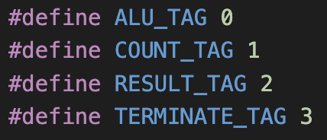
Fault-Tolerant Communication
The system shall implement reliable message passing between nodes using MPI with error detection and graceful handling of node failures.
MPI message passing structured communication protocols using defined message tags
error status tracking
termination synchronization
display.c
computation.c

Slide 6
Synchronous Result Aggregation
The system shall synchronize computation results from distributed nodes and maintain consistency through centralized result collection and validation.
Display node serves as the centralized result aggregator
Result counting and validation
Synchronization mechanism

Slide 7
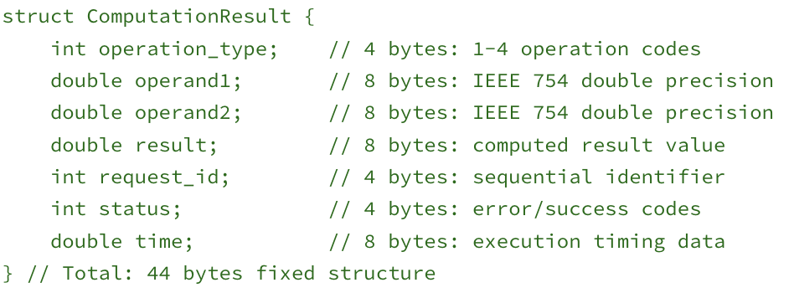
Performance Monitoring and Analytics
The system shall collect timing metrics, throughput statistics, and system performance data across all distributed components in real-time.
Each computation node records execution timing
Statistical analytics
Results are stored

Slide 8
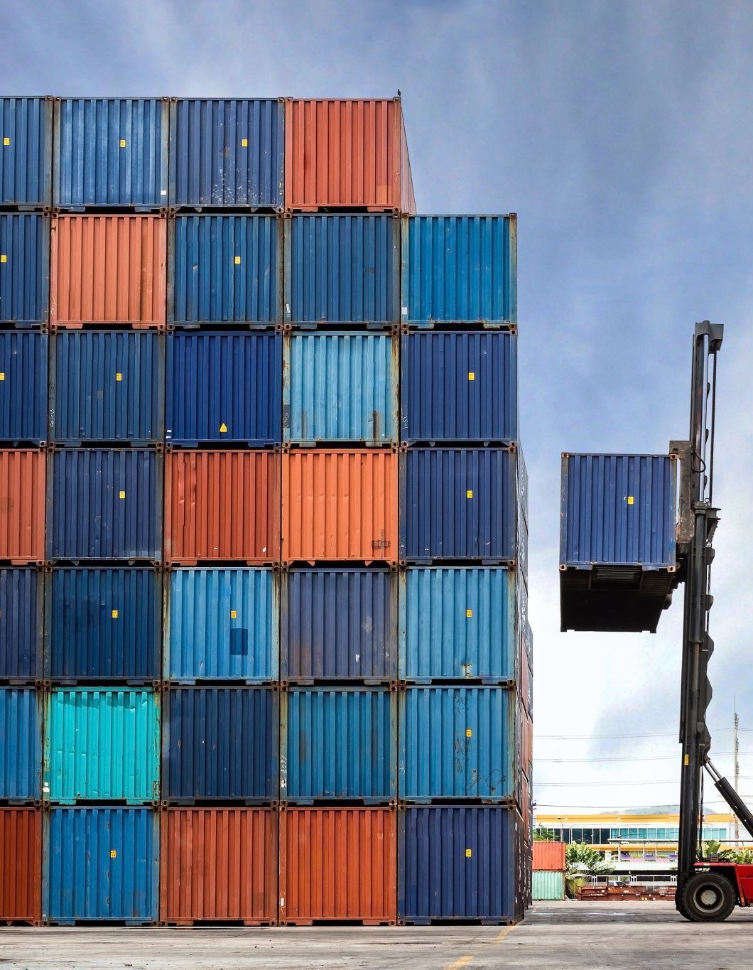
Scalable Container Orchestration
The system shall support dynamic scaling and orchestration of containerized nodes with automated deployment and termination coordination.
Each node runs in its own container with defined inter-container communication via MPI
Automated deployment

Slide 9
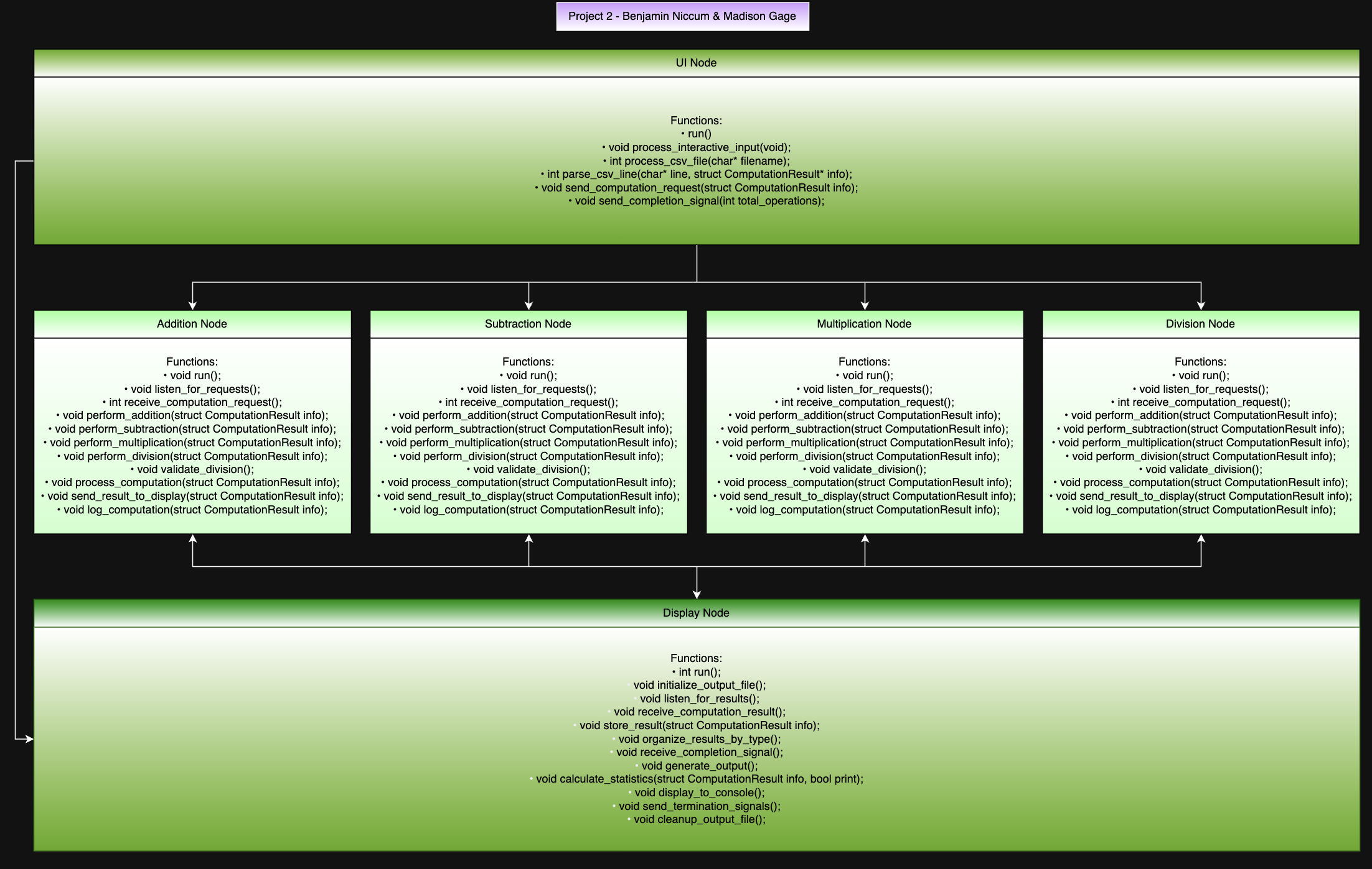
Architecture
We chose a layered architecture to demonstrate how the user interface sends messages to each of the other layers, computation nodes send messages to the Display Node, and the display node sends termination signal messages to the computation nodes.

Slide 10
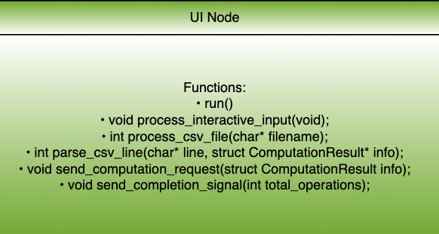

Slide 11
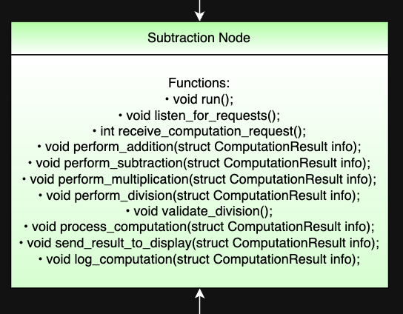
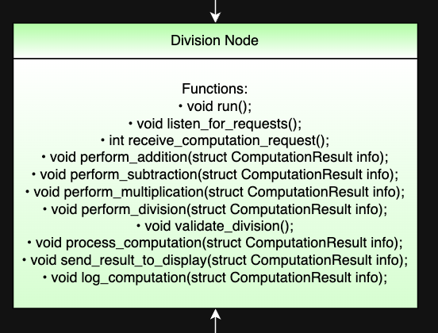
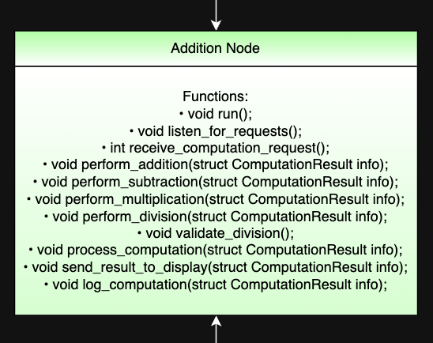
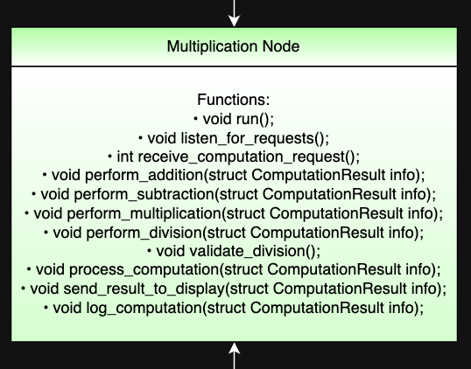
Computation Nodes
Identical code in each Computation node
Every function is included regardless of need
Can be built for redundancy
Workload is determined by user interface sorting

Slide 12
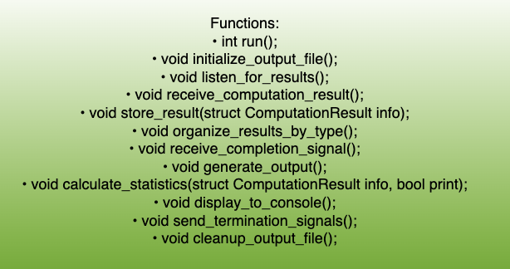
Display Node

Slide 13
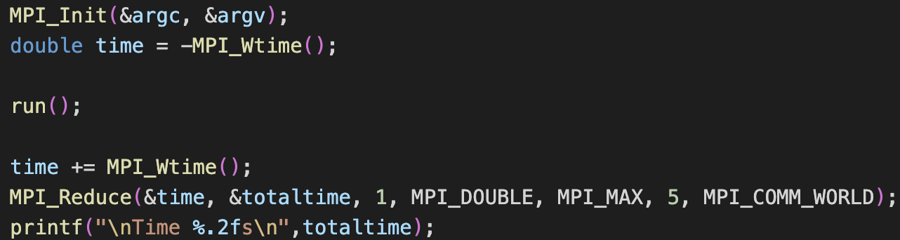
Evaluation Methodology
Measure throughput and latency across 3 different workloads
Small workload
Medium workload
Large workload
MPI_Wtime & MPI_Reduce

Slide 14
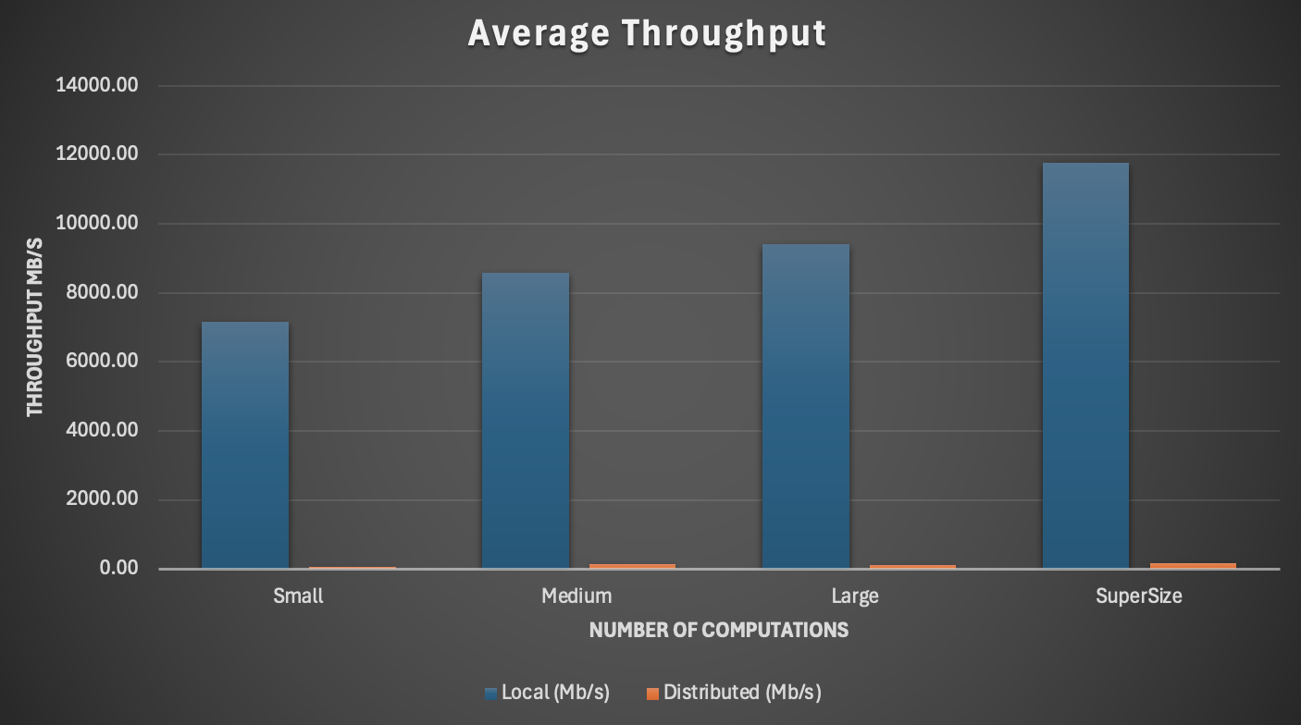
Results
The average throughput of the local system outperformed the distributed system in every size set​

Slide 15
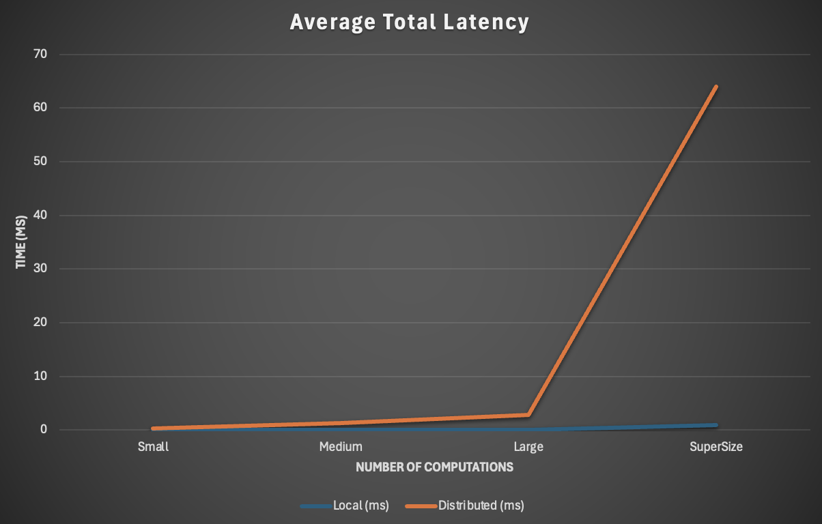
Results
Latency grew as the number of computations increased in both systems, but in the distributed system latency grew exponentially faster.

Slide 16
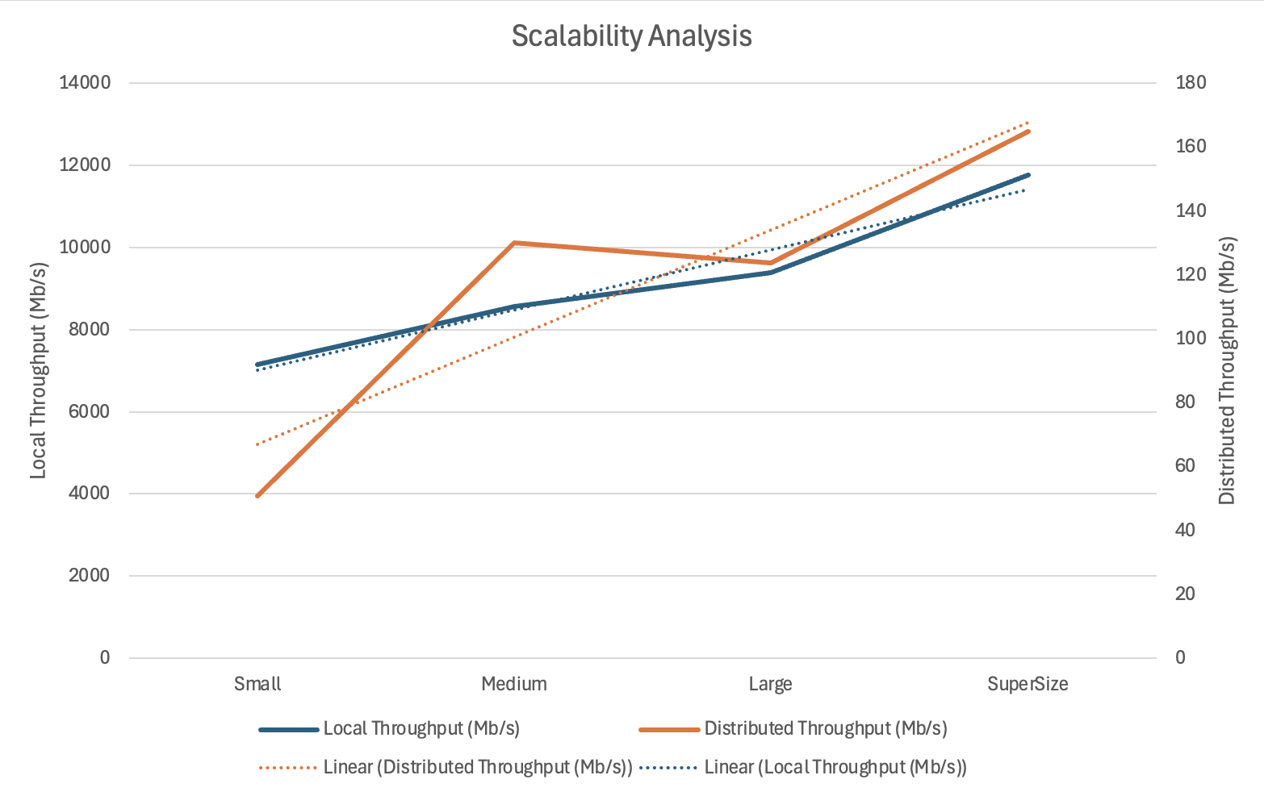
Results
Scale is adjusted with secondary axis
Trendline shows that the local system will scale better than a distributed system

Slide 17
Results
Communication overhead dominates computational benefits for simple arithmetic operations
Distributed system underperformed centralized processing:
50-140x worse throughput
100-160x worse latency

Slide 18

AI Usage Overview
GitHub Copilot
Code completion and syntax assistance during implementation
Claude Sonnet 4
Technical writing, documentation enhancement, infrastructure configuration, and problem-solving guidance

Slide 19
Q & A
Please ask us Questions

