Slide 1
Entry
1. receive m(val) 2. f0 ⬅ 0 3. f1 ⬅ 1 4. if m <= 1 goto L3 5. i ⬅ 2 6. L1: if i <= m goto L2 7. return f2 8. L2: f2 ⬅ f0 + f1 9. f0 ⬅ f1 10. f1 ⬅ f2 11. i ⬅ i + 1 12. goto L1 13. L3: return m
Block 1
B1
Block 2
Block 3
Block 4
B6
B2
Block 5
B3
Block 6
B4
B5
Exit

Slide 2
entry
Entry
k1 ← false
i1 ← 1
j1 ← 2
B1
i3 = Φ(i1,i2)
j3 = Φ(j2,j3)
k3 = Φ(k2,k3)
i3≤n
B2
B3
B4
k3
j2 ← j2 * 2
k2 ← true
i2 ← i2 + 1
B5
B6
exit
print j3
i4 ← i3 + 1
i5 = Φ(i3,i4)
exit

Slide 3
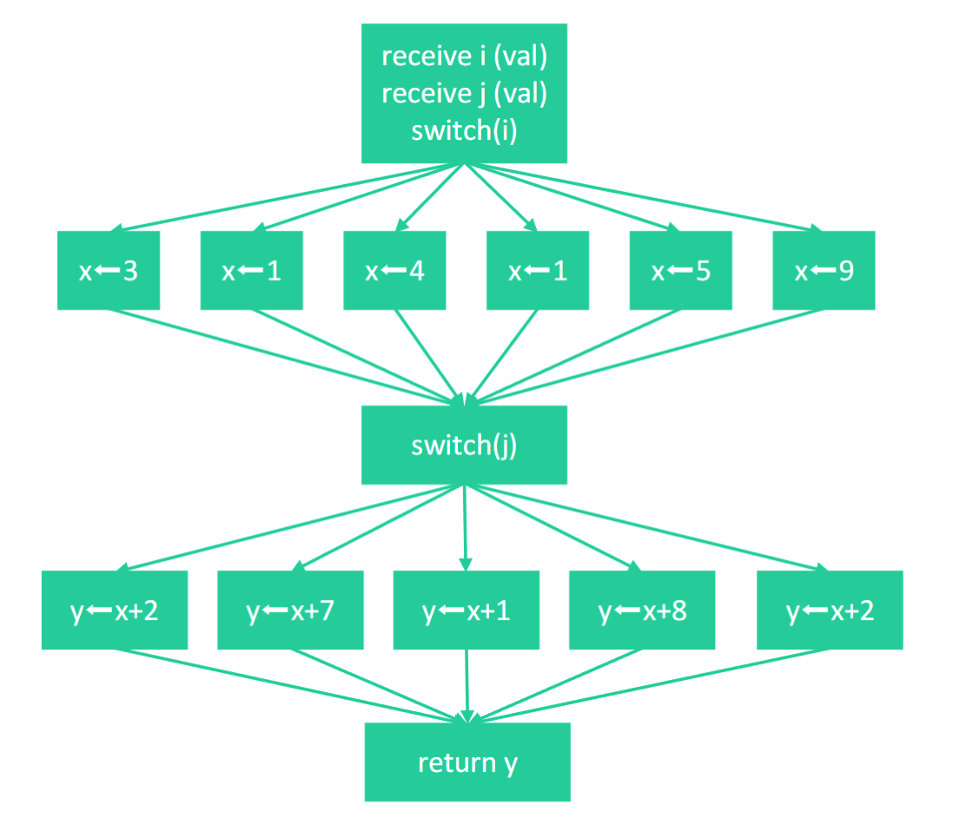
B1
B2
B3
B4
B5
B6
B7
B8
B9
B10
B11
B12
B13
B14

Slide 4
receive i (val) receive j (val) switch(i)
x1 ← 3
x2 ← 1
x3 ← 4
x4 ← 1
x5 ← 5
x6 ← 9
UD chain
x7 = Φ(x1,x2,x3,x4,x5,x6)
switch(j)
y1 ← x7+2
y2 ← x7+7
y3 ← x7+1
y4 ← x7+8
y5 ← x7+2
UD chain
y6 = Φ(y1,y2,y3,y4,y5)
return y6

Slide 5
entry
B1
B2
B3
B4
B5
exit
B6

Slide 6
entry
B1
B2
B3
B4
B5
exit

Slide 7
entry
entry
a1 ← 3
d1 ← 2
a1 ← 3
d1 ← 2
a2 ← Φ(a1,a3)
d2 ← Φ(d1,d3)
f1 ← a2 + d2
g ← 5
a3 ← g – d2
f <= g
a2 ← 3
d2 ← 2
f1 ← 5
g ← 5
a3 ← 3
f <= 5
f ← g + 1
g > a3
f ← 6
d3 ← 2
d3 ← 2
exit

Slide 8
entry
entry
c1 ← a1 + b1
e ← c1*c1
c1 ← a1 + b1
d ← c1
e ← d*d
a2←Φ(a1,a3)
h1←Φ(undef,h3)
f1 ← a2 + c1
a3 ← e+c1
a3<c
a2←Φ(a1,a3)
h1←Φ(undef,h3)
f1 ← a2 + c
g ← e
a3 ← g+d
a3<c
常量传播
h2←e+1
f2←c1-e
f2>a3
h2←g+1
f2←d-g
f2>a3
f3←Φ(f1,f2)
h3=Φ(h1,h2)
b2←e+a3
h3<f3
f3←Φ(f1,f2)
h3=Φ(h1,h2)
b2←g+a3
h3<f3
c2←2
c2←2
exit
exit

Slide 9
sub-group swizzle matmul
1
2
3
4
5
6
7
8
9
10
×
=
A
B
C

Slide 10
sub-group swizzle matmul
1
3
5
7
9
groupSize = 2
2
4
6
8
10
×
=
11
13
12
14
A
B
C

Slide 11
threadblockIdx
Launch once SM is idle.
……
255
SM127
……
[i for i in range(17,128,2)]
200
SM19
199
SM17
SM127
……
[i for i in range(17,128,2)]
144
SM19
143
SM17
SM15
SM15
……
[(i,i) for i in range(1,16,2)]
SM3
SM3
SM1
127
SM1
SM126
SM126
……
[(i,i) for i in range(0,127,2)]
SM2
SM2
SM0
0
SM0
SM Idx
The mapping relationship between SMs and thread blocks on NVIDIA GeForce RTX 4090

Slide 12
SM Idx
the first wave
Greedy Schedule
127
……
……
0
Thread Block 0
Thread Block x
Clock cycle

Slide 13
512
256
256
1
A0
256 TB
256 TB
C0
C1
A1
256 TB
256 TB
C2
C3
B0
B1
A
B
C

Slide 14
512
256
256
1
A0
256 TB
256 TB
C0
C2
A1
256 TB
256 TB
C1
C3
B0
B1
A
B
C

Slide 15
int64_t x;
x
0x8
0xD
0xF
64位计算机一次读取
addr = 0x8; 64位对齐
0x0
0x6
0x7
0x8
0xD
0xF
x
addr = 0x6; 未对齐
第一次读
第二次读
拼接得到x

Slide 16
upstream commit
upstream/main
fork from here
origin/main
contribute
rebase
your commit

