Slide 1
An Approach for Identifying Microservices using Clustering on Control Flow and Data Flow
Supervisor: Dr. rer. nat. Robert Heinrich
Student: Niko Benkler

Slide 2
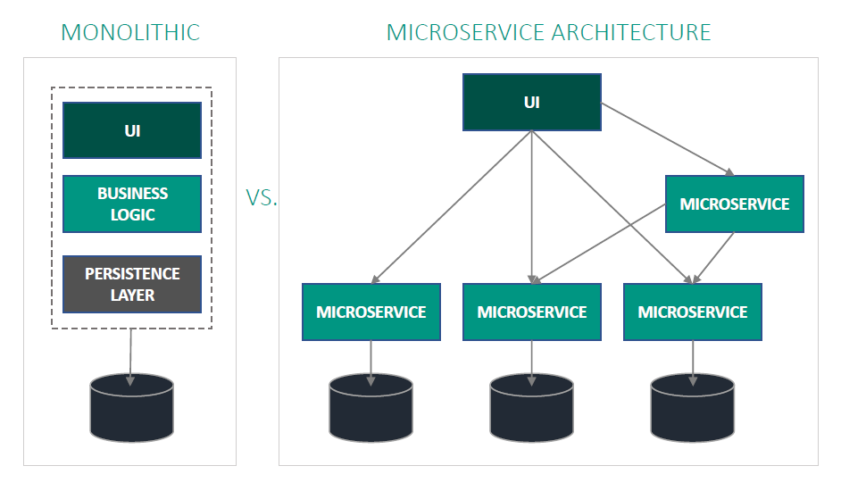
Microservice Architecture
Benefits
Availability, Resilience, Fault Isolation
Scalability, Resource Utilisation
Neutral Development Technology
Challenges
Expensive Communication
Organizational Challenges
Microservice Identification
Motivation
Foundation
Related Work
Approach
Evaluation
Summary

Slide 3
PIBA
Problem
Identify Microservices form System requirements without detailed know-how and manual effort
Idea
Identify microservices using clustering on control flow and data flow
Benefit
Faster identification process
Reduce required expertise and manual effort
Create adequate microservices
Action
Extract control flow (activities) and data flow (data object) dependencies from BPMN models
Create two weighted graphs based on the dependencies
Identify highly cohesive sets of activities and data objects
Match clusters to generate microservice candidates
Motivation
Foundation
Related Work
Approach
Evaluation
Summary

Slide 4
Research Questions
??? Ja nein?
Motivation
Foundation
Related Work
Approach
Evaluation
Summary

Slide 5
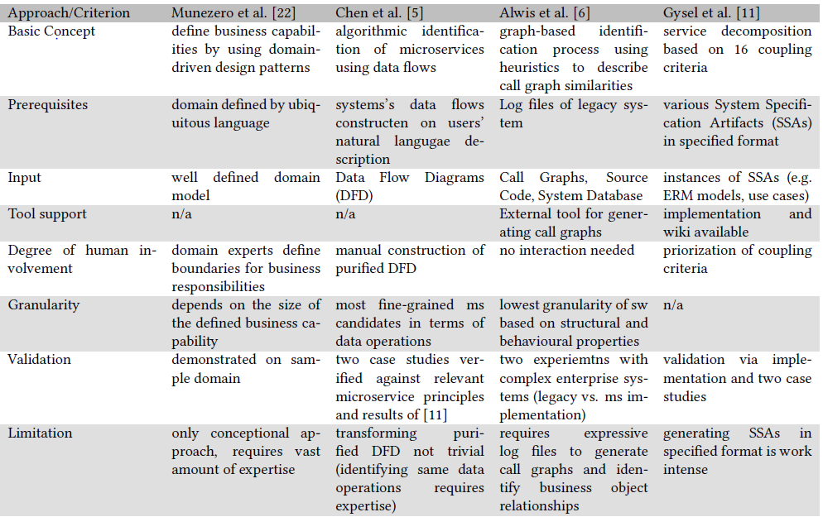
State of the Art I
Motivation
Foundation
Related Work
Approach
Evaluation
Summary

Slide 6
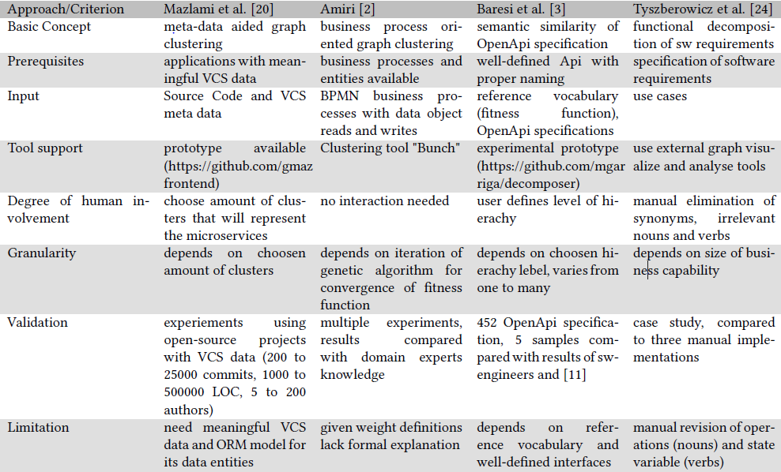
State of the Art II
Motivation
Foundation
Related Work
Approach
Evaluation
Summary

Slide 7
Basic Strategy
Inspired by “Object-Aware Identification of Microservices” [1]
Motivation
Foundation
Related Work
Approach
Evaluation
Summary

Slide 8
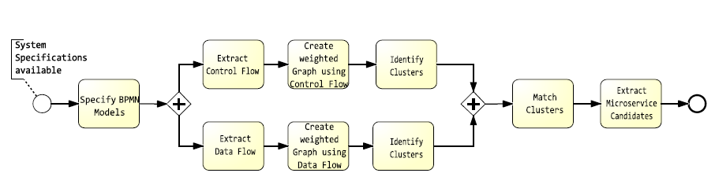
Approach
Motivation
Foundation
Related Work
Approach
Evaluation
Summary

Slide 9
Specify BPMN Models
Bla
Motivation
Foundation
Related Work
Approach
Evaluation
Summary

Slide 10
Extract Control Flow
Bla
Motivation
Foundation
Related Work
Approach
Evaluation
Summary

Slide 11
Extract Data Flow
Bla
Motivation
Foundation
Related Work
Approach
Evaluation
Summary

Slide 12
Create a weighted Graph using Control Flow
Bla
Motivation
Foundation
Related Work
Approach
Evaluation
Summary

Slide 13
Create a weighted Graph using Data Flow
Bla
Motivation
Foundation
Related Work
Approach
Evaluation
Summary

Slide 14
Identify Clusters
Bla
Motivation
Foundation
Related Work
Approach
Evaluation
Summary

Slide 15
Match Clusters
Bla
Motivation
Foundation
Related Work
Approach
Evaluation
Summary

Slide 16
Extract Microservice Candidates
Bla
Motivation
Foundation
Related Work
Approach
Evaluation
Summary

Slide 17
Application of the Approach
CoCoME
Outcome
Motivation
Foundation
Related Work
Approach
Evaluation
Summary

Slide 18
Evaluation
Goals
Metrics
Design
Motivation
Foundation
Related Work
Approach
Evaluation
Summary

Slide 19
Evaluation Results
Resultate und Übereinstimmungen + kurze Diksussion
Motivation
Foundation
Related Work
Approach
Evaluation
Summary

Slide 20
Conclusion
Nochmal RQs beantworten
Motivation
Foundation
Related Work
Approach
Evaluation
Summary

Slide 21
Limitations and Future Work
Bla
Motivation
Foundation
Related Work
Approach
Evaluation
Summary

Slide 22
Text
Bla
Motivation
Foundation
Related Work
Approach
Evaluation
Summary

Slide 23
Text
Bla
Motivation
Foundation
Related Work
Approach
Evaluation
Summary

Slide 24
Text
Bla
Motivation
Foundation
Related Work
Approach
Evaluation
Summary

Slide 25
Bibliography
[1] M. J. Amiri. “Object-Aware Identification of Microservices”. In: (July 2018), pp. 253–256
Motivation
Foundation
Related Work
Approach
Evaluation
Summary

Slide 26

Motivation
Foundation
Related Work
Approach
Evaluation
Summary

