Slide 1
An Approach for Identifying Microservices using Clustering on Control Flow and Data Flow
Supervisor: Dr. rer. nat. Robert Heinrich
Student: Niko Benkler

Slide 2
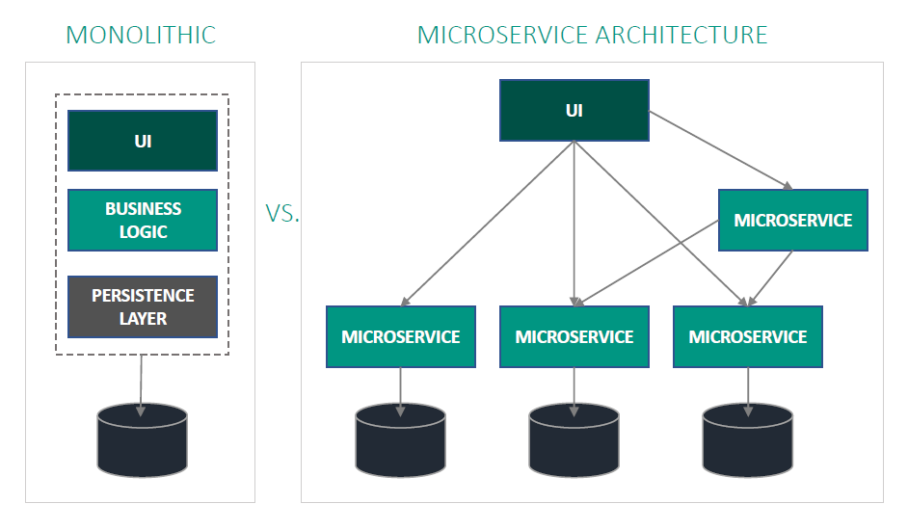
Microservice Architecture
Benefits
Availability, Resilience, Fault Isolation
Scalability, Resource Utilisation
Neutral Development Technology
Challenges
Expensive Communication
Organizational Challenges
Microservice Identification
Motivation
State of the Art
Approach
Evaluation
Summary

Slide 3
PIBA
Problem
Identifying microservices is a cumbersome task and requires detailed knowledge and manual effort
Strong dependencies in control flow and data flow make identification difficult
Idea
Identify microservices using clustering on control flow and data flow
Benefit
Reduce required expertise and manual effort
Create adequate microservices
Action
Extract control flow (activities) and data flow (data object) dependencies from BPMN models
Create two weighted graphs based on the dependencies
Identify highly cohesive sets of activities and data objects
Match clusters to generate microservice candidates
Motivation
State of the Art
Approach
Evaluation
Summary

Slide 4
Research Questions
RQ1: How to identify microservices based on the system specifications?
RQ1.1: Which is an appropriate strategy to decompose a system into microservices?
Literature research to find suitable strategies
RQ1.2: How to identify possible microservices without detailed knowledge and manual effort?
Most promising strategy identified in RQ1.1 as basis
Elaborate approach
RQ1.3: What is the accuracy of the approach?
Comparing the results of the approach with results of other approaches
Motivation
State of the Art
Approach
Evaluation
Summary

Slide 5
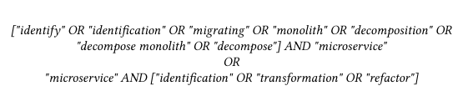
Literature Research
Conducted using digital libraries
IEEE
ACM
SpringerLink
Google Scholar for further information
Eight promising approaches were found
Approaches compared using eight defined criteria
Motivation
State of the Art
Approach
Evaluation
Summary

Slide 6
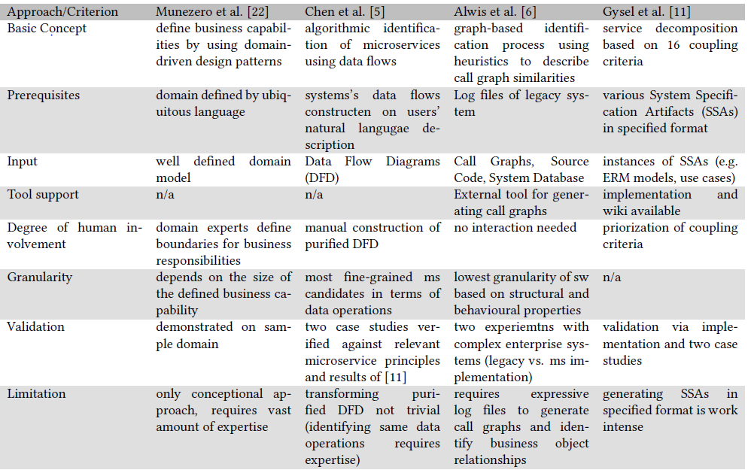
State of the Art I
Motivation
State of the Art
Approach
Evaluation
Summary

Slide 7
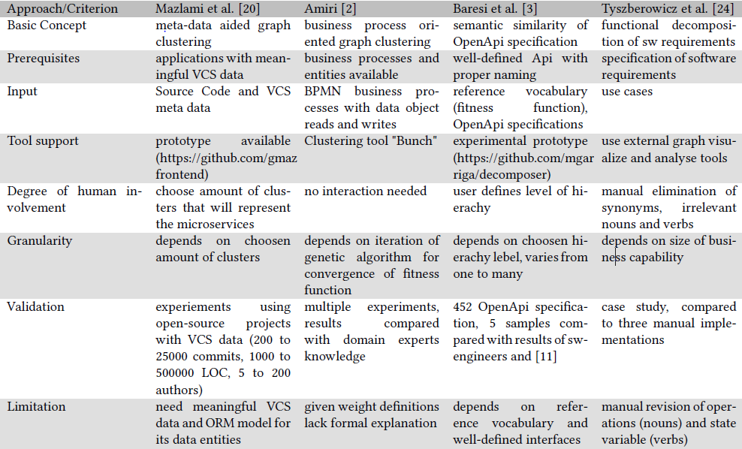
State of the Art II
Motivation
State of the Art
Approach
Evaluation
Summary

Slide 8
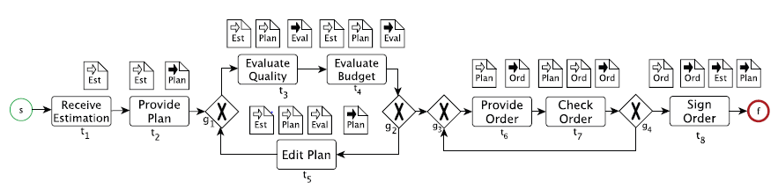
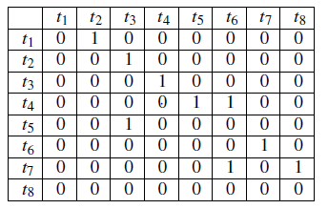
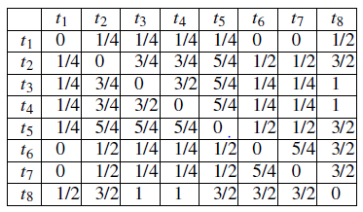
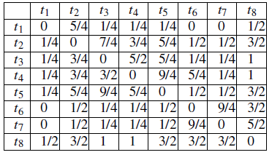

Inspired by "Object-aware Identification of Microservices" [1]
BPMN Graph:
Structural Dependency
Data Object Dependency
Clustering
Aggregation
Microservice candidates
Sources: Object-aware Identification of Microservices, M.J. Amiri [1]
Motivation
State of the Art
Approach
Evaluation
Summary

Slide 9
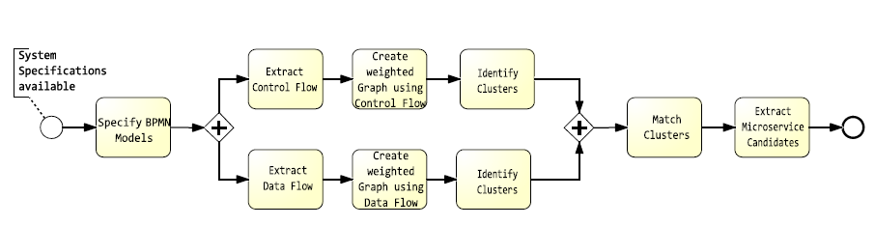
Approach
Divided in nine steps
Motivation
State of the Art
Approach
Evaluation
Summary

Slide 10
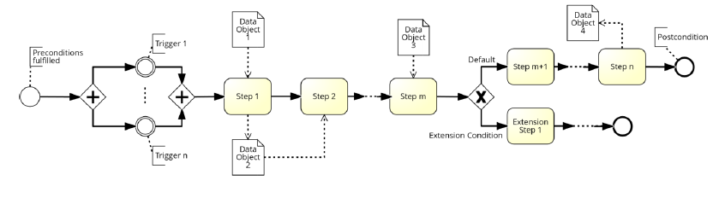
Specify BPMN Models
System requirements in various forms
Transformation into BPMN models
Workshops
Use Case Transformation
Others: BPMN Miner[5] …
Use Case Transformation based on [2]
Motivation
State of the Art
Approach
Evaluation
Summary

Slide 11
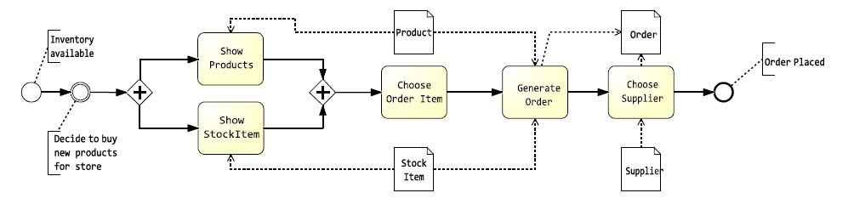
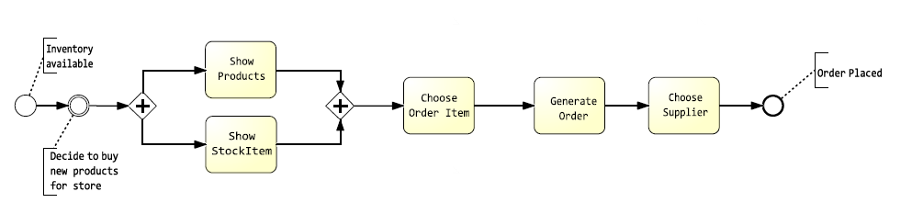
Extract Control Flow
Delete Data Objects and accompanying associations
Original:
Extracted Control Flow:
Motivation
State of the Art
Approach
Evaluation
Summary

Slide 12
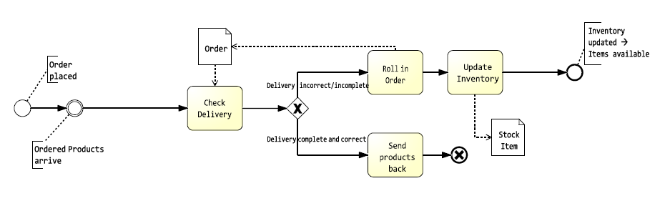
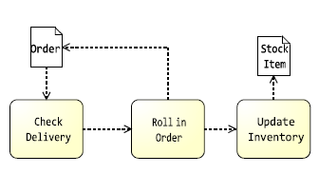
Extract Data Flow
Approximate Data Flow
Delete control flow related parts
Connect pair of tasks if connected by control flow arc
Replace Gates
Replace by two data flow arcs
No distinction between XOR and parallel Gateway
Delete unnecessary tasks
Original:
Extracted Data Flow:
Motivation
State of the Art
Approach
Evaluation
Summary

Slide 13
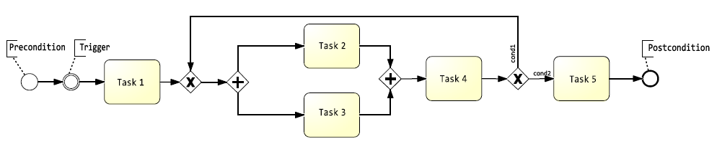
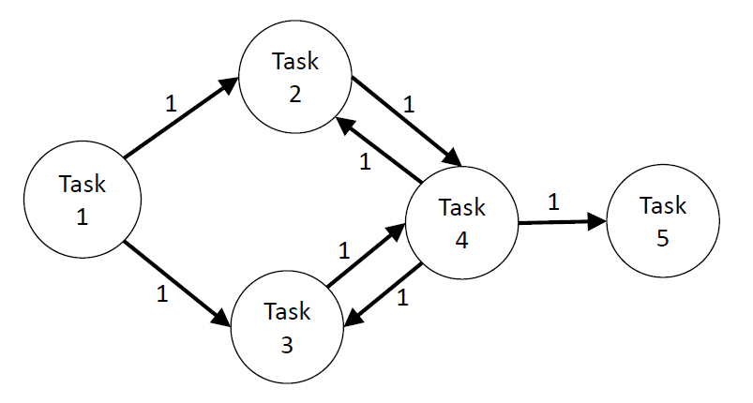
Create a weighted Graph using Control Flow
Generate one Graph by using all control flow models
Connect pair of activities
if directly connected in BPMN models
if only gateways in between
Assign a weight of 1 to all dependencies
Multiple occurrences: Add weights
Motivation
State of the Art
Approach
Evaluation
Summary

Slide 14
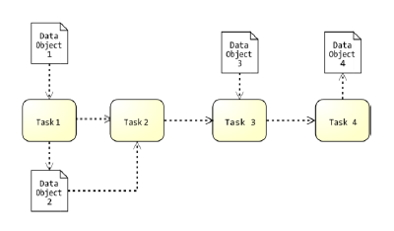
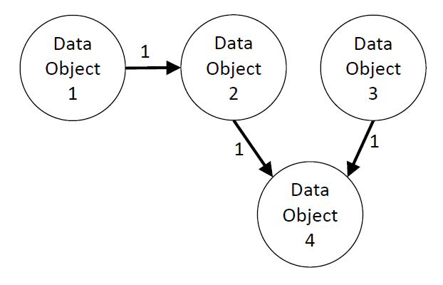
Create a weighted Graph using Data Flow
Generate one Graph by using all data flow models
Connect pair of data objects
if both data objects are read by the same task
if a data object is used to update another data object
max. n tasks in between a task that reads the first data object and another tasks that updates the other data object
Determine parameter n depending on the granularity of the BPMN models
Assign a weight of 1 to all dependencies
Multiple occurrences: Add weights
Motivation
State of the Art
Approach
Evaluation
Summary

Slide 15

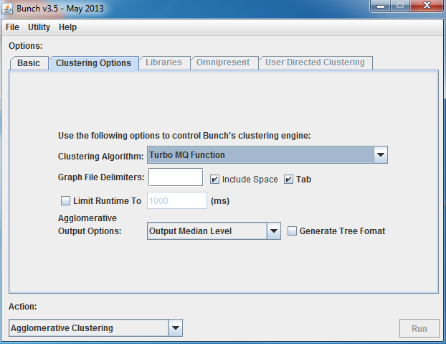
Identify Clusters
Bunch Software [3]
Genetic Algorithm: Randomly picks k cluster
Fitness Function: Turbo-MQ
Cluster Factor: Rewards intra-cluster coupling
Input: List of edges with weights
Output: DOT format
Visualization: GraphViz [4]
Two sets of cluster
Activity cluster
Data Object Cluster
Motivation
State of the Art
Approach
Evaluation
Summary

Slide 16
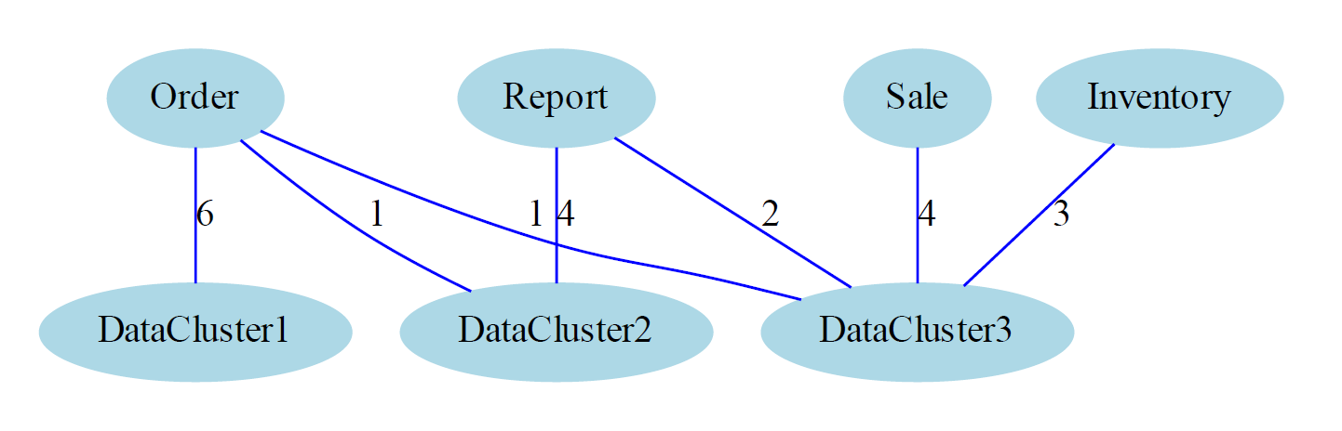
Matching of Clusters
Count data object access between activity clusters and data object cluster
Use amount as weight
Use Bunch to identify compound cluster
Motivation
State of the Art
Approach
Evaluation
Summary

Slide 17
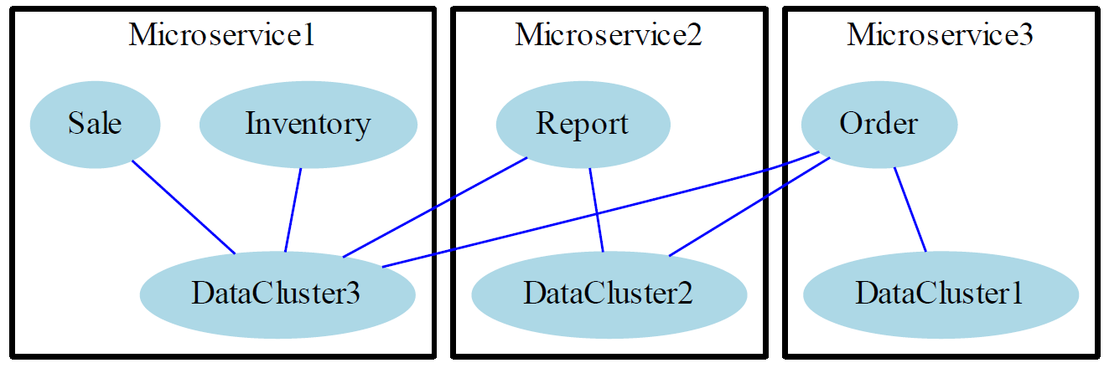
Extract Microservice Candidates
Each compound cluster correspond to a microservice candidate
Motivation
State of the Art
Approach
Evaluation
Summary

Slide 18
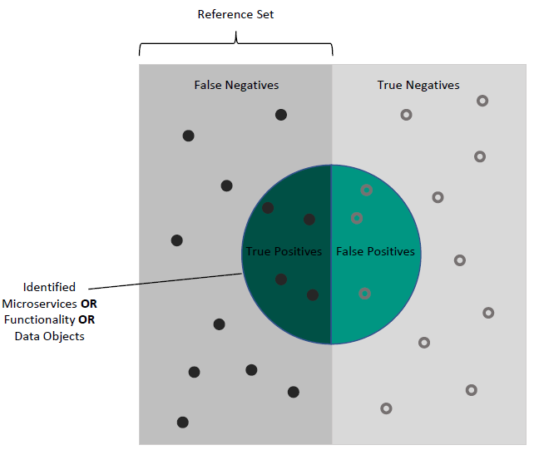


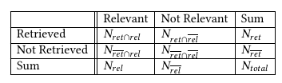
Evaluation
Goal: Determine the accuracy of the approach
Comparison to two Reference Sets
Questions: What is the Precision and Recall regarding the identified
microservices?
functionalities of the microservices?
data objects of the microservices?
Motivation
State of the Art
Approach
Evaluation
Summary

Slide 19
Evaluation Design
CoCoME as running example
Community case study for software evolution
Typical component-based information system
Comparison to two reference sets
Well established procedure to reason about the accuracy
Precision and Recall capable to determine accuracy of the approach
How many relevant instances identified
How many of the identified are correct
Reference Sets
Decomposition by approach in “Identifying Microservices Using Functional Decomposition” [4]
Manual Decomposition
Motivation
State of the Art
Approach
Evaluation
Summary

Slide 20
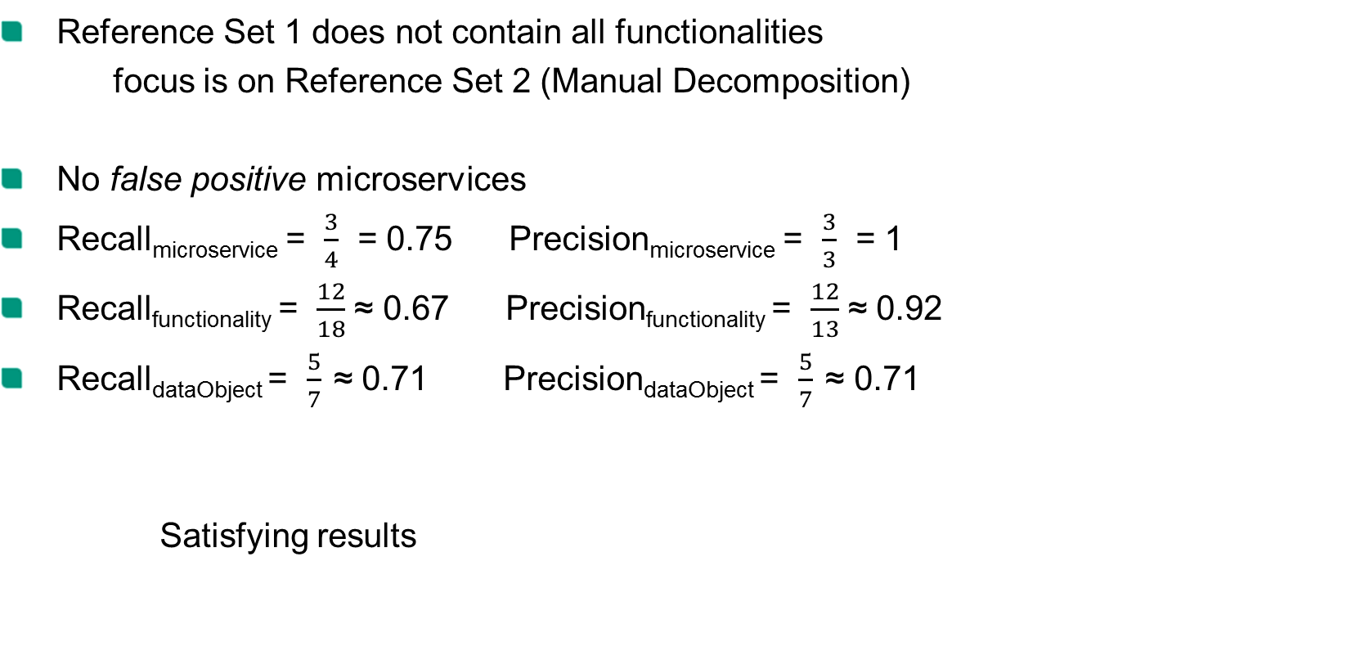
Evaluation Results
Reference Set 1 does not contain all functionalities
focus is on Reference Set 2 (Manual Decomposition)
No false positive microservices
Recall_{microservice} = $\frac{3}{4}$ = 0.75 Precision_{microservice} = $\frac{3}{3}$ = 1
Recall_{functionality} = $\frac{12}{18}$ ≈ 0.67 Precision_{functionality} = $\frac{12}{13}$ ≈ 0.92
Recall_{dataObject} = $\frac{5}{7}$ ≈ 0.71 Precision_{dataObject} = $\frac{5}{7}$ ≈ 0.71
Satisfying results
Motivation
State of the Art
Approach
Evaluation
Summary

Slide 21
Conclusion
Approaches exist, but no one considers control and data flow together
Contributions:
Strategy developed that fills the gap in current research
Approach elaborated for identifying microservices using clustering on control flow and data flow
Evaluation:
(Semi-)automatic approach capable of identifying microservices
Reduces effort and necessary knowledge
Produces adequate microservices in the case of CoCoME
Motivation
State of the Art
Approach
Evaluation
Summary

Slide 22
Limitations and Future Work
Limitations
Transformation of system specifications into BPMN models not trivial
Same granularity for all BPMN models required
Parameter n needs knowledge about granularity
Future Work
Additional data flow diagram needed?
Different clustering algorithms to achieve variable microservice sizes
Approach capable of identifying different microservice sizes?
Cluster matching: Elaborate white box approach
Apply on other systems
Motivation
State of the Art
Approach
Evaluation
Summary

Slide 23
Bibliography
[1] M. J. Amiri. “Object-Aware Identification of Microservices”. In: (July 2018), pp. 253–256
[2] D. Lubke, K. Schneider, and M. Weidlich. “Visualizing Use Case Sets as BPMN Processes”
[3] Bunch Software, https://www.cs.drexel.edu/~spiros/bunch/, Accessed on 15.04.2019
[4] Shmuel Tyszberowicz et al. “Identifying Microservices Using Functional Decomposition”
[5] Raffaele Conforti et al. “BPMN Miner: Automated discovery of BPMN processmodels with hierarchical structure”

Slide 24


Slide 25
PIBA
Problem
Identifying microservices is a cumbersome task and requires detailed knowledge and manual effort
Strong dependencies in control flow and data flow make identification difficult
Idea
Identify microservices using clustering on control flow and data flow
Benefit
Reduce required expertise and manual effort
Create adequate microservices
Action
Extract control flow (activities) and data flow (data object) dependencies from BPMN models
Create two weighted graphs based on the dependencies
Identify highly cohesive sets of activities and data objects
Match clusters to generate microservice candidates
Motivation
State of the Art
Approach
Evaluation
Summary

