Slide 1
An Approach for Identifying Microservices using Clustering on Control Flow and Data Flow
Supervisor: Dr. rer. nat. Robert Heinrich
Student: Niko Benkler

Slide 2
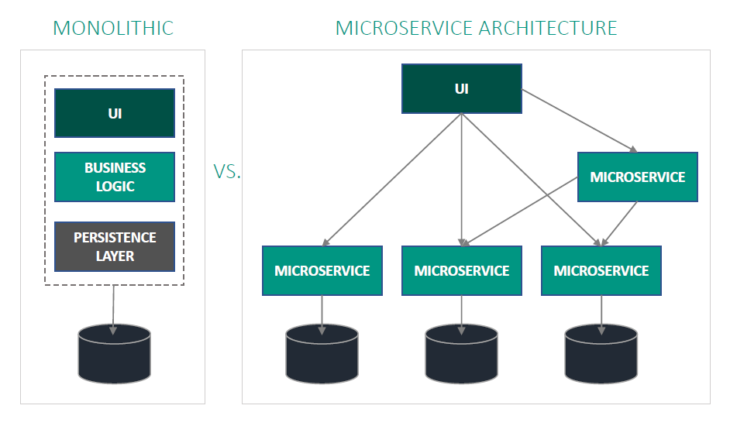
Microservice Architecture
Benefits
Availability, Resilience, Fault Isolation
Scalability, Resource Utilisation
Neutral Development Technology
Challenges
Expensive Communication
Organizational Challenges
Microservice Identification
Motivation
Foundation
Related Work
Approach
Evaluation
Summary

Slide 3
PIBA
Problem
Identify Microservices form System requirements without detailed knowledge and manual effort
Idea
Identify microservices using clustering on control flow and data flow
Benefit
Faster identification process
Reduce required expertise and manual effort
Create adequate microservices
Action
Extract control flow (activities) and data flow (data object) dependencies from BPMN models
Create two weighted graphs based on the dependencies
Identify highly cohesive sets of activities and data objects
Match clusters to generate microservice candidates
Motivation
Foundation
Related Work
Approach
Evaluation
Summary

Slide 4
Research Questions
??? Ja nein?
Motivation
Foundation
Related Work
Approach
Evaluation
Summary

Slide 5
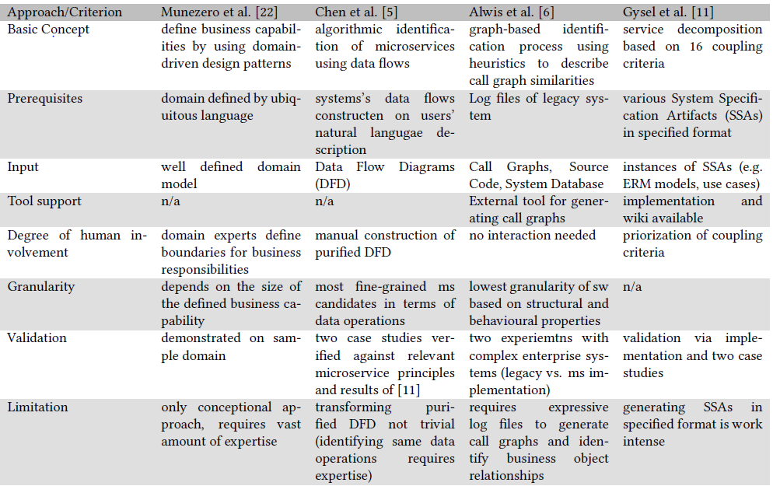
State of the Art I
Motivation
Foundation
Related Work
Approach
Evaluation
Summary

Slide 6
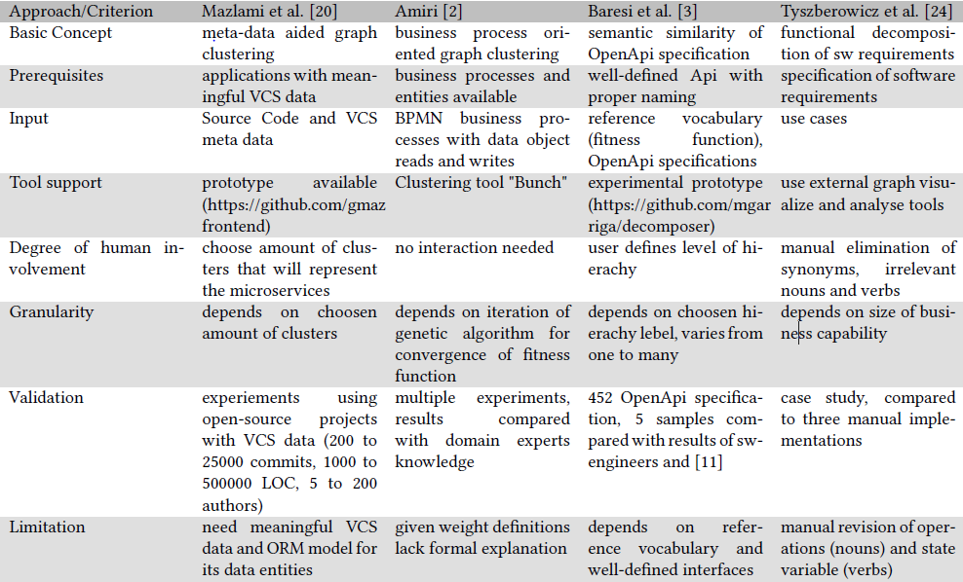
State of the Art II
Motivation
Foundation
Related Work
Approach
Evaluation
Summary

Slide 7
Basic Strategy
Inspired by “Object-Aware Identification of Microservices” [1]
Clustering on structural and data object dependencies
Aggregation of dependencies vague
Results highly influenced if large amount of data accesses
Data flow only implicitly
Strategy:
Extract control flow and data flow from business process models
Create two separate sets of clusters (activity and data object clusters)
Match clusters
Motivation
Foundation
Related Work
Approach
Evaluation
Summary

Slide 8
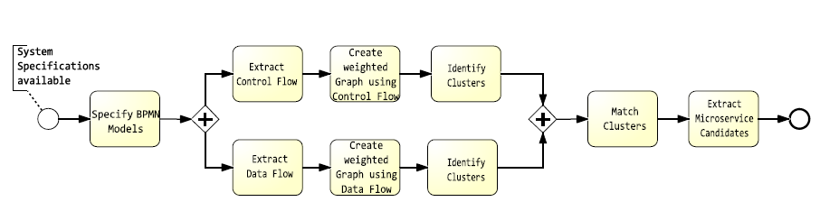

Approach
Divided in nine steps
Motivation
Foundation
Related Work
Approach
Evaluation
Summary

Slide 9
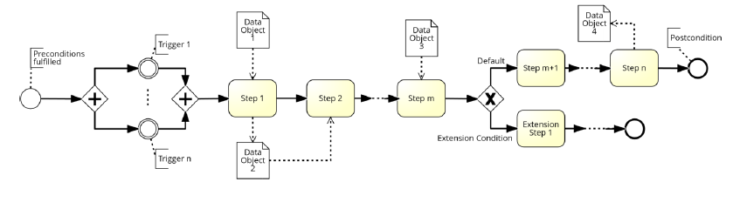
Specify BPMN Models
System requirements in various forms
Transformation into BPMN models
Workshops
Use Case Transformation
Others: BPMN Miner[5] …
Use Case Transformation based on [2]
Motivation
Foundation
Related Work
Approach
Evaluation
Summary

Slide 10
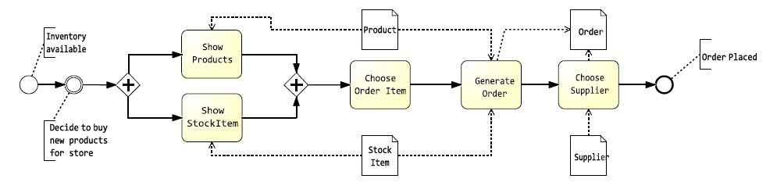
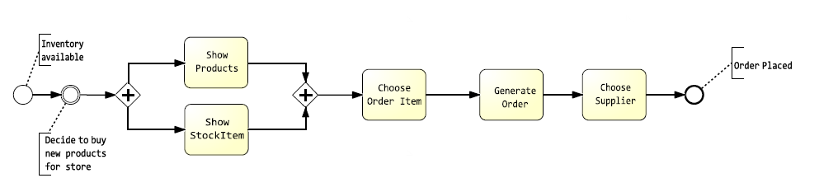
Extract Control Flow
Delete Data Objects and accompanying associations
Original:
Extracted Control Flow:
Motivation
Foundation
Related Work
Approach
Evaluation
Summary

Slide 11
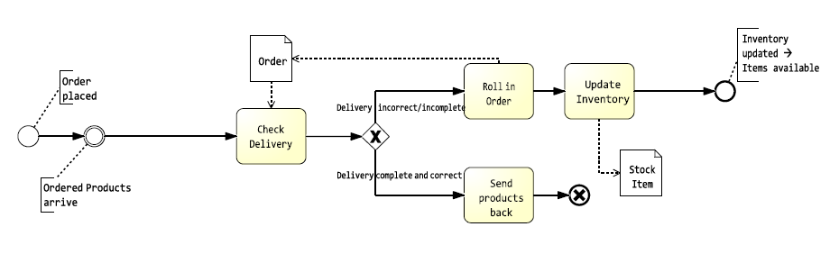
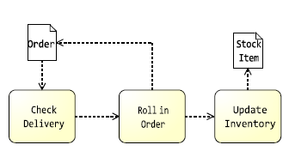
Extract Data Flow
Approximate Data Flow
Delete control flow related parts
Connect pair of tasks if connected by control flow arc
Replace Gates
Replace by two data flow arcs
No distinction between XOR and parallel Gateway
Delete unnecessary tasks
Original:
Extracted Data Flow:
Motivation
Foundation
Related Work
Approach
Evaluation
Summary

Slide 12
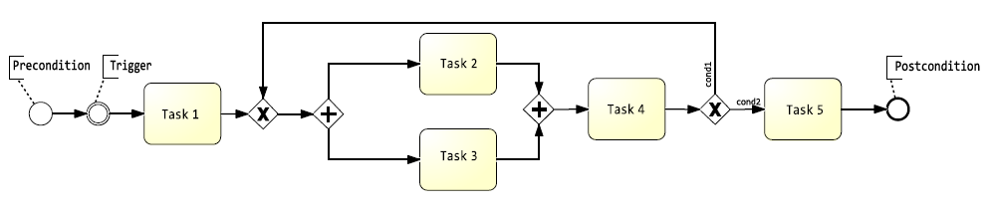
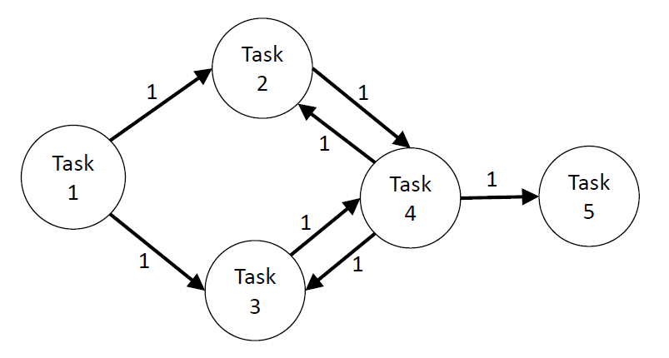
Create a weighted Graph using Control Flow
Generate one Graph by using all BPMN models
Connect pair of activities
if directly connected in BPMN models
if only gateways in between
Assign a weight of 1 to all dependencies
Multiple occurrences: Add weights
Motivation
Foundation
Related Work
Approach
Evaluation
Summary

Slide 13
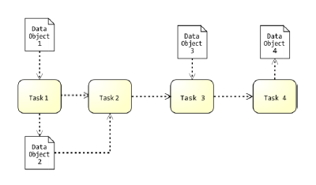
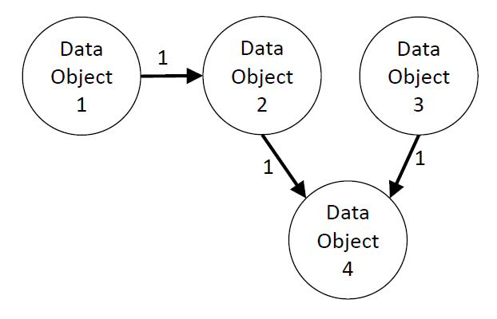
Create a weighted Graph using Data Flow
Generate one Graph by using all BPMN models
Connect pair of data objects
if both data objects are read by the same task
if a data object is used to update another data object
max. n tasks in between a task that reads the first data object and another tasks that updates the other data object
Determine parameter n depending on the granularity of the BPMN models
Assign a weight of 1 to all dependencies
Multiple occurrences: Add weights
Motivation
Foundation
Related Work
Approach
Evaluation
Summary

Slide 14

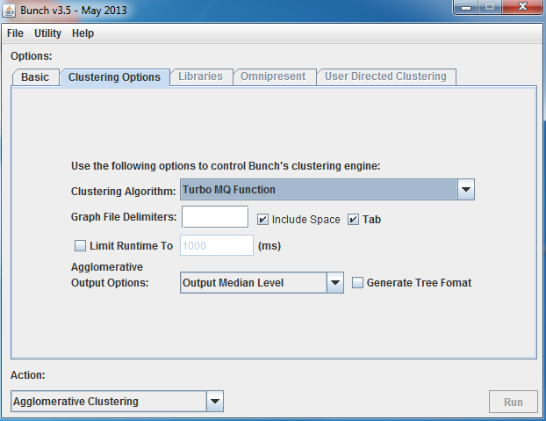
Identify Clusters
Bunch Software [3]
Genetic Algorithm: Randomly picks k cluster
Fitness Function: Turbo-MQ
Cluster Factor: Rewards intra-cluster coupling
Input: List of edges with weights
Output: DOT format
Visualization: GraphViz [4]
Two sets of cluster
Activity cluster
Data Object Cluster
Motivation
Foundation
Related Work
Approach
Evaluation
Summary

Slide 15
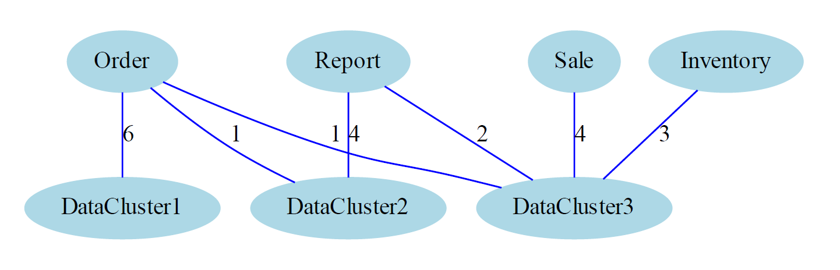
Matching of Clusters
Count data object access between activity clusters and data object cluster
Use amount as weight
Use Bunch to identify compound cluster
Motivation
Foundation
Related Work
Approach
Evaluation
Summary

Slide 16
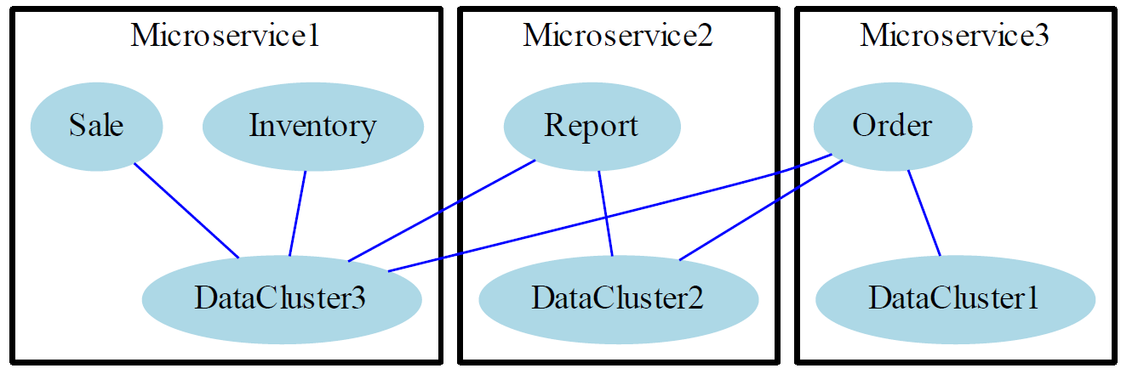
Extract Microservice Candidates
Each compound cluster correspond to a microservice candidate
Motivation
Foundation
Related Work
Approach
Evaluation
Summary

Slide 17
Application of the Approach
Besser implizit bei der Evaluation!?????
Motivation
Foundation
Related Work
Approach
Evaluation
Summary

Slide 18
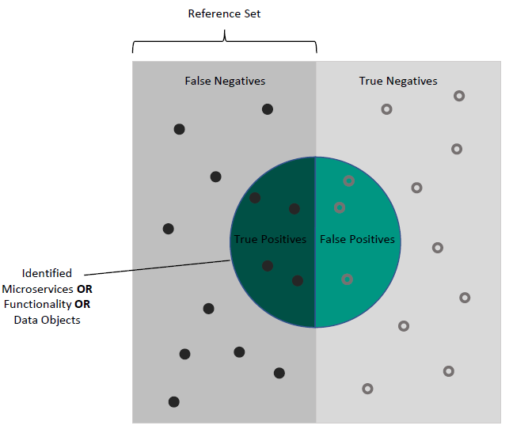
Evaluation
Goal: Determine the accuracy of the approach
CoCoME as running example
Comparison to two Reference Sets
Decomposition by approach in “Identifying Microservices Using Functional Decomposition” [4]
Manual Decomposition
Questions: What is the Precision and Recall regarding the identified
microservices?
functionalities of the microservices?
data objects of the microservices?
Motivation
Foundation
Related Work
Approach
Evaluation
Summary

Slide 19
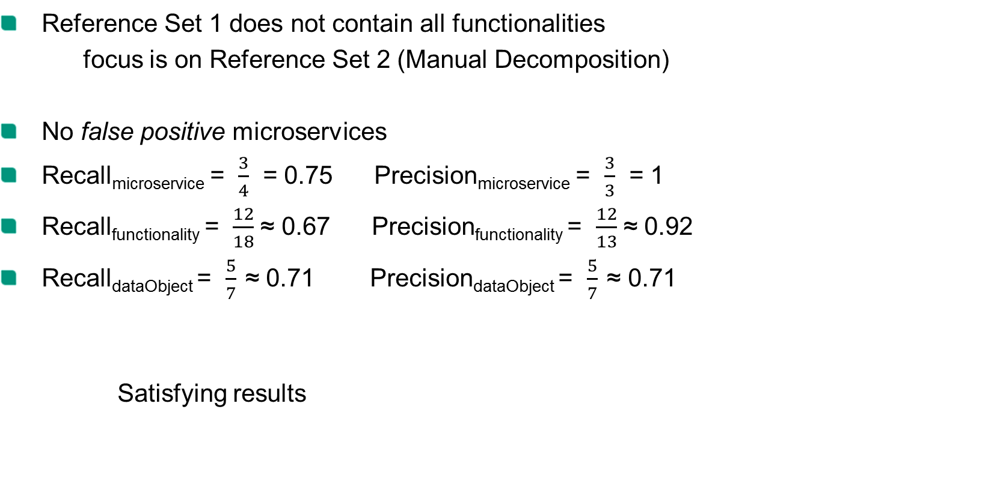
Evaluation Results
Reference Set 1 does not contain all functionalities
focus is on Reference Set 2 (Manual Decomposition)
No false positive microservices
Recall_{microservice} = $\frac{3}{4}$ = 0.75 Precision_{microservice} = $\frac{3}{3}$ = 1
Recall_{functionality} = $\frac{12}{18}$ ≈ 0.67 Precision_{functionality} = $\frac{12}{13}$ ≈ 0.92
Recall_{dataObject} = $\frac{5}{7}$ ≈ 0.71 Precision_{dataObject} = $\frac{5}{7}$ ≈ 0.71
Satisfying results
Motivation
Foundation
Related Work
Approach
Evaluation
Summary

Slide 20
Conclusion
State of the Art
Strategy inspired by "Object-Aware Identification of Microservices" [1]
Acquired: Using control flow information to identify clusters of highly cohesive activities
Added: Using data flow information to identify clusters of highly cohesive data objects
Approach elaborated
Using clustering on control flow and data flow
Input: System specifications in form of BPMN models
Evaluation conducted
Approach applied to CoCoME
Precision and Recall to determine accuracy of the approach
Satisfying results
Motivation
Foundation
Related Work
Approach
Evaluation
Summary

Slide 21
Limitations and Future Work
Limitations
Transformation of system specifications into BPMN models not trivial
Same granularity for all BPMN models required
Parameter n needs knowledge about granularity
Future Work
Additional data flow diagram needed?
Different clustering algorithms to achieve variable microservice sizes
Approach capable of identifying different microservice sizes?
Cluster matching: Elaborate white box approach
Apply on other systems
Motivation
Foundation
Related Work
Approach
Evaluation
Summary

Slide 22
Bibliography
[1] M. J. Amiri. “Object-Aware Identification of Microservices”. In: (July 2018), pp. 253–256
[2] D. Lubke, K. Schneider, and M. Weidlich. “Visualizing Use Case Sets as BPMN Processes”
[3] Bunch Software, https://www.cs.drexel.edu/~spiros/bunch/, Accessed on 15.04.2019
[4] Shmuel Tyszberowicz et al. “Identifying Microservices Using Functional Decomposition”
[5] Raaele Conforti et al. “BPMN Miner: Automated discovery of BPMN processmodels with hierarchical structure”
Motivation
Foundation
Related Work
Approach
Evaluation
Summary

Slide 23

Motivation
Foundation
Related Work
Approach
Evaluation
Summary

