Slide 1
QoS-Aware Configuration of Auto-Scaler
Praktikum: Werkzeuge für Agile Modellierung
Niko Benkler

Slide 2
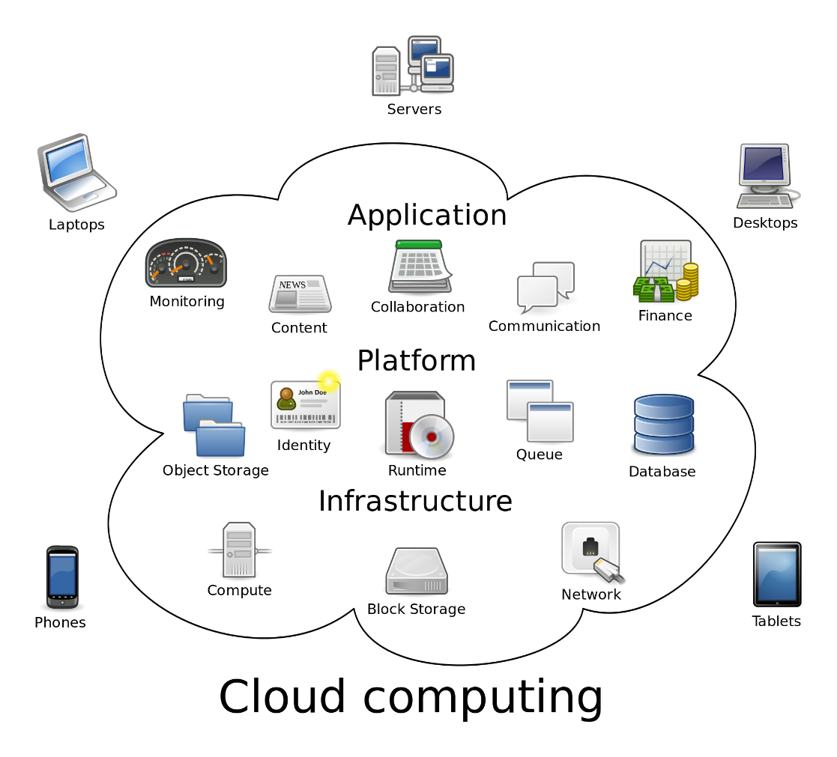
Cloud Computing
On-demand availability of computer system resources
No active management by user
Different service models (SaaS,…) adapted to customer needs
Source: [1]
Motivation
Foundation
Related Work
Approach
Evaluation
Summary

Slide 3
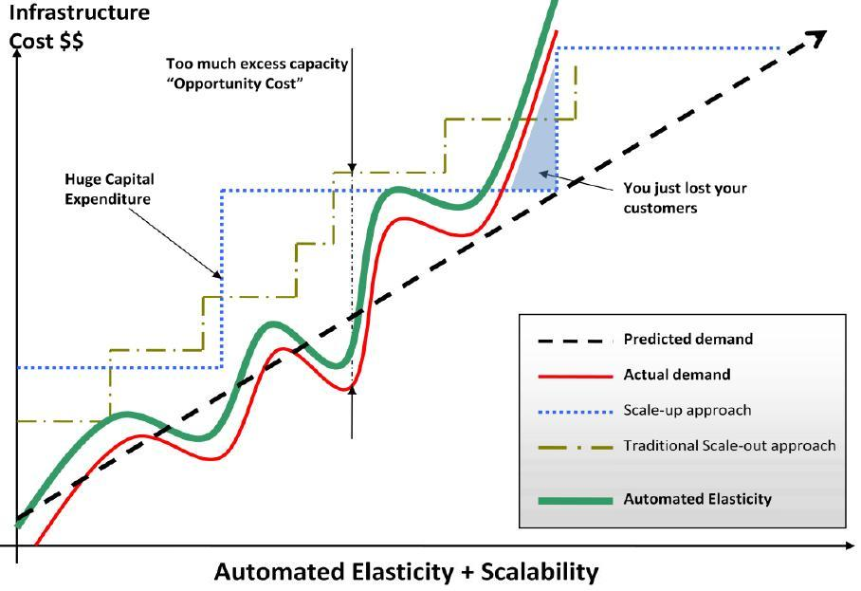
Dynamic Scalability
What does dynamic mean?
Resource demands ≈ Provided resources
Scaling needed!
Benefits:
Improvement in availability
Economic advantages
Ecologic advantages
But: Efficient scaling mechanisms needed!
Motivation
Foundation
Related Work
Approach
Evaluation
Summary

Slide 4
Auto-Scaler
Scaling decisions based on metrics such as
CPU Utilization
Arrival rate vs. current capacity
Queuing delay and queue length
Over-Provisioning: Resources are idle costs money!
Under-Provisioning: QoS-Agreements are not met annoys customers
"Good" Auto-Scalers needed!
Evaluation necessary
Motivation
Foundation
Related Work
Approach
Evaluation
Summary

Slide 5
Evaluation of Auto-Scalers
First attempt: Test behavior under real conditions
Resources required (Allocation of Virtual Machines, …)
Time intensive
Workload needed
Costs money!
Second attempt: Time discrete simulation
Simulate Cloud-Infrastructure to reduce costs
Discritification reduces time
Testbench required!
Motivation
Foundation
Related Work
Approach
Evaluation
Summary

Slide 6
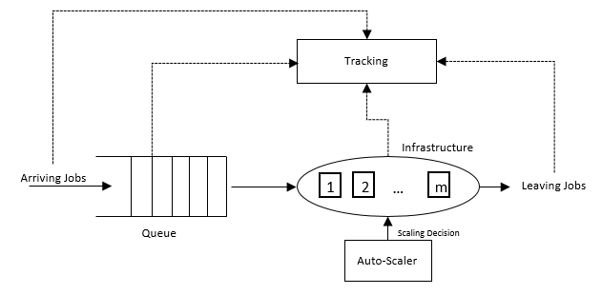
Basic Idea
Based on Queuing Theory which is similar to reality
Three main components
Queue: Handle arriving jobs
Infrastructure: Process Jobs
Tracking: Track behavior
Desires
Configurable infrastructure
Interface for Auto-Scaler
Motivation
Foundation
Related Work
Approach
Evaluation
Summary

Slide 7
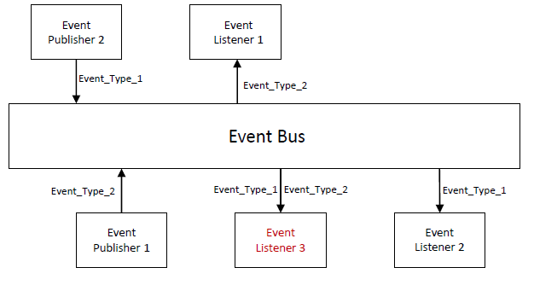
Application Architecture
Event-based architecture
Components do not need to know each other
Add additional Tracker or other components via Listeners
Synchronous Events
Motivation
Foundation
Related Work
Approach
Evaluation
Summary

Slide 8
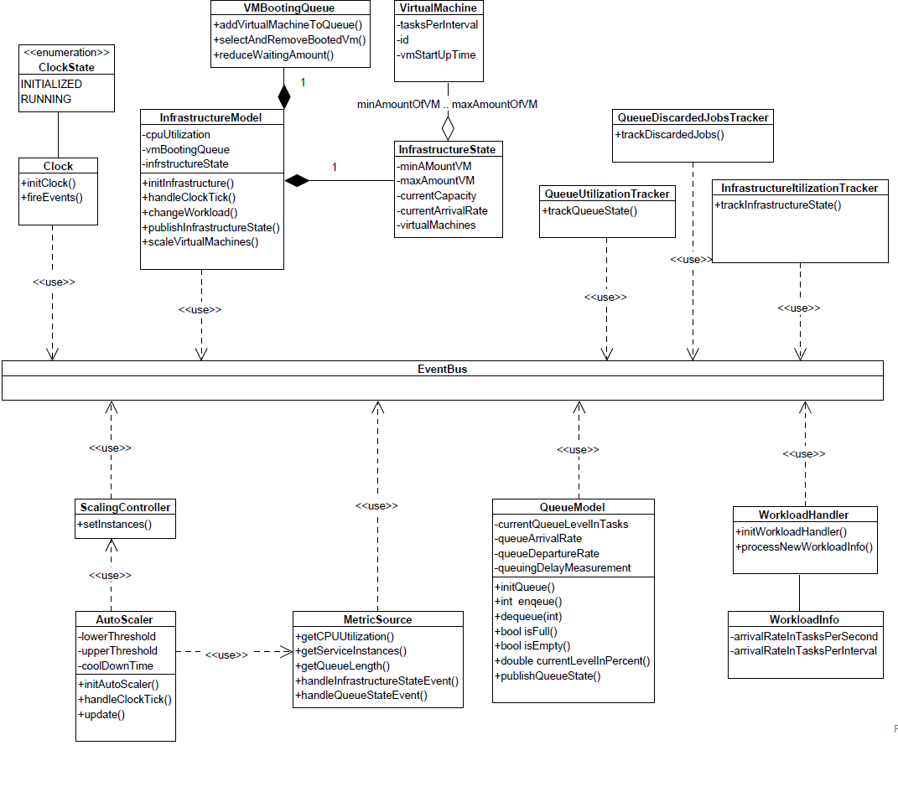
Components
Motivation
Foundation
Related Work
Approach
Evaluation
Summary

Slide 9
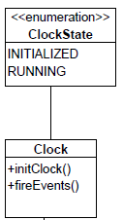
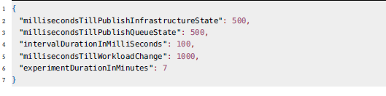
Clock
Clock generator for discrete simulation
Fires Events in predefined order
Trigger Workload Handler
Trigger Auto-Scaler and Infrastructure
Trigger to publish queue state and infrastructure state
Configuration:
Motivation
Foundation
Related Work
Approach
Evaluation
Summary

Slide 10
Components
Motivation
Foundation
Related Work
Approach
Evaluation
Summary

Slide 11
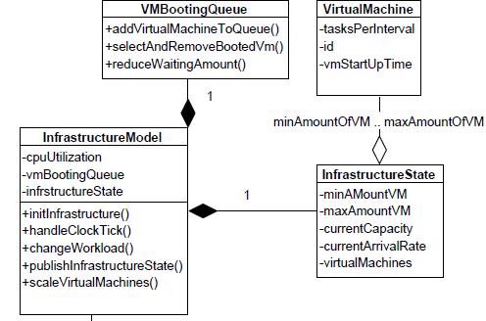
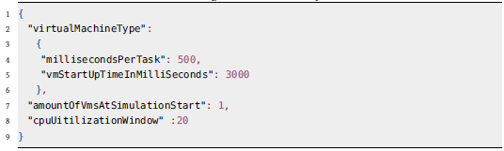
Infrastructure
Processes arriving tasks
Handle Workload changes
Handle scaling decisions
Publish state
Configuration:
Motivation
Foundation
Related Work
Approach
Evaluation
Summary

Slide 12
Components
Motivation
Foundation
Related Work
Approach
Evaluation
Summary

Slide 13
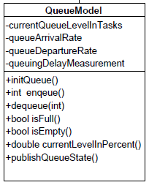

Queue
Enqueue arriving tasks
Dequeue tasks and pass to infrastructure
Acts as buffer if infrastructure is used to capacity
Configuration:
Motivation
Foundation
Related Work
Approach
Evaluation
Summary

Slide 14
Components
Motivation
Foundation
Related Work
Approach
Evaluation
Summary

Slide 15
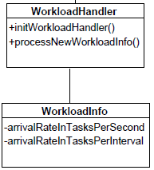
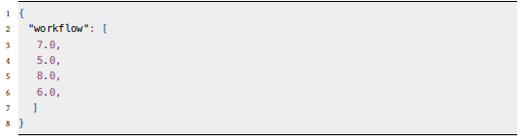
Workload Handler
Processes workload information
Pass information to Infrastructure
Amount of tasks that arrive between two workload changes
Configuration:
Motivation
Foundation
Related Work
Approach
Evaluation
Summary

Slide 16
Components
Motivation
Foundation
Related Work
Approach
Evaluation
Summary

Slide 17
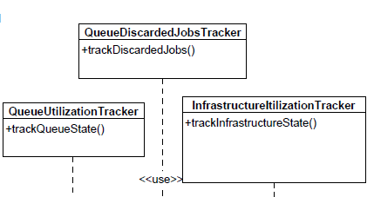
Tracker
Process Infrastructure and Queue State
Convert to CSV-Format and write to file
Motivation
Foundation
Related Work
Approach
Evaluation
Summary

Slide 18
Components
Motivation
Foundation
Related Work
Approach
Evaluation
Summary

Slide 19
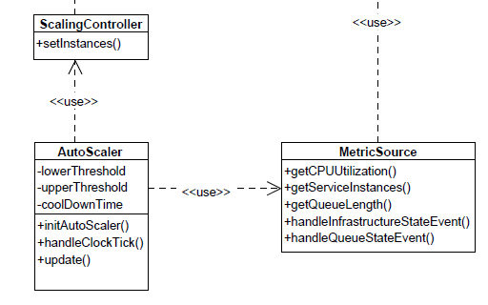
Scaling Controller and Metric Source
Scaling Controller is interface for new scaling decisions
Metric source listens provides metric for Auto-Scaler
CPU-Utilization (VMs)
Queue-Length
Active VMs
…
Motivation
Foundation
Related Work
Approach
Evaluation
Summary

Slide 20
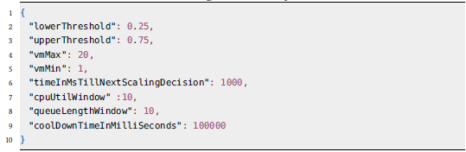
Auto-Scaler
Uses provided interfaces
Can be replaced easily
Need to be triggered either by Clock or externally
Configuration:
Motivation
Foundation
Related Work
Approach
Evaluation
Summary

Slide 21
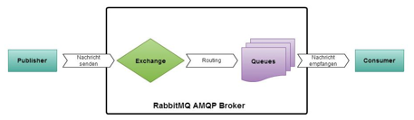
Evaluation Setup
Experiments on real infrastructure
Workload-Service (Producer on a VM)
Message-Broker RabbitMQ forwards Jobs to Consumer
Python-Consumer as scalable Microservice on Bosh IoT Cloud
Auto-Scaler retrieves Metrics directly from Infrastructure
CPU Monitoring and Tracking
Queue Monitoring and Tracking
Quelle: [3]
Motivation
Foundation
Related Work
Approach
Evaluation
Summary

Slide 22
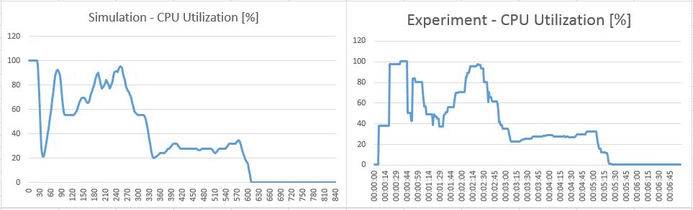
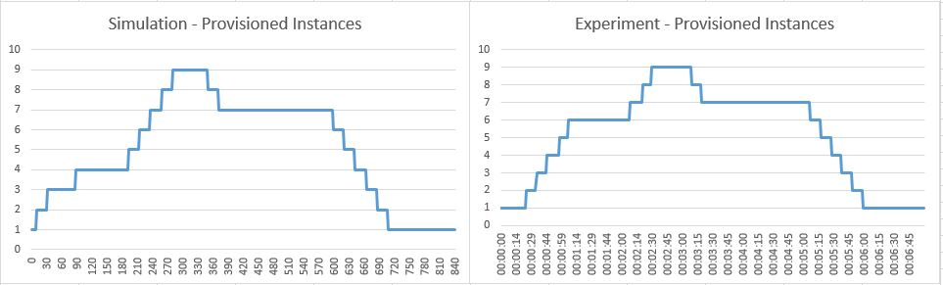
Evaluation Results - Infrastructure
Simulation is close to reals behavior
No ressources needed
Real execution time: 7 Minutes
Simulation time: <5 Seconds
Motivation
Foundation
Related Work
Approach
Evaluation
Summary

Slide 23
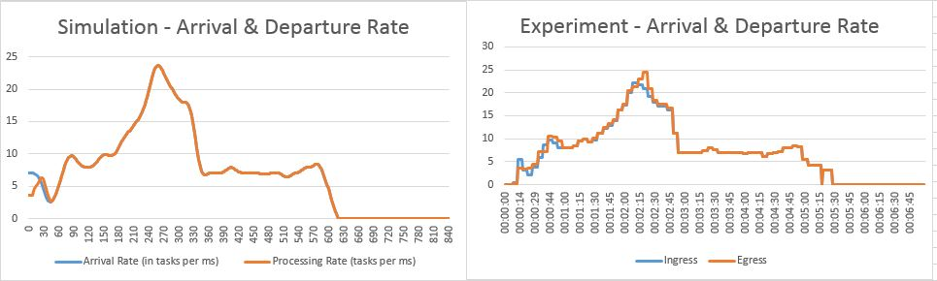
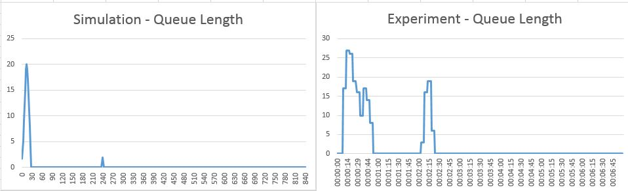
Evaluation Results - Queue
Arrival and Departure Rate also very similar
Queue Length slightly different but peaks are still present
Motivation
Foundation
Related Work
Approach
Evaluation
Summary

Slide 24
Summary
Cloud Computing needs dynamic scaling mechanisms to exploit its advantages
Auto-Scaler Evaluation on real infrastructure to resource and time consuming
Testbench to simulate infrastructure implemented
Interface for Auto-Scaler Evaluation available
Evaluation conducted with satisfactory results

Slide 25
Quellen
[1] https://de.wikipedia.org/wiki/Cloud_Computing
[2] https://www.esds.co.in/blog/what-is-saas-cloud-truth/#sthash.8g8OOefH.dpbs
[3] https://www.orkork.de/development/was-ist-eigentlich-rabbitmq
[4] Niko Benkler. Git-Hub Repository Praktikum:Werkzeuge für agile Modellierung.Accessed on
21.07.2019. url: https://github.com/Benkler/PraktikumWerzeugeAgileModellierung.
[5] M. Jelassi, C. Ghazel und L. A. Saïdane. “A survey on quality of service in cloud computing”. In: 2017 3rd International Conference on Frontiers of Signal Processing (ICFSP). Sep. 2017, S. 63–67. doi: 10.1109/ICFSP.2017.8097142.
[6] Tania Lorido-Botrán, Jose Miguel-Alonso und Jose Antonio Lozano. “A Review of Autoscaling Techniques for Elastic Applications in Cloud Environments”. In: Journal of Grid Computing 12 (Dez. 2014). doi: 10.1007/s10723-014-9314-7.
[7] Alessandro Papadopoulos u. a. “PEAS: A Performance Evaluation Framework for Auto-
Scaling Strategies in Cloud Applications”. In: ACM Transactions on Modeling and Performance Evaluation of Computing Systems 1 (Aug. 2016),
Motivation
Foundation
Related Work
Approach
Evaluation
Summary

