Slide 1
From Traditional Development to Continuous Deployment: Strategies and practices in CI/CD Pipelines

Slide 2
Continuous Software Engineering (CSE)
Software development strategy to deliver software more frequently
Practices:
Continuous Integration (CI)
Continuous Delivery (CDE)
Continuous Deployment (CD)
Benefits:
Reduced time-to-market
Quick user feedback
Challenges:
Organizational, Social, Technical, Architectural Challenges
Introduction
CSE
The Stairway to Haven
Deployment Pipeline
Challenges
Summary

Slide 3
Continuous Integration (CI)
Frequent integration of code into a shared repository
Automated builds and tests (Unit tests, regression tests)
Code Management and Analysis
Test coverage
Coding standards (comments, alignment)
Benefits:
Effective software development process
Improved software quality
Software is always in a ready to deploy state
Introduction
CSE
The Stairway to Haven
Deployment Pipeline
Challenges
Summary

Slide 4
Continuous Delivery (CDE)
Development practice to automatically deploy and deliver software
Pull-based approach: Software can be released to production at any time
Integration, acceptance and performance tests possible
CI is a precondition
Benefits:
Automatic release process reduces risks
Learning from real usage data
Building the right product
Introduction
CSE
The Stairway to Haven
Deployment Pipeline
Challenges
Summary

Slide 5
Continuous Deployment (CD)
Extreme version of Continuous Delivery
Push-based approach: Software is released automatically
Benefits:
No manual tasks
Accelerated time to market
Improved customer satisfaction
Introduction
CSE
The Stairway to Haven
Deployment Pipeline
Challenges
Summary

Slide 6
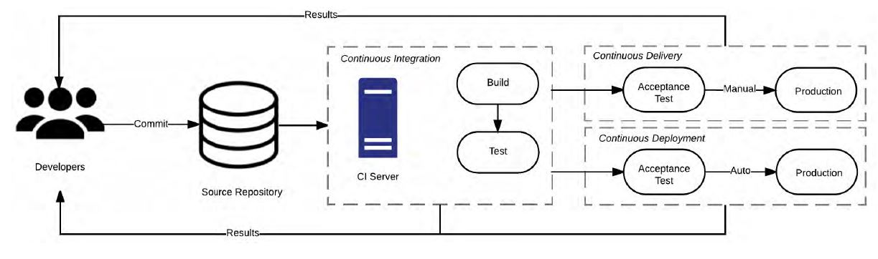
Relationship between CI, CDE and CD
Introduction
CSE
The Stairway to Haven
Deployment Pipeline
Challenges
Summary

Slide 7
Introduction
CSE
The Stairway to Haven
Deployment Pipeline
Challenges
Summary

Slide 8
Introduction
CSE
The Stairway to Haven
Deployment Pipeline
Challenges
Summary

Slide 9
Introduction
CSE
The Stairway to Haven
Deployment Pipeline
Challenges
Summary

Slide 10
Introduction
CSE
The Stairway to Haven
Deployment Pipeline
Challenges
Summary

Slide 11
Introduction
CSE
The Stairway to Haven
Deployment Pipeline
Challenges
Summary

Slide 12
Introduction
CSE
The Stairway to Haven
Deployment Pipeline
Challenges
Summary

Slide 13
Introduction
CSE
The Stairway to Haven
Deployment Pipeline
Challenges
Summary

Slide 14
Introduction
CSE
The Stairway to Haven
Deployment Pipeline
Challenges
Summary

Slide 15
Introduction
CSE
The Stairway to Haven
Deployment Pipeline
Challenges
Summary

Slide 16
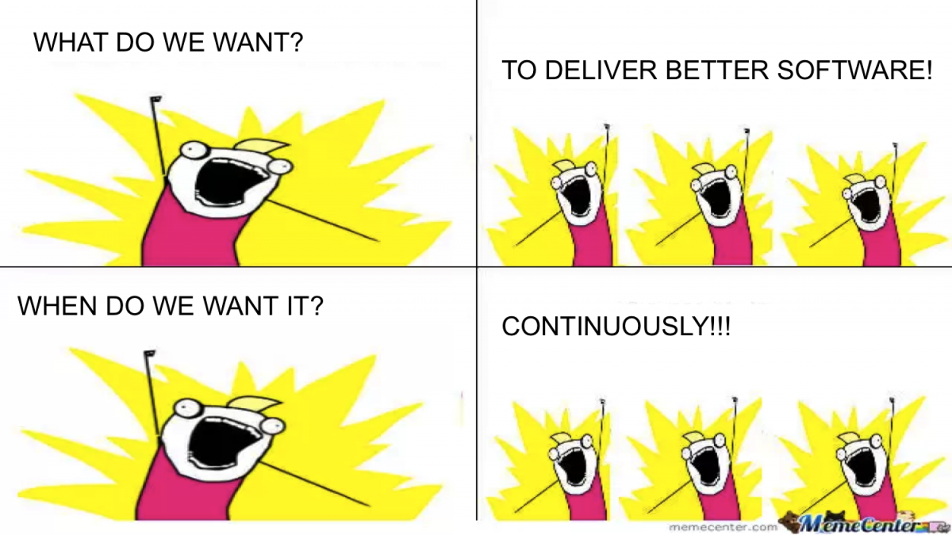
Introduction
CSE
The Stairway to Haven
Deployment Pipeline
Challenges
Summary

