Slide 1
From Traditional Development to Continuous Deployment: Strategies and practices in CI/CD Pipelines

Slide 2
Introduction
CSE
The Stairway to Haven
Deployment Pipeline
Challenges
Summary

Slide 3
Introduction
CSE
The Stairway to Haven
Deployment Pipeline
Challenges
Summary

Slide 4
Introduction
CSE
The Stairway to Haven
Deployment Pipeline
Challenges
Summary

Slide 5
Introduction
CSE
The Stairway to Haven
Deployment Pipeline
Challenges
Summary

Slide 6
Introduction
CSE
The Stairway to Haven
Deployment Pipeline
Challenges
Summary

Slide 7
Introduction
CSE
The Stairway to Haven
Deployment Pipeline
Challenges
Summary

Slide 8
Introduction
CSE
The Stairway to Haven
Deployment Pipeline
Challenges
Summary

Slide 9
Introduction
CSE
The Stairway to Haven
Deployment Pipeline
Challenges
Summary

Slide 10
Introduction
CSE
The Stairway to Haven
Deployment Pipeline
Challenges
Summary

Slide 11
Introduction
CSE
The Stairway to Haven
Deployment Pipeline
Challenges
Summary

Slide 12
Introduction
CSE
The Stairway to Haven
Deployment Pipeline
Challenges
Summary

Slide 13
Introduction
CSE
The Stairway to Haven
Deployment Pipeline
Challenges
Summary

Slide 14
Introduction
CSE
The Stairway to Haven
Deployment Pipeline
Challenges
Summary

Slide 15
Introduction
CSE
The Stairway to Haven
Deployment Pipeline
Challenges
Summary

Slide 16
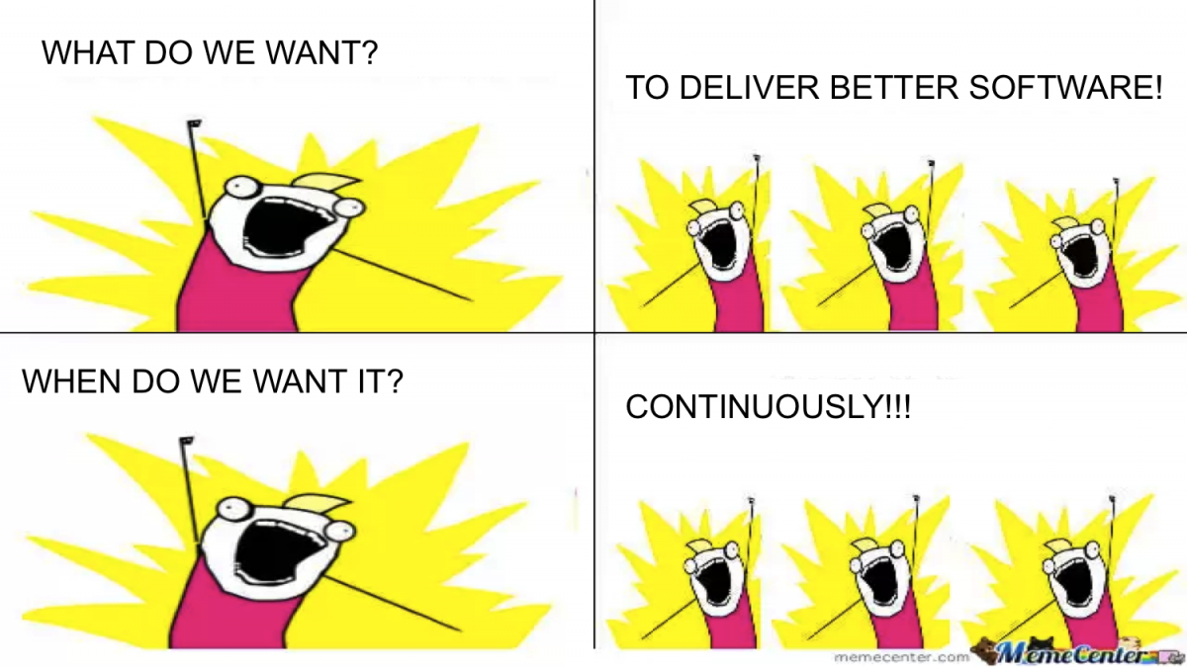
Introduction
CSE
The Stairway to Haven
Deployment Pipeline
Challenges
Summary

