Slide 1
From Traditional Development to Continuous Deployment: Strategies and practices in CI/CD Pipelines

Slide 2
Continuous Software Engineering (CSE)
Software development strategy to deliver software more frequently
Practices:
Continuous Integration (CI)
Continuous Delivery (CDE)
Continuous Deployment (CD)
Benefits:
Reduced time-to-market
Quick user feedback
Challenges:
Organizational, social, technical, architectural challenges
Introduction
CSE
The Stairway to Heaven
Deployment Pipeline
Challenges
Conclusion

Slide 3
Continuous Integration (CI)
Frequent integration of code into a shared repository
Automated builds and tests (Unit tests, regression tests)
Code Management and Analysis
Test coverage
Coding standards (comments, alignment)
Benefits:
Effective software development process
Improved software quality
Software is always in a ready to deploy state
Introduction
CSE
The Stairway to Heaven
Deployment Pipeline
Challenges
Conclusion

Slide 4
Continuous Delivery (CDE)
Automatic software deployment and delivery
Pull-based approach
Integration, acceptance and performance tests possible
Benefits:
Automatic release process reduces risks
Learning from real usage data
Building the right product
Introduction
CSE
The Stairway to Heaven
Deployment Pipeline
Challenges
Conclusion

Slide 5
Continuous Deployment (CD)
Extreme version of Continuous Delivery
Push-based approach: Software is released automatically
Core of CDE and CD is a (fully) automated deployment pipeline
Benefits:
No manual tasks
Accelerated time to market
Improved customer satisfaction
Introduction
CSE
The Stairway to Heaven
Deployment Pipeline
Challenges
Conclusion

Slide 6
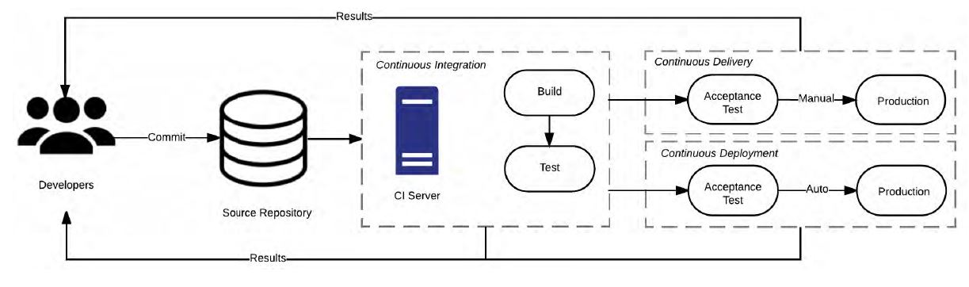
Relationship between CI, CDE and CD
Introduction
CSE
The Stairway to Heaven
Deployment Pipeline
Challenges
Conclusion

Slide 7
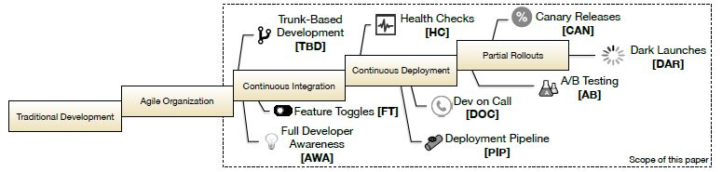
The Stairway To Heaven
Introduction
CSE
The Stairway to Heaven
Deployment Pipeline
Challenges
Conclusion

Slide 8
An exemplary deployment pipeline
Version Control System
Code Management and Analysis
Build System
CI Server
Testing
Configuration and Provisioning
CD Server
Introduction
CSE
The Stairway to Heaven
Deployment Pipeline
Challenges
Conclusion

Slide 9
Challenges for adopting Continuous Practices
Organizational Challenges
Team Structure and poor collaboration
Technical Challenges
Lack of tools
Social Challenges
Resistance to change and lack of motivation
Architectural Challenges
Highly coupled and large monolithic applications are not compatible with CSE practices
Introduction
CSE
The Stairway to Heaven
Deployment Pipeline
Challenges
Conclusion

Slide 10
Conclusion
CSE comes with benefits and challenges
Current papers mainly focus on challenges and mitigation strategies
No universally accepted definitions
Little research on how to better introduce CI,CDE and CD
Few information about implementation details of CD Pipelines
BUT:
CSE receive more and more attraction in all organization types
It might revolutionize software engineering
Introduction
CSE
The Stairway to Heaven
Deployment Pipeline
Challenges
Conclusion
Notes:
CSE changes the way of software development and deployment
Moving an application to CD is challenging
Benefits are immense
No out of the box solutions

Slide 11
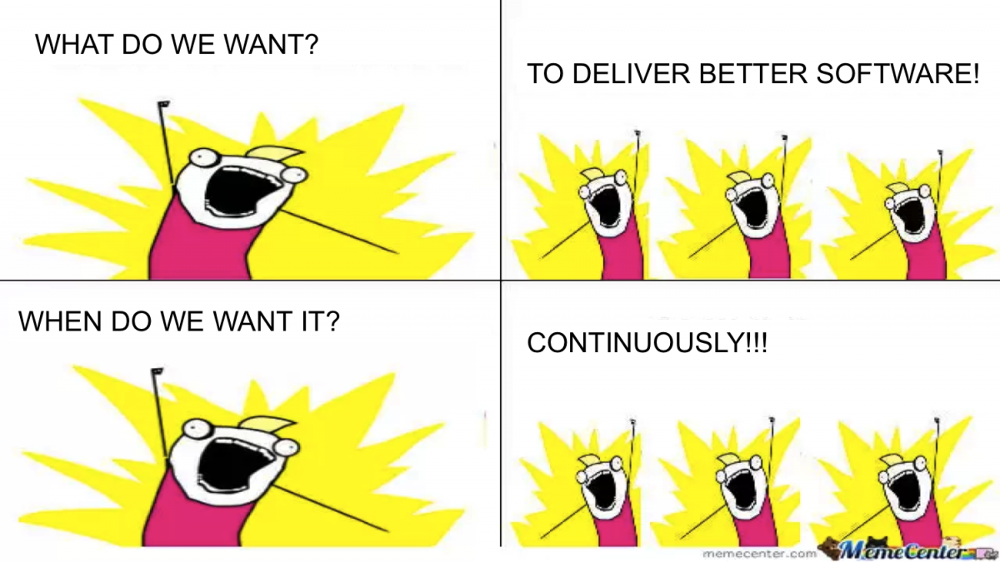
Introduction
CSE
The Stairway to Haven
Deployment Pipeline
Challenges
Summary

Slide 12
References
L. Bass, I. Weber and L. Zhu, DevOps: A Software Architect's Perspective, 1st edition
L. Chen, Continuous Delivery: Huge Benefits, but Challenges Too, IEEE 2015
H. Olsson, H. Alahyari and J. Bosch, Climbing the "Stairway to Heaven": A multiple-case study exploring barriers in the transition from agile development towards continuous deployment of software, IEEE 2012
L. Chen, Towards Architecting for Continuous Delivery, IEEE 2015
M. Shahin, M. Babar and L. Zhu, The Intersection of Continuous Deployment and Architecting Process: Practitioners’ Perspectives, ACM 2016
G. Claps, R. Svensson, A. Aurum On the journey to continuous deployment: Technical and social challenges along the way, Elsevier 2014
M. Shahin, M. Babar and L. Zhu, Continuous Integration, Delivery and Deployment: A Systematic Review on Approaches, Tools, Challenges and Practices, IEEE 2017
E. Laukkanen, T. Lehtinen and J. Itkonen, Bottom-up Adoption of Continuous Delivery in a
Stage-Gate Managed Software Organization, ACM 2016
M. Shahin, M. Babar and L. Zhu, Beyond Continuous Delivery: An Empirical Investigation of Continuous Deployment Challenges, Research Gate 2017
G. Schermann, K. Cito, P. Leitner, U. Zdun, and H. Gall, An Empirical Study on Principles and Practices of Continuous Delivery and Deployment
S. Taheritanjani, S. Krusche, B. Bruegge, A Comparison between Commercial and Open Source Reference Implementations for the Rugby Process Model, TUM
Introduction
CSE
The Stairway to Heaven
Deployment Pipeline
Challenges
Conclusion

