Slide 1
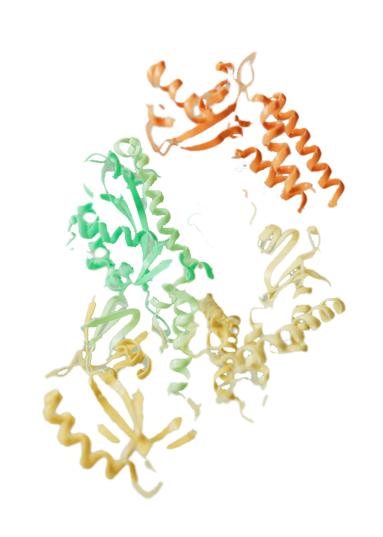
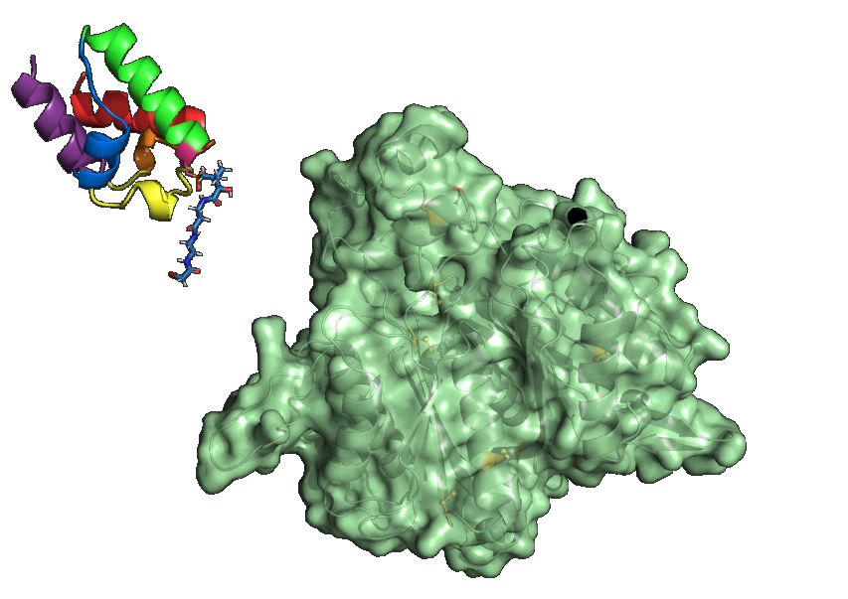



Derivatised pantetheine probes to reveal protein structure and function
Benjamin Kelly
Supervisors: xxx, xxx
Date

Slide 2
Outline
Introduction
Previous applications of this methodology
Synthesis of the bromoacetamide probe
Protein cross-linking reaction trials
Future work

Slide 3
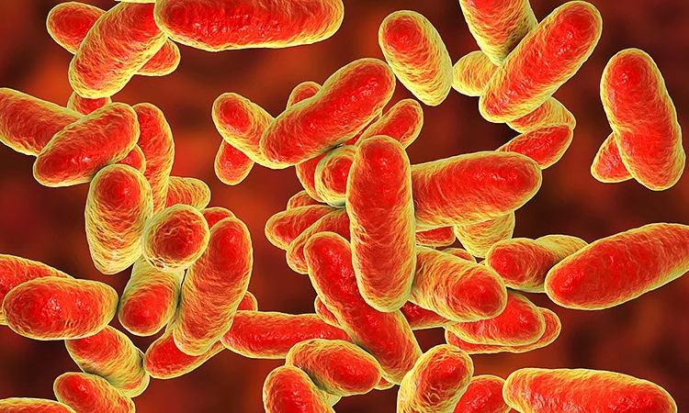
Antibiotic resistance
A recent review (2017-2020) of newly approved and in-pipeline phase III antibiotics reveals the compounds mainly used for treating skin infections and acquired bacterial pneumonia.
Most of these new marketed antibiotics were found to be analogues of pre-existing antimicrobial agents, many show limited effectiveness against high priority organisms identified by the WHO.
Al-Tawfiq, J. A.; Momattin, H.; Al-Ali, A. Y.; Eljaaly, K.; Tirupathi, R.; Haradwala, M. B.; Areti, S.; Alhumaid, S.; Rabaan, A. A.; Al Mutair, A.; Schlagenhauf, P. Antibiotics in the Pipeline: A Literature Review (2017–2020). Infection 2022, 50 (3), 553–564. https://doi.org/10.1007/s15010-021-01709-3.
1

Slide 4
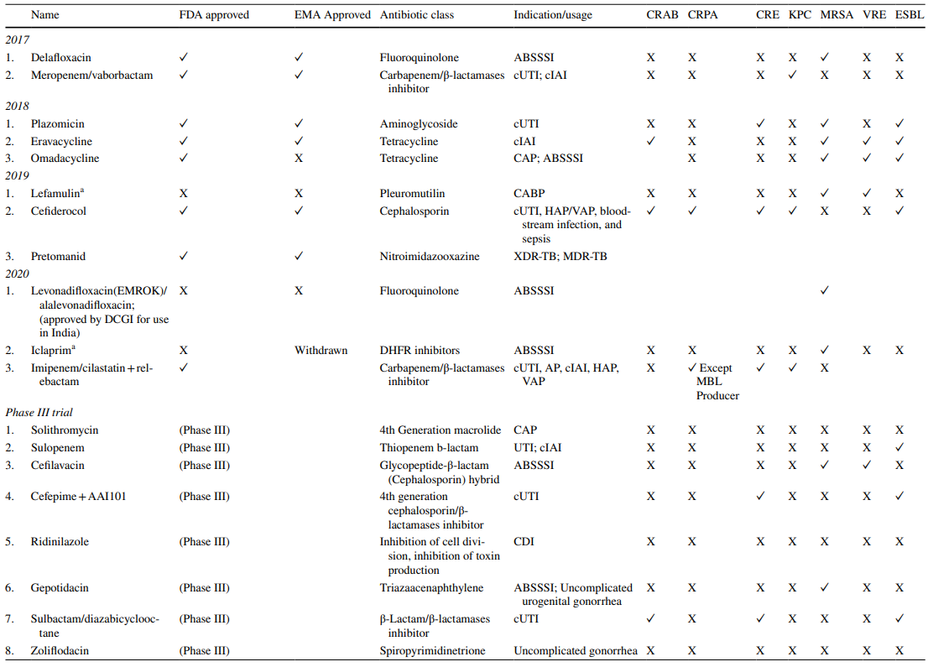
2
Notes:
CRAB: carbapenem-resistant Acinetobacter baumannii; CRPA: carbapenem-resistant Pseudomonas aeruginosa; CRE: carbapenem-resistant Enterobacteriaceae; KPC: Klebsiella pneumoniae carbapenemase; MRSA, methicillin-resistant Staphylococcus aureus; VRE, vancomycin-resistant enterococcus; ESBL, extended-spectrum beta-lactamases; ABSSSI, acute bacterial skin and skin structure infections; cUTI, complicated urinary-tract infections; cIAI, complicated intra-abdominal infections; CAP, community-acquired pneumonia; CABP, community-acquired bacterial pneumonia; HAP/VAP, hospital-acquired pneumonia (nosocomial pneumonia) and ventilator-associated pneumonia; XDR-TB, extensively drug-resistant tuberculosis; MDR-TB, multi-drugresistant tuberculosis; CDI, Clostridium difcile infection

Slide 5
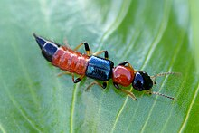
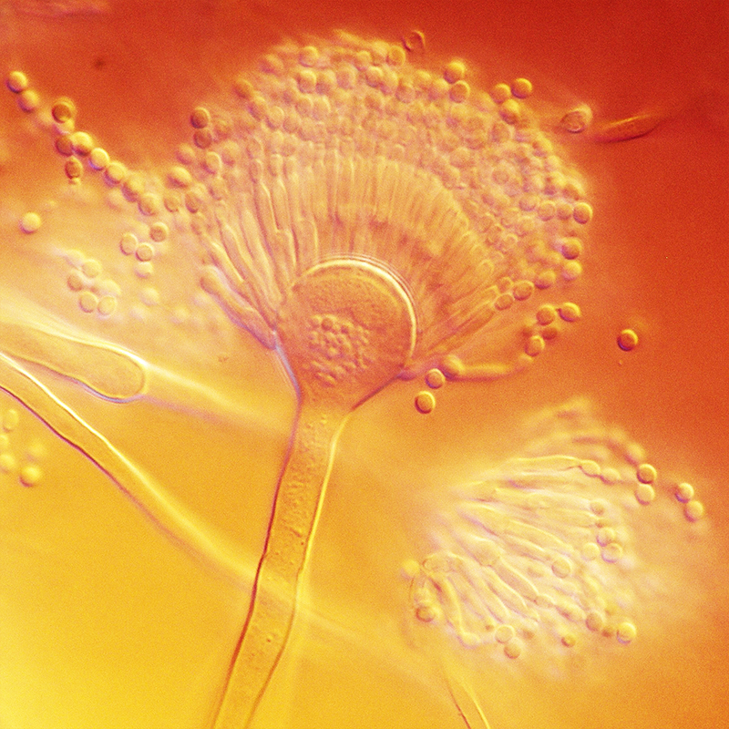
Polyketides
3

Slide 6
Polyketide biosynthesis
4

Slide 7
Polyketide biosynthesis
5

Slide 8
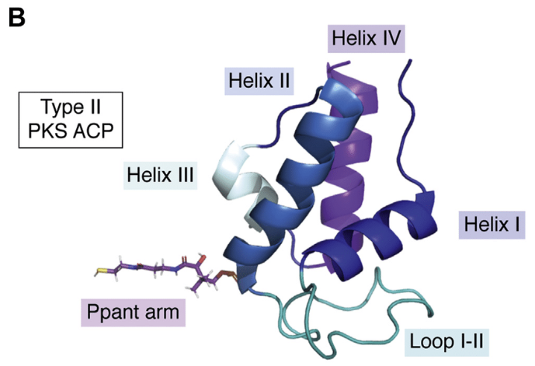
Acyl carrier proteins
Through these molecular level features, ACPs are capable of controlling the order and timing of many chemical steps to assemble complex polyketide products.
The ACP can be thought of an intelligent chip – recognising key enzymatic partners and adapting their molecular recognition features depending on the specific chemical cargo the ACP is transporting.
Characteristic 4-fold α-helical bundle proteins containing a conserved serine residue.
Pantetheine
holo-actinorhodin ACP (pdb code: 2K0X). (Adapted from: A. Sulpizio, C. E. W. Crawford, R. S. Koweek and L. K. Charkoudian, J. Biol. Chem., 2021, 296, 100-158).
6

Slide 9
Crypto-ACPs
Gaining insights into how ACPs function on a molecular level is challenging.
A methodology to overcome the limitations of probing ACP-protein interactions in the native state was first implemented by Michael Burkart in 2006, utilising derivatised pantetheine prosthetic groups.
Worthington, A. S.; Rivera, H. Jr.; Torpey, J. W.; Alexander, M. D.; Burkart, M. D. Mechanism-Based Protein Cross-Linking Probes To Investigate Carrier Protein-Mediated Biosynthesis. ACS Chem. Biol. 2006, 1 (11), 687–691. https://doi.org/10.1021/cb6003965.
7

Slide 10
Crypto-ACPs
8

Slide 11
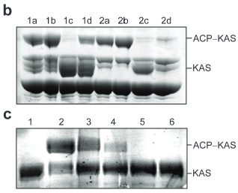
Crypto-ACPs
Cross-linking of E. Coli Fatty Acid Synthase enzymes – focusing on elongating KSs: KASI, KASII perform decarboxylative Claisen condensations with ACP-bound substrates.
KAS I
KAS II
C – Cross-linking between a range of ACPs with KAS I
1 – No ACP; 2 – E. coli ACP; 3 - FrenACP; 4 – OtcACP; 5 – EntB; 6 – VibB
(3&4 Type II PKS ACPs; 5&6; NRPS ACPs)
Worthington, A. S.; Rivera, H. Jr.; Torpey, J. W.; Alexander, M. D.; Burkart, M. D. Mechanism-Based Protein Cross-Linking Probes To Investigate Carrier Protein-Mediated Biosynthesis. ACS Chem. Biol. 2006, 1 (11), 687–691. https://doi.org/10.1021/cb6003965.
9

Slide 12
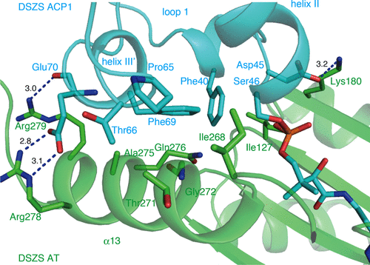
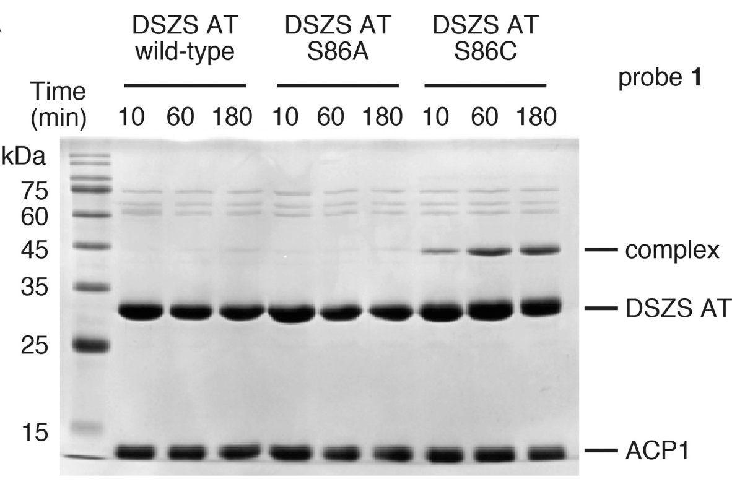

Crypto-ACPs
A similar approach was also adopted by Miyanaga et al. in 2018, utilising a bromoacetamide pantetheine probe to form a AT-ACP complex from the disorazole PKS.
Bromoacetamide
Chloroacetamide
Miyanaga, A.; Ouchi, R.; Ishikawa, F.; Goto, E.; Tanabe, G.; Kudo, F.; Eguchi, T. Structural Basis of Protein–Protein Interactions between a Trans-Acting Acyltransferase and Acyl Carrier Protein in Polyketide Disorazole Biosynthesis. J. Am. Chem. Soc. 2018, 140 (25), 7970–7978. https://doi.org/10.1021/jacs.8b04162
10

Slide 13
Bromoacetamide synthesis
11

Slide 14
Bromoacetamide synthesis
12

Slide 15
Generation of crypto-ACPs
Upgrades
Component | Stock conc. / µM | Desired conc. / µM | Vol to add / µL
Apo-ACP | 120 | 100 | 84.0
CoA | 33 | 1 | 4.0
MupN | 20 | 10 | 10.0
MgSO₄ | 1x10⁶ | 10000 | 1.0
Probe | 1x10⁵ | 1000 | 1.0
ATP | 1x10⁵ | 1000 | 1.0
 |  |  | 101.0
13

Slide 16
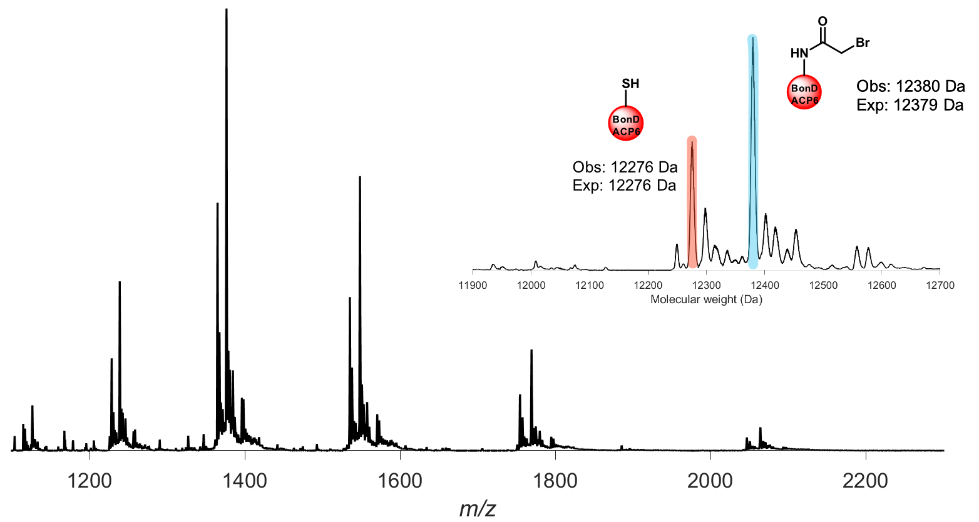
crypto-ACPs
BonD_ACP6
1 hour
Room temperature
14

Slide 17
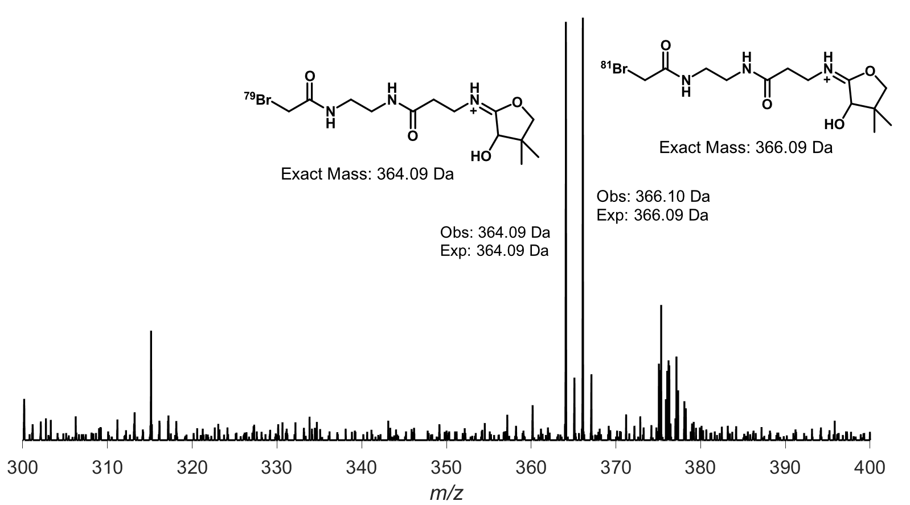
crypto-ACPs
BonD_ACP6
Ppant-ejection
Assay
15

Slide 18
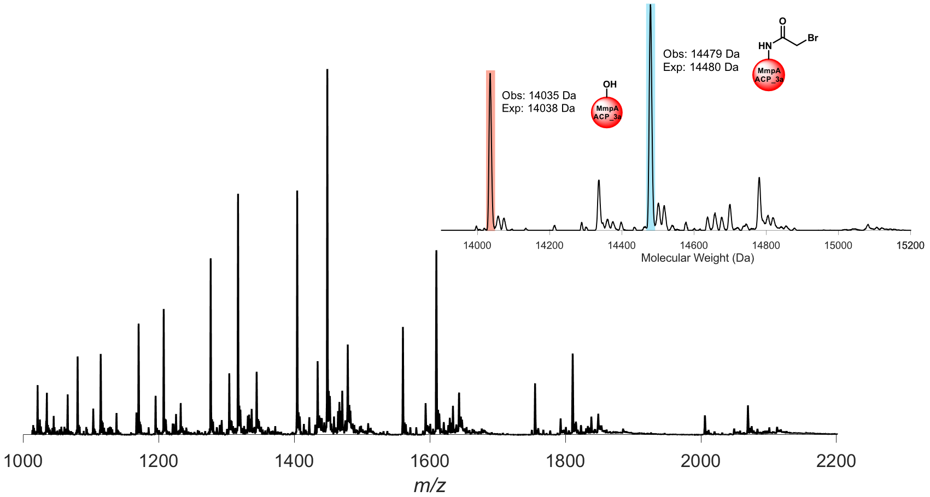
crypto-ACPs
MmpA_ACP_3a
Ppant-ejection
Assay
16

Slide 19
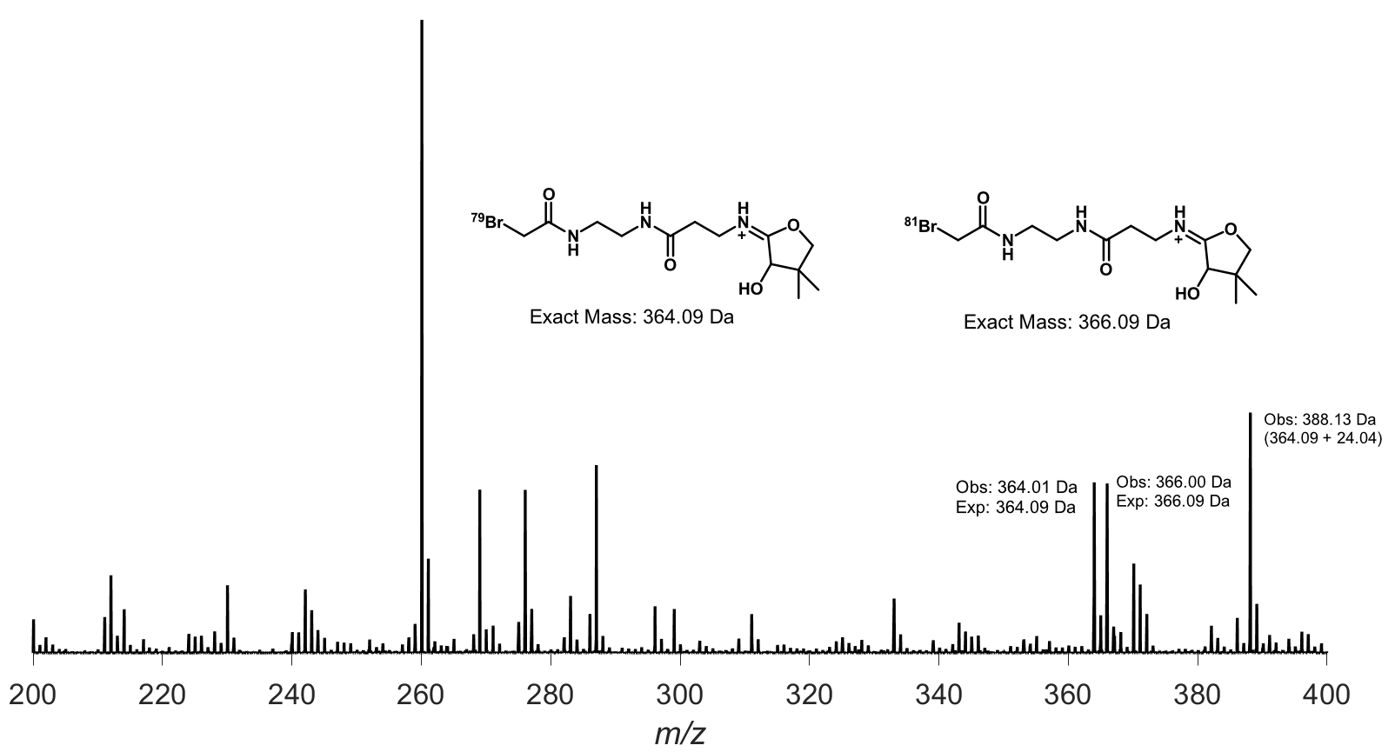
crypto-ACPs
MmpA_ACP_3a
1 hour
Room temperature
40% apo
60% crypto
17

Slide 20
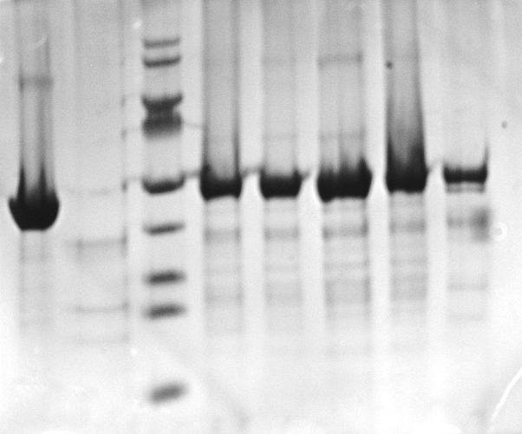
SDS-PAGE Cross-linking
BonD_ACP6-BonD_KS⁰_SxC cross-linking trial
crypto-ACP
Marker
60 min
240 min
120 min
180 min
20 hr
KS⁰
Size / kDa
180
SDS-PAGE gel protocol as reported in the Miyanaga paper.
Noticeable mass increase.
Cross-linking has likely occurred – to be repeated.
130
100
70
55
40
35
25
15
18

Slide 21
Expression and purification of BonD_KS⁰
Growth and Purification of BonD_KS⁰_WT
SEC
SEC
IMAC FT
IMAC
SEC
Marker
Son Lysate
Son Pellet
Size / kDa
70
BonD_KS⁰_WT contains an active site serine residue → ideally, no cross-linking should be observed with cp-ACPs
55
40
35
25
15
10
SDS-PAGE
BonD_KS⁰_WT_Purification (~8 mg/mL)
19

Slide 22
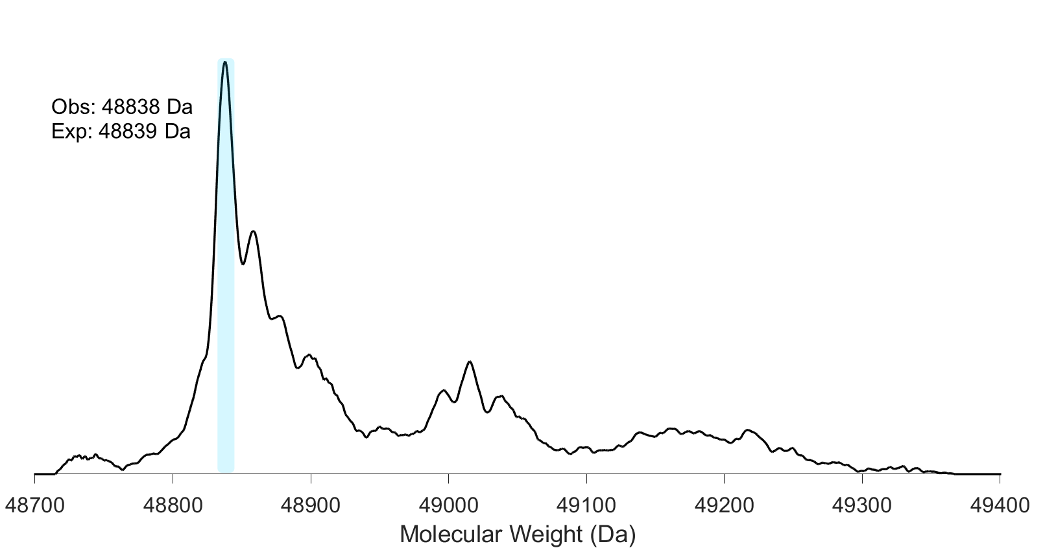
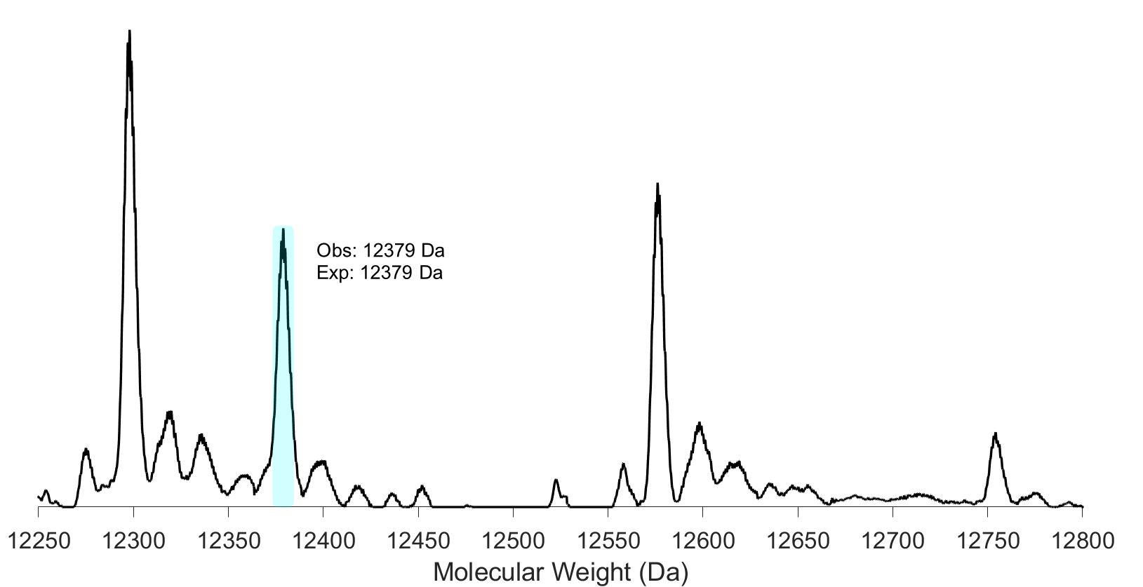
Cross-linking reaction with WT KS⁰
BonD_ACP6 -BonD_KS⁰_WT cross-linking trial
20

Slide 23
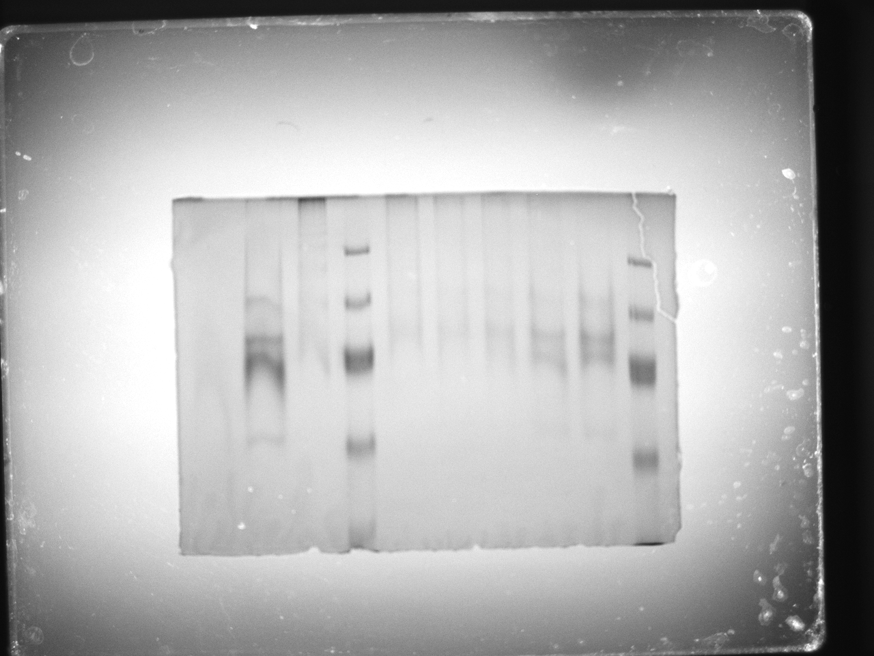
Native gel trials
MmpA_ACP3a-MmpE_M214A_KS⁰ cross-linking trial
crypt-MmpA_ACP3a
crypto-ACP:KS (x:1)
apo-MmpA_ACP3a
MmpE_M214A_KS
Marker
0.125
0.25
0.5
1
2
Marker
Size / kDa
Attempts to work on native gel protocol yielded poor quality gels.
180
130
~70
~10
21

Slide 24
MmpA_ACP3a-MmpE_M214A_KS⁰ cross-linking trial
18-hours
Room temperature
2:1 ACP:KS ratio
22

Slide 25
^{Short-term future work}
Repeat SDS-PAGE results (potentially try using commercial SDS gels)
Acquire MS data for BonD_ACP6-BonD_KS⁰_SxC
23

Slide 26
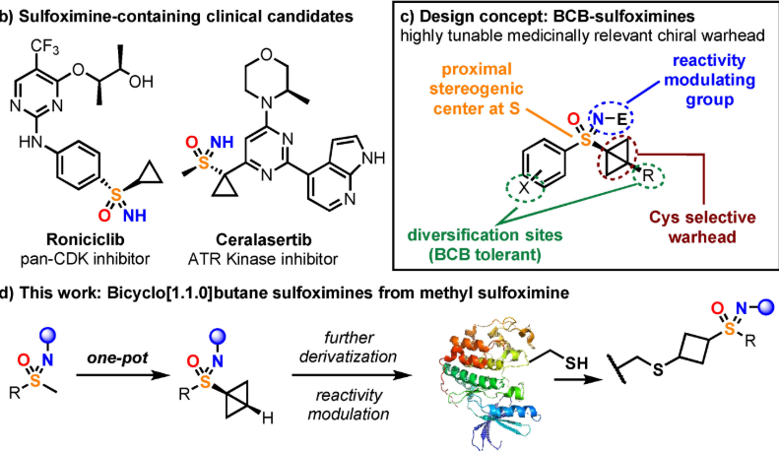
Future work: BCB-sulfoximine probe idea
Z. Zhong, B. J. W. Hocking, C. P. Brown, T.-K. Ma, A. J. P. White, D. J. Mann, A. Armstrong and J. A. Bull, Angew. Chem. Int. Ed., n/a, e202420028.
24

Slide 27
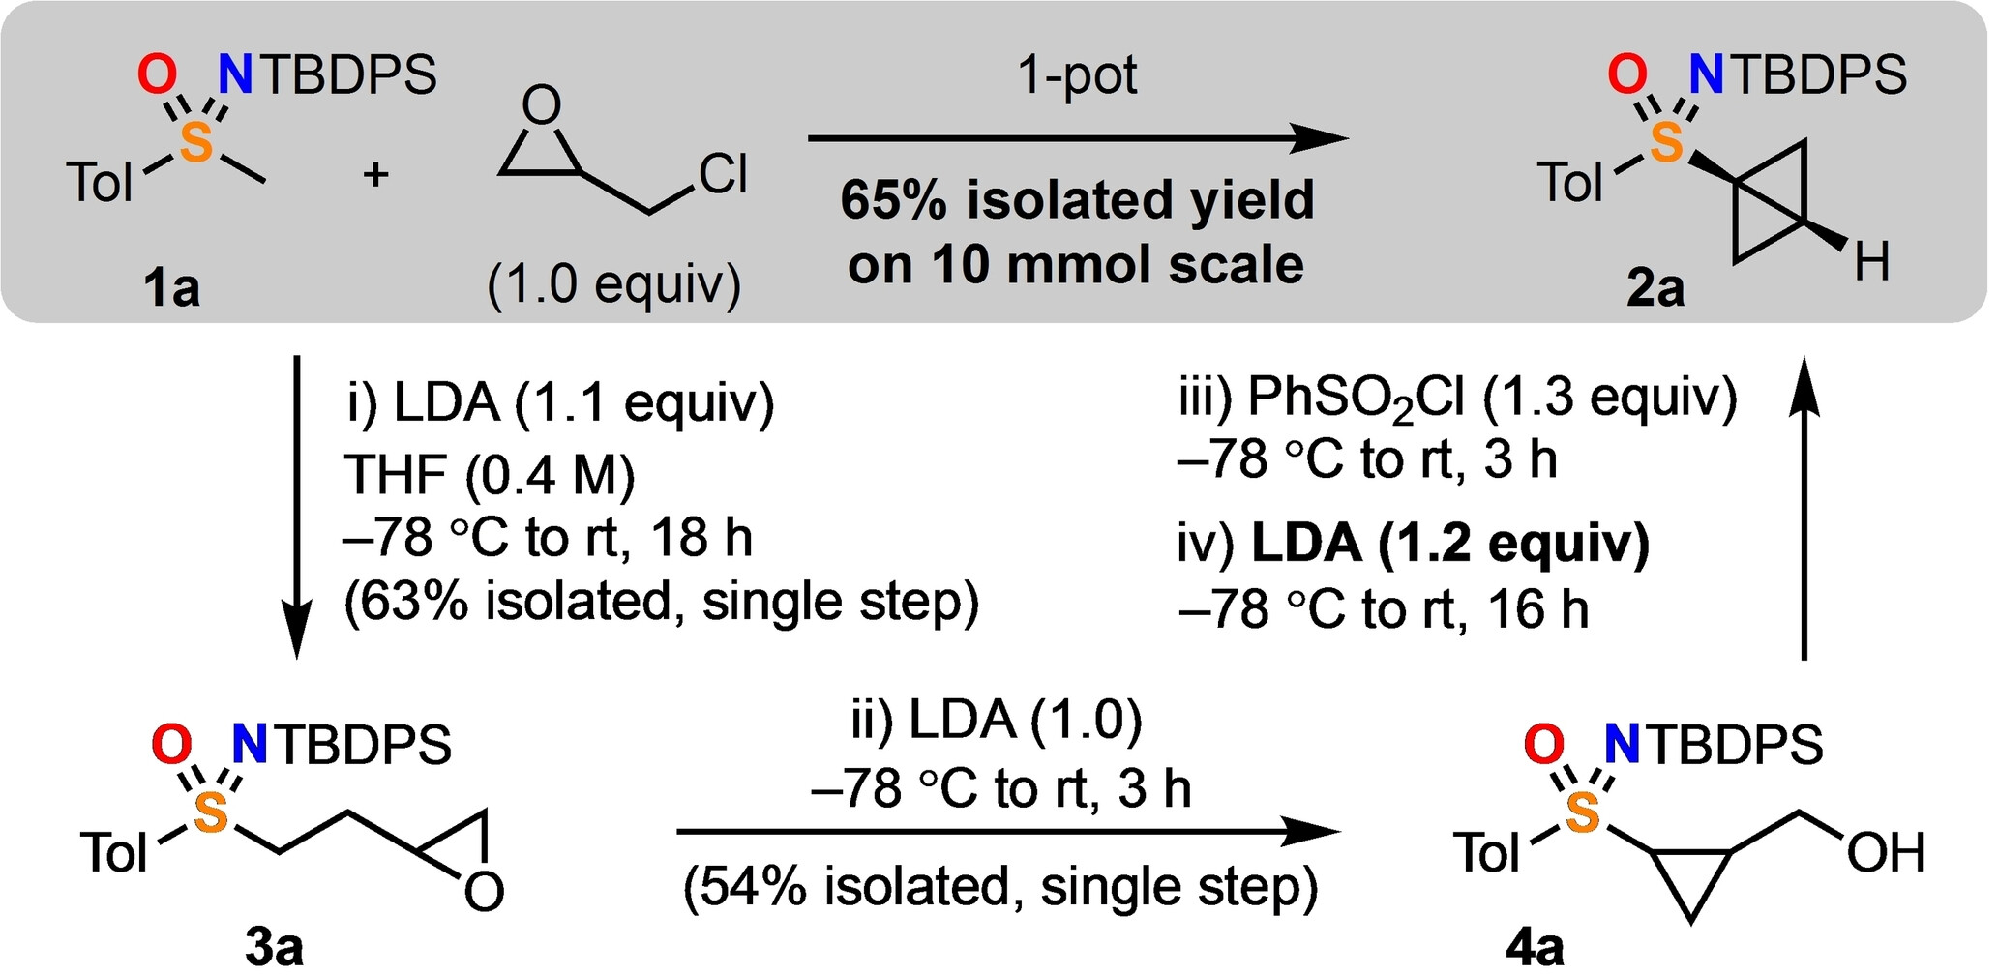
Future work: BCB-sulfoximine probe idea
Z. Zhong, B. J. W. Hocking, C. P. Brown, T.-K. Ma, A. J. P. White, D. J. Mann, A. Armstrong and J. A. Bull, Angew. Chem. Int. Ed., n/a, e202420028.
25

Slide 28
Future work: BCB-sulfoximine probe idea
26

Slide 29
Future work: BCB-sulfoximine probe idea
27

Slide 30


Acknowledgements
xxx

