Slide 1
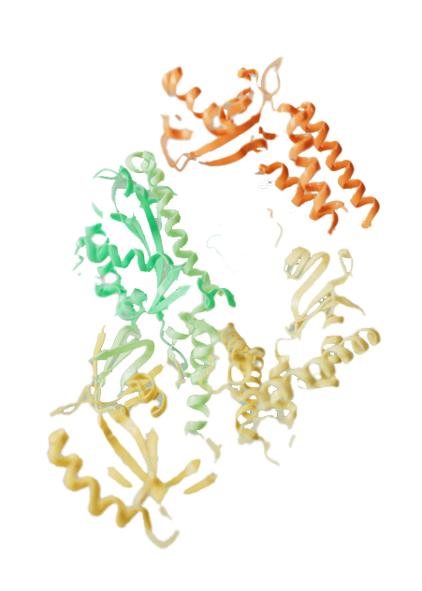



Chemical probes to reveal protein structure and function: Applications in Antibiotic research
TECS CDT Summer Conference
Date: xxx
Benjamin Kelly
Supervisors: xxx, xxx

Slide 2
Purpose
1

Slide 3
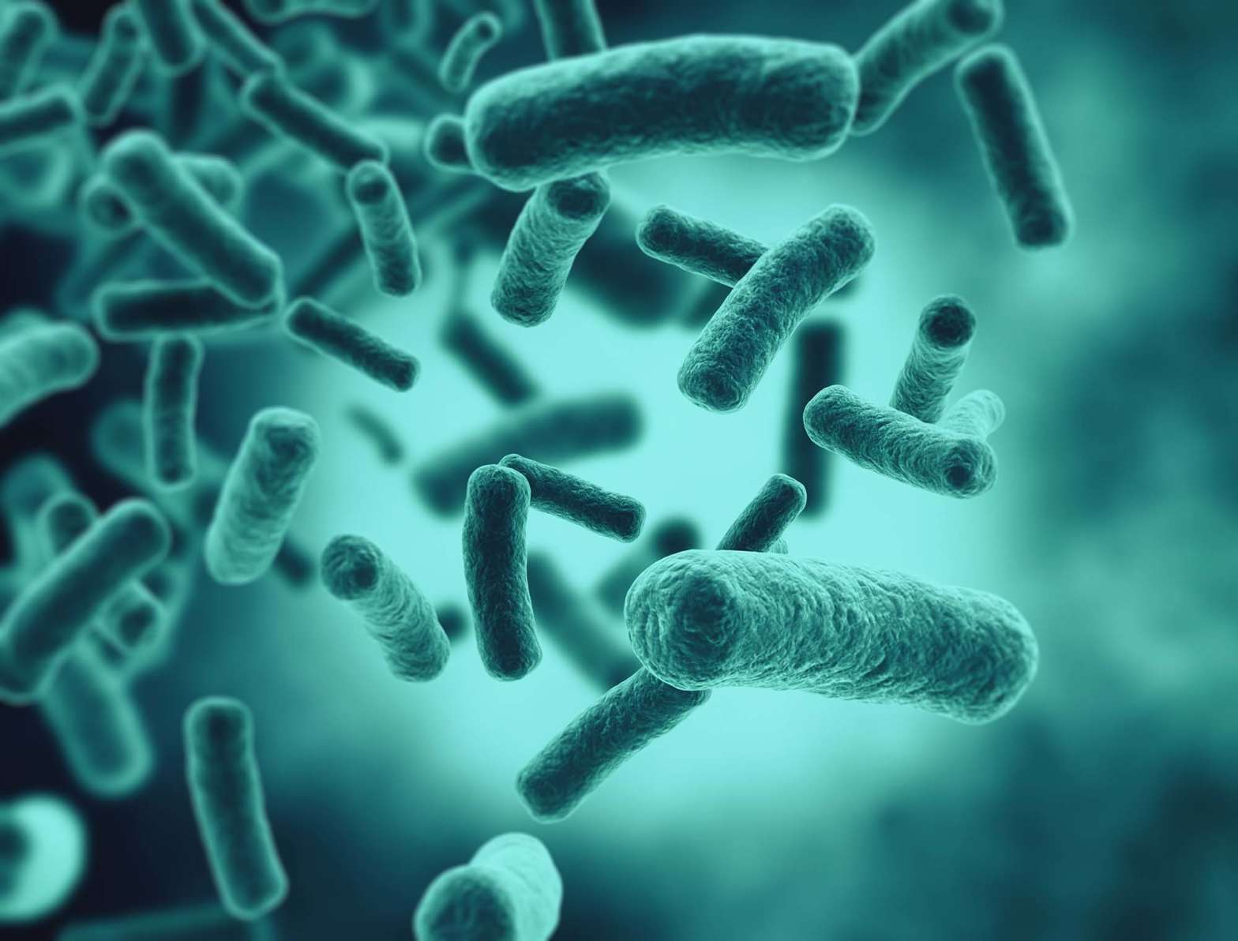
Misuse and over-reliance on antimicrobials in humans, animals and plants has led to the development of drug-resistant pathogens.
2

Slide 4
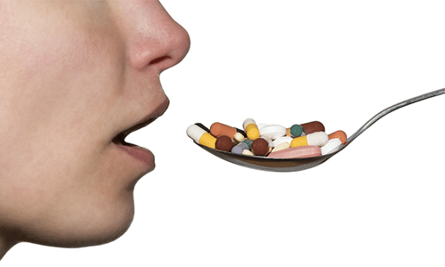
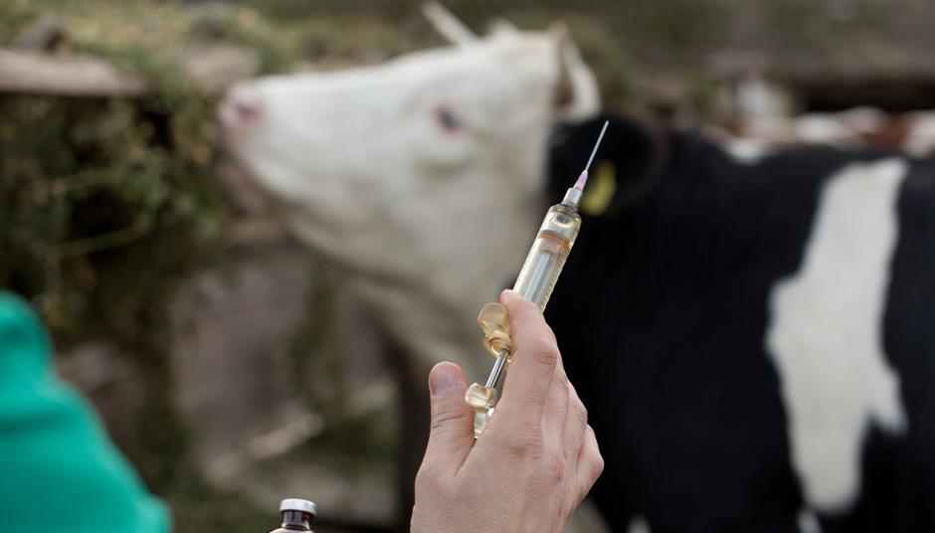
Antimicrobial resistance (AMR) is one of the most pressing global health threats. It is estimated that bacterial AMR contributed to 4.95 million deaths (WHO, 2019)
Antimicrobial resistance. https://www.who.int/news-room/fact-sheets/detail/antimicrobial-resistance (accessed 2024-06-26).
3

Slide 5

AMR also incurs significant economic losses, projections from the World Bank estimate US$1 trillion in additional healthcare costs by 2050.
Antimicrobial resistance. https://www.who.int/news-room/fact-sheets/detail/antimicrobial-resistance (accessed 2024-06-26).
4

Slide 6
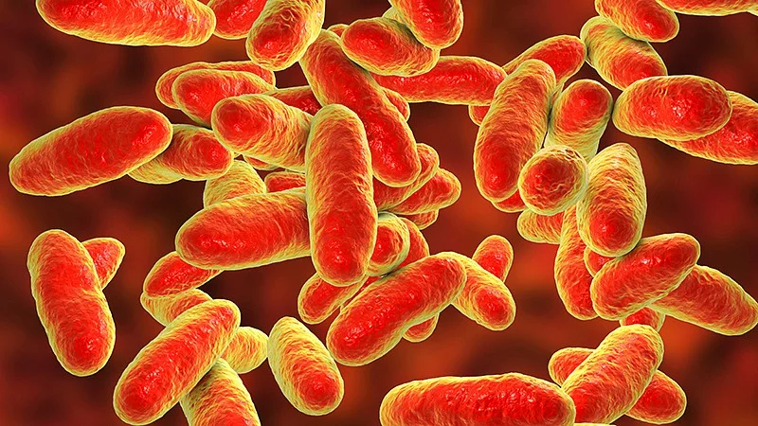
Urgent need to tackle the antibiotic pipeline crisis
Inadequate volume of research into targeting the next class of antibiotics
A recent review (2017-2020) of newly approved and in-pipeline phase III antibiotics reveals the compounds are mainly for treating skin infections and acquired bacterial pneumonia.
Most of these new marketed antibiotics were found to be analogues of pre-existing antimicrobial agents, most showing little effectiveness against high priority organisms.
Al-Tawfiq, J. A.; Momattin, H.; Al-Ali, A. Y.; Eljaaly, K.; Tirupathi, R.; Haradwala, M. B.; Areti, S.; Alhumaid, S.; Rabaan, A. A.; Al Mutair, A.; Schlagenhauf, P. Antibiotics in the Pipeline: A Literature Review (2017–2020). Infection 2022, 50 (3), 553–564. https://doi.org/10.1007/s15010-021-01709-3.
5

Slide 7




Turning to nature
Polyketide biosynthesis
Acyl Carrier Proteins
Crypto-ACPs
Introduction to biosynthesis
6

Slide 8
Turning to nature
Polyketide biosynthesis
Acyl Carrier Proteins
Crypto-ACPs
6

Slide 9
Turning to nature
Polyketide biosynthesis
Acyl Carrier Proteins
Crypto-ACPs
A polyketide natural product consisting of a mixture of pseudomonic acids. Potent antibiotic activity against MRSA, though limited to topical administration. Isolated from Pseudomonas fluorescens (soil bacterium).
6

Slide 10
Turning to nature
Polyketide biosynthesis
Acyl Carrier Proteins
Crypto-ACPs
Assembled by large, multi-modular polypeptides known as polyketide synthases (PKSs).
These systems contain a variety of enzymatic domains which elongate and functionalise growing polyketide chains.
6

Slide 11
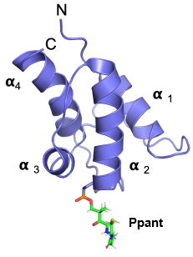
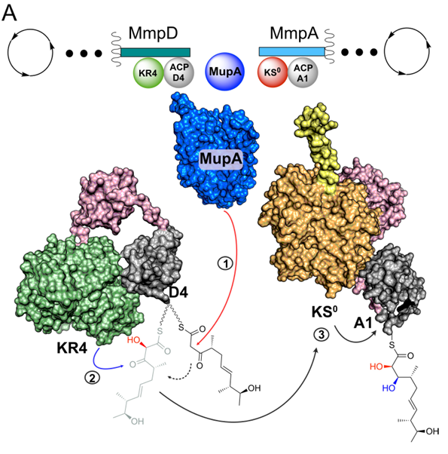
Turning to nature
Polyketide biosynthesis
Acyl Carrier Proteins
Crypto-ACPs
Characteristic 4-fold α-helical bundle with a conserved serine residue.
Phosphopantetheine prosthetic arm converts ACP to its holo-form.
6

Slide 12
Turning to nature
Polyketide biosynthesis
Acyl Carrier Proteins
Crypto-ACPs
First utilised by the Burkhart group (2006).
Pantetheine linker arms with electrophilic warheads are installed onto apo-ACPs → crypto-ACPs.
Worthington, A. S.; Rivera, H. Jr.; Torpey, J. W.; Alexander, M. D.; Burkart, M. D. Mechanism-Based Protein Cross-Linking Probes To Investigate Carrier Protein-Mediated Biosynthesis. ACS Chem. Biol. 2006, 1 (11), 687–691. https://doi.org/10.1021/cb6003965.
6

Slide 13
Turning to nature
Polyketide biosynthesis
Acyl Carrier Proteins
Crypto-ACPs
6

Slide 14
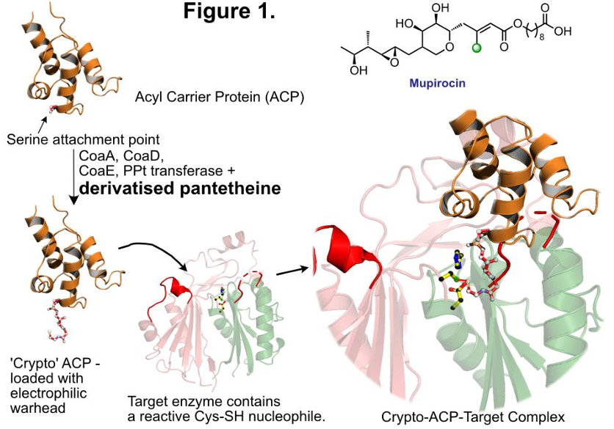
Proposed workflow
Why take this approach?
Covalently linked complex overcomes transient ACP-protein interactions → protein structural studies
Underutilised strategy
Interdisciplinary project → streamline progress
7

Slide 15
Current plans
Synthesis of a variety of derivatised pantetheine linker arms
Chloroacrylamides (originally reported by the Burkhart group, 2006)
Haloacetimides (reported by Miyanaga group, 2018)
Synthesis currently in progress
Miyanaga, A.; Ouchi, R.; Ishikawa, F.; Goto, E.; Tanabe, G.; Kudo, F.; Eguchi, T. Structural Basis of Protein–Protein Interactions between a Trans-Acting Acyltransferase and Acyl Carrier Protein in Polyketide Disorazole Biosynthesis. J. Am. Chem. Soc. 2018, 140 (25), 7970–7978. https://doi.org/10.1021/jacs.8b04162
8

Slide 16
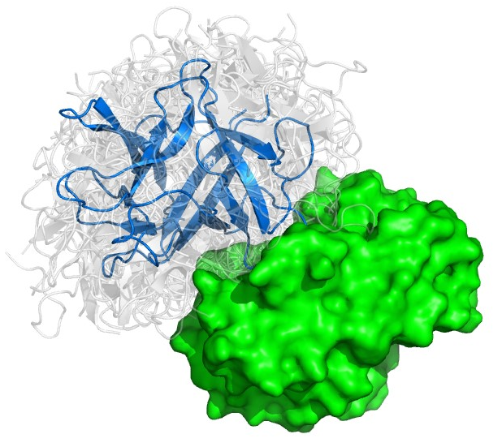
Upgrade linkers onto apo-ACPs to form crypto-ACPs → assays with target proteins to establish ACP-protein structure-function relationships
Initially, this strategy will be employed on the mupirocin biosynthetic pathway, though could be applied to other polyketide systems (leinamycin, kalimantacin etc.)
9

Slide 17

Acknowledgements

Slide 18
Chloroacrylamide synthesis

Slide 19
CBTF reagents?
Reported in 2015 in the context of antibody conjugates
Bioconjugate Chem. 2015, 26, 197–200

Slide 20
Vinyl-heteroarenes
Vinyl-heteroarenes, particularly –pyrimidines and –triazines show selective and fast addition to proteinogenic cysteine residues.
Seki, H.; J. Walsh, S.; D. Bargh, J.; S. Parker, J.; Carroll, J.; R. Spring, D. Rapid and Robust Cysteine Bioconjugation with Vinylheteroarenes. Chem. Sci. 2021, 12 (26), 9060–9068. https://doi.org/10.1039/D1SC02722K.

