Slide 1
Intro to SQL: Kickstarter Project

Slide 2
Goals
Pull data that will help understand what might influence the success of a Kickstarter campaign.
The data source is a selection of fields from Kaggle.
Specifically:
Indicators of projects that are likely to fail

Slide 3
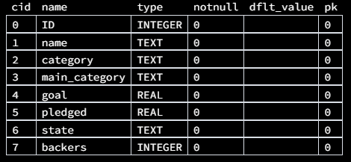
Database
Contains one table ‘ksprojects’
Fields:
ID: Kickstarter project ID
name: Name of project
category: Category of project
main_category: Main category of project
goal: Fundraising goal
pledged: Amount pledged
state: State of project (successful, cancelled, etc.)
backers: Number of project backers

Slide 4
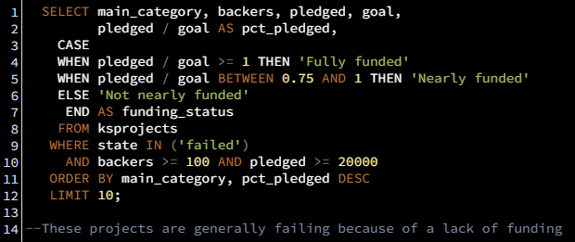
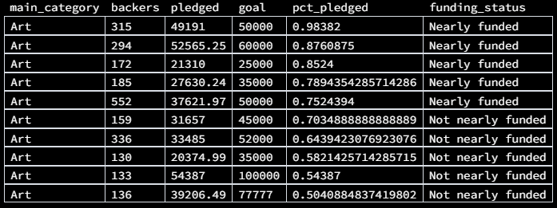

Slide 5
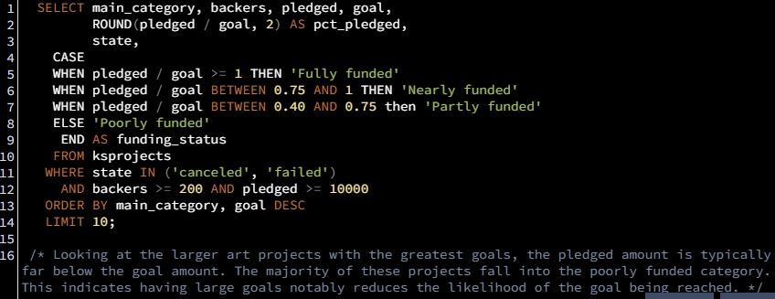
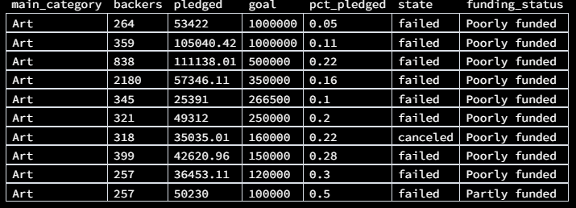

Slide 6
