Slide 1
Advanced Insights from Data: Northwind Traders

Slide 2
Goals
Northwind Traders is a fictional international gourmet food distributing company (based on the Northwind database which provides a real-world-like platform to explore and gain insights from data).
PostgreSQL window functions will be utilized to probe the database on a local PC.
Note, refer to the Jupyter Notebook file for details on SQL scripts executed to obtain the results sets shown in these slides.
Key insights that management would like to uncover:
Evaluation of employee performance to boost productivity
Analysing sales growth rate to identify trends, monitor progress and make more accurate forecasts
Evaluation of customer purchase behaviour to target high-value customers with promotional incentives
An understanding of product sales and category performance to optimize inventory and marketing strategies

Slide 3
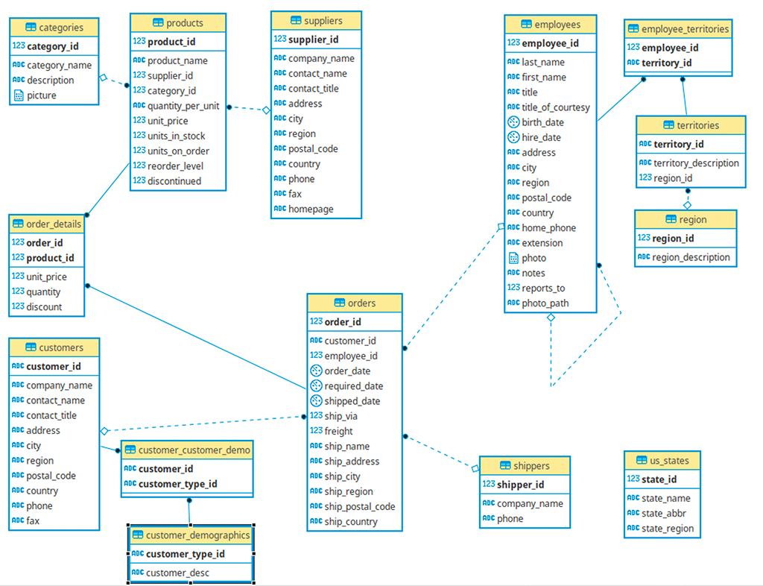
Database Schema
The database contains 14 tables, though the relevant insights only require the need to query 6 (specifically customers, employees, products, orders, order_details and categories)

Slide 4
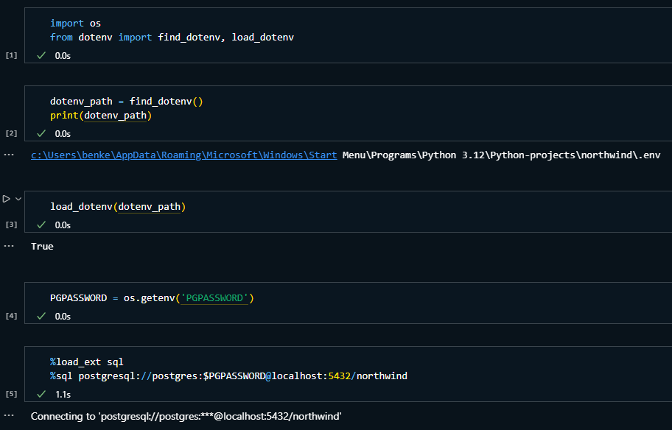
Preparation of the working environment
To query the database, PostgreSQL was installed on a local machine and a connection to the Northwind database was initialized via the available .sql file from the GitHub repository linked in slide 2. Integration with Jupyter Notebook on VScode was then set up, utilizing python environment variable control for security purposes (to keep passwords hidden).

Slide 5
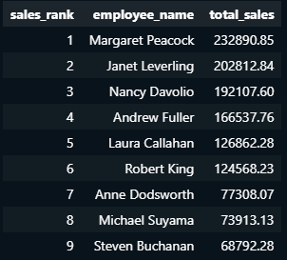
Insight 1 - Ranking Employee Performance by Sales
To give an insight into employee performance, we can rank each employee by the total sales they generate for the company:
From this result set, we could reward the top 3 employees with bonuses/perks and think about investigating further into the lower performing employees to identify why they may not be processing orders as efficiently and address this with further training or allocate resources, as necessary.

Slide 6
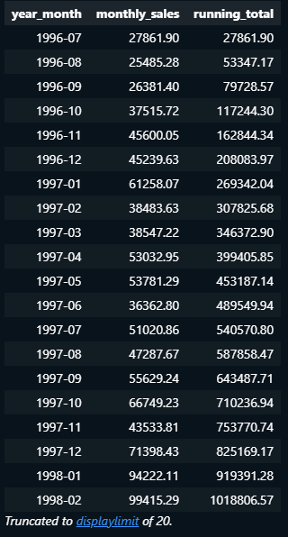
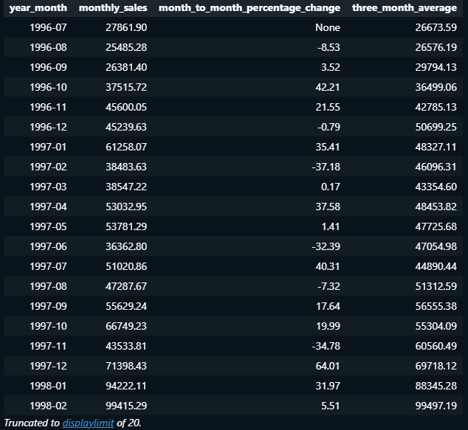
Insight 2 - Monthly Sales Growth Rate
To give a more macro-level insight into sales performance across the company, monthly total sales, percentage change and a three-month moving average is returned in the results sets below:
Results sets such as these lead to improved understanding of the company’s sales performance over time.
Benefits of such analyses include trend identification, improved forecasting capability and a means to monitor sales.

Slide 7
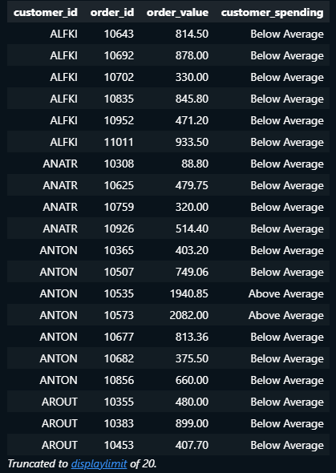
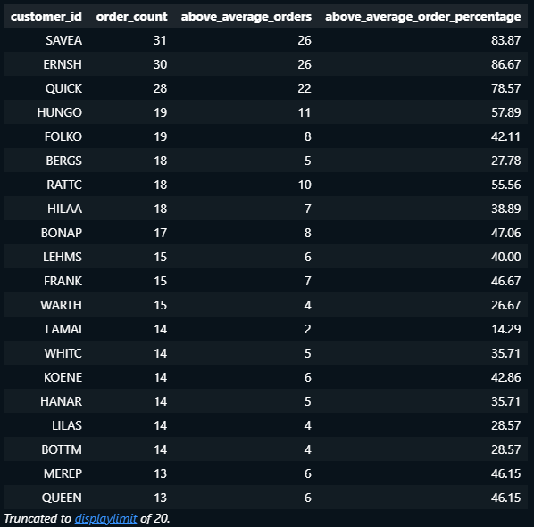
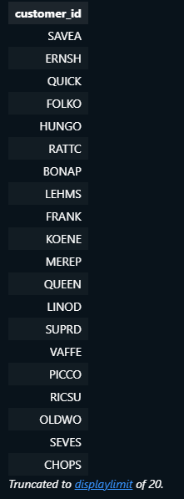
Insight 3 - Identifying high-value customers
Looking into customer purchase behaviour is a wise course of action to gain a better understanding of clients that are most valuable to the company. Clients which consistently spending in volumes greater than the average should be targeted with promotional offers/special offers to potentially enhance customer acquisition, increase sales, and maintain customer retention.
The list of customer_ids to the immediate left have been filtered from the results set in the centre with above average order percentages of 40% or greater.
They can be considered a group of highly valuable clients.

Slide 8
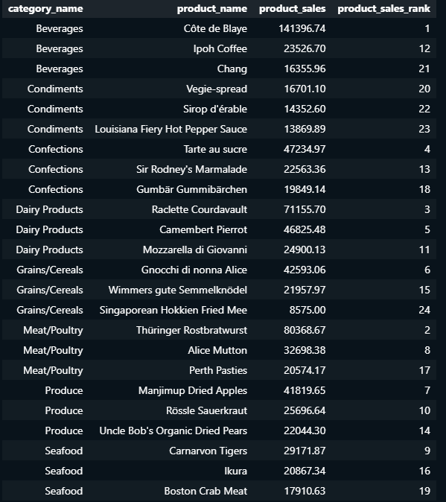
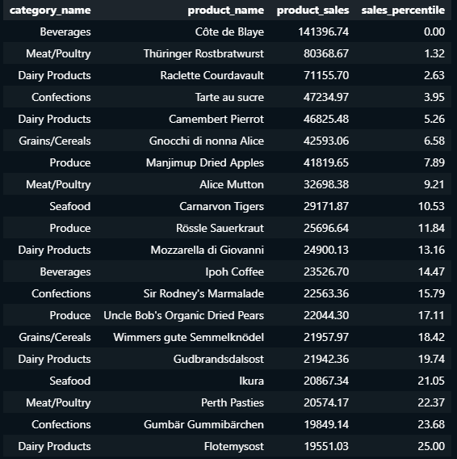
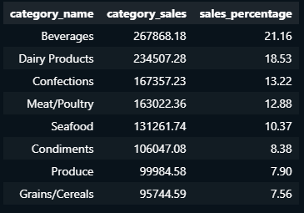
Insight 4 - Product and Category Performance
The leftmost table illustrates each category’s percentage contribution to the total sales made by the company. The centre table returns the top 3 highest performing products per category (and ranks the products sales out of this list of all top 3 performers). The rightmost table offers an alternative way to assess the highest performing products by instead returning all products that lie in the top 25% of total sales across all products sold.
Insights such as these can provide managers with knowledge to properly assess which categories should be promoted and which products should be stocked aggressively.

