Slide 1

Python Web Basics
Course Introduction
SoftUni Team
Technical Trainers
Software University
https://softuni.bg/

Slide 2
Table of Contents
Course Objectives
Training Team
Course Organization
Course Infrastructure
Evaluation Criteria
2

Slide 3
Have a Question?
sli.do
#python-web

Slide 4













SoftUni Diamond Partners

Slide 5

Educational Partners

Slide 6

Course Objectives

Slide 7
Python Web Basics Objectives
Working with HTTP Requests
Get familiar with the MTV architecture
Get familiar with the basic Web concepts
Build the foundations of Django development
Create URLs and views
Work with models and a database
Add forms and templates
7

Slide 8
Practical Programming Exam
Exam - 4 hours
1 practical problem
Creating Django template application
Handling CRUD (Create, Read, Update, Delete) operations using Django
8

Slide 9
Theoretical Exam
You will have 30 minutes once you enter
Multiple-choice with 1 correct answer
Test will be in English
Automated quiz system
Available on the day of the practical exam
You can submit your answers just one time
9

Slide 10

The Team

Slide 11
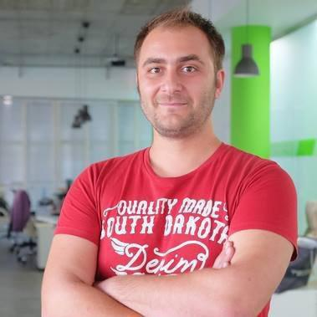
Doncho Minkov
Technical lead, Architect and DevOps at SoftUni
10+ years of experience as a Technical Trainer
Front-end developer by heart
Software developer by need
Experienced in Django, Node.js, .NET and others
Fluent in Python, JavaScript, C#, Java, C++
"30 under 30" - Forbes 2017 - Education

Slide 12

Course Organization

Slide 13
Python Web Basics Course
12-Sep-2022
30-Oct-2022
21-Dec-2022
Python Web Basics
6 weeks * 2 times / week
12 credits
Start: 12-Sep-2022
Final exam: 30-Oct-2022
Theoretical Exam: 30-Oct-2022
Retake Exams
Final Exam Retake: 21-Dec-2022
Theoretical Retake Exam: 21-Dec-2022

Slide 14


SoftUni Certificate
Practical Exam 100%
Evaluation
14

Slide 15
CPE Certificate
Practical Exam
Theoretical Exam
Evaluation
15

Slide 16


Course, Forum and FB Group
Official web site:
Official discussion forum:
Official Facebook group:
Python Community Facebook group:
https://softuni.bg/trainings/3858/python-web-basics-september-2022
https://softuni.bg/forum/categories/790/module-python-web
https://www.facebook.com/groups/PythonWebSeptember2022
https://www.facebook.com/groups/SoftUniPythonCommunity

Slide 17
Questions?
Notes:
17

Slide 18
Trainings @ Software University (SoftUni)
Software University – High-Quality Education, Profession and Job for Software Developers
softuni.bg, softuni.org
Software University Foundation
softuni.foundation
Software University @ Facebook
facebook.com/SoftwareUniversity
Software University Forums
forum.softuni.bg
18
Notes:
18

Slide 19

License
This course (slides, examples, demos, exercises, homework, documents, videos, and other assets) is copyrighted content
Unauthorized copy, reproduction, or use is illegal
© SoftUni – https://about.softuni.bg
© Software University – https://softuni.bg
Notes:
19

