Slide 1
HIV/AIDS
MR G. K. NGUUTU
BscCM

Slide 2
ABBREVIATIONS
HIV-human immunodeficiency virus
AIDS- acquired immunodeficiency syndrome
PMTCT- prevention of mother to child transmission
CD4- T-lymphocyte cell bearing CD4 receptor
DBS- dried blood spot
ART- antiretroviral therapy
HAART- highly active antiretroviral therapy
DNA- deoxyribonucleic acid
RNA- ribonucleic acid
INH- Isoniazid
IPT- Isoniazid preventive therapy
OI – Opportunistic infections

Slide 3
CAUSATIVE ORGANISM
AIDS is caused by the HIV.
HIV belongs to the Lentivirinae subfamily retroviruses which are RNA virus.
The virus is capable of transcribing a DNA copy of the RNA genome after penetrating into the host cell.
This form of reverse transcription is achieved by the presence of the enzyme reverse transcriptase.
New copies of viral copies are rapidly produced in the host;- 10.3x109 virus/day

Slide 4
Drugs which inhibit the enzyme production also inhibit viral multiplication
HIV shows great diversity
HIV has 2 pathogenic types to man
HIV 1
HIV 2

Slide 5
HIV 1
Commonest cause of HIV disease throughout the world – 92.5% of HIV infections.
world-wide distribution, responsible for world pandemic, including Kenya.
Most aggressive type and produce a more severe disease
More readily transmitted from mother to child
HIV-1 has many subtypes (11 subtypes : A-K )
A-E are the predominant subtypes

Slide 6
HIV 2
Less aggressive
less easily transmitted,
Less pathogenic
Produce milder disease
Slower in progression
Less rapidly transmitted from mother to child
Less common
Has 5 subtypes A – E
Common in west Africa, Mozabique and Angola.

Slide 7
Structure HIV

Slide 8
The viral structure comprises of :- envelop , capsid, core
Envelop:-
membrane which surrounds the virus
Lipid layer derived from host cell membrane and has host proteins
Has viral encoded glycoprotein gp41
Also has glycoprotein knob gp120 that binds to CD4 receptors

Slide 9
Capsid:- protein coat surrounding the virus core- has protein 17 ( p17) and p18
Core:- inner mass of the virus with 2 identical single strand of viral RNA
Also contains enzymes reverse transcriptase and protease
Main core protein is p24
RNA carries the genetic material of the virus

Slide 10
MODES OF TRANSMISSION
Horizontal transmission:
Sexual intercourse :- peno-vaginal,peno-anal, peno-oral, oral-vaginal.
Sharing of unsterilized instruments:- injection- drug addits, surgical procedures
Transfusion of unscreened blood and blood products
Organ transplant
Occupational – needle stick injuries.

Slide 11
Vertical transmission:
(mother to child transmission) (MTCT) – during pregnancy, delivery period or during breastfeeding.

Slide 12
NB
Exclusive breastfeeding is safer than mixed feeding
Presence of other STIs and ulcer in genitalia favours easier transmission
Presence of other concomitant infections favour the progression of HIV as well
Most of the secretions and tissue material contain the virus and are infective
Blood and blood products, semen and vaginal secretions are rich in virus load and therefore highly infective
Saliva and breast may contain the virus in smaller numbers

Slide 13
HIV life Cycle
When introduced into the human host the virus circulates in the plasma only for short period ( 1-6 hours)
It rapidly enters the CD4 lymphocytes which have got glycoprotein on the surface , multiply and within 1-2 days large number of daughter viruses are shed which infect further and further CD4 lymphocytes.

Slide 14
HIV enters the cells through interaction of an envelope glycoprotein (gp120) and the cellular receptor.
The receptors are expressed on T-helper lymphocytes (CD4 lymphocytes), macrophages, dendritic cells (in lymph notes and mucosal surfaces)and microglial cells in the brain.

Slide 15
STEPS IN REPLICATION
The virus life cycle can be divided into a number of distinct steps , each of which is a current or potential therapeutic drug target.
Binding/attachment/Fusion and entry:- viral gp120 binds to the CD4 receptor on host cell surface.
2. Reverse transcription:- viral RNA is reverse transcribed into viral DNA. This process is mediated by the enzyme reverse transcriptase(RT). This enzyme has no proof-reading function and therefore the process is error prone and responsible for rapid development of drug resistant mutations.

Slide 16
3. Integration:- the pro-viral DNA is inserted into host cell chromosomal DNA using the viral enzyme integrase. This is the step that establishes replication competent virus in the body and makes HIV incurable even with effective ART. Further drug resistant virus that occurs in patients on ART may also be archived in the same way establishing a permanent pool of resistant viruses.

Slide 17
4. Transcription and Translation :- host cell enzymes transcribe viral DNA into viral RNA . Viral RNA uses host cell energy and synthetic pathways to make viral proteins.
5. Assembly, Budding and Maturation:- viral proteins and RNA aggregate on the cell surface for assembly into a mature viral particle by budding through host cell membrane.

Slide 18
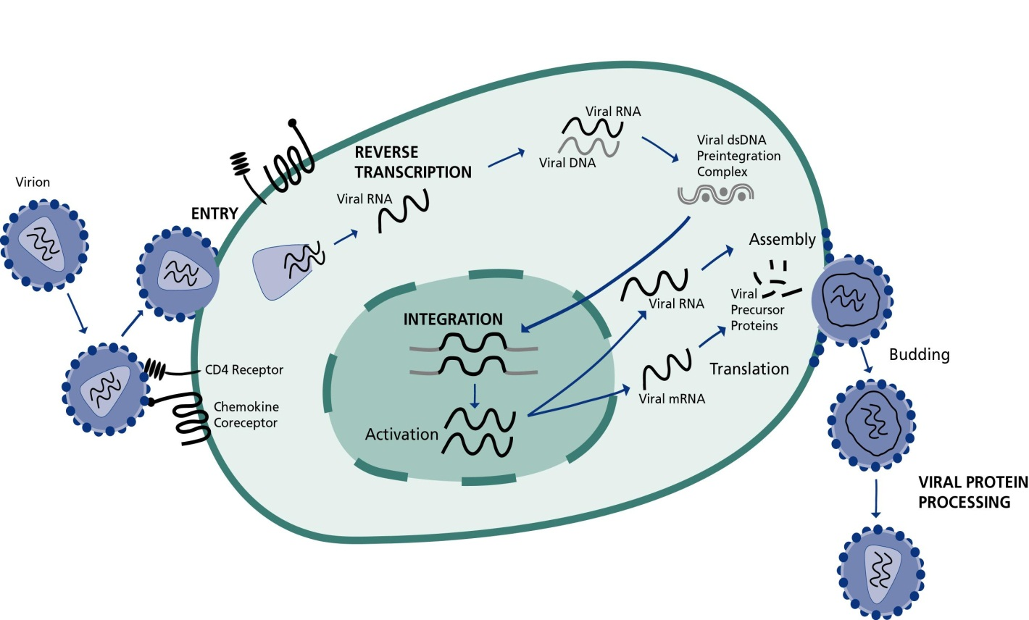

Slide 19
Most important viral enzymes :-
Reverse Transcriptase (RT) :-
converts viral single-stranded RNA into a double stranded DNA.
DNA is incorporated into host nucleus as the proviral DNA.
2 classes of ARVS(Antiretrovirals) act to this enzyme
nucleoside/nucleotide reverse transcriptase inhibitors(NRTI’S) e.g ?
nonnucleoside reverse transcriptase inhibitors (NNRTI’S) e.g ?

Slide 20
2. Protease :- splits generated macro-proteins into smaller viral proteins (core, envelope & regulatory proteins and enzymes) which go into forming new viral particles
PROTEASE INHIBITORS(PI’S) act to this enzyme e.g ?
3. Integrase :- facilitates integration of the DNA into the host’s chromosomal DNA
NB--Another class of ARVs FUSION INHIBITORS :- Blocks entry into the cell e.g ?

Slide 21
NATURAL HX OF HIV INFECTION
Following infxn of HIV , there is an initial rapid rise in viral load which may be associated with flu like symptoms (primary HIV infection).
A vigorous immune response occurs within weeks of infection with production of both antibodies and cellular mediated responses. Thus antibodies to HIV can be detected within 2 wks of infection.(seroconversion)
The immune response inhibits HIV replication with the result that the viral load declines and stabilizes within the 1st 6-12months after infxn.(intermediate stage)
Thereafter the patient remains asymptomatic for average 6-10 years in the majority of patients, before the ongoing immune destruction begins to manifest in symptomatic HIV-related diseases. (AIDS).

Slide 22
PATHOPHYSIOLOGY AND PATHOGENESIS
How HIV Affects Immune System
HIV attaches to cells of the immune system through special surface markers called CD4 receptors
The following immune cells have CD4 receptors
T-Lymphocytes – CD4+ Cells
Macrophages
Monocytes
Dendritic cells
Microglial cells
The virus destroys and depletes these CD4 T lymphocytes weakening the immune system.

Slide 23
HIV EFFECT ON OTHER PARTS OF IMMUNE SYSTEM
Lymphoid tissue destruction.
CD8+ cell dysfunction.
B cell abnormalities.
Thymic dysfunction
Autoimmune abnormalities

Slide 24
Average time taken for development of AIDS following infection
Average developer
develop AIDS within approximately 10 years
Rapid developers
develop AIDS within 2years following infection (10%)
Slow developers
who remain asymptomatic for over 10 years without
significant decline in CD4T cell count (5%).

Slide 25
CLINICAL FEATURES
Symptoms start after a latent period of 2-12/52.
This period marks the onset of seroconversion whereby a non specific illness manifests.
Asymptomatic phase may follow which may last for a few months upto 10-12years.

Slide 26
1.Early symptoms:-
Fever
Headache
Transient arthralgia
Maculopapular rash
Mouth ulcers
Diarrhoea
Rarely signs of encephalopathy
2. Persistent generalized lymphadenopathy(PGL)- presence of LN enlargement exceeding 1cm in size in two or more unrelated anatomical sites lasting for 3 months or more and not attributed to other cause. Biopsy only reveals reactive hyperplasia.

Slide 27
3. Infections
Disseminated CMV infxn
Mucocuteneous disseminated herpes simplex
Infxn exceeding 1/12
Pcp
Candidiasis of oesophagus, bronchi and lung
Toxoplasmosis of brain
Cryptosporidiosis more than 1/12
Other fungal infxns:- histoplasmosis, cocidioidomycosis and cryptococcosis.
Isosporiasis
Papovavirus infxn- multifocal leucoencephalopathy.

Slide 28
4. Neoplasms:-
Kaposi’s sarcoma
Primary lymphoma – brain
Non Hodgkin’s lymphoma
5. Skin conditions :-
Various bacterial , viral and fungal infxn
Drug eruptions
Oral lesions
Angulostomatitis
Gingivitis hairy leukoplakia
Viral infxns- CMV, Herpes
Complicated aphthous ulcers
Warts
KS

Slide 29
5. Alimentary system:-
Diarrhoea
Maldigestion
Malabsorption
Wt loss
Dysphagia
6. Hepatobiliary system
painful and tender hepatomegally
Hepatitis- A, B and C and cytomegalovirus
Acalculus cholangitis

Slide 30
7. Hematological system
Immune thrombocytopenic purpura
Anaemia
Myelosuppresion by ARV drugs
8. Heart :- cardiomyopathy
-tuberculosis pericarditis
9. Gynaecological manifestation
PID
Cervical dysplasia and neoplasia
Disseminated genital candidiasis

Slide 31
WHO clinical staging of HIV/AIDS in adults and adolescents
Clinical stage 1
1. Asymptomatic
2. Persistent generalized lymphadenopathy (PGL)

Slide 32
Clinical stage 2
1. Moderate unexplained weight loss (<10% of presumed or measured body weight)
2. Minor mucocutaneous manifestations (seborrheic dermatitis, popular pruritic eruptions, fungal nail infections, recurrent oral ulcerations, angular cheilitis)
3. Herpes zoster
4. Recurrent upper respiratory tract infections (sinusitis, tonsillitis, bronchitis, otitis media, pharyngitis)

Slide 33
Clinical stage 3
1. Unexplained severe weight loss (over 10% of presumed or measured body weight)
2. Unexplained chronic diarrhoea for longer than one month
3. Unexplained persistent fever (intermittent or constant for longer than one month)
4. Persistent oral candidiasis
5. Oral hairy leukoplakia
6. Pulmonary tuberculosis (PTB)
7. Severe bacterial infections (e.g. pneumonia, empyema, pyomyositis, bone or joint infection, meningitis, bacteraemia)
8. Acute necrotizing ulcerative stomatitis, gingivitis or periodontitis
9. Unexplained anaemia (below 8 g/dl ), neutropenia (below 0.5 x 109/l) and/or chronic thrombocytopenia (below 50 x109 /l)

Slide 34
Clinical stage 4
Conditions where a presumptive diagnosis can be made using clinical signs or simple investigations:
1. HIV wasting syndrome
2. Pneumocystis jiroveci pneumonia (PCP)
3. Recurrent severe bacterial pneumonia (≥ 2 episodes within 1 year)
4. Cryptococcal meningitis
5. Toxoplasmosis of the brain
6. Chronic orolabial, genital or ano-rectal herpes simplex infection for >1 month
7. Kaposi sarcoma (KS)
8. HIV encephalopathy
9. Extra pulmonary tuberculosis (EPTB)

Slide 35
Conditions where confirmatory diagnostic testing is necessary:
1. Cryptosporidiosis, with diarrhoea >1 month
2. Isosporiasis
3. Cryptococcosis (extra pulmonary)
4. Disseminated non-tuberculous mycobacterial infection
5. Cytomegalovirus (CMV) retinitis or infection of the organs (other than liver, spleen, or lymph nodes)
6. Progressive multifocal leucoencephalopathy (PML)
7. Any disseminated mycosis (e.g. histoplasmosis, coccidiomycosis)
8. Candidiasis of the oesophagus or airways
9. Non-typhoid salmonella (NTS) septicaemia
10. Lymphoma cerebral or B cell Non Hodgkin’s Lymphoma
11. Invasive cervical cancer
10. Visceral leishmaniasis
11. Symptomatic HIV-associated nephropathy or HIV-associated cardiomyopathy

Slide 36
HIV wasting syndrome:-
weight loss of >10% of bodyweight
unexplained chronic diarrhoea (>1 month)
unexplained fever (> 1 month)
chronic weakness

Slide 37
DIAGNOSIS
Elisa (HIV enzyme linked immunenosorbent assay)
Western blot
P24 antigen
PCR and cultures- neonates
HIV viral load tests
CD4 lymphocyte count (normal 800-1200cells/mm) AIDS OI’s cd4 less than 200cells/mm
CD4 lymphocyte percentage- AIDS -20% or less.
CBC- anaemia, neutropenia and thrombocytopenia.
LFTs - Alanine aminotransferase (ALT)*
U/E/Cs - Creatinine (Cr)*

Slide 38
TREATMENT
Therapy for OI’s and malignancies
OI’s prophylaxis
ARV treatment
PEPs

Slide 39
OI’s prophylaxis
Cotrimoxazole (CTX) 960mg OD
DAPSONE 100mg OD
Isoniazid (INH) 300mg OD – IPT

Slide 40
ARV TREATMENT
NRTI – ABC, Didanosine (DDI), 3TC, D4T, AZT
NNRTI- NVP, EFV
PI- Ritonavir, saquinavir, lopinavir, atazanavir
Entry inhibitors – e.g fusion inhibitors – enfuvirtide
Integrase strand transfer inhibitors

Slide 41
PEP’s

Slide 42
DDX
Cancer
Chronic infxns
TB
Endocarditis
Endocrinologic dses
Hyperthyroidism
Alcoholism
Liver dse
Renal dysfxn
Thyroid dse
Malabsorption syndrome
Inflammatory bowel dse
Chronic meningitis
Infectious enterocolitis

Slide 43
PREVENTION
Sexual practices:- Absteinance , faithful to one uninfected partner, condom use/ practice safe sex, Avoid intergeneration sex (young to old sex).
Intravenous drug use- no exchange of fluids
Screening of blood products
Fluid precaution- gloves, gown, mask and goggles
ARV’s – PEPs
HIV risk for healthcare professionals- preventing needle stick injury (avoid recapping needles, use of safety box)
Preventing perinatal transmission of HIV- ARVs, nevirapine prophylaxis, avoid mixed feeding.
Sterilization of instruments-autoclaving, chlorine,

Slide 44
Therapy for OI’s and malignancies
KS
PCP

