Slide 1
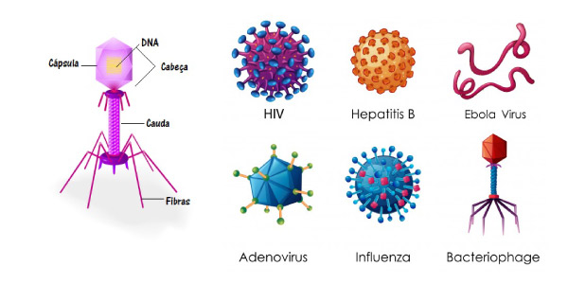

Slide 2
ANTIVIRAL AGENTS: INTRODUCTION
Viruses are obligate intracellular parasites; their replication depends primarily on synthetic processes of the host cell.
Therefore, to be effective, antiviral agents must either block viral entry into or exit from the cell or be active inside the host cell.
As a corollary, nonselective inhibitors of virus replication may interfere with host cell function and produce toxicity.

Slide 3
Viral replication consists of several steps;
  Attachment of the virus to the host cell
  Entry of the virus through the host cell membrane
  Uncoating of viral nucleic acid
  Synthesis of early regulatory proteins, eg, nucleic acid polymerases
  Synthesis of RNA or DNA
  Synthesis of late, structural proteins
  Assembly (maturation) of viral particles
  Release from the cell.
Antiviral agents can potentially target any of these steps.

Slide 4
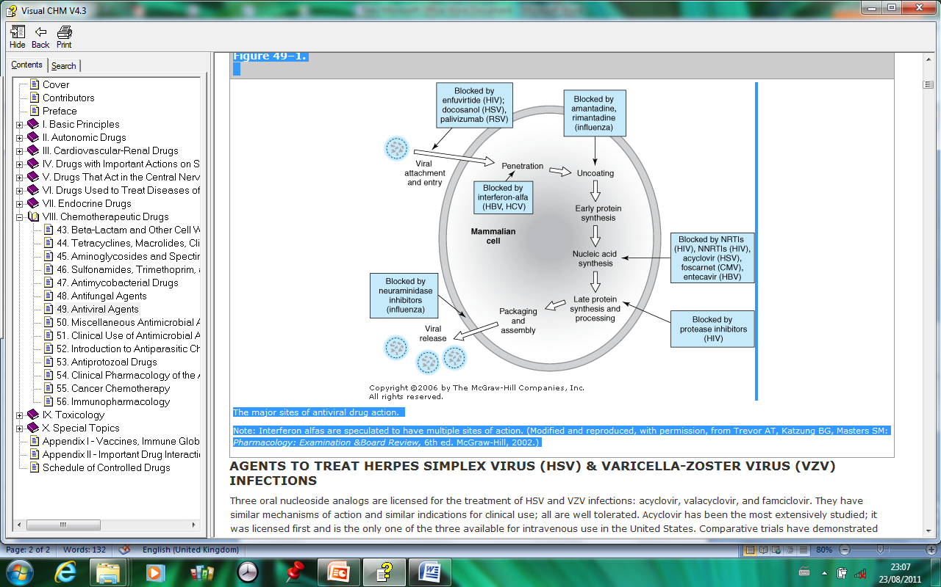
The major sites of antiviral drug action

Slide 5
AGENTS TO TREAT HERPES SIMPLEX VIRUS (HSV) & VARICELLA-ZOSTER VIRUS (VZV) INFECTIONS
Three oral nucleoside analogs used for the treatment of HSV and VZV infections: acyclovir, valacyclovir, and famciclovir.
They have similar mechanisms of action and similar indications for clinical use; all are well tolerated.
Acyclovir is the only one of the three available for intravenous use.
Comparative trials have demonstrated similar efficacies of these three agents for the treatment of HSV but modest superiority of famciclovir and valacyclovir over acyclovir for the treatment of herpes zoster.
Neither valacyclovir nor famciclovir have been fully evaluated in pediatric patients; thus, neither is indicated for the treatment of varicella infection.

Slide 6
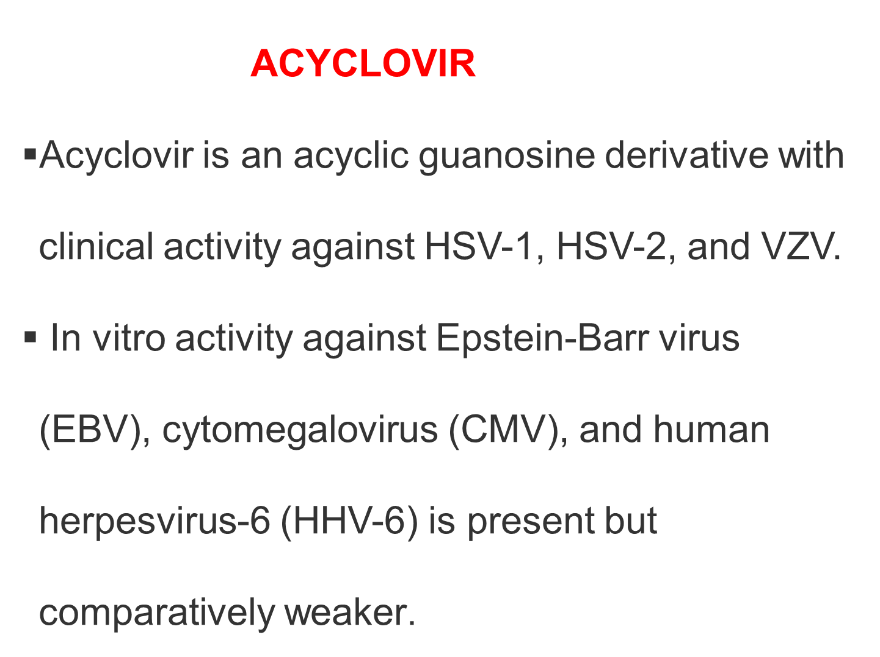

Slide 7
Acyclovir requires three phosphorylation steps for activation.
It is converted first to the monophosphate derivative by the virus-specified thymidine kinase and then to the di- and triphosphate compounds by host cell enzymes.
Because it requires the viral kinase for initial phosphorylation, acyclovir is selectively activated, and the active metabolite accumulates, only in infected cells.
Acyclovir triphosphate inhibits viral DNA synthesis by two mechanisms:
    Competition with deoxyguanosine triphosphate for the viral DNA polymerase, resulting in binding to the DNA template as an irreversible complex;
    Chain termination following incorporation into the viral DNA.

Slide 8
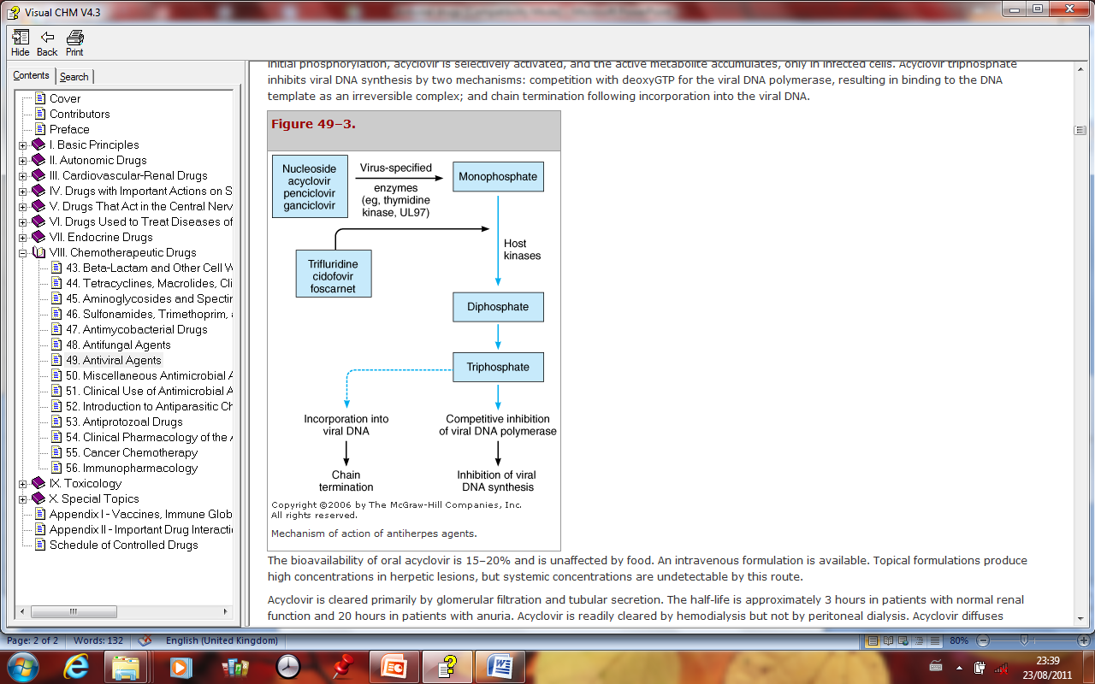
Notes:
Penciclovir- guanosine analogue antiviral drug for Tx of Herpes. Has poor oral absorption thus given as a topical agent. Neucloside analogue with low toxicity and good selectivity

Slide 9
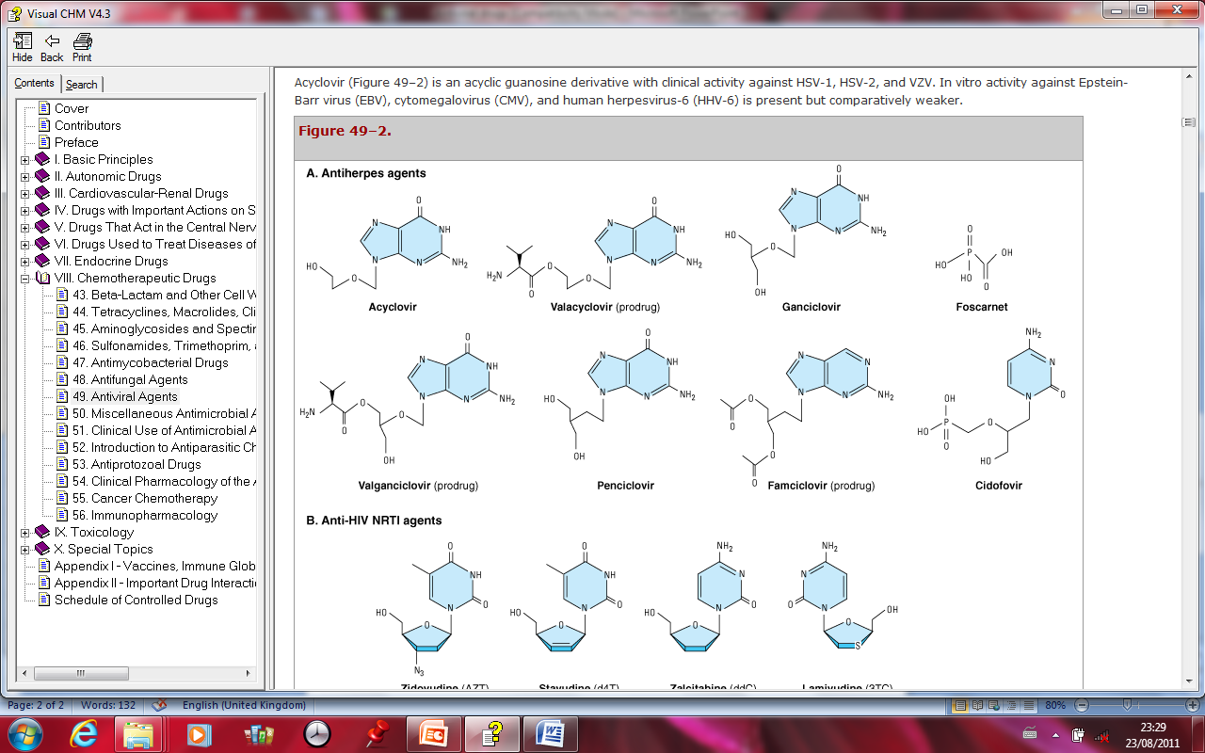

Slide 10
Pharmacokinetics
The bioavailability of oral acyclovir is 15–20% and is unaffected by food. An intravenous formulation is available.
Topical formulations produce high concentrations in herpetic lesions, but systemic concentrations are undetectable by this route.
Acyclovir is cleared primarily by glomerular filtration and tubular secretion.
The half-life is approximately 3 hours in patients with normal renal function and 20 hours in patients with anuria.
Acyclovir is readily cleared by hemodialysis but not by peritoneal dialysis.
Acyclovir diffuses readily into most tissues and body fluids. Cerebrospinal fluid concentrations are 50% of serum values.
Notes:
Mechanism of Action
Interferes with DNA polymerase to inhibit DNA replication via chain termination
Absorption
Absorption: PO, 15-30%
Peak serum time: 1.5-2 hr (PO); 1 hr (IV)
Distribution
Distributed widely (brain, kidney, lungs, liver, spleen, muscle, uterus, vagina, cerebrospinal fluid [CSF])
Protein bound: 9-33%
Vd: 0.8 L/kg (63.6 L)
Metabolism
Metabolized by liver (in small amounts)
Elimination
Half-life: 4 hr (Neonates); 2-3 hr (children 1-12 years); 3 hr (adults)
Excretion: Urine (62-90% as unchanged drug)

Slide 11
Oral acyclovir has multiple uses.
In first episodes of genital herpes, oral acyclovir shortens the duration of symptoms by approximately 2 days, the time to lesion healing by 4 days, and the duration of viral shedding by 7 days.
Treatment of first-episode genital herpes does not alter the frequency or severity of recurrent outbreaks.
Long-term suppression of genital herpes with oral acyclovir in patients with frequent recurrences decreases the frequency of symptomatic recurrences and of asymptomatic viral shedding, thus decreasing the rate of sexual transmission.
Outbreaks may resume upon discontinuation of suppressive acyclovir.

Slide 12
Oral acyclovir is only modestly beneficial in recurrent herpes labialis. It significantly decreases the total number of lesions, duration of symptoms, and viral shedding in patients with varicella (if begun within 24 hours after the onset of rash) or cutaneous zoster (if begun within 72 hours).
However, because VZV is less susceptible to acyclovir than HSV, higher doses are required .
When given prophylactically to patients undergoing organ transplantation, oral acyclovir (200 mg every 8 hours or 800 mg every 12 hours) or intravenous acyclovir (5 mg/kg every 8 hours) prevents reactivation of HSV infection.

Slide 13
Adverse Effects
>10%
Oral
Malaise (≤12%)
1-10%
Parenteral
Inflammation or phlebitis at injection site (9%)
Nausea (7%)
Vomiting (7%)
Rash or hives (2%)
Elevated transaminase levels (1-2%)
Oral
Nausea (2-5%)
Vomiting (≤3%)
Diarrhea (2-3%)
Headache (2%)

Slide 14
Adverse Effects <1%
Abdominal pain
Aggression/confusion
Agitation
Alopecia
Anaphylaxis
Anemia
Angioedema
Anorexia
Ataxia
Coma
Disseminated intravascular coagulation (DIC)
Dizziness
Fatigue

Slide 15
Contraindications
Hypersensitivity
Cautions
  Avoid rapid infusion because of risk of renal damage
  Renal failure, resulting in death, has occurred
  Use with caution in immunocompromised patients (potential risk of thrombotic thrombocytopenic purpura [TTP]/hemolytic uremic syndrome [HUS])
  Use with caution in patients with renal impairment
  Treatment should begin within 24 hours of appearance of rash
  Use with caution in patients receiving nephrotoxic drugs
  Maintain adequate hydration during PO or IV therapy

Slide 16
Genital Herpes
  Initial treatment: 200 mg PO q4hr while awake (5 times daily) for 10 days or 400 mg PO q8hr for 7-10 days
  Intermittent treatment for recurrence: 200 mg PO q4hr while awake (5 times daily) for 5 days; initiate at earliest sign or symptom of recurrence
  Chronic suppression for recurrence: 400 mg PO q12hr for up to 12 months; alternatively, 200 mg 3-5 times daily
Herpes Simplex Virus Encephalitis
  10-15 mg/kg IV q8hr for 10 days; up to 14-21 days reported

Slide 17
Mucocutaneous Herpes Simplex Virus Infection
  Treatment in immunocompromised patients
  IV: 5 mg/kg q8hr for 7 days; dosing up to 14 days reported
  PO (off-label): 400 mg q4hr while awake (5 times daily) for 7 days

Slide 18
Herpes Zoster (Shingles)
  Acute treatment: 800 mg PO q4hr while awake (5 times daily) for 7-10 days
  Immunocompromised patients
  10 mg/kg IV q8hr for 7 days
  CrCl 25-50 mL/min: Full recommended IV dose q12hr
  CrCl 10-25 mL/min: Full recommended IV dose once daily
  CrCl 0-10 mL/min: 50% of recommended IV dose once daily
Varicella Zoster (Chickenpox)
  >40 kg (immunocompetent): 800 mg PO q6hr for 5 days
  Immunocompromised patients: 10-15 mg/kg IV q8hr for 7-10 days

Slide 19
Dosage Modifications
  Dose adjustment based on renal clearance and normal dosage regimen
  200 mg every 4 hr
  <10 mL/min/1.73 m²: 200 mg q12hr
  ≥10 mL/min/1.73 m²: 200 mg q4hr (five times daily)
  400 mg every 12 hr
  <10 mL/min/1.73 m²: 200 mg q12hr
  ≥10 mL/min/1.73 m²: 400 mg q12hr
  800 mg every 4 hr
  <10 mL/min/1.73 m²: 800 mg q12hr
  10-25 mL/min/1.73 m²: 800 mg q8hr
  >25 mL/min/1.73 m²: 800 mg q4hr (five times daily)

Slide 20
Dose adjustment based on dosage form
  Renal impairment (IV)
  CrCl 25-50 mL/min/1.73 m²: Give recommended dose q12hr
  CrCl 10-25 mL/min/1.73 m²: Give recommended dose q24hr
  CrCl <10 mL/min/1.73 m²: Give 50% of recommended dose q24hr
  Renal impairment (PO)
  Normal dosage 200 mg q4hr or 400 mg q12hr and CrCl <10 mL/min/1.73 m²: Decrease to 200 mg q12hr
  Normal dosage 800 mg q4hr and CrCl 10-25 mL/min/1.73 m²: Decrease to 800 mg q8hr
  Normal dosage 800 mg q4hr and CrCl <10 mL/min/1.73 m²: Decrease to 800 mg q12hr

Slide 21
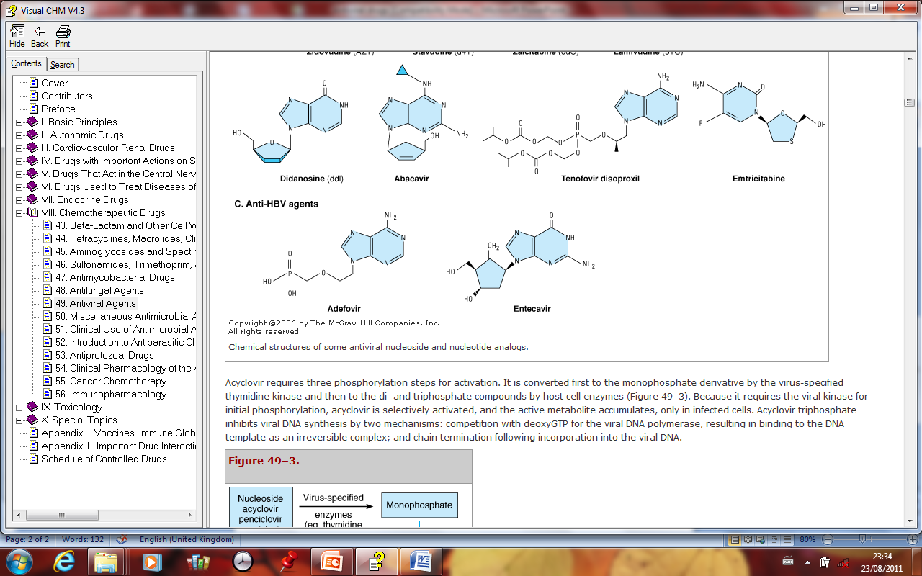

Slide 22
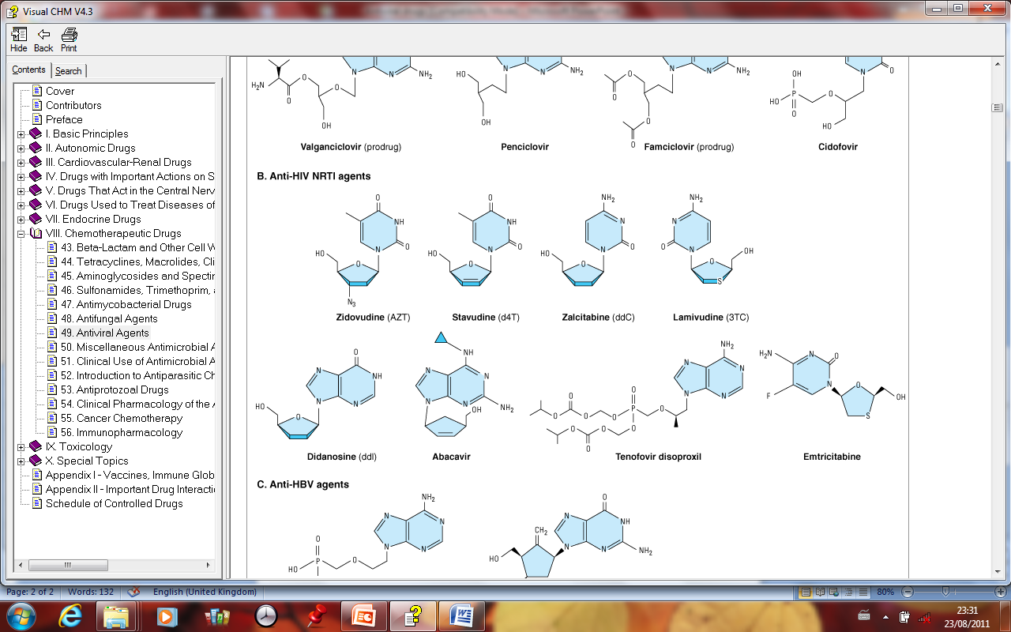

Slide 23
Other Drugs for HSV and VSV Infections
Several newer agents have characteristics similar to acyclovir.
Valacyclovir is a prodrug converted to acyclovir by hepatic metabolism after oral administration and reaches plasma leveles 3–5 times greater than those achieved by acyclovir. Valcyclovir has a longer duration of action than acyclovir.
Penciclovir undergoes activation by viral thymidine kinase, and the triphosphate form inhibits DNA polymerase but does not cause chain termination.
Famciclovir is a prodrug converted to penciclovir by first-pass metabolism in the liver. Used orally in genital herpes and for herpes zoster, famciclovir is well tolerated and is similar to acyclovir in its pharmacokinetic properties. None of the acyclovir congeners has activity against TK– strains of HSV.
Notes:
Docosanol is an aliphatic alcohol that inhibits fusion between the HSV envelope and plasma membranes. It prevents viral entry and subsequent replication. Used topically docosanol shortens healing time.

Slide 24
Ganciclovir
Mechanisms
Ganciclovir, a guanine derivative, is triphosphorylated to form a nucleotide that inhibits DNA polymerases of cytomegalovirus (CMV), and HSV and causes chain termination.
The first phosphorylation step is catalyzed by virus-specific enzymes in both CMV-infected and HSV-infected cells.
CMV resistance mechanisms involve mutations in the genes that code for the activating viral phosphotransferase and the viral DNA polymerase.
Thymidine kinase-deficient HSV strains are resistant to ganciclovir.

Slide 25
Pharmacokinetics
Ganciclovir is usually given intravenously and penetrates well into tissues, including the eye and the central nervous system (CNS).
The drug undergoes renal elimination in direct proportion to creatinine clearance.
Oral bioavailability is less than 10%.
An intraocular implant form of ganciclovir can be used in CMV retinitis.
Valganciclovir, a prodrug of ganciclovir, has high oral bioavailability and has decreased the use of intravenous forms of ganciclovir (and also of intravenous cidofovir and foscarnet) in end-organ CMV disease.

Slide 26
Clinical Uses and Toxicity
Ganciclovir is used for the prophylaxis and treatment of CMV retinitis and other CMV infections in immunocompromised patients.
Systemic toxic effects include leukopenia, thrombocytopenia, mucositis, hepatic dysfunction, and seizures.
The drug may cause severe neutropenia when used with zidovudine or other myelosuppressive agents

Slide 27
Cidofovir
Mechanisms and Pharmacokinetics
Cidofovir is activated exclusively by host cell kinases and the active diphosphate, which inhibits DNA polymerases of HSV, CMV, adenovirus, and papillomavirus (HPV).
Because phosphorylation does not require viral kinase, cidofovir is active against many acyclovir and ganciclovir-resistant strains.
Resistance is due to mutations in the DNA polymerase gene.
The drug is given intravenously and undergoes renal elimination.
Dosage should be adjusted in proportion to creatinine clearance and full hydration maintained.

Slide 28
Clinical Uses and Toxicity
Cidofovir is effective in CMV retinitis, in mucocutaneous HSV infections, including those resistant to acyclovir, and in genital warts.
Nephrotoxicity is the major dose-limiting toxicity of cidofovir, additive with other nephrotoxic drugs including amphotericin B and aminoglycoside antibiotics

Slide 29
Foscarnet
Mechanisms
Foscarnet is a phosphonoformate derivative that does not require phosphorylation for antiviral activity.
Although it is not an antimetabolite, foscarnet inhibits viral RNA polymerase, DNA polymerase, and HIV reverse transcriptase.
Resistance involves point mutations in the DNA polymerase gene.
Pharmacokinetics
Foscarnet is given intravenously and penetrates well into tissues, including the CNS.
The drug undergoes renal elimination in direct proportion to creatinine clearance.

Slide 30
Clinical Uses and Toxicity
The drug is an alternative for prophylaxis and treatment of CMV infections, including CMV retinitis, and has activity against ganciclovir-resistant strains of this virus.
Foscarnet inhibits herpes DNA polymerase in acyclovir-resistant strains that are thymidine kinase–deficient and may suppress such resistant herpetic infections in patients with AIDS.
Adverse effects are severe and include nephrotoxicity (30% incidence) with disturbances in electrolyte balance (especially hypocalcemia), genitourinary ulceration, and CNS effects (headache, hallucinations, seizures).

Slide 31
Other Antiherpes Drugs
Vidarabine
Vidarabine is an adenine analog and has activity against HSV, VZV, and CMV. Its use for systemic infections is limited by rapid metabolic inactivation and marked toxic potential.
Vidarabine is used topically for herpes keratitis but has no effect on genital lesions.
Toxic effects with systemic use include GI irritation, paresthesias, tremor, convulsions, and hepatic dysfunction. Vidarabine is teratogenic in animals.
Idoxuridine and Trifluridine
These pyrimidine analogs are used topically in herpes keratitis (HSV-1). They are too toxic for systemic use.
Fomivirsen
Fomivirsen is an antisense oligonucleotide that binds to mRNA of CMV, inhibiting early protein synthesis.
The drug is injected intravitreally for treatment of CMV retinitis.
Cross-resistance between fomivirsen and other anti-CMV agents has not been observed.
Concurrent systemic anti-CMV therapy is recommended to protect against extraocular and contralateral retinal CMV disease. Fomiversin causes iritis, vitreitis, increased intraocular pressure and changes in vision.

Slide 32
Anti-Influenza Agents
Amantadine and Rimantadine
Mechanisms
Amantadine and rimantadine inhibit an early step in replication of the influenza A (but not influenza B) virus.
They prevent "uncoating" by binding to a protein M2.
This protein functions as a proton ion channel required at the onset of infection to permit acidification of the virus core, which in turn activates viral RNA transcriptase.
Adamantine-resistant influenza A virus mutants are now common.

Slide 33
Clinical Uses and Toxicity
These drugs are prophylactic against influenza A virus infection and can reduce the duration of symptoms if given within 48 h after contact.
However, adamantine-resistant influenza A virus mutants including H3N2 strains causing seasonal influenza in the United States have increased drammatically in the last 2–3 yr.
The H1N1 strain responsible for the recent pandemic that contain genes derived from both avian and porcine influenza viruses is also resistant to the adamantines.
Fortunately, there is minimal cross-resistance to the neuraminidase inhibitors.
Toxic effects of these agents include GI irritation, dizziness, ataxia, and slurred speech. Rimantadine's activity is no greater than that of amantadine, but it has a longer half-life and requires no dosage adjustment in renal failure.

Slide 34
Oseltamivir and Zanamivir
Mechanisms
These drugs are inhibitors of neuraminidases produced by influenza A and B and are currently active against both H3N2 and H1N1 strains.
These viral enzymes cleave sialic acid residues from viral proteins and surface proteins of infected cells.
They function to promote virion release and to prevent clumping of newly released virions.
By interfering with these actions, neuraminidase inhibitors impede viral spread.
Decreased susceptibility to the drugs is associated with mutations in viral neuraminidase, but worldwide resistance remains rare.

Slide 35
Clinical Use and Toxicity
Oseltamivir is a prodrug used orally, activated in the gut and the liver.
Zanamivir is administered intranasally. Both drugs decrease the time to alleviation of influenza symptoms and are more effective if used within 24 h after onset of symptoms.
Taken prophylactically, oseltamivir significantly decreases the incidence of influenza.
GI symptoms may occur with oseltamivir;
zanamivir may cause cough and throat discomfort and has induced bronchospasm in asthmatic patients

Slide 36
Agents Used in Viral Hepatitis
The agents available for use in the treatment of infections caused by hepatitis B virus (HBV) are suppressive rather than curative.
The primary goal of drugs used for infections caused by hepatitis C virus (HCV) is viral eradication.
The drugs available include interferon-(IFN- ), lamivudine, adefovir dipivoxil, entacavir, telbivudine, tenofovir, and ribavirin.

Slide 37
IFN- Mechanisms
IFN- is a cytokine that acts through host cell surface receptors increasing the activity of Janus kinases (JAKS).
These enzymes phosphorylate signal transducers and activators of transcription (STATS) to increase the formation of antiviral proteins.
The selective antiviral action of IFN- is primarily due to activation of a host cell ribonuclease that preferentially degrades viral mRNA.
IFN- also promotes formation of natural killer cells that destroy infected liver cells.

Slide 38
Pharmacokinetics
There are several forms of IFN- with minor differences in amino acid composition.
Absorption from intramuscular or subcutaneous injection is slow; elimination of IFN- is mainly via proteolytic hydrolysis in the kidney.
Conventional forms of IFN- are usually administered daily or 3 times a week.
Pegylated forms of IFN- conjugated to polyethylene glycol can be administered once a week.

Slide 39
Clinical Uses
Interferon- is used in chronic HBV as an individual agent or in combination with other drugs.
When used in combinations with ribavirin, the progression of acute HCV infection to chronic HCV is reduced. Pegylated IFN- together with ribavirin is superior to standard forms of IFN- in chronic HCV.
Other uses of IFN- include treatment of Kaposi's sarcoma, papillomatosis, and topically for genital warts.
Interferons also prevent dissemination of herpes zoster in cancer patients and reduce CMV shedding after renal transplantation

Slide 40
Toxicity
Toxic effects of IFN- include GI irritation, a flu-like syndrome, neutropenia, profound fatigue and myalgia, alopecia, reversible hearing loss, thyroid dysfunction, mental confusion, and severe depression.
Contraindications include autoimmune disease, a history of cardiac arrhythmias, and pregnancy

Slide 41
Adefovir Dipivoxil
Mechanisms
Adefovir dipivoxil is the prodrug of adefovir, which following its phosphorylation by cellular kinases, competitively inhibits HBV DNA polymerase and results in chain termination after incorporation into the viral DNA.
HBV resistance to adefovir—though uncommon—has recently been reported.
Pharmacokinetics and Clinical Use
Adefovir has good oral bioavailability unaffected by foods.
The drug is eliminated by the kidney, and dose reductions are required in renal dysfunction.
Adefovir suppresses HBV replication and improves liver histology and fibrosis.
However, serum HBV DNA reappears after cessation of therapy. Adefovir has activity against lamivudine-resistant strains of HBV.

Slide 42
Adefovir Dipivoxil
Mechanisms
Adefovir dipivoxil is the prodrug of adefovir, which following its phosphorylation by cellular kinases, competitively inhibits HBV DNA polymerase and results in chain termination after incorporation into the viral DNA.
HBV resistance to adefovir—though uncommon—has recently been reported.
Pharmacokinetics and Clinical Use
Adefovir has good oral bioavailability unaffected by foods.
The drug is eliminated by the kidney, and dose reductions are required in renal dysfunction.
Adefovir suppresses HBV replication and improves liver histology and fibrosis.
However, serum HBV DNA reappears after cessation of therapy. Adefovir has activity against lamivudine-resistant strains of HBV.
Notes:
Toxicity
Nephrotoxicity is dose-limiting. Lactic acidosis and severe hepatomegaly with steatosis may also occur.

Slide 43
Entecavir
Entecavir is a guanosine nucleoside that inhibits HBV DNA polymerase. Effective orally, the drug has an intracellular half-life of more than 12 h and undergoes renal elimination in part via active tubular secretion.
Clinical efficacy is similar to that of lamivudine and there is cross-resistance between the 2 drugs.
The drug causes headache, dizziness, fatigue, and nausea.

Slide 44
Lamivudine
This nucleoside inhibitor of HIV reverse transcriptase is active in chronic HBV infection.
Lamivudine has a longer intracellular half-life in HBV-infected cells than in HIV-infected cells and thus can be used in lower doses for hepatitis than for HIV infection.
Used as monotherapy, lamivudine rapidly suppresses HBV replication and is remarkably nontoxic.
However, coinfection with HIV may increase the risk of pancreatitis.
Lamivudine–resistant HBV mutants emerge at a rate of about 20% per year if the drug is used alone.
On reappearance of detectable levels of HBV DNA, patients should be switched to IFN- or adefovir.

Slide 45
Ribavirin
Mechanisms
Ribavirin inhibits the replication of a wide range of DNA and RNA viruses, including influenza A and B, parainfluenza, respiratory syncytial virus (RSV), paramyxoviruses, HCV, and HIV.
Although the precise antiviral mechanism of ribavirin is not known, the drug inhibits guanosine triphosphate formation, prevents capping of viral mRNA, and can block RNA-dependent RNA polymerases.

Slide 46
Pharmacokinetics and Clinical Uses
Ribavirin is effective orally (avoid antacids) and is also available in intravenous and aerosolic forms.
It is eliminated by the kidney, necessitating dose reductions in renal dysfunction.
Ribavirin is used adjunctively with IFN- in chronic HCV infection in patients with compensated liver disease.
Monotherapy with ribavirin alone is not effective.
Early intravenous administration of ribavirin decreases mortality in viral hemorrhagic fevers.
Despite its alleged activity against RSV, ribavirin has been shown to have no benefit in treatment of RSV infections, although it is still recommended by some authorities in immunocompromised children.
Toxicity
Systemic use results in dose-dependent hemolytic anemia.
Aerosolic ribavirin may cause conjunctival and bronchial irritation.
Ribavirin is a known human teratogen, absolutely contraindicated in pregnancy.

Slide 47
Newer Drugs for HBV
Telbivudine, a nucleoside analog, is phosphorylated by cellular kinases to the triphosphate form, which inhibits HBV DNA polymerase.
The drug is at least as effective as lamivudine in chronic HBV infections and is similar in terms of its safety profile.
However, like lamivudine, HBV mutants emerge at a rate of about 20% per year if the drug is used alone.
Tenofovir , an antiretroviral drug, is also approved for chronic HBV infection and is active against lamivudine- and entacavir-resistant strains

