Slide 1
CONGENITAL HEART DISEASES
Mr. Gk

Slide 2
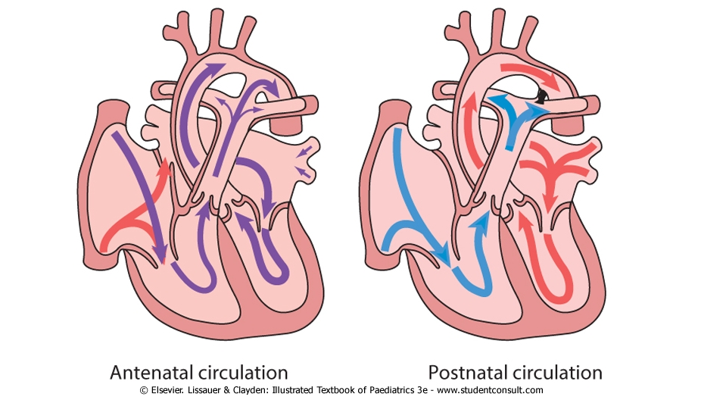
CIRCULATORY CHANGES AT BIRTH

Slide 3
Congenital heart diseases
Abnormalities of the heart or great vessels that are present at birth - faulty embryogenesis.
Generally incidence is approximately 1% of live births
higher in premature infants and in stillborns.
Most common type of heart disease among children.
Failure of normal cardiac development or persistence of the fetal circulation after birth.

Slide 4
ETIOLOGY
Maternal disorders
Rubella infection (30-35%)
Maternal drugs
Warfarin therapy (5%)
Fetal alcohol syndrome (25%)
Chromosomal abnormality
Down’s syndrome (30%)
SLE (35%)
DM (2%)
Complete heart block
PDA, peripheral pulmonary stenosis
PDA, pulmonary valve stenosis
ASD, VSD, tetralogy of Fallot
Atrioventricular septal defect, VSD
Edward’s and Patau’s syndrome (60-80%)
Complex disorders
Turner’s syndrome (15%)
Aortic valve stenosis, coarctation of the aorta
Most cases are multifactorial.

Slide 5
CLASSIFICATION
CHD
Acyanotic
Cyanotic
Tetralogy of Fallot
Transposition of the great arteries
Atrioventricular septal defect (AVSD)
Tricuspid atresia
Truncus arteriosus
Total anomalous pulmonary venous return
Pulmonary stenosis
Hypoplastic left ventricle
Left-to-right shunts
Outflow obstruction
- Ventricular Septal Defect (VSD)
- Persistent Ductus Arteriosus (PDA)
- Atrial Septal Defect (ASD)
- Aortic Stenosis
-Coarctation of aorta

Slide 6
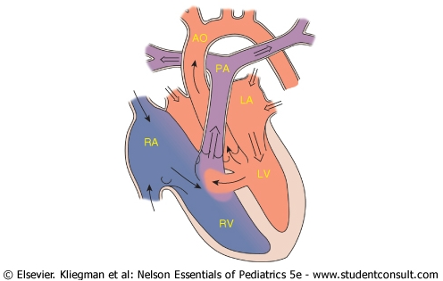
LEFT-TO-RIGHT SHUNTS

Slide 7
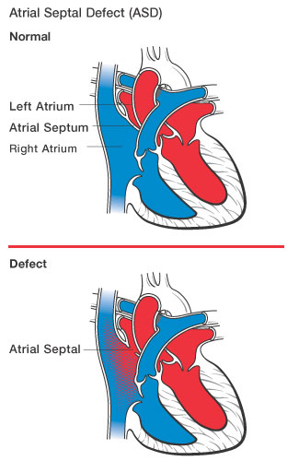
1. ATRIAL SEPTAL DEFECT (ASD)

Slide 8
ASD
Due to increased pressures on the left side of the heart, there is left to right shunting of oxygenated blood
If large defect, can cause enlarged right atria, right ventricle, and pulmonary artery resulting in abnormal arrhythmias
CHF can occur if left untreated.
10% of all CHD. F>Ms
One third of all congenital defects detected in the adult are ASDs.
2-3 times more likely to occur in women

Slide 9
ASD – Clinical F
Majority repaired in childhood, but may present in adolescence/adulthood
Asymptomatic
murmur, abnormal ECG/CXR
Symptomatic
dyspnea/CHF
CVA/emboli
Atrial Fibrillation
Shortness of breath or palpitations are possible

Slide 10
TREATMENT FOR ASD
If defect is small (less than 2mm), will usually resolves spontaneously
If defect is large, surgical correction is needed
Minimally invasive procedures available
Transcatheter devices, such as a septal occluder may be used

Slide 11
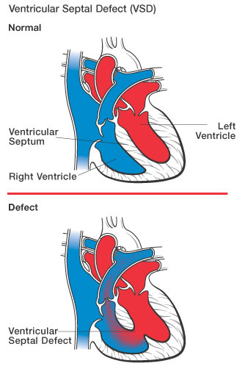
2. VENTRICULAR SEPTAL DEFECT (VSD)

Slide 12
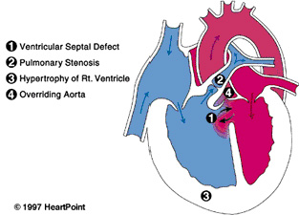
VENTRICULAR SEPTAL DEFECT (VSD)

Slide 13
VSD
Defect in the septum separating the right and left ventricles
Most common type of congenital heart disease accounting for 25% of all cases
Can occur singly or in multiples anywhere along the ventricular septum
Small defects often close spontaneously in the first 2 years of life while large defects require surgical repair within the 1st year

Slide 14
VSD
Prevalence equal between boys and girls
Due to increased pressures in the left ventricle, left to right shunting of oxygenated blood occurs
With the increased pulmonary blood flow, pulmonary hypertension can occur with large defects

Slide 15
SYMPTOMS OF VSD
Rapid breathing
Irritability
Excessive Sweating
Poor weight gain
Congestive Heart Failure, usually within 6 to 8 weeks of life if defect is large
Pulmonary Hypertension if defect is large

Slide 16
TREATMENTS FOR VSD
Lasix and Aldactone to decrease symptoms of CHF
Digoxin to increase effectiveness of myocardial function
If surgery needed, patching or suturing the defect can be done
Mortality from surgery is low

Slide 17
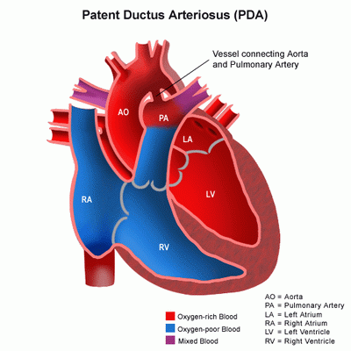
3. PATENT DUCTUS ARTERIOSUS (PDA)
The ductus arteriosus (DA) connects the pulmonary artery to the descending aorta during fetal life.
PDA results when the ductus fails to close after birth.
PDAs account for about 10% of cases of congenital heart lesions;

Slide 18
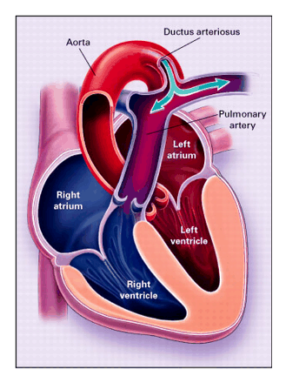
PDA

Slide 19
PDA
Pathophysiology:
Blood flows from aorta to the pulmonary
artery, creating a left to right shunt, resulting
in left atrium and ventricle overload.
Increased pulmonary blood flow can result in
pulmonary hypertension and reversal of the
shunt, which is known as Eisenmenger’s
reaction. This results in flow of
desaturated blood to the lower extremities.

Slide 20
PDA
Symptoms:
Children with small patent ductus arteriosus are usually asymptomatic.
Large left to right shunts develop symptoms of congestive heart failure such as tachypnea, tachycardia, poor feeding and slow growth
Physical exam:
Continuous murmur heard best at the upper left sternal border (machinery murmur) (audible as harsh "machinery-like" murmurs).
Bounding pulse

Slide 21
PDA
Lab Studies:
CXR: enlarged cardiac silhouette secondary to left atrial and ventricular enlargement with prominent pulmonary vascular markings.
ECG: left atrial enlargement, Left ventricular hypertrophy
ECHOCARDIOGRAPHY: doppler flow through the ductus
Treatment:
Surgical division or ligation of the PDA
Childhood- indomethacin – inhibits prostagladin production and stimulate ductus closure.

Slide 22
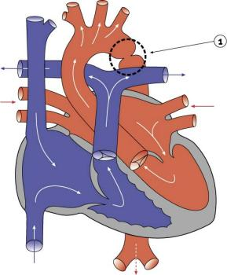
4. COARCTATION OF THE AORTA

Slide 23
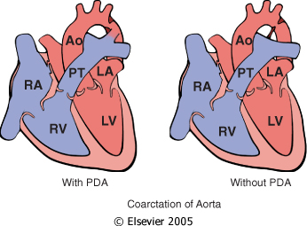
COARCTATION OF THE AORTA

Slide 24
COARCTATION OF THE AORTA
Narrowing of the aorta
Males more affected than females (2:1) Females with Turners frequently have coarctation
Of two types
■Infantile (shows symptoms early in life and is associated with PDA) and
■adult type( without PDA and children are asymptomatic till late in life)

Slide 25
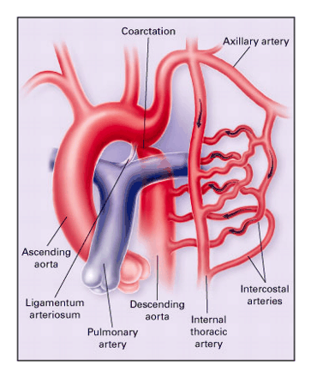
Aortic Coarctation

Slide 26
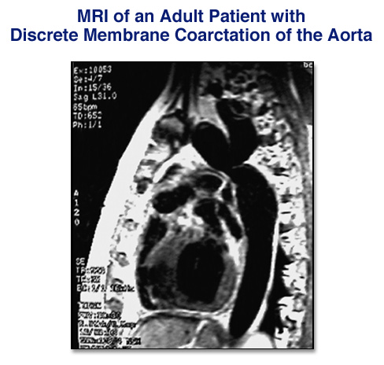
Coarctation of Aorta
Narrowing in proximal descending aorta
May be long/tubular but most commonly discrete ridge
Natural hx: poor prognosis if unrepaired
Aortic Aneurysm/dissection
CHF
Premature CAD
Mean age of death is 38 years

Slide 27
Coarctation of Aorta: Clinical
Most repaired, but adult presentation may be:
HTN-headache, epistaxis
murmur (continuous or systolic murmur heard in back or SEM/ejection click of bicuspid AV)
Weak/delayed Lower extremity pulses (radio femoral delay)
Cold legs
Claudication/pain at cuff muscles
Rib notching on CXR pathognomonic
Pansystolic murmur
LV hypertrophy

Slide 28
Investigations
CXR
ECG
ECHO
Aortography
CT scan
MRI

Slide 29
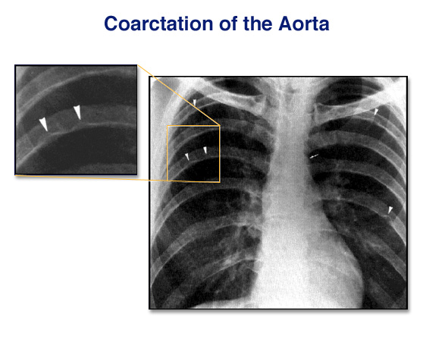
Rib notching

Slide 30
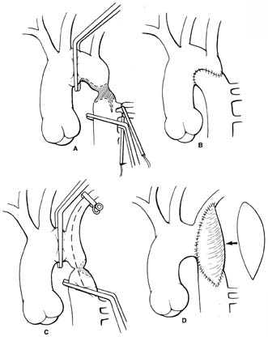
Coarctation Repair
Surgical correction
1) Patch aortoplasty with removal of segment
and end to end anastomosis or
subclavian flap repair
2) bypass tube grafting around segment
3) Baloon dilatation

Slide 31
Right-to-Left Shunts (Cyanotic CHD)
Cardiac malformations associated with right-to-left shunts are distinguished by
cyanosis at or near the time of birth.
poorly oxygenated blood from the right side of the heart is introduced directly into the arterial circulation.
severe, long-standing cyanosis;
clubbing of the fingertips (hypertrophic osteoarthropathy) and polycythemia

Slide 32
CYANOTIC CHDs
The “Ts”
Tetralogy of Fallot (TOF)
Transposition of the great arteries (TGA)
Tricuspid atresia
Truncus arteriosus
Total anomalous pulmonary venous return
Others : AVSD, Hypoplastic left ventricle, pulmonary stenosis

Slide 33
CYANOTIC CHDs
Cause of Cyanosis in CHD
RIGHT to LEFT shunt
Systemic venous return
Right heart
Left heart
Systemic circulation

Slide 34
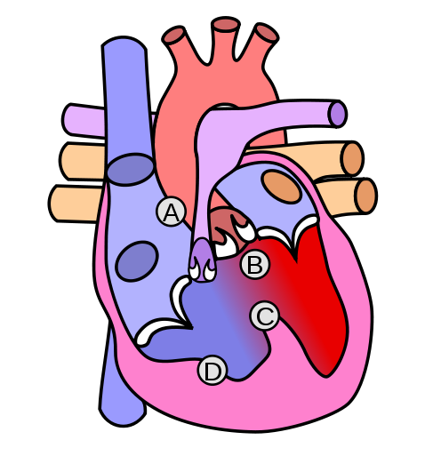
1. TETRALOGY OF FALLOT
A. Pulmonary artery
stenosis
B. Overriding Aorta(malposition)
C. Ventricular septal
defect (VSD)
D. Right ventricular
hypertrophy (RVH)

Slide 35
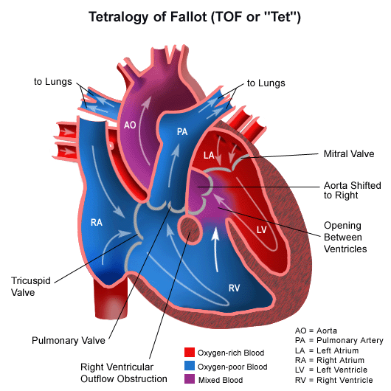
TETRALOGY OF FALLOT
TOF is the most common cyanotic CHD,
≈ 10% of all CHDs
Occurs in approx 400 per 1,000,000 livebirths
Untreated TOF Survival is ≈75% after the first yr of life, 60% by four yrs, 30% by ten yrs, and 5% by forty yrs.

Slide 36
TETRALOGY OF FALLOT
Pathophysiology:
Increased resistance by the pulmonary
stenosis
Deoxygenated systemic venous return is
diverted from RV, through VSD to the
overriding aorta and systemic circulation
systemic hypoxemia and cyanosis

Slide 37
TETRALOGY OF FALLOT
Signs and Symptoms:
Dyspnea on exertion or when crying
Tet spells: irritability, cyanosis, hyperventilation and sometimes syncope or convulsions due to cerebral hypoxemia.
Patients learn to alleviate symptoms by squatting (or folding themselves on their knees) which increases systemic resistance and decreases the right-to-left shunt and directs more blood to the pulmonary circulation.

Slide 38
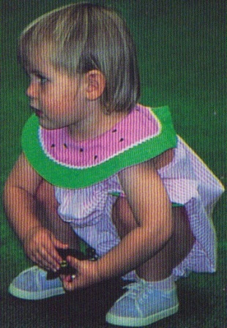
TETRALOGY OF FALLOT
Other signs and symptoms
Failure to thrive
Lack of energy
Frequent Infections
Polycythemia
Finger clubbing
Cerebral abscesses
Cardiomegaly
Hyperactive precordium
Pigeon chest
Parasternal heave

Slide 39
HYPOXIC SPELLS/’TET’ SPELLS in TOF
Usually occur in the first 2 years of life (peak incidence between 2 and 4 months of age)
Severe hypoxia→ tissue acidosis→ breathlessness and pallor
Rapid increase in cyanosis
Restless and agitated
Inconsolable crying
An ambulatory toddler may squat
Severe spells: Prolonged unconsciousness and convulsions, Hemiparesis OR death!!

Slide 40
TETRALOGY OF FALLOT
Physical exam:
Clubbing of the fingers and toes
Systolic ejection murmur heard at the upper left sternal border created by turbulent blood flow through stenotic RV outflow tract
Investigations
CXR: Normal to slightly enlarged heart, prominent RV, ‘boot shaped heart’ Coeur en sabot, ↓ pulm vascular markings (due to pulm. Oligaemia)
ECG: RVH, right axis deviation
ECHOCARDIOGRAPHY: displays and quantifies extent of RV outflow tract obstruction, coronary artery anomalies in ~5%

Slide 41
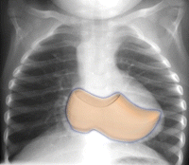
CXR in TOF (1)

Slide 42
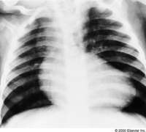
CXR in TOF (2)

Slide 43
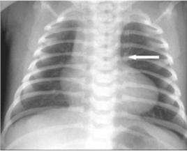
CXR in TOF (3)

Slide 44
MANAGING ‘TET’ SPELLS
‘Tet’/’Hypoxic’/’Hypercyanotic’ spells (beyond about 15 minutes):
O2 administration
Place the child in the knee-chest position
Give Morphine SO₄ Subcutaneously or IM (to relax pulm. infundibulum , also supresses the resp centre thus abolishes hyperpnoea, + sedation)
Phenylephrine(an α-adrenoreceptor agonist) – causes systemic vasoconstriction
β-Blockers (propranolol): reduces the heart rate, helps reverse the spell

Slide 45
MANAGING ‘TET’ SPELLS
‘TET’ SPELLS MANAGEMENT (Ctd)
Ketamine iv over 1 min also works well for spells. It increases systemic vascular resistance and sedates the infant
Sodium Bicarbonate (NaHCO₃) to treat acidosis (i.v). Same dose can be repeated in 10-15 mins. NaHCO₃ reduces the resp centre-stimulating effect of acidosis.

Slide 46
TETRALOGY OF FALLOT
Treatment:
Surgical closure of the VSD and enlargement of the pulmonary outflow tract
Overall incidence of sudden death in TOF patients after surgical repair is about 0.3%.
Life-long follow up
Prophylactic antibiotics – prevent endocarditis

Slide 47
2. TRANSPOSITION OF GREAT ARTERIES
5% of CHD (the most common cyanotic CHD in newborn period)
Abnormality in septation of truncus arteriosus
Aorta arises from the RV, anterior and to the right of the pulmonary artery, which arises from the LV
Naturally occurring associated anomalies that cause mixing: VSD, ASD, PDA
More common in infants of diabetic mothers

Slide 48
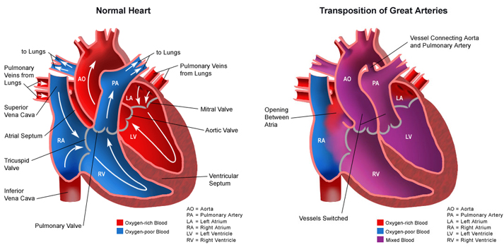

Slide 49
CLINICAL FEATURES of TGA
Cyanosis is always present
Finger clubbing
Tachypnea
Single Second heart sound
Usually no murmur
Signs of congestive heart failure in children with transposition and a large VSD.

Slide 50
INVESTIGATIONS FOR TGA
CXR
Narrow upper mediastinum with an ‘egg on side’ appearance of the cardiac shadow
Increased pulmonary vascular markings
ECG
Right axis deviation and RVH
Echocardiography
Transposition of the great arteries, the sites and the amount of blood mixing occuring

Slide 51
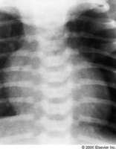
CXR in TGA “egg on side”

Slide 52
MANAGEMENT OF TGA
IV Prostaglandin E1 infusion to ensure PDA
Balloon septostomy
Surgery: arterial switch procedure (2-4weeks of age)
VSD closure before three months of age.
Untreated, 90% die in first month, if no ASD

Slide 53
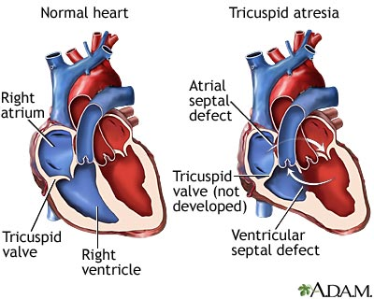
3. Tricuspid atresia

Slide 54
TRICUSPID ATRESIA
Absence of the tricuspid valve
Cyanosis is almost always present at birth and is
progressive
Features: Absent tricuspid valve, Atrial septal
defect, Ventricular septal defect
Blood is shunted through an atrial septal defect or patent foramen ovale to the left atrium and through the ventricular septal defect to the pulmonary artery

Slide 55
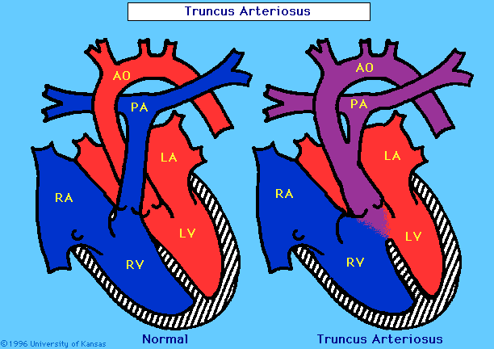

Slide 56
4. TRUNCUS ARTERIOSUS
Failure of separation into aorta and pulmonary
artery
Results in single great artery which receives blood from both ventricles [leads to early systemic cyanosis]
Accompanying VSD
↑ pulmonary blood flow with danger of irreversible pulmonary hypertension

Slide 57
5. TOTAL ANOMALOUS PULMONARY VENOUS RETURN (TAPVR)
Also known as Total anomalous pulmonary venous connection (TAPVC), or Total anomalous pulmonary venous drainage (TAPVD)
Is a rare cyanotic CHD in which all 4 pulmonary veins are malpositioned and make anomalous connections to the systemic venous circulation.
A patent foramen ovale or an ASD must be present or else the condition is fatal due to a lack of systemic blood flow.

Slide 58
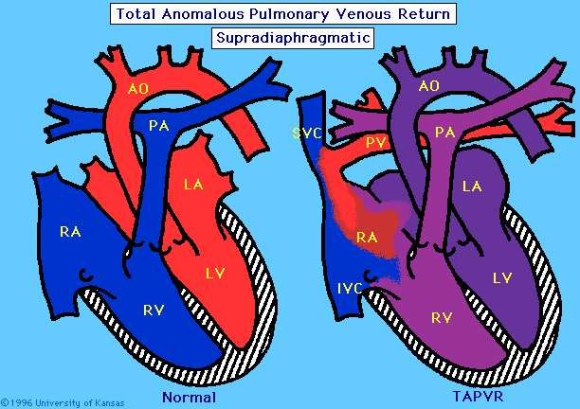
TOTAL ANOMALOUS PULMONARY VENOUS RETURN
TAPVR

Slide 59
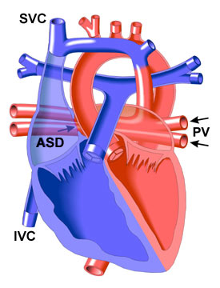
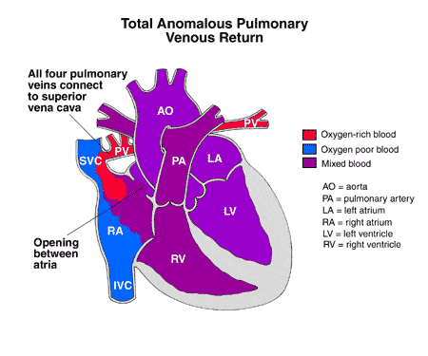
SUPRACARDIAC TAPVR

Slide 60
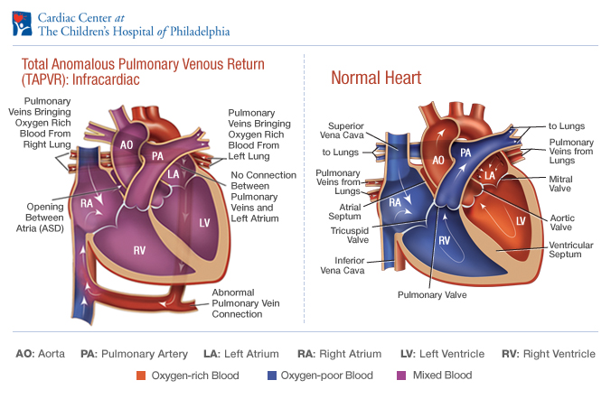
INFRACARDIAC TAPVR

Slide 61
TAPVR
All 4 pulmonary veins join a common chamber which eventually reaches Right atrium.
Supracardiac- common chamber drains to innominate vein or to SVC.
Cardiac- drains to coronary sinus or Right atrium
Infracardiac (Infradiaphragmatic). Descending vertical vein → portal vein → ductus venosus → Inferior vena cava.

Slide 62
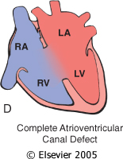
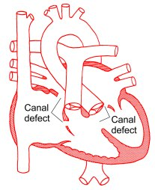
6. ATRIOVENTRICULAR SEPTAL DEFECT (AVSD)

Slide 63
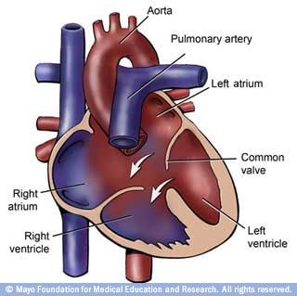
AVSD

Slide 64
AVSD
AVSD results from incomplete fusion of the endocardial cushions, which help to form the lower portion of the atrial septum, the membranous portion of the ventricular septum and the septal leaflets of the triscupid and mitral valves.
Contiguous atrial and ventricular SD with abnormal AV valves
They account for 4% OF ALL CHD
Common in Down’s syndrome (20-25% of cases)

Slide 65
AVSD
Incomplete AVSD maybe indistinguishable from ASD - usually asymptomatic.
Congestive heart failure in infancy.
Recurrent pulmonary infections.
Failure to thrive.
Exercise intolerance, easy fatigability.
Late cyanosis from pulmonary vascular disease with R to L shunt.
Surgery is always required

Slide 66
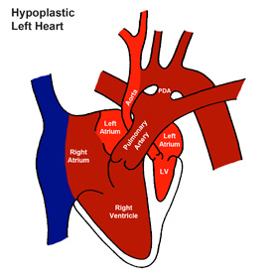
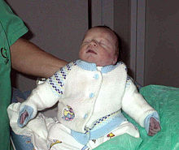
7. HYPOPLASTIC LEFT HEART SYNDROME

Slide 67
HYPOPLASTIC LEFT HEART SYNDROME
Hypoplastic left heart syndrome (HLHS) is a rare CHD in which the left ventricle of heart is severely underdeveloped.
In HLHS, the right side of the heart often must pump blood to the body through a PDA. As the DA usually closes within eleven days after birth, blood flow is severely restricted and eventually cut off, leading to dangerously low circulation and eventually to shock.

Slide 68
QUESTIONS

