Slide 1
HEART FAILURE
gnguutu@gmail.com

Slide 2
HEART FAILURE
Definition:
Impaired cardiac pumping such that heart is unable to pump adequate amount of blood to meet metabolic needs
Not a disease but a “syndrome”
It may be acute or chronic.
The term congestive heart failure (CHF) is used for the chronic form of heart failure in which the patient has evidence of congestion of peripheral circulation and of lungs.
Results from any structural or functional abnormality that impairs the ability of the ventricle to eject blood (Systolic Heart Failure) or to fill with blood (Diastolic Heart Failure).

Slide 3
Heart Failure (HF) - Key Concepts
CO = SV x HR-becomes insufficient to meet metabolic needs of body
SV- determined by preload, afterload and myocardial contractility
*Classifications HF
Systolic failure- decreased contractility
Diastolic failure- decreased filling
Mixed
Notes:
An ejection fraction (EF) is one of the measurements used by physicians to assess how well a patient’s heart is functioning. “Ejection” refers to the amount of blood that is pumped out of the heart’s main pumping chamber during each heartbeat. “Fraction” refers to the fact that, even in a healthy heart, some blood always remains within this chamber after each heartbeat. Therefore an ejection fraction is a percentage of the blood within the chamber that is pumped out with every heartbeat. An EF of 55 to 75 percent is considered normal. A higher than normal ejection fraction could indicate the presence of certain heart conditions, such as hypertrophic cardiomyopathy. A low ejection fraction could be a sign that the heart is weakened.

Slide 4
Aetiology of CCF
PUMP FAILURE.
Ischaemic heart disease- attributed by coronary artery dse – responsible for about 40% of all HF cases.
Myocarditis
MI
Cardiomyopathies- dilated cardiomyopathy(DCM)
Metabolic disorders e.g. beriberi
poisons
Disorders of the rhythm e.g. atrial fibrillation and flutter.

Slide 5
2. INCREASED WORKLOAD ON THE HEART.
May be in the form of pressure load or volume load.
Hypertension.
Valvular lesions e.g.MS, AS, PS.
Chronic lung diseases.
Severe anaemia
Thyrotoxicosis
Thiamine deficiency (alcohol)
Congenital heart dses e.g VSD, ASD
Hypoxia due to lung diseases.

Slide 6
3. IMPAIRED FILLING OF CARDIAC CHAMBERS.
Extra-cardiac causes or defect in filling of the heart:
Cardiac tamponade e.g. haemopericardium, hydropericardium
Constrictive pericarditis.
Hypertrophic obstructive cardiomyopathy (HOCM)
Restrictive cardiomyopathy

Slide 7
Risk factors
Primary risk factors
Coronary artery disease (CAD)
Advancing age
Contributing risk factors
Hypertension
Diabetes
Tobacco use
Obesity
High serum cholesterol
African American descent
Valvular heart disease
Hypervolemia

Slide 8
Precipitants of heart failure
Anaemia
Infections including pneumonia and infective endocarditis
Uncontrolled HTN
Uncontrolled hyperglyceamia
Thyrotoxicosis –patients with heart failure must have the thyroid gland examined
Excessive exercise
Drugs – NSAIDS, steroids, CCBs
Pulmonary embolism
Patients already on medication (for CCF) and are non- compliant
Substance abuse
A new MI
Pregnancy
Arrhythmias
Electrolyte imbalance of whatever cause

Slide 9
TYPES OF HEART FAILURE
Heart failure may be:-
acute or chronic,
right-sided or left-sided,
forward or backward failure,
diastolic or sytolic and
high output or low output.

Slide 10
Clinical syndromes of heart failure
Left ventricular failure
Right ventricular failure
Systolic heart failure – inadequate cardiac or forward failure.
Diastolic heart failure ( backward failure)
High output failure – associated with high cardiac output ( A-V shunt, beriberi, severe anaemia or thyrotoxicosis) and elevation in pulmonary venous pressure.
Biventricular heart failure (Lt + Rt ventricular failure)
Acute and chronic heart failure

Slide 11
ACUTE AND CHRONIC HEART FAILURE.
Acute heart failure:
Sudden and rapid development of heart failure
In acute heart failure, there is sudden reduction in cardiac output resulting in systemic hypotension but oedema does not occur.
Instead, a state of cardiogenic shock and cerebral hypoxia develops
Chronic heart failure:
More often, heart failure develops slowly

Slide 12
LEFT-SIDED AND RIGHT-SIDED HEART FAILURE:
Though heart as an organ eventually fails as a whole, but functionally, the left and right heart act as independent units.
From a clinical point of view, therefore, it is helpful to consider failure of the left and right heart separately.
The clinical manifestations of heart failure result from accumulation of excess fluid upstream to the left or right cardiac chamber whichever is initially affected.

Slide 13
Left-sided heart failure:
It is initiated by stress to the left heart. The major causes are as follows:
i) Systemic hypertension
ii) Mitral or aortic valve disease (stenosis)
iii) Ischaemic heart disease
iv) Myocardial diseases e.g. cardiomyopathies, myocarditis.
v) Restrictive pericarditis.
The clinical manifestations of left-sided heart failure result from decreased left ventricular output and hence there is accumulation of fluid upstream in the lungs.

Slide 14
Accordingly, the major pathologic changes are as under:
i) Pulmonary congestion and oedema causes dyspnoea and orthopnoea - Initially, DOE , then PND , Then dyspnea at rest.
ii) Decreased left ventricular output causing hypoperfusion and diminished oxygenation of tissues e.g.
a) Kidneys- causing ischaemic acute tubular necrosis,
b) Brain causing hypoxic encephalopathy,
c) Skeletal muscles causing muscular weakness and fatigue.

Slide 15
Right-sided heart failure:
Right-sided heart failure occurs more often as a consequence of left-sided heart failure.
However, some conditions affect the right ventricle primarily,
producing right-sided heart failure. These are as follows:
i) As a consequence of left ventricular failure.
ii) Cor pulmonale in which right heart failure occurs due to
intrinsic lung diseases.
iii) Pulmonary or tricuspid valvular disease.
iv) Pulmonary hypertension secondary to pulmonary
thromboembolism.
v) Myocardial disease affecting right heart.
vi) Congenital heart disease with left-to-right shunt.
Whatever be the underlying cause, the clinical
manifestations of right-sided heart failure are upstream of the
right heart such as systemic (due to caval blood) and portal
venous congestion, and reduced cardiac output

Slide 16
Accordingly, the pathologic changes are as under:
i) Systemic venous congestion in different tissues and organs e.g. subcutaneous oedema on dependent parts, passive congestion of the liver, spleen, and kidneys, ascites, hydrothorax, congestion of leg veins and neck veins.
ii) Reduced cardiac output resulting in circulatory stagnation causing anoxia, cyanosis and coldness of extremities.
In summary, in early stage the left heart failure manifests with features of pulmonary congestion and decreased
left ventricular output, while the right heart failure presents
with systemic venous congestion and involvement of the liver and spleen.
CHF, however, combines the features of both left and right heart failure.

Slide 17
BACKWARD AND FORWARD HEART FAILURE.
The mechanism of clinical manifestations resulting from heart failure can be explained on the basis of mutually interdependent backward and forward failure.
Backward heart failure: According to this concept, either of
the ventricles fails to eject blood normally, resulting in rise
of end-diastolic volume in the ventricle and increase in
volume and pressure in the atrium which is transmitted
Backward producing elevated pressure in the veins.
Forward heart failure: According to this hypothesis, clinical
manifestations result directly from failure of the heart to
pump blood causing diminished flow of blood to the tissues,
especially diminished renal perfusion and activation of renin- angiotensin- aldosterone system.

Slide 18
Pathophysiology
The pathophysiologic changes are usually due to overwhelmed compensatory mechanisms for the heart to meet the body’s metabolic demands. The pathology results from:-
Haemodynamic changes- decreased output and decreased filling.
Neurohormonal changes – stimulation of RAAS- Vasoconstriction , salt n water retention n sympathetic activation - increased myocardial contractility, HR and peripheral vasoconstriction.
Cardiac compensatory mechanisms
Tachycardia
Ventricular dilatation - Starling’s law
Myocardial hypertrophy(myocytes) / cardiac hypertrophy and dilatation
Hypoxia leads to decreased contractility

Slide 19
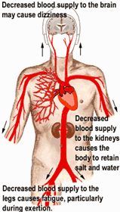
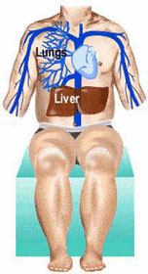
Heart Failure manifestations

Slide 20
Clinical Presentation of Heart Failure
Dyspnea (most sensitive symptom)
Edema
Hepatic congestion
Ascites
Orthopnea, Paroxysmal Nocturnal Dyspnea (PND)
Nocturnal cough
Wheeze (cardiac asthma)
Wt loss and mss wasting (cardiac cachexia)-anorexia, malabsorption, loss of nutrients, increased metabolic rates
Fatigue (especially with exertion
Weakness

Slide 21
Physical Examination in Heart Failure
S3 gallop - Low sensitivity, but highly specific
Cool, pale, cyanotic extremities
Have sinus tachycardia, diaphoresis and peripheral vasoconstriction
Crackles or decreased breath sounds at bases (effusions) on lung exam
Elevated JVP
Lower extremity edema
Ascites,Hepatomegaly,Splenomegaly
Anarsaca
Displaced Apex beat

Slide 22
Clinical features of RHF/Cor pulmonale
Fatigue, lethergy, anorexia, nausea, breathlessness
Venous congestion
Peripheral pitting edema
Weight gain
Ascites
Hepatomegaly- tender smooth
Splenomegaly
Jugular venous distension
Pleural effusion ( transudate)
cardiomegally

Slide 23
Lt HF features
Fatique
Exertional dyspnoea
Orthopnoea
PND
Cardiomegally
Hyperactivity of precordium with displaced apex
Tarchycardia – gallop rhythm (like jumping horse)
Crackles at lung bases
Mitral valve murmur

Slide 24
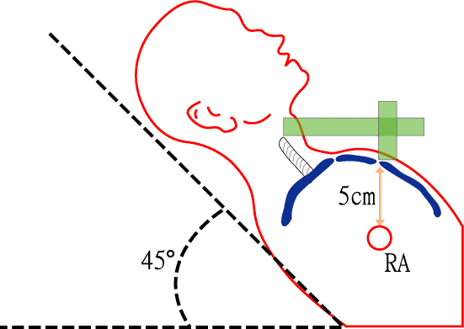
Measuring Jugular Venous Pressure

Slide 25
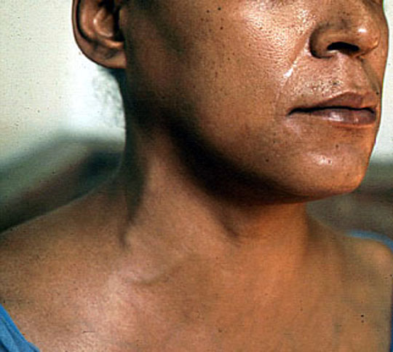
JVD

Slide 26
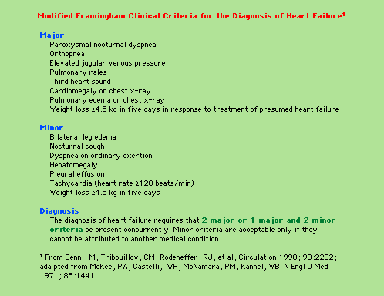

Slide 27
Investigation
CBC- Hb, wbc
Serum electrolytes and creatinine
Fasting Blood glucose
Thyroid function tests (TFTs)
Iron studies - screen for hereditary hemochromatosis as cause of heart failure.
CXR – Cardiomegaly ,Cephalization of the pulmonary vessels ,Kerley ABC-lines (linear opacities – p. oedema) , Pleural effusions
LFTs –
ECG
Echo
MRI
Cardiac catheterization
Exercise Testing - Should be part of initial evaluation of all patients with CHF.
Coronary arteriography
Endomyocardial biopsy

Slide 28
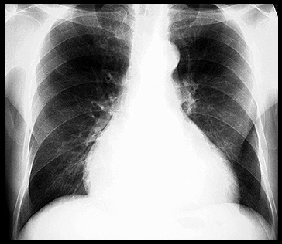
Cardiomegaly

Slide 29
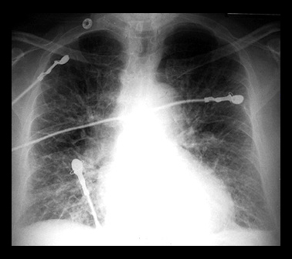
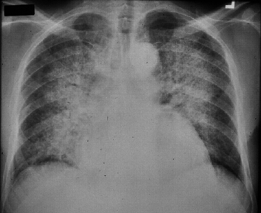
Pulmonary Edema due to Heart Failure

Slide 30
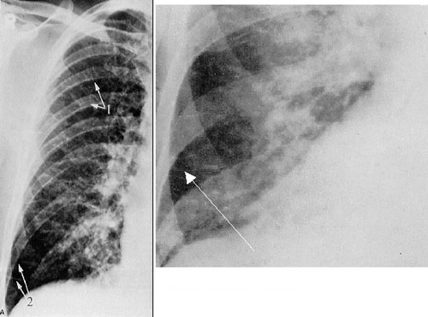
Kerley B lines

Slide 31
Clinical staging of Heart Failure symptoms/Classification of severity for heart failure
New York Heart Association (NYHA) classification
Class I – symptoms of HF only at levels that would limit normal individuals.
Class II – symptoms of HF with ordinary exertion
Class III – symptoms of HF on less than ordinary exertion
Class IV – symptoms of HF at rest

Slide 32
Management of HF
Correction of systemic factors/ precipitants/ treat underlying cause
Thyroid dysfunction
Infections
Uncontrolled diabetes
Hypertension
Limit fluid intake (input/output chart)
Lifestyle modification
Lower salt intake- 2g/day
Alcohol and smoking cessation
Medication compliance
Maximize medications
Discontinue drugs that may contribute to heart failure (NSAIDS, antiarrhythmics, calcium channel blockers)

Slide 33
Heart Failure (ADHF) Pneumonic (emergency mgmt)
U Upright Position (prop up)
N Nitrates
L Lasix (iv frusemide)
O Oxygen
A ACE, ARBs, Amiodorone
D Digoxin, Dobutamine
M Morphine Sulfate (opiates)
E Extremities Down

Slide 34
Order of Therapy
Loop diuretics – frusemide 40-80mg OD
ACE inhibitor (or ARB if not tolerated)- captopril 6.25mg TID, enalapril 10-20 BD, lisinopril 5-40mg OD s/e cough , change to ARB Losartan
Beta blockers – carvedilol , bisoprolol, metoprolol
Digoxin 0.125mg OD – antiarrhythmic-can use ICD (implantable cardiovertor defibrillator)
Potassium sparing diuretcs – spironolactone 25-50mg daily
Vasodilators – Hydralazine 25mg tid plus Isosorbide Nitrate 40mg tid = failure to improve on above drugs
Anticoagulant – pts with A . fib

Slide 35
Diuretics
Loop diuretics
Furosemide, bumetanide
For Fluid control, and to help relieve symptoms
Potassium-sparing diuretics
Spironolactone, eplerenone
Help enhance diuresis
Maintain potassium
Shown to improve survival in CHF

Slide 36
ACE Inhibitors
Improve survival in patients with all severities of heart failure.
Begin therapy low and titrate up as possible:
Enalapril – 2.5 mg po BID
Captopril – 6.25 mg po TID
Lisinopril – 5 mg po QDaily
If cannot tolerate, may try ARB

Slide 37
Beta Blocker therapy
Certain Beta blockers (carvedilol, metoprolol, bisoprolol) can improve overall and event free survival in NYHA class II to III HF, probably in class IV.
Contraindicated:
Heart rate <60 bpm
Symptomatic bradycardia
Signs of peripheral hypoperfusion
Asthma
PR interval > 0.24 sec, 2nd or 3rd degree block

Slide 38
Hydralazine plus Nitrates
Dosing:
Hydralazine
Started at 25 mg po TID, titrated up to 100 mg po TID
Isosorbide dinitrate
Started at 40 mg po TID/QID
Decreased mortality, lower rates of hospitalization, and improvement in quality of life.

Slide 39
Digoxin
Given to patients with HF to control symptoms such as fatigue, dyspnea, exercise intolerance
Shown to significantly reduce hospitalization for heart failure, but no benefit in terms of overall mortality.

Slide 40
Meds to AVOID in heart failure
NSAIDS -Can cause worsening of preexisting HF
Thiazolidinediones
Include rosiglitazone and pioglitazone
Cause fluid retention that can exacerbate HF
Metformin - people with HF who take it are at increased risk of potentially lethal lactic acidosis

Slide 41
Heart Failure Complications
Uraemia / renal failure
Hypokalaemia
Hyperkalaemia
Hyponatriemia
Pleural effusion
Atrial fibrillation (most common dysrhythmia)
Thromboembolism
Impaired liver fxns

