Slide 1
ECTOPIC PREGNANCY
DR. OCHIENG

Slide 2
Outline
Introduction
Definition
Classification and incidence
Aetiology
Clinical findings

Slide 3
Laboratory findings
Special examinations
Treatment
Medical
Surgical
Prevention.

Slide 4
Introduction
Ectopic pregnancy is a significant cause of maternal morbidity and mortality.
Significant cause of fetal loss in early pregnancy.
Early diagnosis minimizes potential complications e.g. hemorrhage.

Slide 5
The blastocyst normally implants in the endometrial lining of the uterine cavity
Definition
Pregnancy in which the fertilized ovum implants in an area other than the endometrial lining of the uterine cavity.
‘Ektopos’ greek word meaning ‘out of place’

Slide 6
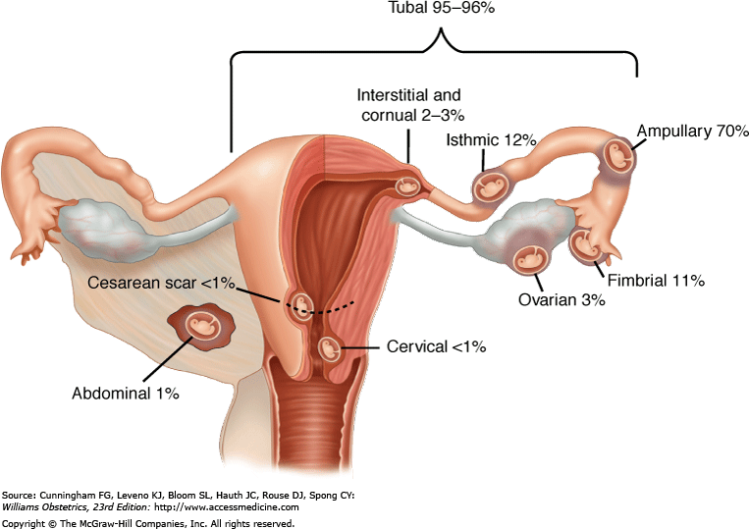

Slide 7
More than 95% of ectopic pregnancy occurs in the fallopian tubes.
Classification and incidence
Implantation sites
Tubal (>95%)
Ampullary 70 %
Isthmic 12%

Slide 8
Fimbrial 11%
Interstitial 2-3 %
2. Other implantation sites (<5%)
Cervical
Ovarian
Abdominal
3. Intraligamentous

Slide 9
4. Heterotopic
An ectopic pregnancy occurring in combination with an intrauterine pregnancy
5. Bilateral ectopic pregnancy

Slide 10
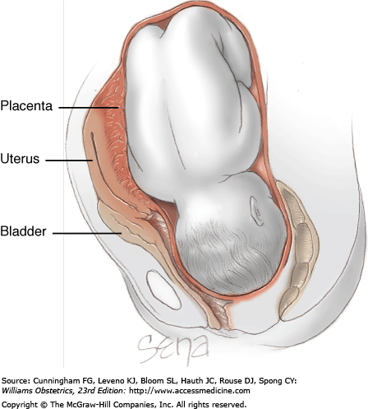

Slide 11
Aetiology
Aetiology of ectopic pregnancy not well understood
Risk factors:
Tubal factors
Ectopic pregnancy commoner in women who have had salpingitis.
The following are risk factors for tubal ectopic pregnancy

Slide 12
Tubal surgery
Previous ectopic pregnancy
Previous abortion
Multiple sexual partners
Previous pelvic or abdominal surgery
STIs e.g. Chlamydia
Interfere with passage of the fertilized ovum in the fallopian tubes.

Slide 13
2. Exogenous hormones
Progesterone only contraceptive pills.
Progesterone has smooth muscle relaxant effects.
3. Other factors
IUCD
Smoking
4. Assisted Reproductive Technology

Slide 14
Epidemiology
There has been an increase in the rate of ectopic pregnancies
Causes for increased ectopic pregnancy rates :
High prevalence of STIs
Induced abortions followed by salpingitis
Tubal surgery
Contraceptive failure eg IUCD, E-pill, BTL

Slide 15
Tubal rupture
Rupture is usually spontaneous
Isthmic pregnancies rupture earliest 6-8 weeks gestation.
Ampullary pregnancy rupture at 8-12 weeks
Interstitial pregnancies are the last to rupture 12-16 weeks. Myometrium allows more room to grow than the tubal wall.
Interstitial rupture is dangerous because of proximity to uterine and ovarian vessels.

Slide 16
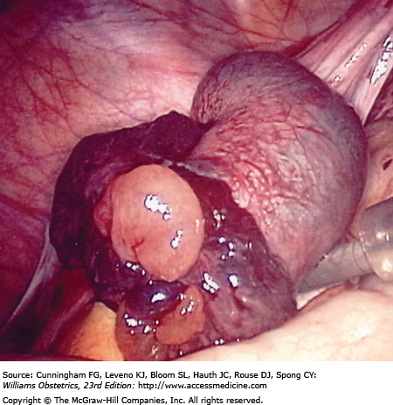

Slide 17
Clinical findings
Early diagnosis is crucial
High index of suspicion when any pregnant woman presents with bleeding or abdominal pain in early pregnancy.
Clinical presentation diverse and depend on whether rupture has occurred or not.

Slide 18
Symptoms:
Pain
Reported by 95% of patients
Pelvic or abdominal pain.
Unilateral or bilateral
Shoulder pain in intraabdominal hemorrhage due to irritation of the diaphragm.

Slide 19
2. Bleeding
Abnormal uterine bleeding usually spotting occurs in 75% of patients.
Bleeding represents decidual sloughing.
Maybe mistaken for POCs.
3. Amenorrhea
4. Syncope: Dizziness, fainting spells

Slide 20
Signs:
1. Tenderness
Diffuse or localized tenderness.
Adnexial or cervical motion tenderness
POD full and tender.
2. Adnexial mass:
Unilateral adnexial mass
Cul de sac mass

Slide 21
3. Uterine changes:
Uterus soft and bulky due to pregnancy changes.
4. Hemodynamic changes:
Vital signs reflect hemodynamic status of patient.
With rupture there are signs and symptoms of shock.

Slide 22
INVESTIGATIONS
Laboratory
FBC
Haematocrit (pcv), Hb, WBC
2. Urine pregnancy test
3. Serum B- hcG.
4.GXM in readiness for transfusion and theatre
5. U/E/ creatinine – preparation for theatre

Slide 23
Radiological investigation
Pelvic ultrasound
Transabdominal ultrasound
Transvaginal ultrasound
Other diagnostic procedures
Laparoscopy
Diagnostic and for management
Laparotomy
Culdocentesis- Passage of a needle into the posterior cul de sac to determine whether free blood is present.

Slide 24
Paracentesis
Needle inserted in iliac fossa to obtain free blood.
In ectopic non clotting blood is obtained.
Treatment
General measures.
I.V. Access
I.V. Fluids plasma expanders- N/Saline
- Haemacel

Slide 25
Surgical
Salpingectomy -
Open surgery
Laparoscopic surgery
Salpingostomy
2. Medical management
Methotrexate
Destroy proliferating trophoblast
Small unruptured ectopic pregnancy

Slide 26
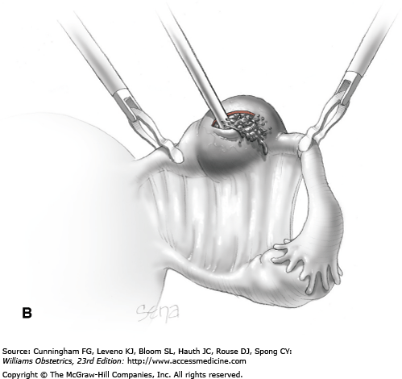

Slide 27
Contraindicated in ectopic pregnancy > 3.5cm with fetal heart motions.
Monitor BhCG levels.
Prevention
Prevention of sexually transmitted diseases
Optimum treatment of STIs

Slide 28
Thank you

