Slide 1
PTE
G.K. NGUUTU

Slide 2
Pulmonary Thromboembolism (PTE)
DEF:-
Refers to obstruction of the pulmonary artery or one of its branches by material that originated elsewhere in the body
Examples of PE :- thrombus/ blood clot, tumor/neoplastic cells, air, fat droplets , parasite, injected material)
Pulmonary embolism is the most serious complication of venous thrombosis

Slide 3
Perspective
A Common disorder and potentially deadly
650,000 cases occurring annually
Highest incidence in hospitalized patients
Autopsy reports suggest it is commonly “missed” diagnosed
It is the third most common cause of death in the US
As many as 60% of deaths in hospitalized patients are found to have pulmonary emboli
So, generally speaking it is a hard diagnosis to make….
As clinicians we must consider the diagnosis in patients to put us on the right path
Notes:
Pulmonary embolism is the most serious complication of venous thrombosis
It is the third most common cause of death in the US
As many as 60% of deaths in hospitalized patients are found to have pulmonary emboli
So, generally speaking it is a hard diagnosis to make….
As clinicians we must consider the diagnosis in patients to put us on the right path

Slide 4
Classification
PE can be classified as acute or chronic.
Patients with acute PE typically develop symptoms and signs immediately after obstruction of pulmonary vessels. often results in acute right ventricular failure and death
Patients with chronic PE tend to develop slowly progressive dyspnea over a period of years due to pulmonary hypertension.

Slide 5
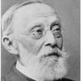
Pathophysiology
Rudolph Virchow, 1858
(German pathologist)
Virchow’s Triad:
Hypercoagulability
Stasis to flow
Vessel injury
Notes:
Everyone I’m sure is familiar with Virchow’s triad. It was first described by this German pathologist.
If we think of risk factors, we should think of them as the embodiment of the triad: hypercoagulability, stasis, and vessel injury.
So, essentially, under normal conditions, microthrombi are continually formed and lysed with the venous circulatory system.
When any one of the “risk states” exists, potential microthrombi may escape the normal fibrinolytic system and grow and propagate.
Pulmonary Emboli occurs when fragments of thrombus break loose and are carried through the right side of the heart into the pulmonary arterial tree.

Slide 6
Risk Factors
Hypercoagulability
Malignancy
Thrombophilia
Pregnancy
Postpartum status (<4wk)
Estrogen/ OCP’s
Genetic mutations (Protein C & S deficiency, Factor VIII, Prothrombin mutations, anti-thrombin III deficiency)
Venous Statis
Bedrest > 24 hr
Recent cast or external fixator
Long-distance travel or prolong automobile travel
Venous Injury
Recent surgery
Recent trauma (especially the lower extremities and pelvis)
Notes:
Cancers of primarily adenocarcinoma and CNS tumors most often cause thrombosis.
We need to make special mention about patients with a prior history of DVT or PE.
Studies have revealed these patients have between a 5 to 30 times increased risk of a new DVT in response to a triggering event compared to those who have not had prior episodes.

Slide 7
Clinical Features
Symptoms
Dyspnea
Chest Pain, pleuritic (pleurisy)
Anxiety
Cough
Hemoptysis
Sweating
Chest Pain, nonpleuritic
Syncope
Notes:
These are the common symptoms that are associated with PE
As we mentioned in the previous slide, dyspnea and chest pain are not always preset.
The explanation is that with a small V/Q mismatch, the adaptive physiology of the pulmonary vasculature and bronchi produce intermittent shortness of breath. Because of this, we are easily distracted and looking for a cardiogenic cause of the dyspnea.
What about pleuritic chest pain, still not a home run!
In fact, up to 25% of patients ultimately diagnosed with a PE, never had any chest pain!
This is what makes the diagnosis so difficult!

Slide 8
Signs
Tachypnea > 20/min
Tachycardia >100/min
Hypotension
Fever > 37.8
Diaphoresis
Rales/Crackles
S3 or S4 gallop
Thrombophlebitis
Lower extremity edema
Notes:
Lets look a t a couple of these:
Tachycardia!
Myth #2 We are all taught this is a key component of the diagnosis. Right?
In fact, actually not having tachycardia is more commonly seen in patients who are found to have a PE!
What about fever? If a patient has a fever, it must not be a PE, right?
Not true.
Although not common, Among patients with PE and no other source of fever, fever was present in one study in 43 of 311 patients (14%).

Slide 9
Clinical Presentation
The Classic Triad: (Hemoptysis, Dyspnea, Pleuritic Pain)
Not very common!
Occurs in less than 20% of patients with documented PE
Notes:
All the above symptoms are a manifestation of cardiopulmonary stress caused by the cloth in the lung.
These produce symptoms perceived by the patient and the signs observed by you!
There are three common clinical presentations that you should be aware of:
1. Patient’s with pulmonary infarction may have pleuritic chest pain and can be hard to distinguish between that patient with infection pneumonitis
2. Submassive embolism are the hardest of all. By definition, they have an angiographically defined blockage of flow to an area served by less than two lobar arteries.
These patients have acute or unexplained dyspnea with exertion or at rest. So, they can be easily confused with infection, asthma, CHF and the like.
3. Finally, Massive PE, or a clot which obstructs two lobar arteries, so-called “Saddle Embolus”. These patients have acute cor pulmonaly often with syncope. You might think there having an MI or look septic!

Slide 10
Diagnostic Test
Imaging Studies
CXR – “Hampton’s hump or a Westermark sign.”
Spiral Chest CT
Pulmonary Angiography
Echocardiograpy - RH dilatation
Laboratory Analysis
CBC, ESR, Hgb/Hct – polycythemia, raised wbc
D-Dimer - Fibrin split product
ABGA’s
ECG --Tachycardia or nonspecific ST/T-wave changes
Pulse Oximetry
Notes:
As you can see there are a variety of test that we use to arrive at a diagnosis.
Some better than others!
So, lets talk about these individually.

Slide 11
Chest X-ray of PE
Westermark's sign
A dilation of the pulmonary vessels proximal to the embolism along with collapse of distal vessels, sometimes with a sharp cutoff.
Hampton’s Hump
A triangular or rounded pleural-based infiltrate with the apex toward the hilum, usually located adjacent to the hilum.

Slide 12
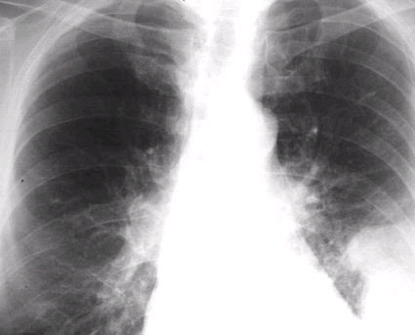
Radiographic Eponyms - Hampton’s Hump, Westermark’s Sign
Westermark’s Sign
Hampton’s Hump
Notes:
Here we see the dilated vessels and oligemia of westermark’s sign
And below Hampton’s Hump

Slide 13
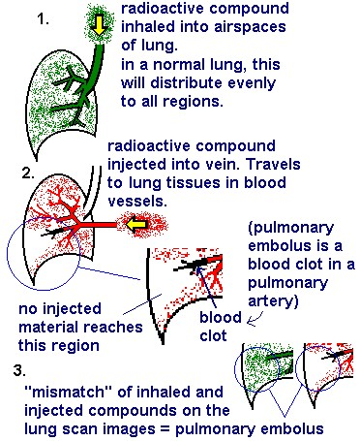
V/Q Scan
Technique
Interpretation
Normal
Low probability/”nondiagnostic” (most common)
High Probability
Simplified interpretation of results:
High probability →Treat for PE
Normal Scan →If low pre-test, your done
Everything else→Purse another study (CT, Angio)
Notes:
Essentially, a patient is injected with a radioisotope that travels through the pulmonary microcirculation and are detected by a gamma camera over the patient
A normal Perfusion study will have evenly distributed blood flow.
Then a patient inhales a radioactive gas and it is viewed as it washes over the bronchopulmonary tree.
A mismatch, areas of blocked perfusion and normal ventilation is interpreted by the radiologist and given reading as normal (never), high probability, or non-diagnostic/low-probability
The reason the low probability or non diagnostic scan category is so suspect is because in the PIOPED study this group had terrible inter-reader reliability. So, just beware.

Slide 14
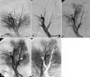
Pulmonary Angiography
“Gold Standard”
Notes:
Right now there is no better test on the horizon of the immediate present to virtually rule out or in PE.

Slide 15
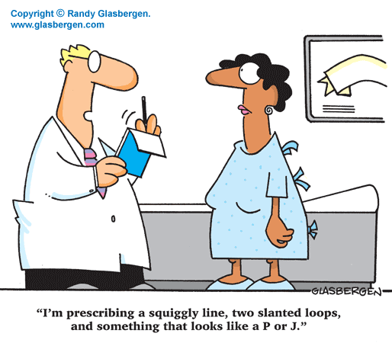
Treatment:
Goals:
Prevent death from a current embolic event
Reduce the likelihood of recurrent embolic events
Minimize the long-term morbidity of the event
Notes:
I thought this cartoon kind of summarizes how patients sometimes feel about the medical jargon we throw about and the puzzled look are there face when we try to explain this condition and how to treat it.
So what are our goals???

Slide 16
supportive Rx
Resuscitation - Stabilize the patient
Respiratory support:- supplemental O2 (hypoxemia)
Hemodynamic support:-iv fluids cautiously (hypotension)

Slide 17
Specific Treatment
Anticoagulants
Heparin
Available as Unfractionated or LMW Heparin
Unfractionated: 80 units/kg bolus, then 18 units/kg/hr infusion to maintain INR at 2.5-3
LMWH: 1 mg/kg every 12hrs or 1.5mg/kg per Day
LMWH prefered in pregnant patients
Notes:
FDA approved dose for Unfractionated heparin is 80units/kg IV bolus, then 18 units/kg/hr infusion to maintain the INR at 2.5-3
Lovenox is dosed at 1mg/kg every 12 hours or 1.5 mg/kg per day.
LMWH in pregnancy only preferred for convenience sake.

Slide 18
ii. Warfarin
Causes temporary hypercoagulable state in first 5 days of treatment
Important a patient is anticoagulated with heparin before initiating warfarin therapy
Target INR is 2.5 – 3.0
Notes:
This is because the anticoagulants protein C and S have short half-lives compared with the procoagulant vitamin K-dependent proteins.
So, this gives rise to the clinical importance that heparin must be continued for at least five days after beginning Coumadin
The incidence of progressive thrombosis and embolization is 40% when starting warfarin directly, compared to only 8% when beginning after a patient has been anticoagulated with heparin.
Treatment is usually for 6 months, but may continue lifelong

Slide 19
2. Fibrinolytic Therapy/ thrombolytic
Altivase 100mg as a continuous IV infusion.
For critically ill patients, a very rapid infusion of 100mg over 10 minutes is preferred.
ii. Retavase, you can give it as two IV doses of 10 units, each over two minutes.
Streptokinase
Urokinase
Notes:
For critically ill patients, a very rapid infusion of 100mg over 10 minutes is preferred.
Alternative is Retavase, you can give it as two IV doses of 10 units, each over two minutes.

Slide 20
3. Embolectomy
Carries a 40% operative mortality
Transvenous Catheter Embolectomy
4. IVC filter
5. NB-fat embolism—corticosteroids—methylprednisone 1.5mg/kg iv 8hourly x 2/7.
Notes:
This is a procedure where a suction tip catheter is placed in contact with the thrombus under fluoroscopy and sucked out while catheter is withdrawn

Slide 21
THANKS!!!!

Slide 22
quiz
1. Which of the following is not a part of virchows triad?
Hypercoagulability
Stasis to flow
Vessel injury
History of previous DVT

Slide 23
Which of the following is the proper treatment of fat emboli?
Platelets
High dose steroids
Heparin
cryoprecipitate

Slide 24
The Classic Triad of patients presenting to the ED with PE includes all of the following except:
Hemoptysis
Dyspnea
+ Homans’ sign
Pleuritic Pain

Slide 25
What is the most common symptom in a patient with Angio Proven PTE?
Dyspnea
Chest Pain, pleuritic
Anxiety
Cough

Slide 26
What is the most common ecg finding in patients with PE?
Right axis deviation
RBBB
S1-Q3-T3
Tall peaked T-waves in lead II (P pulmonale)
Sinus tachycardia

Slide 27
Answers
D
B
C
A
E

