Slide 1
Valvular heart dses
gknbscclinmed

Slide 2
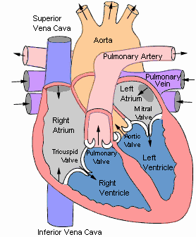

Slide 3
Valvular heart lesions occurs either as acquired dse or congenital heart lesions(maldevelopment in embryology).
Problem that arises :- Valvular stenosis, valvular regurgitation(incompetence) (insufficiency) or mixed (stenosis + incompetence).
The severity of the lesion determines the clinical presentation of the pt.
Stenosis- failure of valves to open completely during diastole
Regurgitation – Failure of a valve to close completely during systole.

Slide 4
Possible lesions:-
Aortic Stenosis
Mitral Stenosis
Aortic Regurgitation
Mitral Regurgitation
Tricuspid stenosis
Tricuspid regurgitation
Pulmonary stenosis
Pulmonary regurgitation

Slide 5
Etiology
Pathophysiology
Physical Exam
Natural History
Testing
Treatment

Slide 6
Causes of VHD
Acquired or congenital causes
RHD
Develops in about ½ of pts with carditis.
2/3 of cases are females.
Is the most common acquired heart dse with lt sided part of the heart affected more than rt,
Main pathology is progressive fibrosis,
Mitral valve is affected in >90% of cases followed by aortic valve , tricuspid then pulmonary valve

Slide 7
2. Other cause of valvular heart disease
Infective endocarditis ( IE)
Non bacterial thrombotic endocarditis.
Liebman’s sacks endocarditis – specifically in SLE
Syphilitic valvulitis
Calcific aortic valve stenosis
Calcification of mitral annulus
Myxomatous degeneration / floppy valve syndrome
Carcinoid heart disease.
Marfans syndrome
Osteogenesis imperfecta
Rheumatoid arthritis

Slide 8
1. Mitral Stenosis
Definition: Obstruction of LV inflow that prevents proper filling during diastole
Normal MV Area: 4-6 cm²
Symptoms begin at areas less than 2 cm²
Almost always rheumatic in origin.
About 2/3 of cases are female patients.

Slide 9
Etiology of Mitral Stenosis
Rheumatic heart disease: 77-99% of all cases
Infective endocarditis: 3.3%
Mitral annular calcification: 2.7% - elderly
Carcinoid tumours

Slide 10
MS Pathophysiology
LA dilation →pul venous HTN---pulmonary congestion (reduced emptying) – pul oedema.
Pul HTN --- rt VH---rt HF.
Increased Transmitral Pressures: Leads to left atrial enlargement and atrial fibrillation.
Hemoptysis: due to rupture of bronchial vessels due to elevated pulmonary pressure

Slide 11
Clinical features
Symptoms:-
Asymptomatic until MS valve <2cm /severe cases
Breathlessness (exertional) due to pul. congestion & HTN
Fatigue due to ↓CO.
Oedema and ascites due to Rt heart failure
Palpitations – A. fib
Haemoptysis due to congestion and PE
Cough due to pul. HTN.
Chest pain due to pul. HTN.

Slide 12
Signs
low vol pulse- may be irregularly irregular/regular.
Oedema
Raised JVP
Cyanosis.
Orthopnoea.
Atrial fibrilation -- palpitation
Mitral facies – malar (check) flush, darkening over maxillar/cheeks because of vasoconstriction.
Tapping apex but not displaced(apical heave).
Loud S1, opening snap, rumbling mid –diastolic murmur (Graham Steel murmur may occur)..
Crackles, rhonchi due to cardiac asthma.
P/A – pulsating tender hepatomegally + ascites.

Slide 13
Investigations
ECG – Lt atrial hypertrophy (P. mitrale; broad M shaped P- wave).
Rt. ventricular hypertrophy
May see atrial fibrillation.
2.CXR – Enlarged Lt atrium, signs of pulmonary congestion / pul hypermarkings.
3. Echocardiogram – Thickened immobile cusps, reduced valve area. The GOLD STANDARD for diagnosis. Asses mitral valve mobility, gradient and mitral valve area
4. Doppler echo – To determine pressure gradient across the mitral valve is a definitive evaluation of ms, pulmonary artery pressure and Lt ventricular fxn can be assessed.
5. Cardiac catheterization – demonstrate size of stenosis

Slide 14
Management of MS
Aim
To control symptoms
To provide 2⁰ prevention
Manage heart failure
Diuretics
Digoxin
Beta blockers
Rate limiting calcium antagonists for controlling A. fib ( Rate control)
↓Salt diet
2. Anticoagulate to prevent systemic thromboembolism
3. Give penicillin – prophylaxis against rheumatic fever (2⁰ prevention).
4. Prophylaxis against infective endocarditis
Prophylaxis for dental or surgical procedures.
5. Management of A. fib; Anticoagulate, Rhythm control,Rate control
6. Surgery – Mitral valvectomy or valve replacement.

Slide 15
CMXs of MS
A . Fib
Embolism
Pul HTN
Pul infarction
Tricuspid regurgitation
Rt V Failure
Infective endocarditis

Slide 16
2. Mitral regurgitation
Def. Mitral regurgitation (MR) refers to abnormal leaking / backflow of blood from the Lt Ventricle to the Lt atrium
Backflow of blood from the LV to the LA during systole
Mild (physiological) MR is seen in 80% of normal individuals.
It occurs more in males than females

Slide 17
Aetiology
Chronic RHD is the cause of severe MR in about 1/3 of cases.
Congenital anomaly
I. Endocarditis
MI:
Ischaemia HD
Infective endocarditis
Mitral valve prolapse (floppy mitral valve - degeneration/ calcification).
Trauma to mitral valve
Lt ventricular systolic dysfxn.
HOCM
SLE
Hypertropic cardiomyopathy
Collagen abnormalities eg marfans syndrome
Dilated cardiomyopathy
Hypertensive HD

Slide 18
Pathophysiology of MR
Pure Volume Overload
Compensatory Mechanisms: Left atrial enlargement, LVH and increased contractility
Progressive enlargement of the Lt atrium and later Lt ventricular enlargement
Progressive left ventricular volume overload leads to dilation and progressive heart failure.
Progressive left atrial dilation and right ventricular dysfunction due to pulmonary hypertension.

Slide 19
Symptoms
Mild –mod MR – Asymptomatic
Fatigue
Palpitations
Breathlessness
Exertional dyspnoea
Orthopnoea
Angina

Slide 20
Signs
Low volume pulse in severe MR
Oedema
Increased JVP in severe MR
Apex usually displaced, heaving apex (hyperdynamic precordium)
S3 gallop- split 2nd HS.
S₁ usually reduced or soft.
Pansystolic murmur (murmur throughout systole) that radiates to axilla.
+ signs of pul. HTN and Rt heart failure in severe MR.

Slide 21
Grading of murmurs - assign
Graded 1 -6, usually according to loudness
Grade 1 – soft & not heard to most people.
Grade 2 – soft but detectable
Grade 3 – moderate, no thrill
Grade 4 – loud, thrill just palpable
Grade 5 – very loud, thrill easily palpable
Grade 6 – very loud, can be heard even without placing stethoscope

Slide 22
Investigations
ECG -LVH QRS > 35mm, Tall R- waves
2. CXR – Cardiomegally enlarged LV, Lt. atrium, features of pul. oedema
3. Echocardiogram- dilated lt atrium & lt ventricle.
4. Doppler echo –measures the regurgitant vol.
5. cardiac catheterization
6. MRI

Slide 23
Tx of MR
Medical mnx
Vasodilator such as hydralazine
Nitrates – nitroprusside
Rate control for atrial fibrillation with β-blockers, CCB, digoxin
Anticoagulation in atrial fibrillation and flutter
Diuretics for fluid overload
A/B prophylaxis for IE

Slide 24
Surgical mnx
Mainstay of Rx
Mitral valve replacement / repair
Balloon valvoplasty
NB: Serial Echocardiography

Slide 25
3. Aortic Stenosis
Normal Aortic Valve Area: 3-4 cm²
Symptoms: Occur when valve area is 1/4th of normal area.
Types:
Supravalvular
Subvalvular
Valvular
About 80% of adults are asymptomatic and are usually males

Slide 26
Etiology of AS
Congenital
Rheumatic HD
Degenerative changes /Calcification

Slide 27
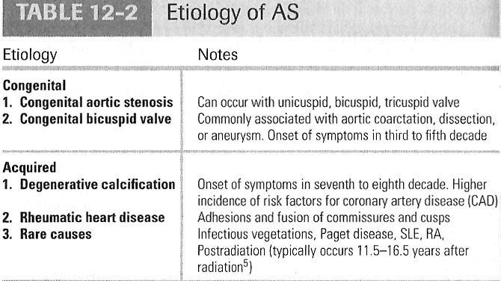

Slide 28
Pathophysiology of AS
Obstruction of Lt ventricular outflow
A pressure gradient develops between the left ventricle and the aorta. (increased afterload)
LV function initially maintained by compensatory pressure hypertrophy
When compensatory mechanisms exhausted, LV function declines.

Slide 29
Risk factors
Age
Male sex
Smoking
Diabetic
HTN
Increased LDL, HDL
Increased CRP
Congenitally affected valves may be involved at birth.

Slide 30
Presentation of AS
Symptoms:-
Syncope: (exertional)- Dizziness, fainting-low CO
Angina: Reduced O2 supply
Dyspnea: on exertion due to heart failure.
Sudden death

Slide 31
Signs
Low volume pulse
Narrow pulse pressure
Slow rising small carotid pulse (pulsus tardus)
Soft and split second heart sound, S4 gallop due to LVH.
Systolic ejection murmur- cresendo-decrescendo character.

Slide 32
Investigations of AS
Echocardiography is the most valuable test for diagnosis.
ECG- LVH, ST wave changes.
CXR- cardiomegally
Catheterization- confirm systolic pressure difference, confirms abnormality.

Slide 33
Management of AS
A. medical
Hardly useful
ACE-I to decrease preload
Prophylaxis for IE
B. SURGICAL
Aortic Balloon Valvotomy- shows little benefit.
Valve Replacement: Definitive treatment

Slide 34
Complications
Infective endocarditis
HF
Sudden cardiac death

Slide 35
4. Aortic Regurgitation

Slide 36
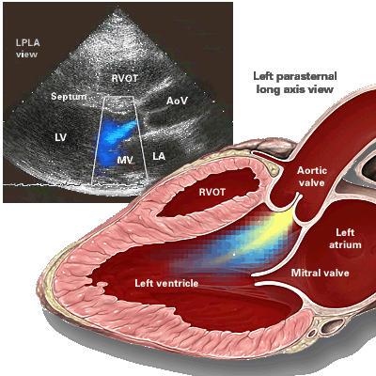

Slide 37
Aortic Regurgitation
Definition:
Leakage of blood into LV during diastole due to ineffective coaptation of the aortic cusps
Leaking of the aortic valve that causes blood to flow in reverse direction during diastole.
It is a fairly common condition in our set up due to rheumatic heart disease.

Slide 38
Etiology of AR
Rheumatic HD
Infective endocarditis
Congenital e.g Bicuspid aortic valve
Valve rupture in trauma
Other causes :- Aortic Dissection, RA, SLE, syphilis, marfans syndrome, osteogenesis imperfecta.

Slide 39
Pathophysiology of AR
Results to increase in EDV and increased preload.
With time the LV dilates and hypertrophies in an effort to meet the demands.
Consequently decrease in diastolic pressure leads to decreased myocardial oxygenation and ischaemia.
Compensatory Mechanisms: LV dilation, LVH. Progressive dilation leads to heart failure

Slide 40
Clinical features of AR
Asymptomatic until 4th or 5th decade
The course of the disease may run for 10 – 15yrs before patients become symptomatic.
Progressive Symptoms include:
- Dyspnea: exertional, orthopnea, and paroxsymal nocturnal dyspnea
Nocturnal angina: due to slowing of heart rate and reduction of diastolic blood pressure
Palpitations: due to increased force of contraction
Easy fatigability
Diaphoresis
Features of HF

Slide 41
Physical Exam findings of AR
Pulses:--
Wide pulse pressure: most sensitive, - low DBP
Large volumeor collapsing pulse( water hammer pulse)
Bounding peripheral pulses
Apex beat:-
Hyperactive/ Hyperdynamic apex beat
Displaced apical impulse
Apical heave
Auscultation:-
High pitched early diastolic murmur best heard in Lt sternal boarder 4ics
Mid diastolic murmur - called Austin flint murmur (apex):
Systolic ejection murmur: due to increased flow across the aortic valve

Slide 42
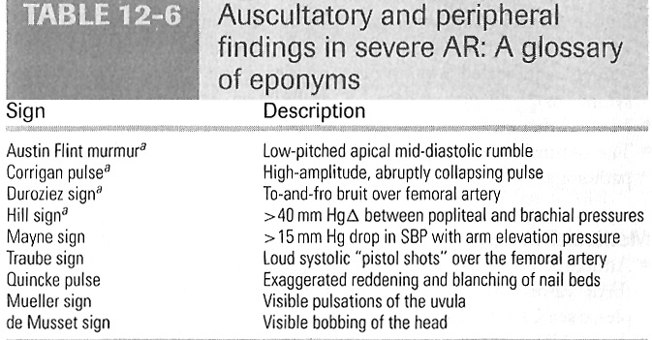

Slide 43
Other rare signs due to hyperdynamic flow
Quincke’s sign- capillary pulsation in nail bed
De musset’s sign- head nodding with each heart beat
Corrigan’s sign- carotid pulsation
Traube’s sign- piston shot sounds over femoral artery.
Duroziez’s sign- femoral diastolic murmur as blood flows backwards in diastole.

Slide 44
Investigations of AR
CXR: enlarged cardiac silhouette (cardiomegally) and aortic root enlargement.
ECHO:
ECG
Aortography: Used to confirm the severity of disease
MRI
Cardiac catheterization

Slide 45
Management of AR
Rx of underlying cause e.g RHD, syphilis.
Medical supportive: nitrates, Vasodilators (ACEI’s), beta blockers, CCB
Serial Echocardiograms: to monitor progression.
Surgical Treatment- Aortic valve replacement: Definitive Tx
Prophylaxis against IE

Slide 46
RIGHT HEART VALVE DISEASE
5. Tricuspid stenosis
Is rare and occurs more in women than men.
Usually due to RHD
Also seen in carcinoid syndrome
Nearly always associated with mitral & aortic valve disease..

Slide 47
Features
Fatigue
Ascites, abdo. pains
Hepatomegally
Peripheral oedema
Giant a wave & slow descent in JVP
Rumbling mid-diastolic murmur – louder in inspiration heard best over lower left sternal border.
Opening snap

Slide 48
Management:
Doppler echo, CXR
Diuretics, ↓salt intake, Valve repair/Replacement

Slide 49
6. Tricuspid regurgitation
Causes
Functional (secondary)- RV dilatation due to LVF, MI, Cor pulmonale, pul HTN
Organic / primary – RHD, IE, carcinoid syndrome, Ebstein’s anomaly(congenitally malpositioned tricuspid valve).

Slide 50
S+S
Rt HF due to systemic venous congestion
JVP
Hepatomegally
Ascites
jaundice

Slide 51
Management
Treat underlying cause; Drugs – diuretics, digoxin, ACE –I
Surgery- valve repair or replacement

Slide 52
7. Pulmonary stenosis
Usually congenital – Turners syndrome, Normans syndrome, William syndrome, Fallot’s tetralogy, rubella)
Acquired causes- Rh. fever, carcinoid sydrome
Ps may be valvular, subvalvular or supravalvular.
Features
Dyspnoea, fatigue, oedema, ascites
Dysmorphic facies (cong. causes), prominent a wave in JVP, RV heave.
Ejection systolic murmur that radiate to Lt. shoulder
Widely split S₂
CXR - RV/RA hypertrophy.
ECG
Echo
Cardiac catheterisation is diagnostic
Management
Balloon valvotomy or valvoplasty

Slide 53
8. Pulmonary regurgitation
Usually caused by pulmonary hypertension
Results from dilatation of pul valve ring due to P. HTN
PR rarely causes symptoms and treatment is rarely necessary.

