Slide 1


SEA × OPENAI REGIONAL CODEX HACKATHON · 31 OCT 2026
Make the second
drop land.
Alodi rescues failed deliveries for Vietnamese e-commerce. The courier taps once; the agent messages, calls and hands back the context for the next attempt.
10:02
Courier taps · No answer
10:02
Chat sent to the buyer
11:18
Context card ready · 0.94
Team Develarper Nomura Yoshio · Long Quan Ton · Khanh Tuong Huynh · Thanh Loi Tran
Photo: frank mckenna, CC0
Notes:
Open on the moment everyone knows: the courier calls, you are in a meeting, the parcel goes back. Alodi makes the second drop land.

Slide 2
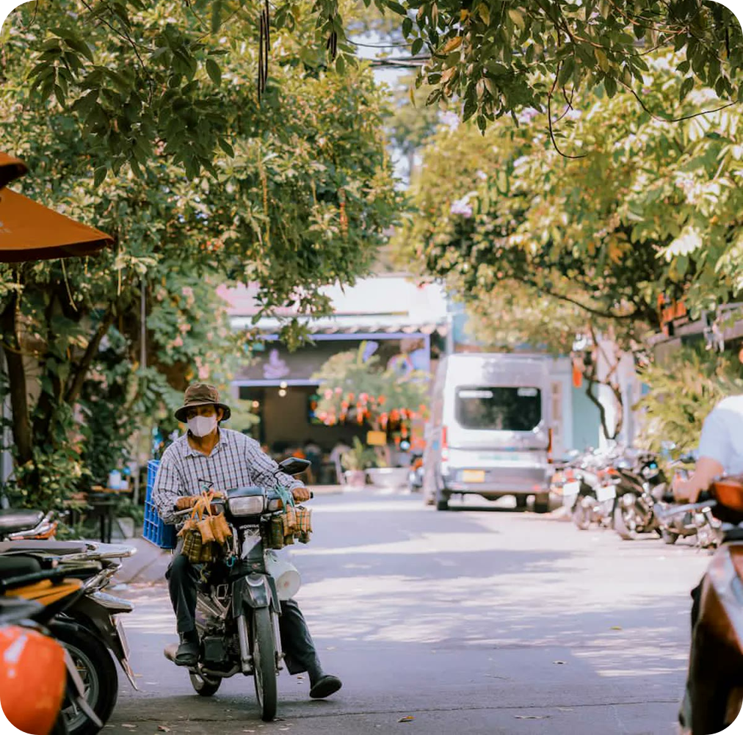
01 · THE PROBLEM
The courier calls. The buyer is in a meeting. The parcel goes back.
10:02
Courier calls twice
No answer. The buyer is in a meeting.
10:03
One error code
“Buyer unreachable”. When, where and who are lost.
Day 2
Same route, same time
The second attempt repeats the first, and fails.
Day 5
Back to the seller
₫40,000 return fee. The buyer edges toward a COD lock.
Photo: Lemic302, CC0
Notes:
Every failed delivery is a time negotiation that happens off the system. The context that would fix it is compressed into one error code, so the next attempt repeats the same conditions.

Slide 3
01 · THE PROBLEM IN NUMBERS
It happens every day. And someone always pays.
₫40,000
8–12%
return fee the seller pays per failed order
of orders refused at the door, nationwide
Shopee §7.1 · GHN
VECOM, NLĐ Jul 2025
0
₫473M
WE ASKED BOTH SIDES
Placeholder until the interview export lands
delivery windows a Shopee buyer can choose
lost a month in one area of 4,000 orders a day
86%
66%
27%
83%
Shopee Help 79559
Team model, PRD §18.8
buyers want to pick a window
buyers couldn’t reach the courier back
courier calls go unanswered
couriers would use Alodi
Source: Shopee Return & Refund Policy §7.1 and GHN (₫40,000 cap since Apr 2025); VECOM via Nguoi Lao Dong (19 Jul 2025); Shopee Help Center 79559; team cost model PRD §18.8. Survey: buyers n = 100, couriers n = 12.
Notes:
Return fees alone are ₫288M a month for one area. The survey tests the two sides of the same call: buyers who can't pick a time, couriers whose calls go unanswered. Replace the survey values with the interview export before the final pitch.

Slide 4
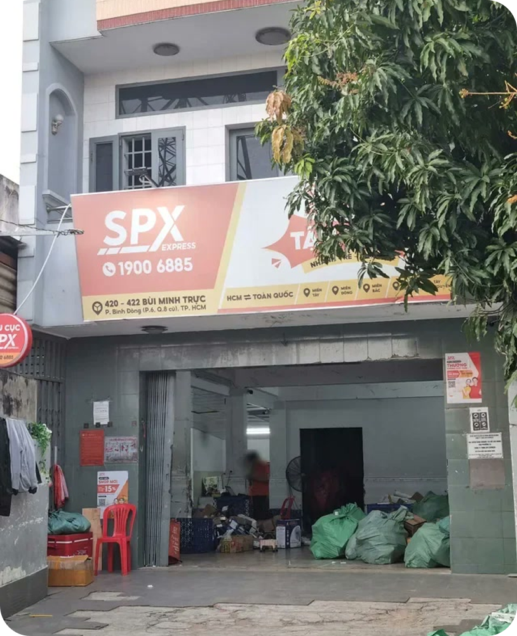
01 · THE ROOT CAUSE
Nothing is broken in the route. The context dies in a phone call.
0
windows to choose
Delivery time is negotiated by phone, outside every system the carrier runs.
1
error code
“No answer” replaces when, where and who. The next courier starts from zero.
≈ 5
full-time callers
Per area, just to phone 320 buyers twice a day. People don’t scale; rules can.
Field visit · SPX Express hub, HCMC
Notes:
The root cause is not routing. It is that the buyer's answer never enters the system. Three numbers: zero windows, one error code, about five callers per area.

Slide 5
02 · INTRODUCING ALODI
Alodi is the AI agent that rescues failed deliveries.
FOR
Carriers like SPX, their couriers and buyers
STARTS WITH
One tap: No answer · Rescheduled · Refused
DOES
Chats now, calls if silent, writes a context card
Demo video · 2:00
NEVER
Labels or returns an order without a person
Insert the film here: Insert › Video, then fit it to this frame
BUILT ON
OpenAI Agents SDK, gpt-oss-20b, Codex
The full rescue: the courier’s tap, the chat, the AI call, the context card and the second drop.
Notes:
Play the two-minute film here. To embed it: Insert > Video > This Device, then resize to the dark frame and delete the placeholder.

Slide 6
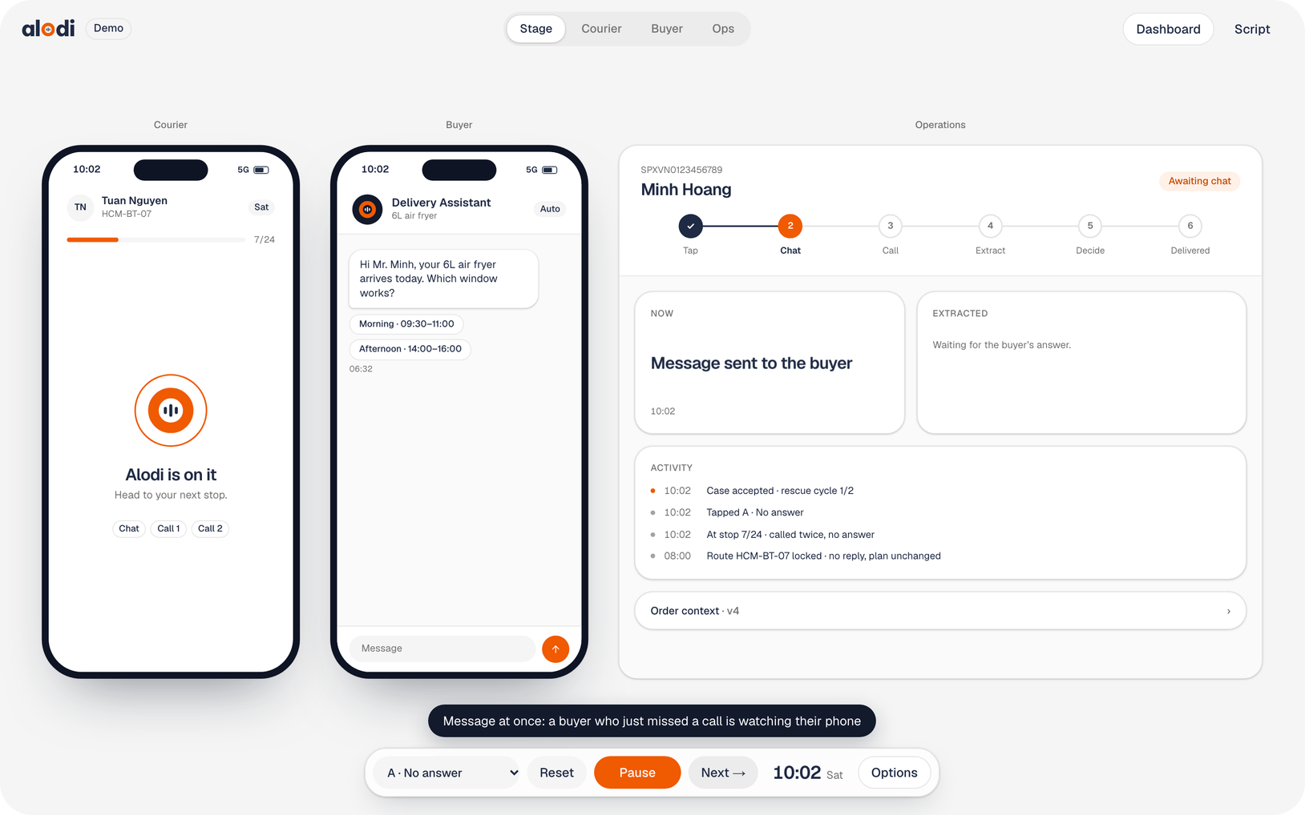
02 · WHAT WE BUILT
Four screens, one agent, live on stage.
One tap, no typing
The courier picks No answer, Rescheduled or Refused.
Chat first, call if silent
Chat at once; AI call after 60′, again after 2 h. 08:00–20:30 only.
Context card
Window, drop-off, backup receiver as JSON. ≥ 0.85 applies itself.
People decide
Refusals, labels and returns always go to customer service.
Ops dashboard
A hub view on a 4,000-order mock day: pipeline, routes, CS queue.
Notes:
Courier phone, buyer chat, ops console and a control screen stay in sync. The demo runs on a fast-forward clock and mock data for one hub.

Slide 7
02 · OUTCOMES
Measured on stage. Projected for one area.
MEASURED ON STAGE · PRD §2.3, §23
< 10 s
≥ 0.90
< 2%
0
time-to-context
extraction F1
wrong auto-applies
without a person
buyer’s answer → courier’s card
held-out chat, call and memo
of cases closed alone
labels, returns, calls out of hours
ONE AREA · PROJECTED · PRD §18.8
416
96
24 min
₫194M
CS calls a day
fewer wasted trips
back per courier
net saving a month
handled by the agent, ≈ 28 h
a day, 320 × 0.3 attempts
every day
41% of the ₫473M loss
Source: PRD §2.3 and §23 targets; team cost model PRD §18.8, best-in-class rescue 25% → 65% (Shipsy vendor range), base case ₫99M a month. Full formulas: alodi-numbers.pdf.
Notes:
Three numbers are measured live from the event log and the eval set. Money is projected: ₫473M lost a month, Alodi recovers ₫215M, costs ₫21M to run, ₫194M net.

Slide 8


03 · OPENAI ECOSYSTEM
Built on OpenAI, from the first line to the last call.
RUNTIME · ONE AGENT, SIX WORKERS
Window
Rescue chat
Voice
gpt-oss-20b
gpt-oss-20b
gpt-4o-mini-tts
Alodi Agent
Agents SDK · gpt-oss-20b
Extractor
Fallback
Guardrails
Structured Outputs
Responses API · masked
code + SDK guardrails
BUILD TIME · CODEX
01 Specify
02 Build
03 Parallelise
04 Review
05 Evaluate
PRD → scripts
Codex CLI · AGENTS.md
Codex cloud tasks
Codex in GitHub
one change per round
Source: PRD §16.7 OpenAI platform, §18.8 local-first deployment. Production design; the demo runs the OpenAI API behind the same interfaces.
Notes:
Draft: more OpenAI components will be added. Runtime: one agent built on the Agents SDK with six workers, gpt-oss-20b on the area server, the API only as a masked fallback. Build time: Codex from spec to review and the eval loop.

Slide 9
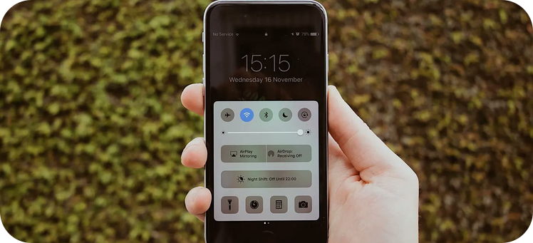
04 · WHAT COMES NEXT
From a stage demo to a national rollout.
31 OCT 2026
NOV 2026
Q1 2027
Q2 2027
H2 2027
2028
MVP demo
Full build
Shadow mode
Controlled channels
Region
National
Four screens, mock data, AC-01 to AC-15 pass in rehearsal
Server engine, real call audio, ≥ 200 eval samples
One area, real events, no buyer contact; thresholds tuned
Real chat and calls for risky orders; rescue rate measured
5–20 hubs; Vietnamese ASR and TTS self-hosted
20–100 hubs, GPU pool, break-even
Source: PRD §28 release plan. Photo: Samson Vowles, CC0.
Notes:
Next: a full build in November, shadow mode at one area in Q1 2027 with no buyer contact, then controlled real channels, a region and national scale by 2028.

Slide 10
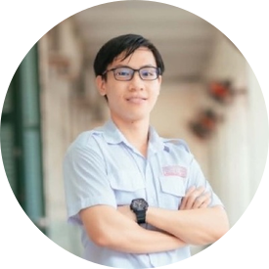

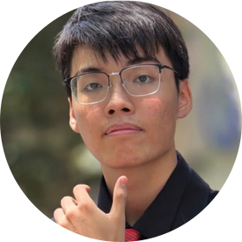

Make the second
drop land.
QR code
to the live demo
Couriers stop repeating failed attempts. Buyers get asked, not chased. Every high-stakes decision stays with a person.
Try it yourself
Scan to open the four-screen demo and the ops dashboard.
Nomura Yoshio
Long Quan Ton
Khanh Tuong Huynh
Thanh Loi Tran
Team Lead · Presenter
AI Engineer · Architect
AI Engineer · Deployment
Data Engineer · Backend
Team Develarper · Sea × OpenAI Regional Codex Hackathon · 31 Oct 2026
Notes:
Close on the line: make the second drop land. Point to the QR code for the live demo. Replace the QR placeholder with the final link once the demo is deployed.

