Slide 1








SEA × OPENAI REGIONAL CODEX HACKATHON · OCTOBER 2026
Make the second
drop land.
Every failed delivery, rescued with one tap. The shipper taps once; Alodi chats, calls and hands the next shipper when, where and who.
RESCUE · SPXVN0123456789
Shipper taps · No answer
10:02
Chat sent to the buyer
10:02
Card ready · 1 Nov, 17–20h
11:15
Team Develarper
Built with OpenAI and Codex
Notes:
Open with the name and the line: make the second drop land. Then roll the skit.

Slide 2
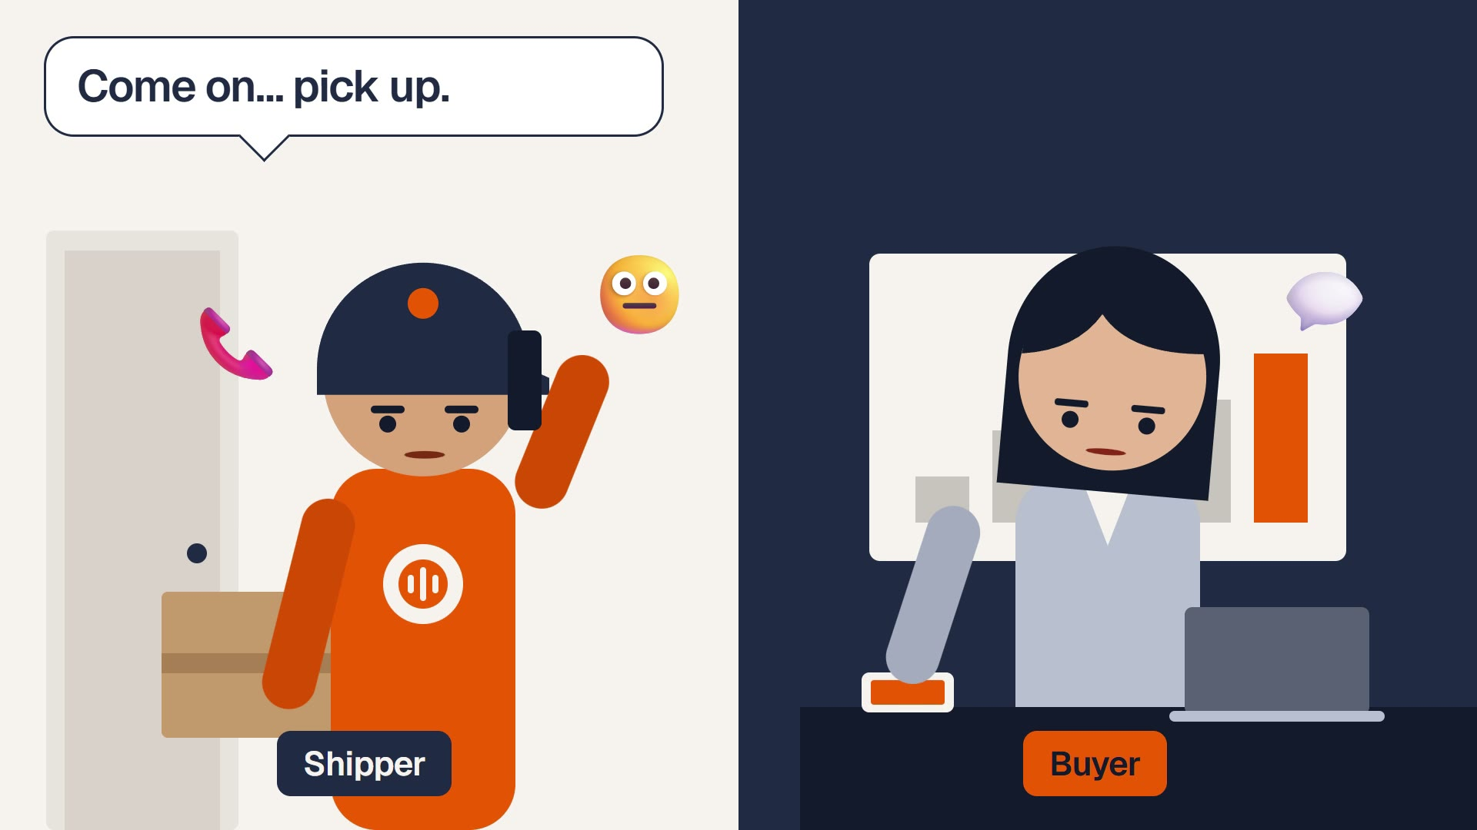
Notes:
The 20-second skit starts by itself when this slide opens.

Slide 3

01 TL;DR
Alodi is the AI agent that rescues failed deliveries.
FOR
Carriers like SPX, their shippers and buyers
STARTS WITH
One tap: No answer · Rescheduled · Refused
WHAT THE NEXT SHIPPER SEES
When
1 Nov, 17:00–20:00
DOES
Chats now, calls if silent, writes a context card
Where
Tower A reception
Who
Receptionist can sign
NEVER
Labels or returns an order without a person
Confidence
0.92, applied
03 / 15
Notes:
In one breath: the shipper taps once, Alodi talks to the buyer, and the next attempt arrives with when, where and who. Anything about money or a buyer's record stays with a person.

Slide 4
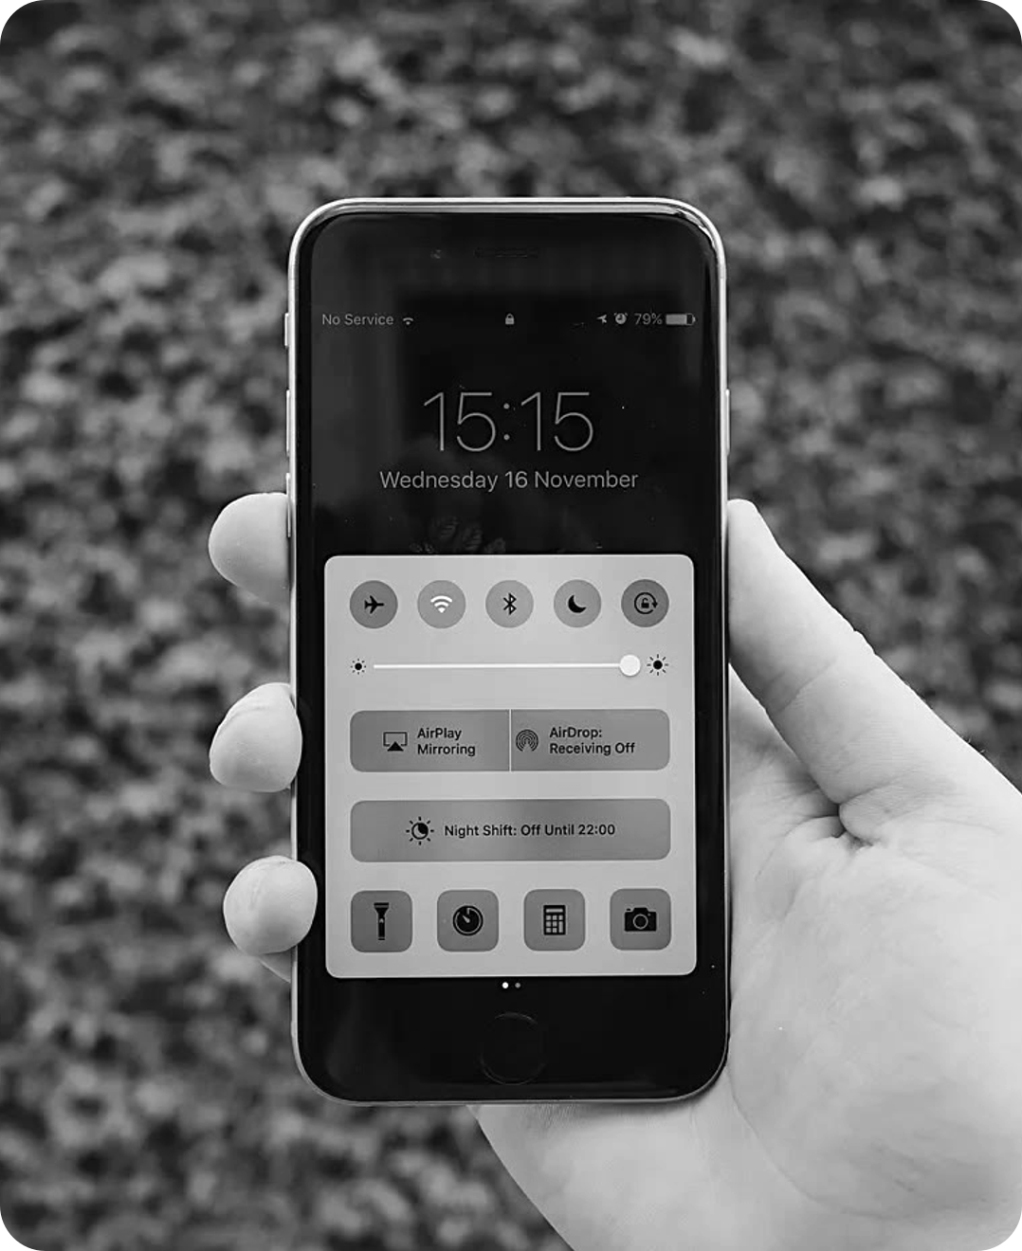



02 OUR STORY
This happened to us. Again and again.
Missed call from the shipper
10:02
In a meeting. The phone was on silent.
We called back
10:40
No answer. The shipper was already riding.
We left a note on the order
11:15
“Please leave it at reception.” Nobody read it.
Delivery failed
12:30
Reason on the app: buyer unreachable.
“Called twice. No answer.”
Returned to seller
Day 5
We still wanted the parcel.
04 / 15
Notes:
Tell it plainly and slowly, as your own story: we missed the call, we called back, we left a note, and the parcel still went back. Annoying for us, wasted trips for the shipper, a fee for the seller.

Slide 5
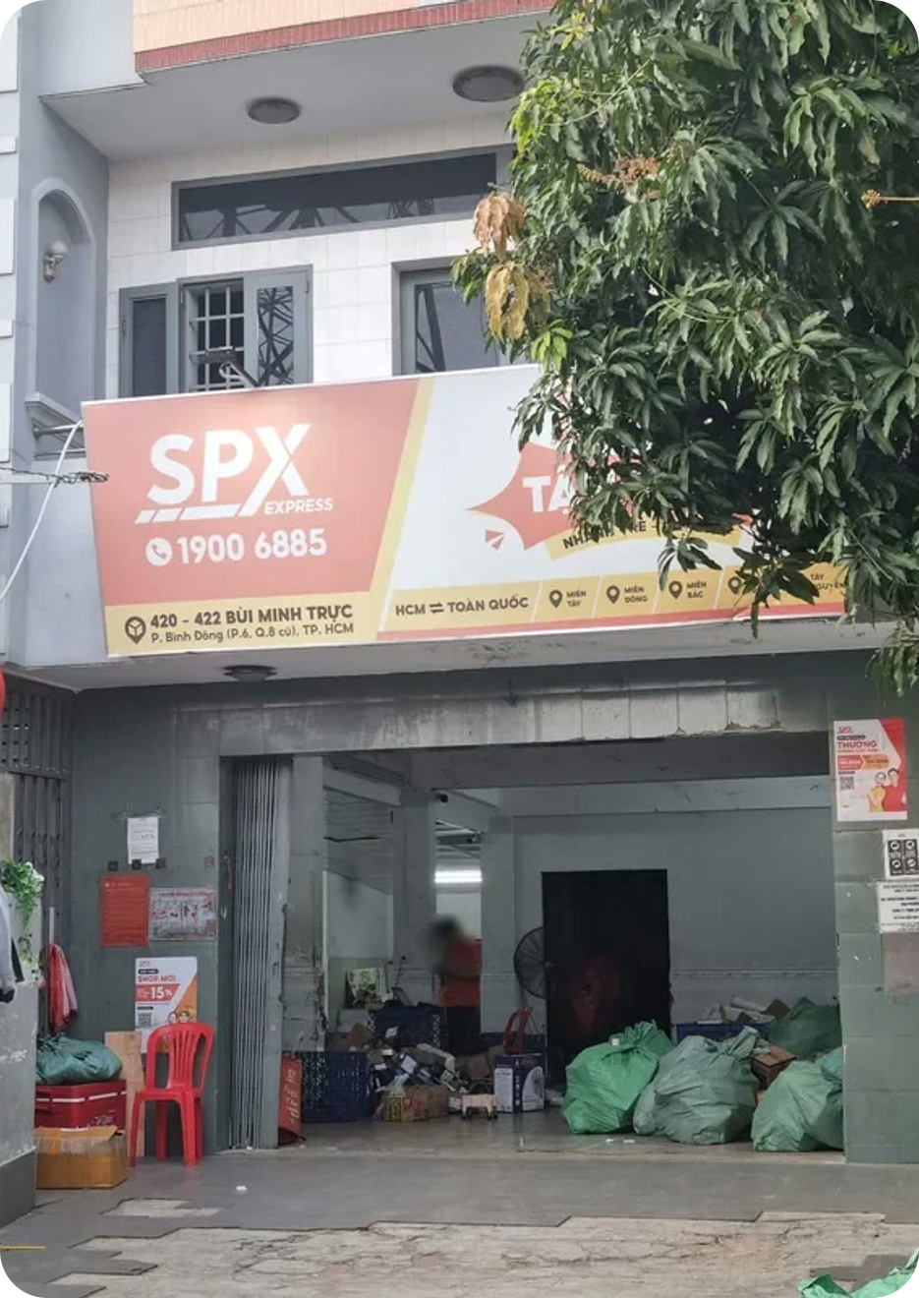







03 PROBLEM 1 · WHAT WE HEARD
We asked both sides of the same missed call.
BUYERS · N = 100
86%
66%
want to choose a delivery window [1]
called the shipper back and couldn’t reach them [1]
SHIPPERS · N = 12 · 6 CARRIERS
27%
83%
of their calls to buyers go unanswered [1]
would use an Alodi-like system [1]
FIELD VISIT · SPX EXPRESS HUB, HCMC
05 / 15
Notes:
These values are still the generated placeholders in prep/06-survey. Replace them with the interview export, then delete the status line, before quoting them as findings.

Slide 6
03 PROBLEM 2 · THE RESEARCH
The public numbers tell the same story.
LOSS · ONE AREA · A MONTH
₫473M
VN · RETURN FEE
the seller pays to ship back a failed Shopee order; only 1 in 4 is rescued today. [2][3][8]
₫40,000
VN · REFUSED AT THE DOOR
of orders nationwide; up to 20% in remote areas, 25–30% in sale season. [4]
8–12%
Return fees paid by sellers
₫288M
Shipper pay for redelivery
₫101M
SHOPEE · DELIVERY WINDOWS
a buyer can choose. The time is agreed by phone, within 2–3 contacts and 5 days. [5][6]
CS calling buyers back
₫45M
0
Shipper time at unanswered doors
₫39M
20 shippers, 4,000 orders a day. Modelled. [7][9]
06 / 15
Notes:
Our story is not unusual. Sellers pay up to ₫40,000 per failed order, 8 to 12 percent are refused at the door, and buyers have no window to pick. For one area that models to about ₫473M a month.

Slide 7


04 WHY WE BUILT ALODI
The route isn’t broken. The context dies in a phone call.
Shipper
TAP
AI AGENT
Next shipper
CARD
Taps one outcome
Gets when, where and who
When
1 Nov, 17:00–20:00
Buyer
ANSWER
Where
Tower A reception
Customer service
PERSON
Answers in chat or on a call
Who
Receptionist can sign
Takes refusals and doubts
DATA
Calls 08:00–20:30 only · ≤ 2 calls a cycle · applies alone at ≥ 0.85 · a person handles labels
SAVED
Hub ops
Seller
Route and order data
Pays fewer return fees
0
windows to choose
1
error code
≈ 5
callers per area
So the time is agreed by phone, off the system. [5]
“No answer” replaces when, where and who.
Just to phone 320 buyers twice a day. [9]
07 / 15
Notes:
That is why we built Alodi. The buyer's answer never enters the system, so the agent collects it inside the carrier's rules and hands it to the next shipper. Anything about money or a buyer's record goes to a person.

Slide 8
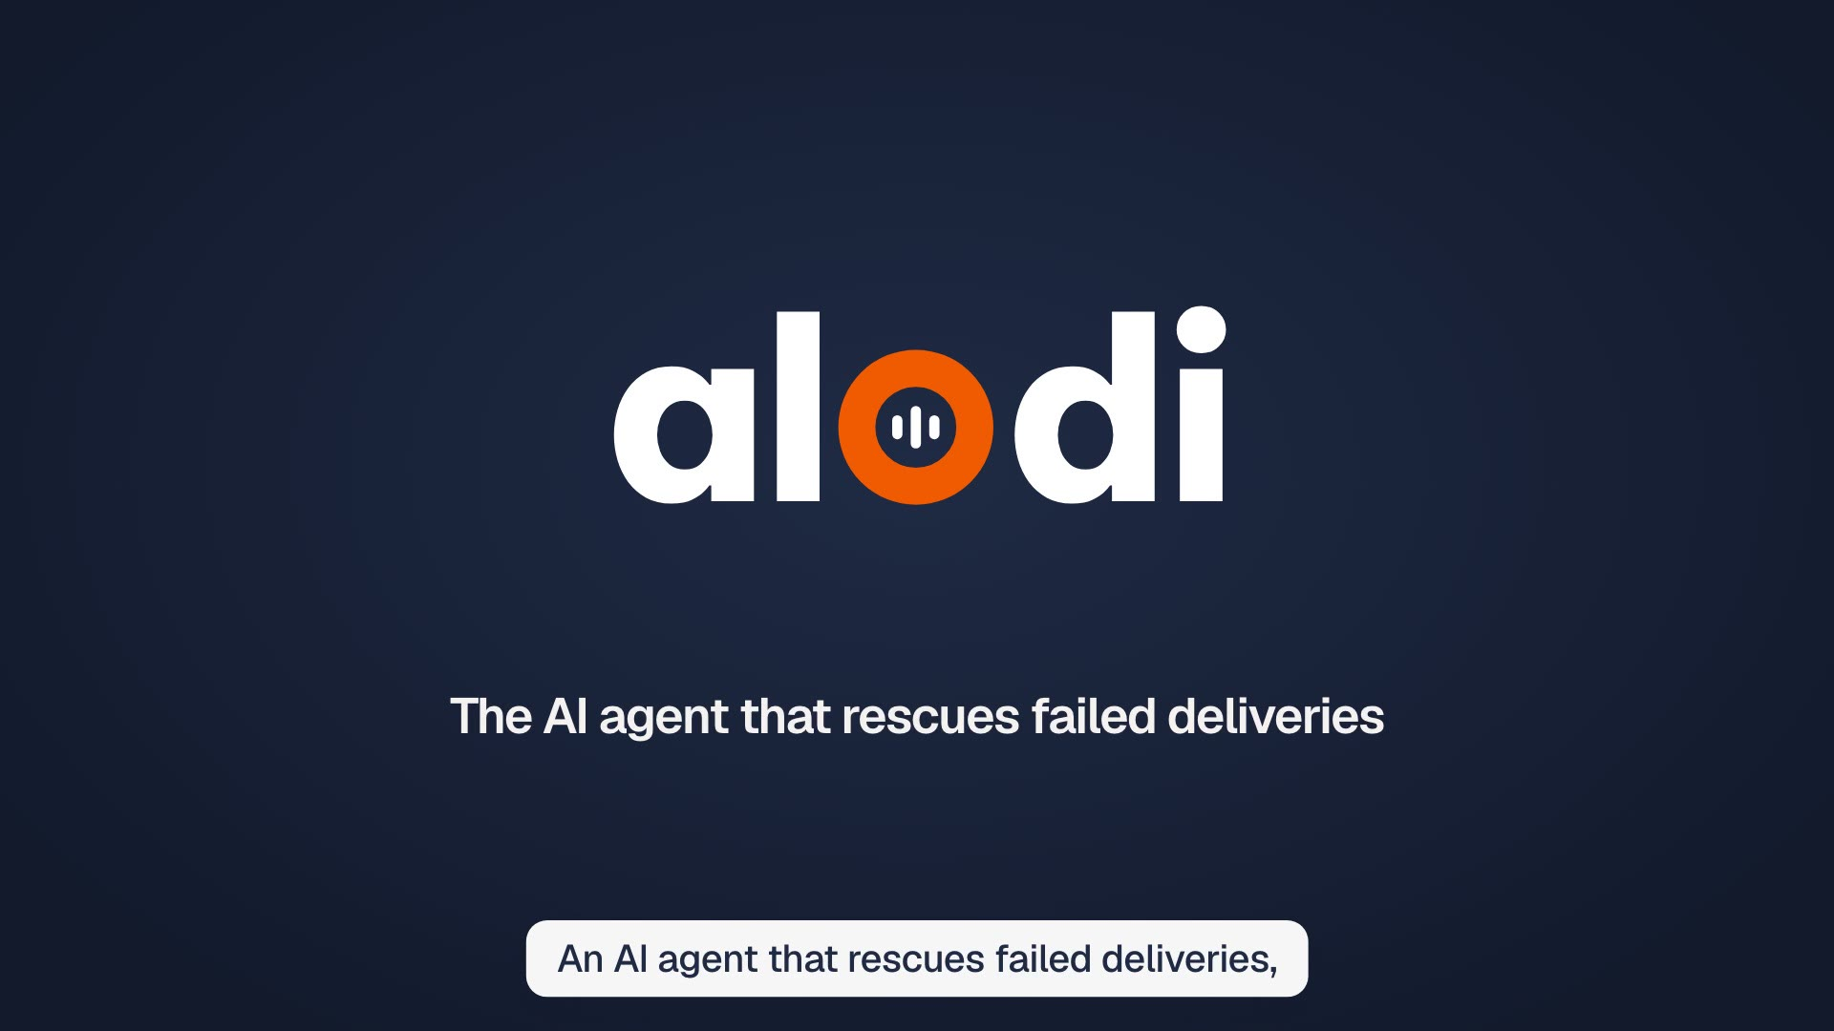
Notes:
The film starts by itself when this slide opens and runs 2:05.

Slide 9

LIVE
Customer’s phone
Now, the real thing.
Watch one rescue, live.
The chat and the call arrive
SPX dashboard
One shipper’s tap on a real phone. Everything else follows on this screen, in sync.
The hub sees the rescue move
In the shipper’s hand
A real phone, on stage
Alodi agent
Each step as it happens
09 / 15
Notes:
Say the line, then switch to the live screen: the shipper's phone drives it, and the customer's phone, the dashboard and the agent follow.

Slide 10

05 TECH STACK · OPENAI ECOSYSTEM
≈ ₫7.2M
OpenAI API a month, one area [9]
Every step of the rescue is an OpenAI API call.
GPT-Live-1 ₫5.2M · Terra ₫1.5M · Luna ₫0.5M
TRIAGE
VOICE
MEMO
AGENT
Decisions API
GPT-Live-1
GPT Transcribe
GPT-6.1 Terra
GPT-6 Luna
Live sessions, WebRTC
Audio transcriptions
Responses API, Agents SDK
Sorts every signal: which case, which window, how sure. Probabilities drive the 0.85 rule.
Calls the buyer. Listens while it speaks and hands reasoning to the agent.
Turns the shipper’s 10-second voice memo into text the agent can read.
Runs the case under policy and writes the card with Structured Outputs.
/v1/decisions
/v1/live/sessions
/v1/audio/transcriptions
/v1/responses
Every message · 6.0M tokens a day
≤ 134 billed minutes a day
Reschedules with a memo
≈ 20% of traffic, after triage
Structured Outputs
Evals
gpt-oss-20b
Codex
the context card schema
gate every prompt change
offline fallback
spec → build → review
Demo build: GPT-Live-1, GPT Transcribe, GPT-6.1 Terra. Decisions API, Agents SDK, Evals and gpt-oss-20b are the production design. [10][11]
10 / 15
Notes:
Walk it left to right: triage, voice, memo, agent. Every step is an API call behind one policy guard, and the API bill for one area is about ₫7.2M a month in the cost model: GPT-Live-1 ₫5.23M, Terra ₫1.50M, Luna ₫0.47M. Memos are costed on the local model in that figure.

Slide 11
06 OUTPUT
Less money lost. A second drop that just works.
SAVED A MONTH · ONE AREA · PROJECTED
FROM ANSWER TO CARD · TARGET
₫187M
< 10 s
Buyer answers
Shipper sees the card
40% cost saving [8][9]
After running costs, at a best-in-class rescue rate.
No form to fill, no extra step. The next attempt simply knows. [11]
11 / 15
Notes:
Two numbers. For the carrier: about ₫187M saved a month in one area, projected at a best-in-class rescue rate. For the people: under ten seconds from the buyer's answer to the card on the shipper's phone, our target on stage.

Slide 12
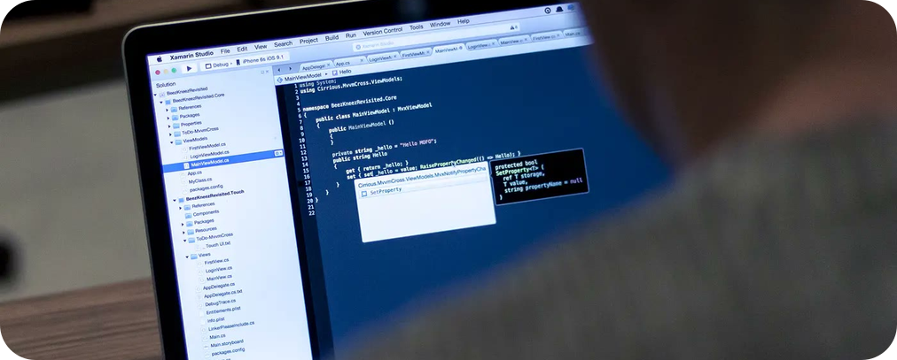




07 FUTURE PLAN
From a stage demo to a national rollout.
OCT 2026
NOV 2026
Q1 2027
Q2 2027
H2 2027
2028
MVP demo
Full build
Shadow mode
Real channels
Region
National
Demo screens and a working backend, built at this hackathon [12]
Connect the demo to the backend, real call audio, ≥ 200 eval samples
One area, real events, no buyer contact
Chat and GPT-Live-1 calls for risky orders
5–20 hubs, cost per case on target
20–100 hubs, break-even
12 / 15
Notes:
Next: a full build in November, shadow mode at one area in Q1 2027 with no buyer contact, then controlled real channels, a region and national scale by 2028.

Slide 13

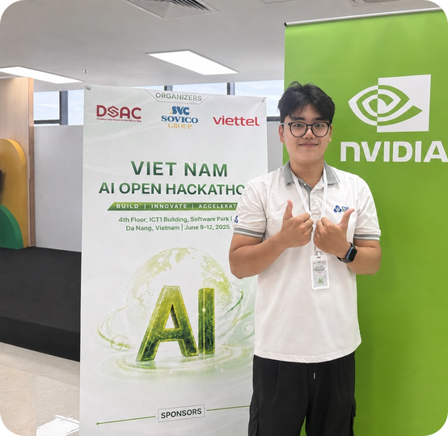


08 TEAM
Team Develarper. Four people, one agent.
Nomura Yoshio
Long Quan Ton
Khanh Tuong Huynh
Thanh Loi Tran
Team Lead · Presenter
AI Engineer · Solution Architect
AI Engineer · Deployment
Data Engineer · Backend
Product, demo script, pitch
Orchestrator, voice agent, eval loop
Context extractor, ASR, policy guard
Order Context Object, APIs, metrics log
13 / 15
Notes:
One line each: who we are and what each of us built.

Slide 14





THANK YOU
Make the second
drop land.
Team Develarper
Sea × OpenAI Regional Codex Hackathon · October 2026
Notes:
Close on the line: make the second drop land. Thank you.

Slide 15
09 REFERENCES
Every number, and where it comes from.
[1]
Team survey: 100 buyers, 12 shippers; placeholder values pending the interview export
[7]
GHN: shipper earns ₫6,000–8,000 per delivered order
prep/06-survey
ghn.vn/blogs/tip-ban-hang/mot-don-hang-shipper-shopee-duoc-bao-nhieu-tien
[2]
Shopee Refund Policy §7.1: seller pays return shipping on failed orders
[8]
Shipsy: rescue 20–30% industry, 50–65% best-in-class (vendor)
help.shopee.vn/portal/4/article/77251
shipsy.ai/insights/what-is-ndr-non-delivery-report-management
[3]
GHN: ₫40,000 return-fee cap per order since 1 Apr 2025 (₫20,000 express)
[9]
Team cost model, PRD §18.8: one area, 20 shippers, 4,000 orders a day
ghn.vn/blogs/tip-ban-hang/tra-hang-shopee-ai-chiu-phi
prep/02-technical/cost-model · alodi-numbers.pdf
[4]
Nguoi Lao Dong, 19 Jul 2025: refusal rates, VECOM and Tran Anh Tung
[10]
OpenAI: GPT-Live-1, GPT-6.1 Terra, Decisions API on GPT-6 Luna
tuoitre.vn/nld/nhuc-nhoi-nan-bom-hang-19625071822023801.htm
developers.openai.com · openai.com/index/decisions-api · checked 31 Oct 2026
[5]
Shopee Help Center 79559: no specific delivery time can be chosen
[11]
Alodi PRD §2.3, §16.7 and §23: stack, output metrics and evaluation targets
help.shopee.vn/portal/4/article/79559
prep/02-technical/PRD.md
[6]
Shopee Help Center 79569: 2–3 contacts, reschedule within 5 days
[12]
Alodi PRD §28: release plan
help.shopee.vn/portal/4/article/79569
prep/02-technical/PRD.md
frank mckenna (cover), Lemic302 (slides 3, 14), Samson Vowles (slide 4), Tirza van Dijk (slide 12): CC0 via Wikimedia Commons. SPX hub (slide 5): Team Develarper field visit.
PHOTOS
15 / 15
Notes:
Appendix: every reference marker in the deck points here.

