Slide 1

Pitch Deck
The Race against the Virus

Slide 2
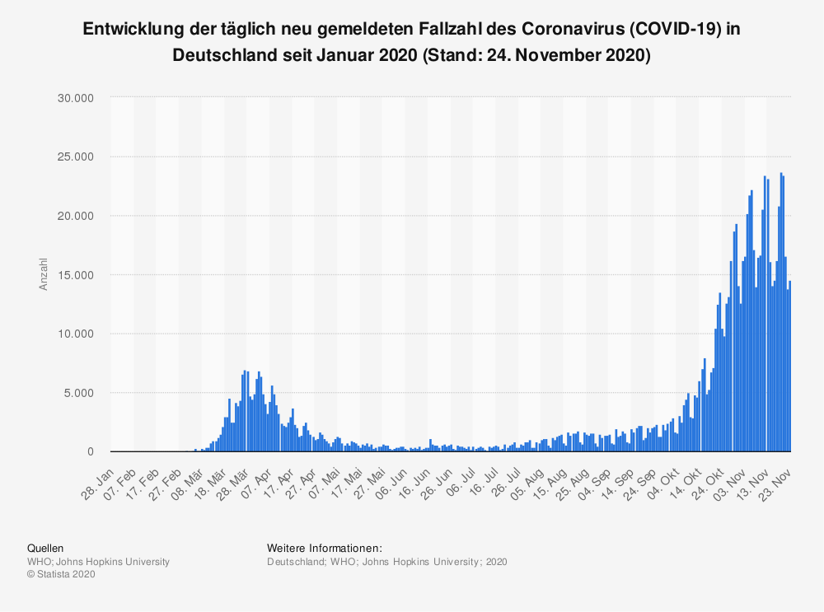
Pandemic

Slide 3



Our Solution
Private
Easy to use
Inexpensive to implement

Slide 4



Business Model
Free to use
Sponsorship
Open Source
Value: Open stores

Slide 5



New Entry
Unique user ID
Location ID
Timestamp

Slide 6

Saved Data
Unique user ID
Unique user ID
Location ID
Timestamp

Slide 7

Report Case
Other unique user IDs
Unique user ID
Location ID
Timestamp

Slide 8
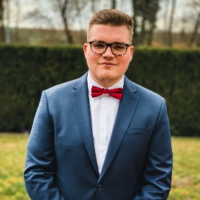
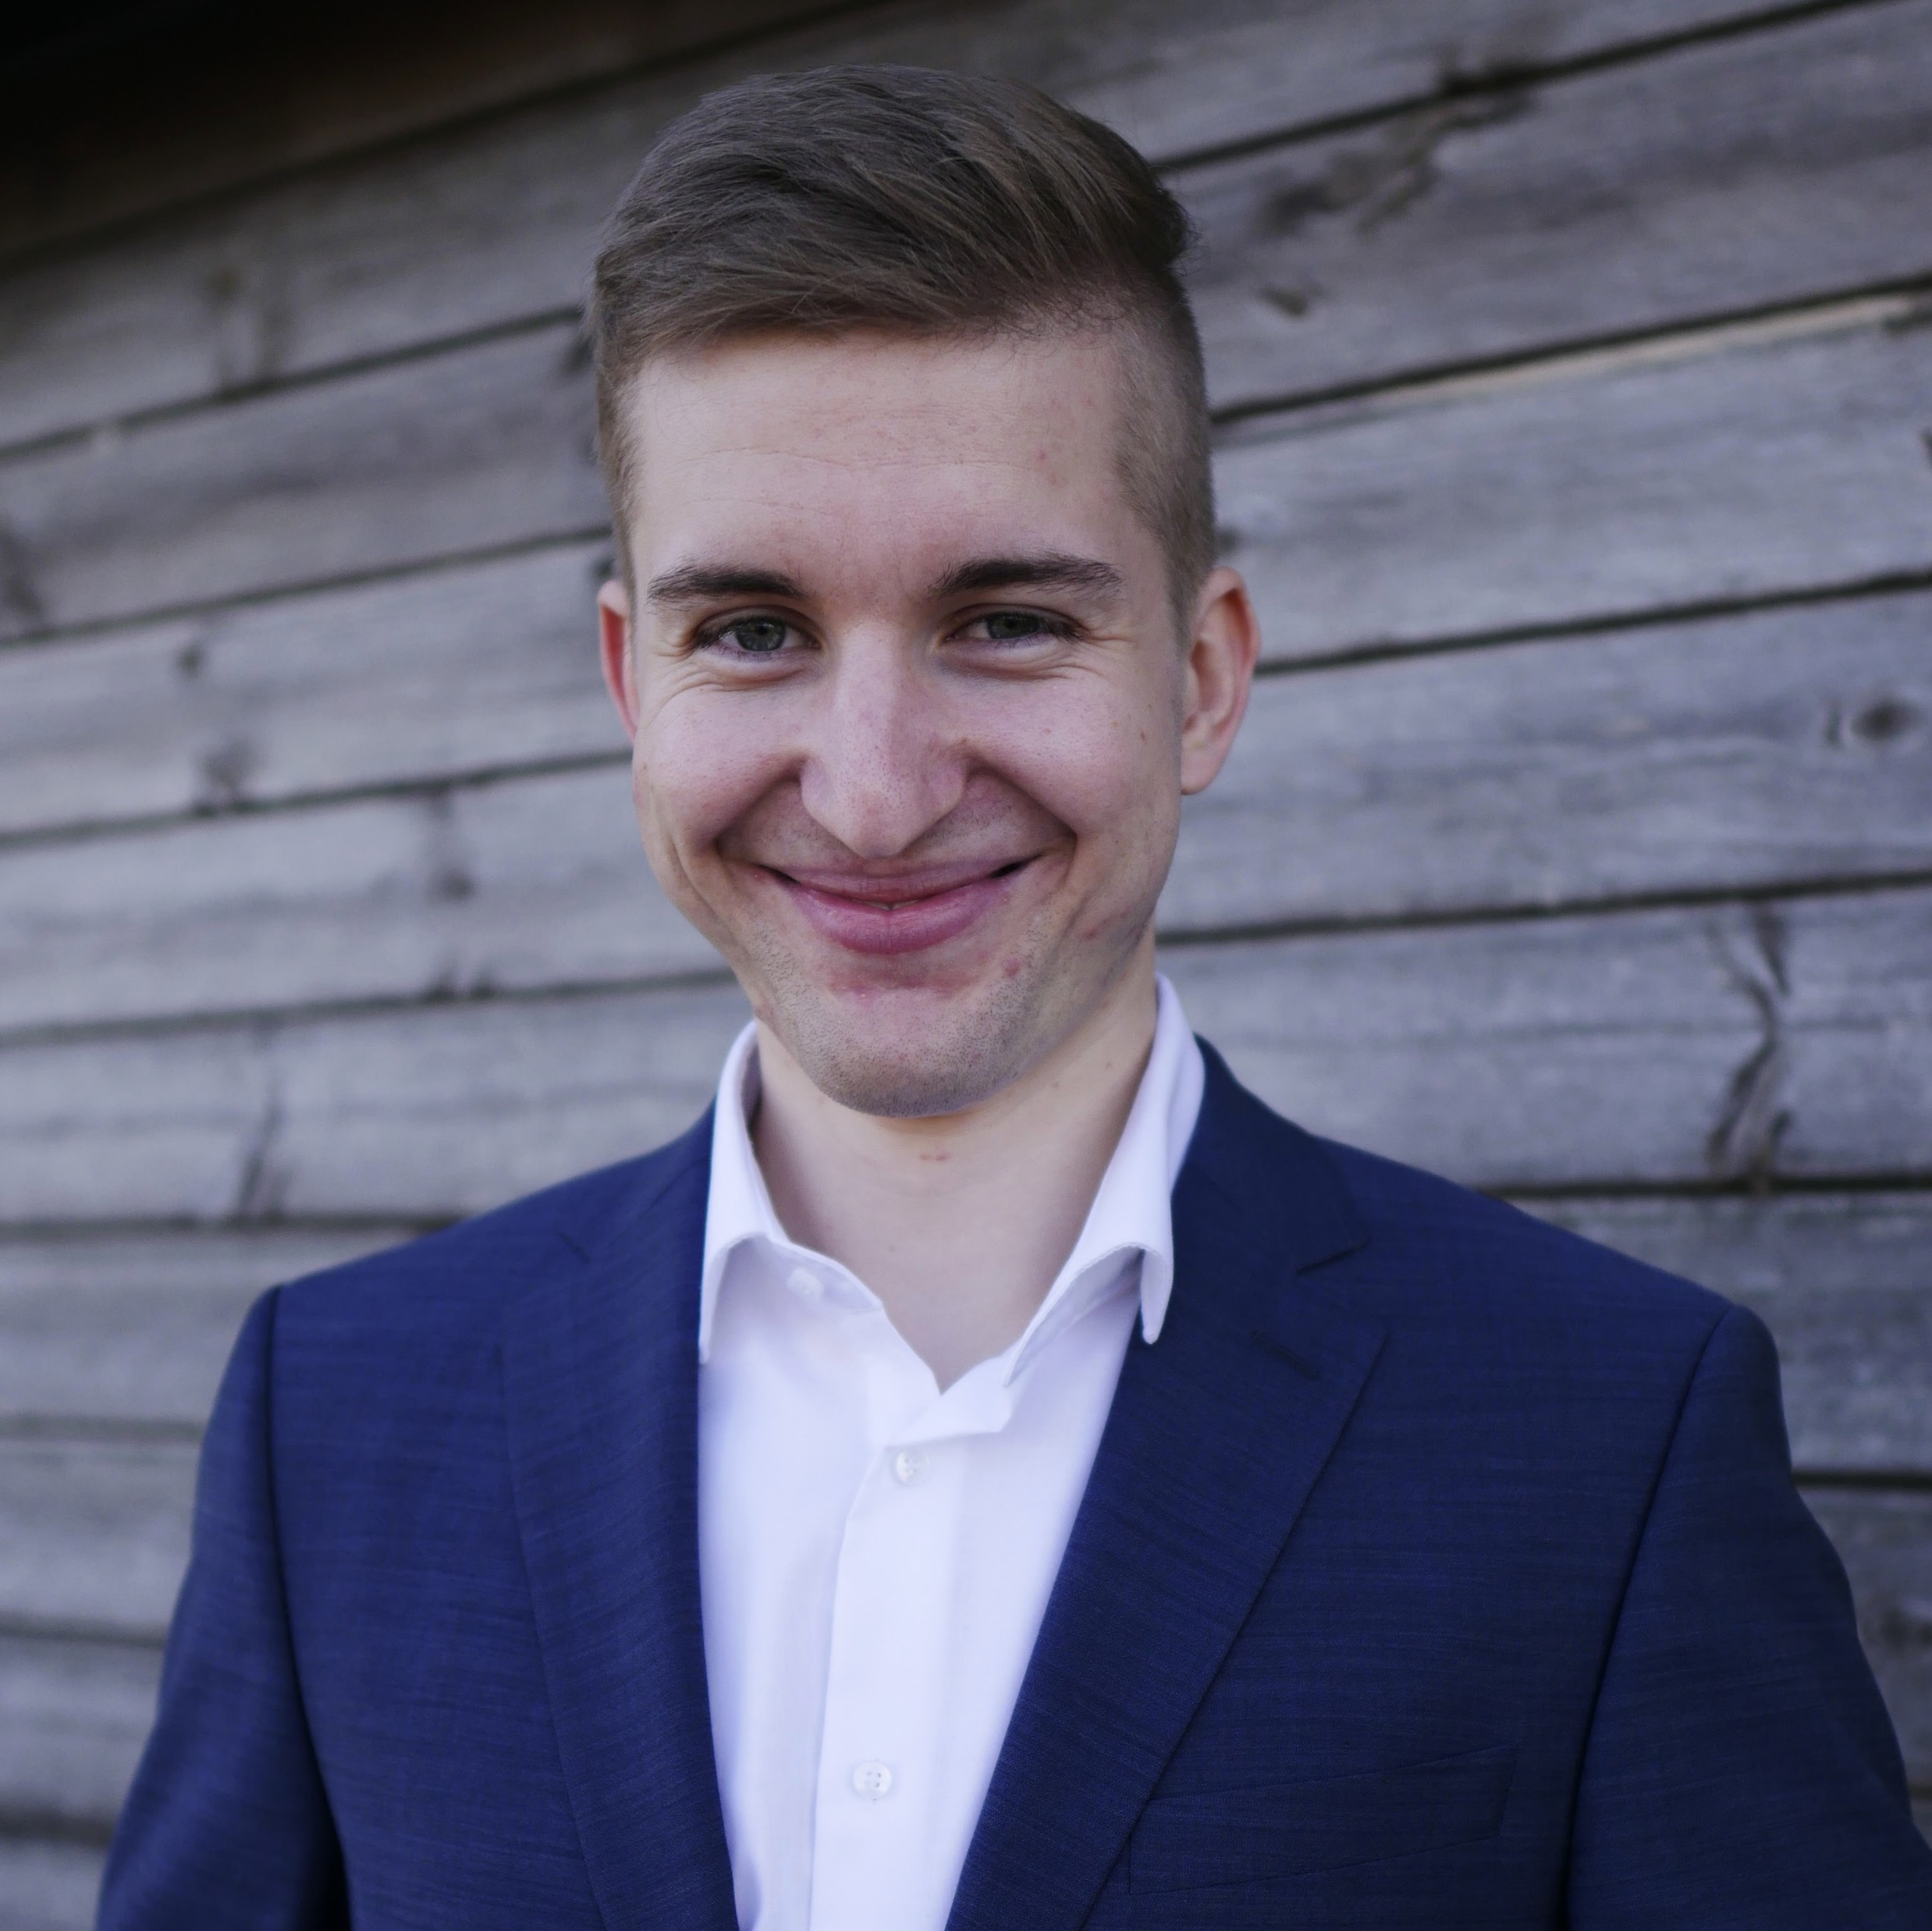


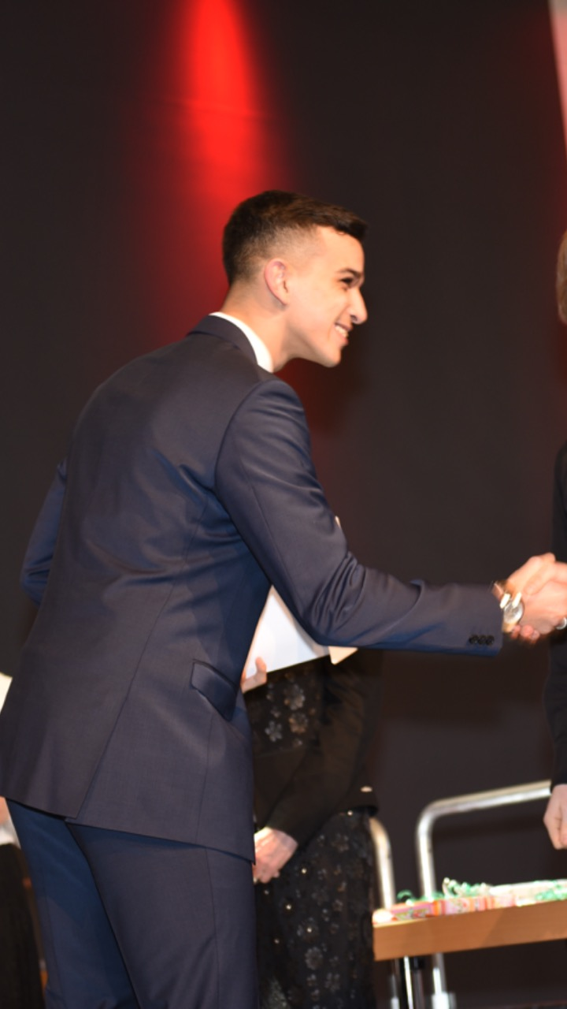
Our Team
lukas_benner@outlook.de
Lukas Bach Frontend
Lukas Benner Business
Nico Heller Frontend
linkedin.com/in/lukasbenner/
Marie Krieger Frontend
Ayman Madhour Backend
Georgios Paschaloglou Backend

