Slide 1

Pitch Deck
The Race against the Virus

Slide 2
Pandemic

Slide 3



Our Solution
Private
Easy to use
Inexpensive to implement

Slide 4



System – New Entry
Unique user ID
Location ID
Timestamp

Slide 5
System – Saved Data
Unique user ID
Unique user ID
Location ID
Timestamp

Slide 6

System – Report Case
Other unique user IDs
Unique user ID
Location ID
Timestamp

Slide 7
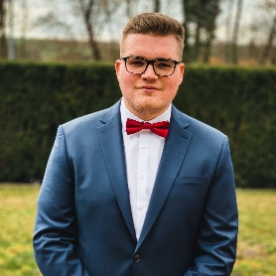
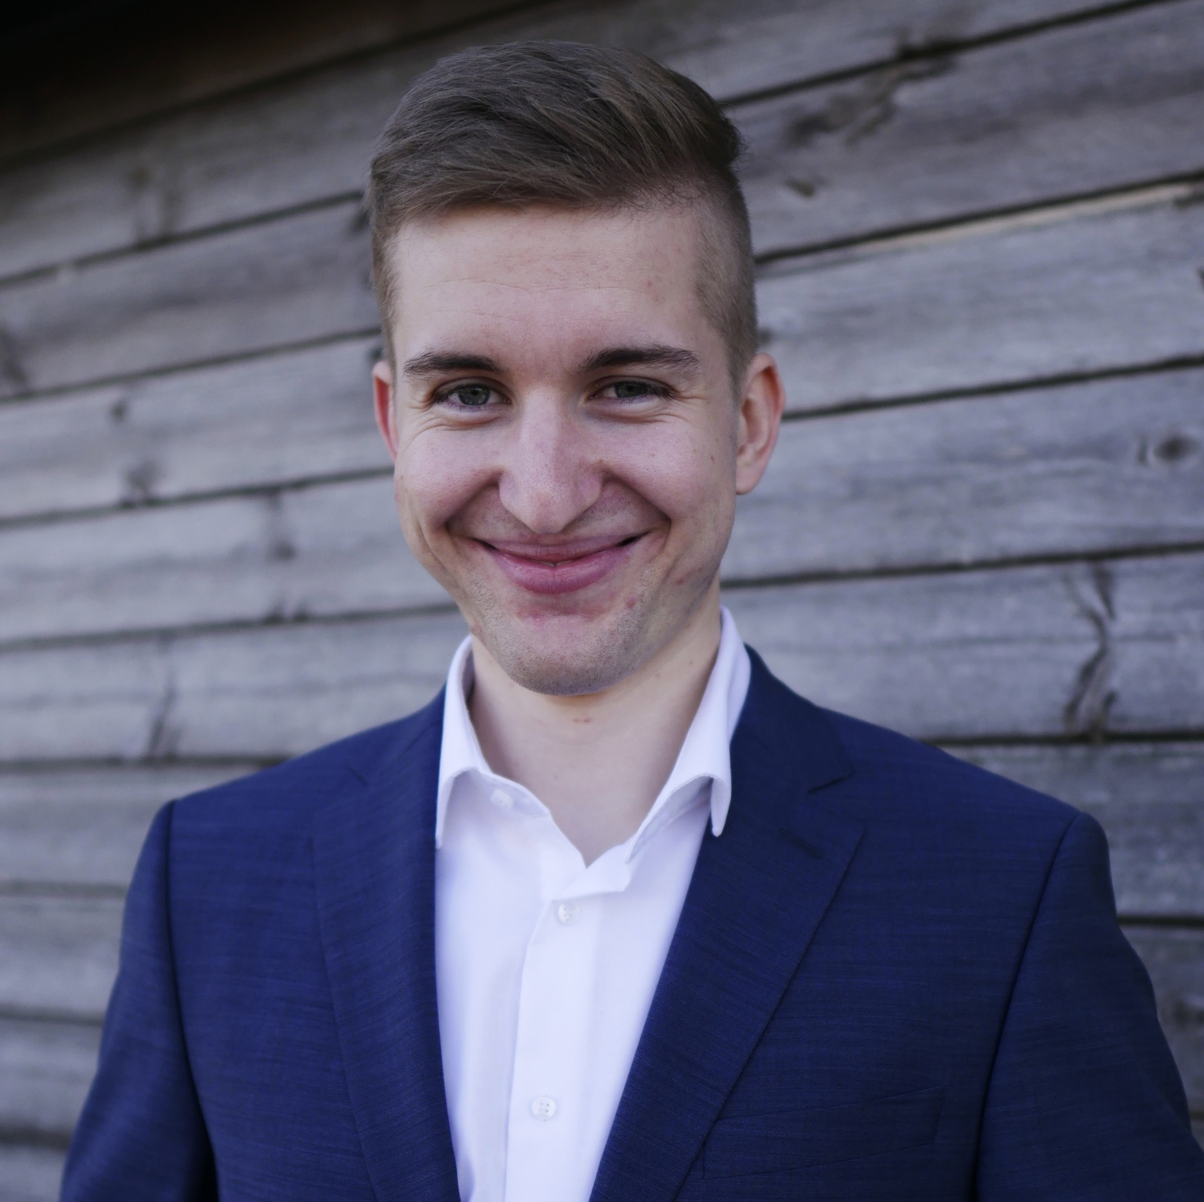
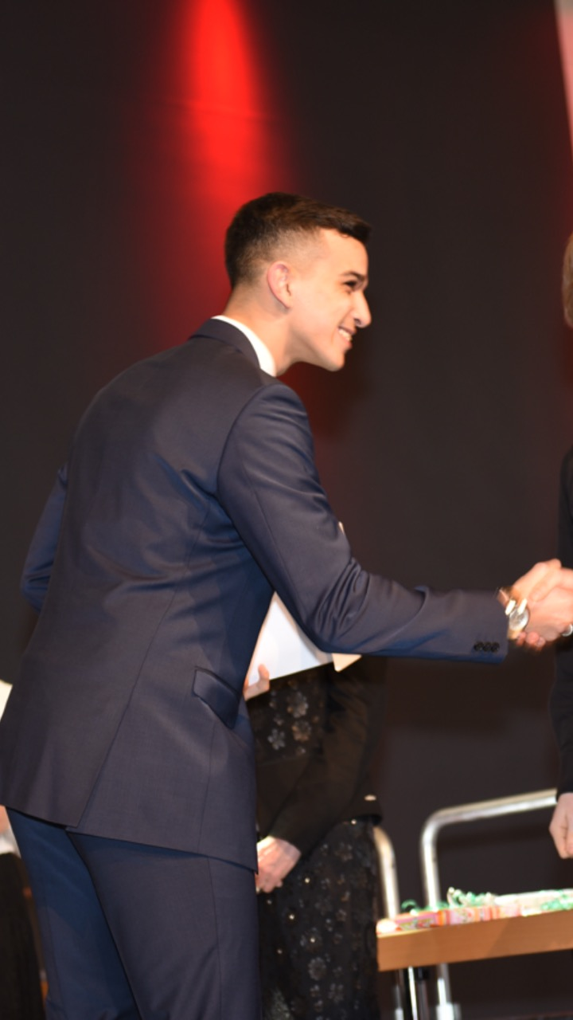
Our Team
Lukas Bach Frontend
Lukas Benner Business
Nico Heller Frontend
Marie Krieger Frontend
Ayman Madhour Backend
Georgios Paschaloglou Backend

