Slide 1

Tracer
The Race against the Virus

Slide 2
Pandemic

Slide 3
Our Solution

Slide 4
Technical System

Slide 5
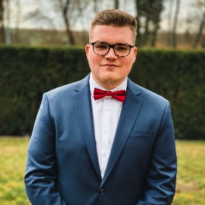
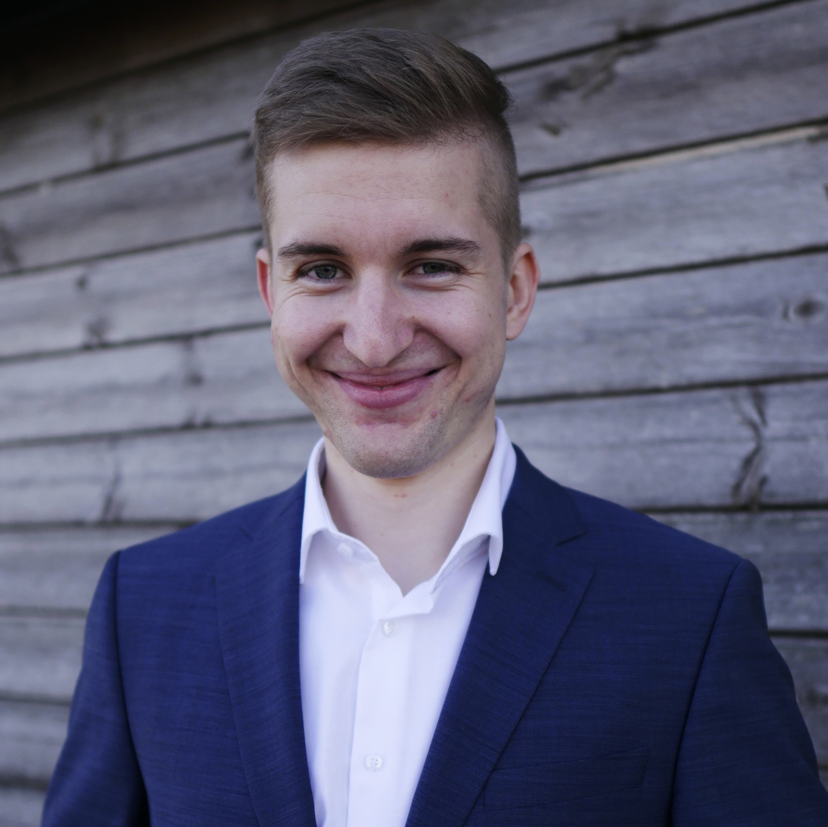

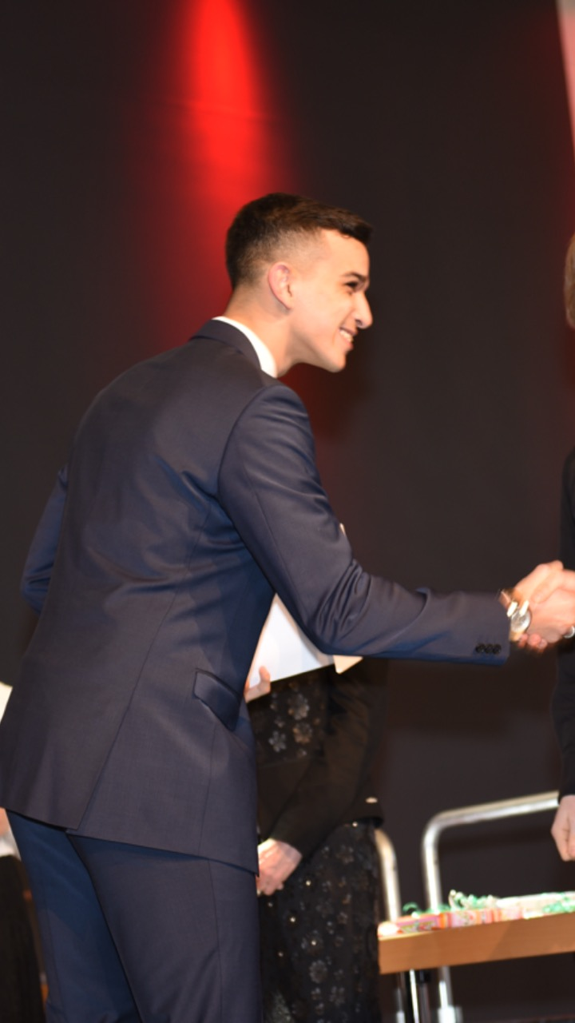
Our Team
Lukas Bach Frontend
Lukas Benner Business
Nico Heller Frontend
Marie Krieger Frontend
Ayman Madhour Backend
Georgios Paschaloglou Backend

