Slide 1
Media Ecologies
Presentation by Bennett Dierckman

Slide 2
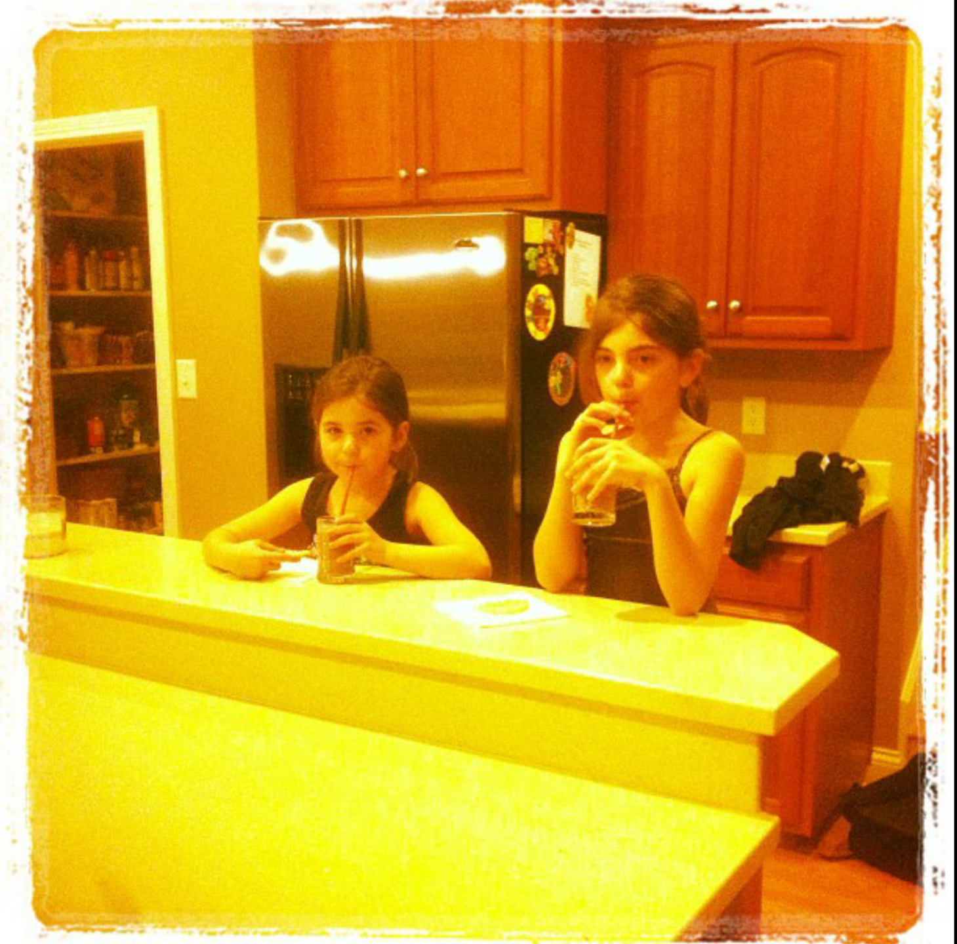

Slide 3
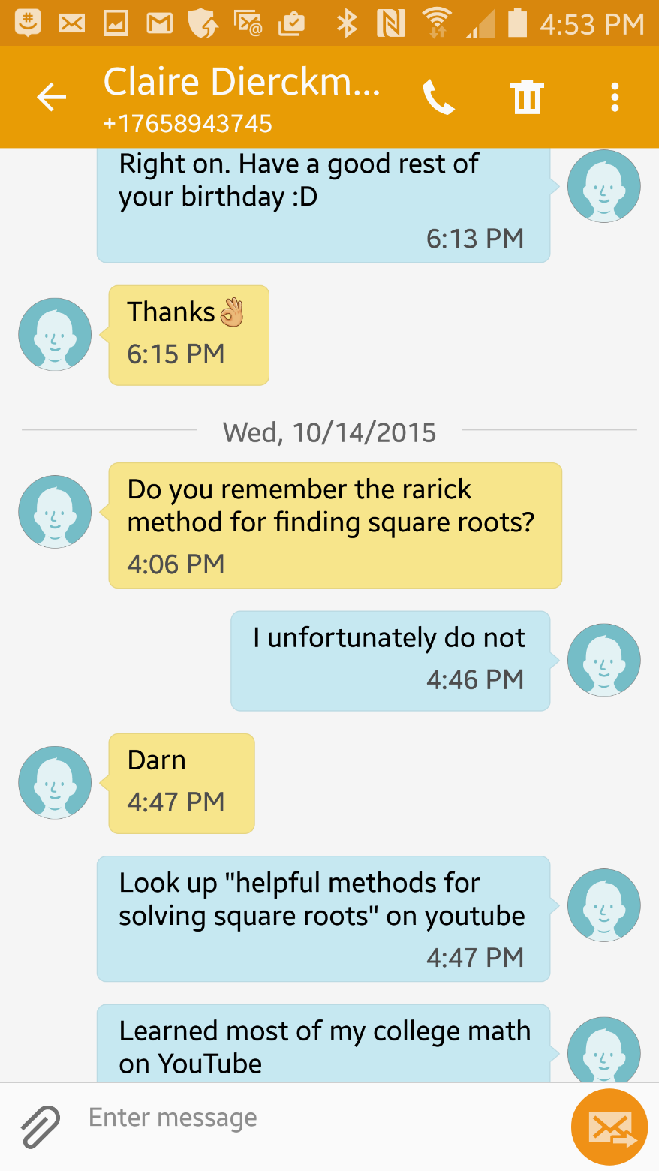

Slide 4
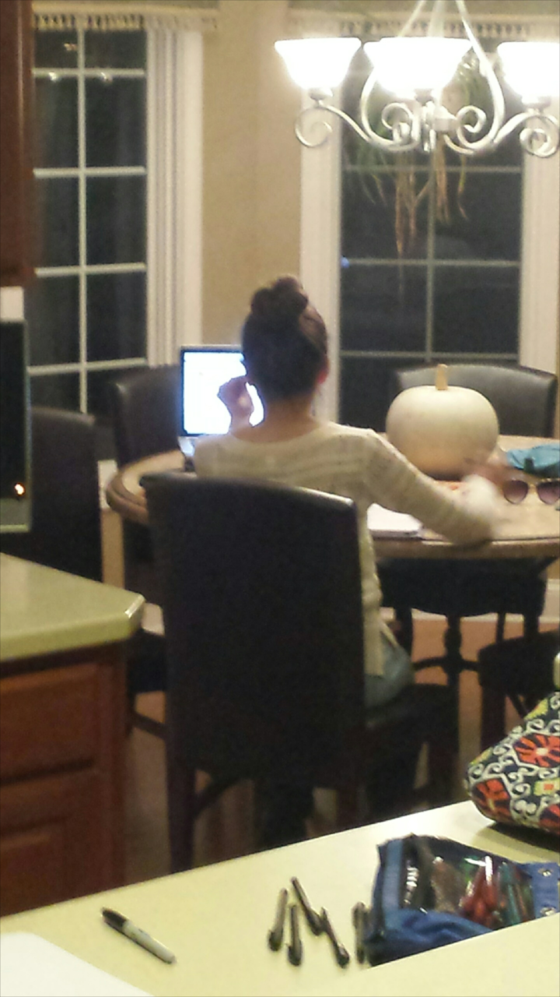

Slide 5
Hanging out

Slide 6
Messing Around

Slide 7
Geeking Out

Slide 8
Understanding It All

