Slide 1
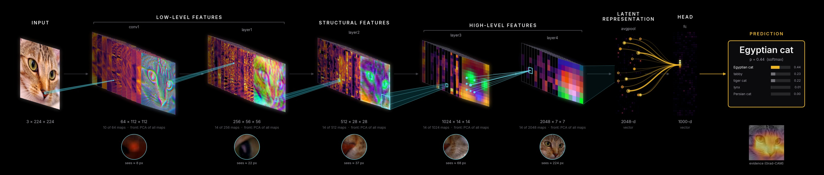
neural_flow
Seeing what a network sees: representation-flow visualisation for PyTorch
pymodelvis · MASI Lab / VALIANT, Vanderbilt University · September 2026
ResNet-50 (ImageNet weights) looking at a cat
Notes:
neural_flow shows what one real input becomes as it moves through a PyTorch network, and why the network decides what it decides. The banner is the ResNet-50 example: books of feature maps, beams between stages, and what one unit in each stage sees.

Slide 2
PROJECT SCOPING
From boxes-and-arrows to representations
The problem
Graph viewers such as Netron and TensorBoard graphs draw operations as boxes. They don't show what a specific input becomes, which region drives a decision, or how representations change as the input changes. That is what we need for teaching, debugging, papers and talks, and especially for 3-D medical models.
The goal
For any PyTorch model and a real input, show the flow INPUT → FEATURES → LATENT → HEAD(S) → OUTPUT using the actual activations, at presentation quality, and as movies over changing inputs.
In scope
Arbitrary PyTorch models: CNN, U-Net, ViT/Swin, 3-D, multi-input / multi-head
Automatic stage selection with explicit overrides
Static PNG / SVG / PDF, interactive HTML, movies
Gradient explanations: receptive fields, contributions, Grad-CAM
Memory-safe capture of very large 3-D activations
Out of scope
Training or fine-tuning models
Editing or exporting computational graphs
Feature visualisation by optimisation (DeepDream-style)
Non-PyTorch frameworks; clinical validation
Delivered: Python package · 50 CPU tests · 4 design docs · 9 examples on 5 real and 3 trained demo models · 4 movies · UNesT checkout
Notes:
Scope: representation flow for one real input (or a sequence of inputs), not graph drawing. Deliberately out of scope: training, graph editing, optimisation-based feature visualisation, and any claim of clinical validity for the demo models.

Slide 3
DESIGN CRITERIA
Six rules the package is built around
01
02
03
Representation, not computation
Architecture-agnostic
Non-invasive and memory-safe
5–12 meaningful stages chosen automatically. ReLUs, norms, dropout and reshapes are folded away.
Forward hooks plus runtime dataflow tracing recover skips, merges and branches. torch.fx is optional; failures fall back gracefully.
eval() + no_grad(); every hook removed; user tensors untouched. Large tensors are reduced on-device within max_capture_mb.
04
05
06
Faithful
Explanatory
Presentation-grade
Every pixel comes from the actual input. Percentile normalisation; outputs are never presented as probabilities unless they are; ≈ marks summaries.
Beams: which region feeds the strongest unit. Circles: what that unit sees. Lines: W·x contributions. Grad-CAM evidence.
Black cinematic theme, Inter typeface, 16:9 wrapping, vector SVG/PDF. Movies keep channels, colours and scale fixed across frames.
Notes:
These criteria came from the original specification: representation-flow rather than a computational graph, arbitrary architectures, memory safety for large 3-D tensors, faithful rendering, and presentation quality. Explanations and movies were added in the second round.

Slide 4
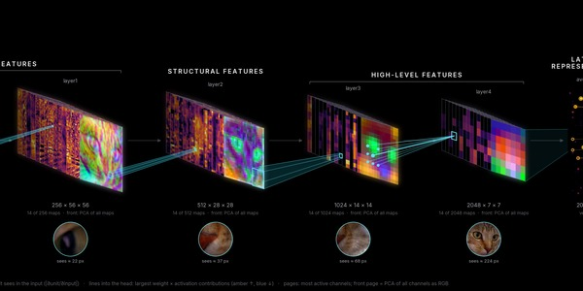
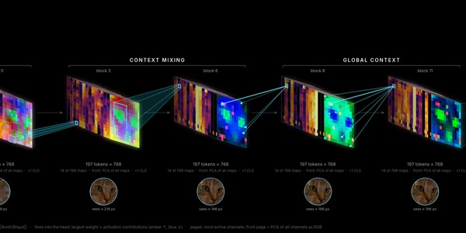
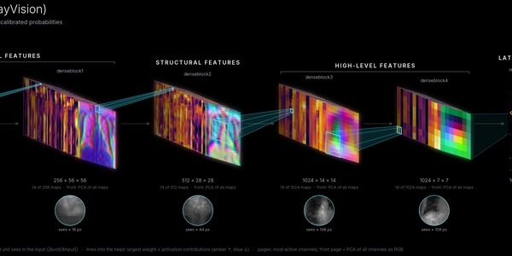
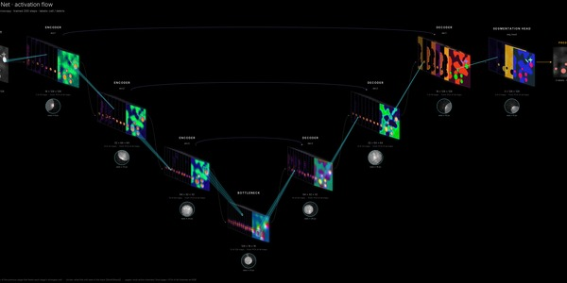
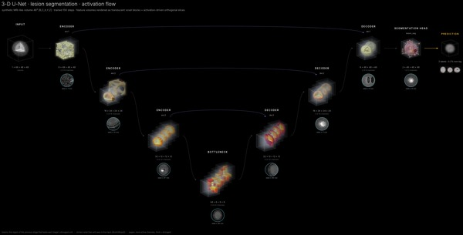
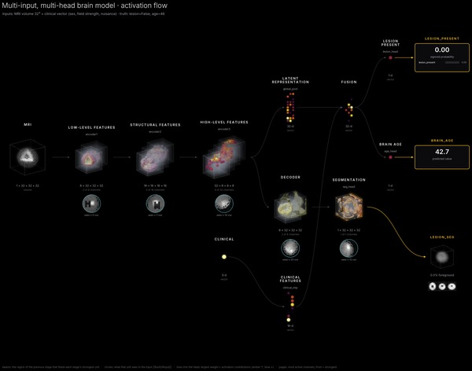
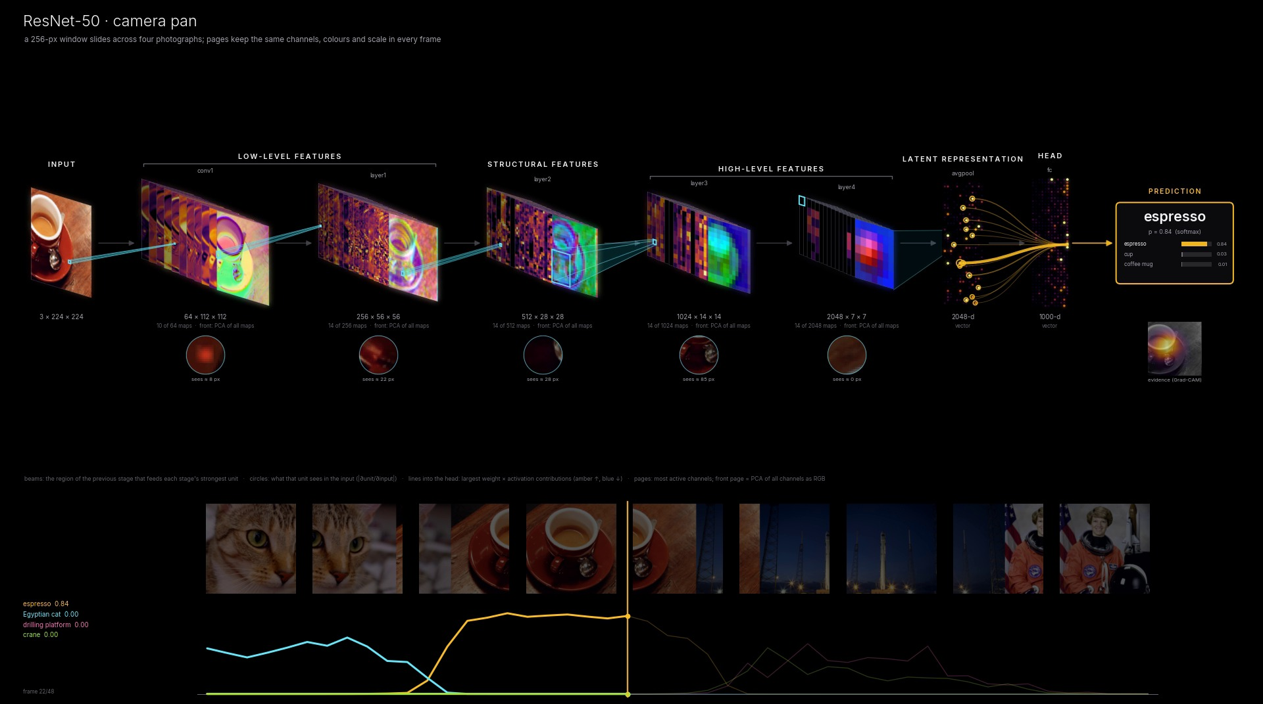
SUMMARY OF EXAMPLES
Nine examples, five with real pretrained weights
EXAMPLE
MODEL / WEIGHTS
WHAT IT SHOWS
ResNet-50 · the cat
Real ImageNet weights (timm / torchvision)
Hierarchy of features, receptive fields 8 → 224 px, Grad-CAM
ViT-B/16
Real ImageNet weights
Tokens as a 14×14 grid; attention globalises by block 4
Chest X-ray DenseNet-121
Real: TorchXRayVision, NIH ChestX-ray14 image
Cardiomegaly evidence on the heart; ± contributions
2-D U-Net
Trained on synthetic microscopy
Skip connections, U layout, segmentation overlay
3-D U-Net
Trained on synthetic MRI volumes
[B,C,X,Y,Z] as voxel blocks; ortho slices; 3-D segmentation
Multi-input, multi-head
Trained on synthetic MRI + clinical
Fusion and branching into 3 heads
Movies
ResNet-50, ViT, DenseNet, multi-head
Camera pan, subject ageing, occlusion sweep
Ready to run on your machine: MASI UNesT whole-brain segmentation (MONAI bundle) via tools/checkout_real_models.py
Notes:
Real weights: ResNet-50, ViT-B/16 and the TorchXRayVision DenseNet. The U-Net, 3-D U-Net and multi-head models were trained briefly on built-in synthetic data, so their activations are meaningful. They demonstrate the tool, not clinical performance.

Slide 5
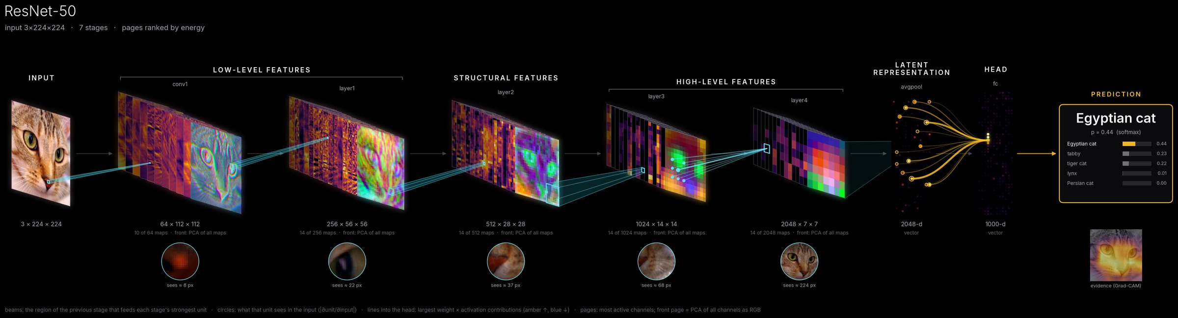
EXAMPLE 1 · REAL WEIGHTS
ResNet-50 looks at a cat
style="cinematic" · theme="black" · 7 stages chosen automatically from 183 module calls
1
Front page = PCA of all maps
2
Beams between stages
3
What one unit sees
4
Why 'Egyptian cat'
Three principal components of every channel as RGB: the whole layer at a glance. Deep layers separate the face.
The region of the previous stage that feeds each stage's strongest unit: a small window, then wider after downsampling.
|∂unit/∂input| crops: the receptive field grows 8 → 22 → 37 → 68 → 224 px.
Amber and blue lines are the largest weight × activation terms. Grad-CAM evidence lies on the face.
Notes:
The hero example, kept from the first round. Everything is computed from this one input: activations from the capture pass; beams, circles, lines and Grad-CAM from one gradient pass.

Slide 6
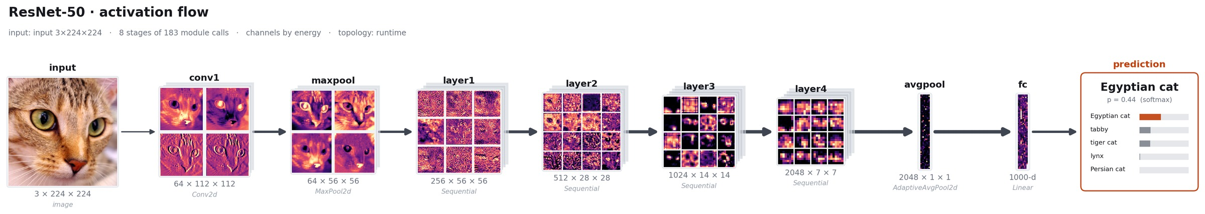
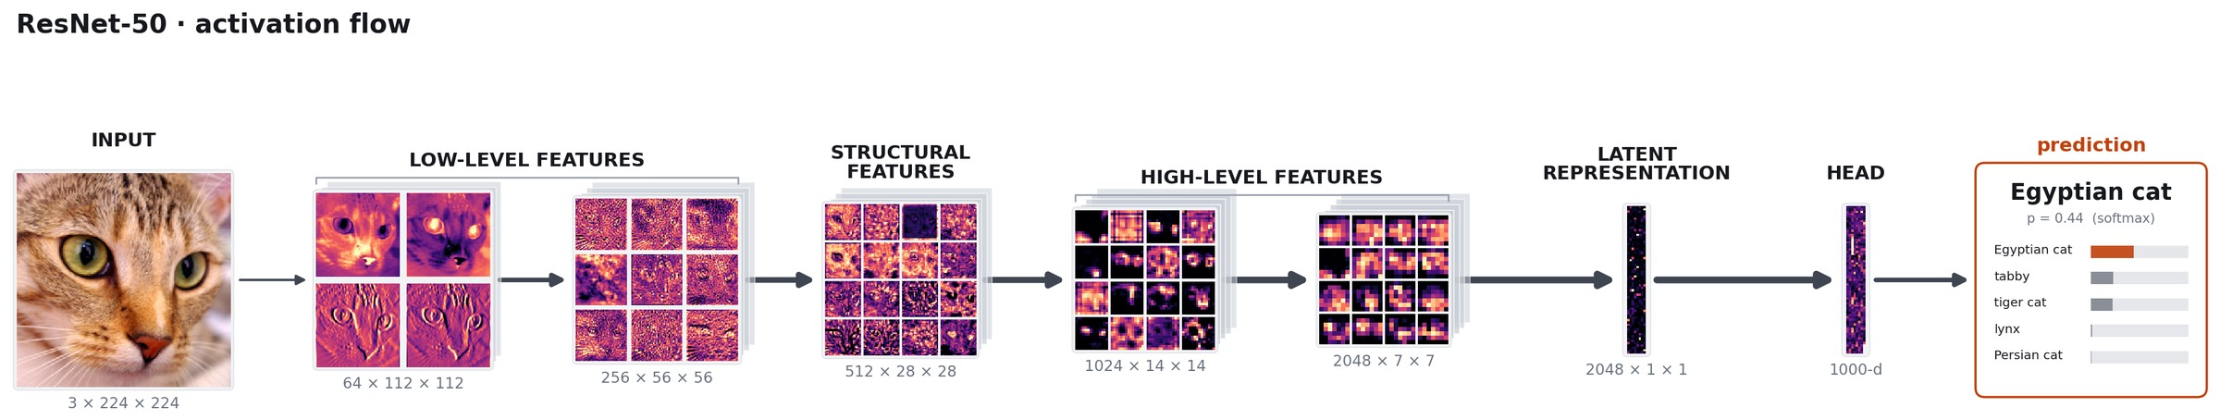
EXAMPLE 1 · SAME TRACE, OTHER RENDERERS
Technical figures for papers, story mode for teaching
style="technical": channel mosaics, module names and types, exact shapes; channel depth shown as offset sheets
style="story": conceptual stages with grouped labels (LOW-LEVEL → STRUCTURAL → HIGH-LEVEL → LATENT → HEAD)
Notes:
The same FlowResult can be rendered three ways. The technical style targets publications (SVG/PDF keep text and arrows as vectors); the story style targets teaching.

Slide 7
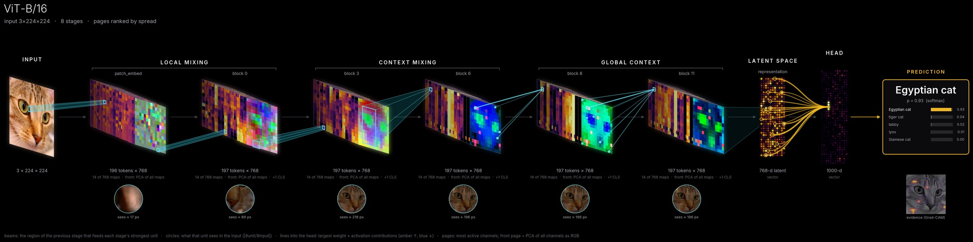
EXAMPLE 2 · REAL WEIGHTS
A Vision Transformer mixes the whole image early
timm vit_base_patch16_224 · blocks sampled 0, 2, 4, 7, 9, 11 · Egyptian cat p = 0.98
1
Tokens become a grid
2
Rays instead of windows
3
Receptive fields go global
4
Robust channel ranking
197 tokens × 768: CLS separated, 196 patch tokens reshaped to 14 × 14 pages.
Dependencies between blocks are scattered: every token can draw on the whole image.
17 px at the patch embedding, 42 px at block 2, ≈ 170 px by block 4. Compare the CNN's gradual growth.
Transformers carry a few near-constant 'massive' channels, so pages are ranked by p90 − p10 spread.
Notes:
ViT-B/16 (ImageNet-1k, JAX port via timm). Same input as ResNet-50: Egyptian cat, p = 0.98.

Slide 8
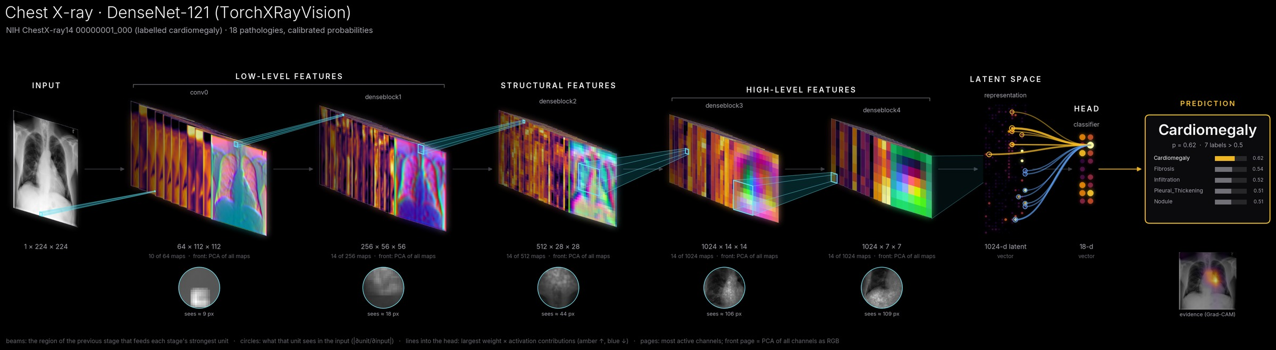
EXAMPLE 3 · REAL MEDICAL MODEL
Chest X-ray: where the Cardiomegaly evidence lies
DenseNet-121 dense blocks 1–4 · 1024-d latent · 18 calibrated outputs
1
Real model, public image
2
Evidence on the heart
3
Arguments for and against
4
Honest outputs
TorchXRayVision DenseNet-121 (7 datasets, 18 pathologies) on NIH ChestX-ray14 00000001_000.
Grad-CAM for Cardiomegaly (p = 0.62) concentrates on the cardiac silhouette.
Amber latent units push Cardiomegaly up; blue ones push it down. Both are shown.
output_types = multilabel_probs: calibrated probabilities, top-5 listed, 7 labels above 0.5.
Notes:
Real clinical-style model on a real, public chest radiograph. The occlusion movie (later) tests whether the prediction depends on the heart region.

Slide 9
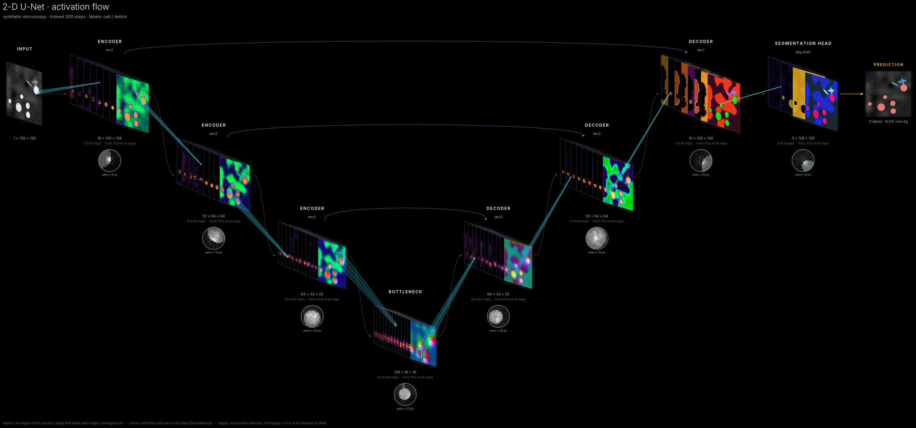
EXAMPLE 4 · TRAINED ON SYNTHETIC DATA
2-D U-Net: skip connections as bridges
Topology from the actual execution
A TorchFunctionMode records every tensor op; walking back from each stage's inputs finds enc1 → dec1, enc2 → dec2 … even through torch.cat in forward().
U layout, automatically
Resolution-matched skips trigger a layout that dips by resolution level, so skips become horizontal bridges.
Segmentation overlay
Cells (red) and debris (blue) are overlaid on the input; connector layers such as pooling and up-convs are absorbed into their blocks.
Notes:
A small U-Net trained for 200 steps on built-in synthetic microscopy images. Skip connections come from runtime dataflow, not from names.

Slide 10

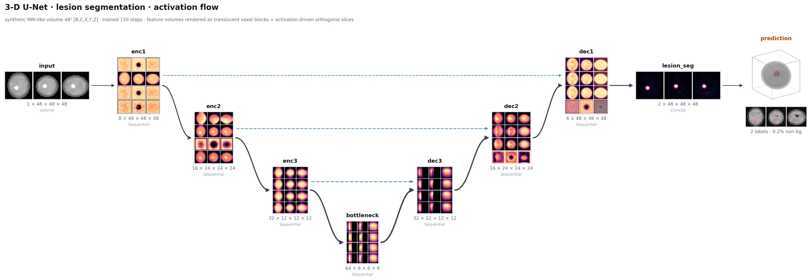
EXAMPLE 5 · [B, C, X, Y, Z] AS A FIRST-CLASS TENSOR
3-D U-Net: from anatomy to voxel blocks
volume_mode="projection" (max-intensity per axis)
Input: cut-away anatomy with orthogonal slices through the centre of mass.
Features: solid voxels for the strongest activations inside a translucent block; small volumes keep discrete cubes.
Slices through each stage's activation peak, not the geometric centre.
Output: 'glass' anatomy with an opaque lesion (Dice 0.89 on the test volume).
Notes:
The 3-D U-Net is trained on synthetic MRI-like head phantoms with lesions. The renderer is a small orthographic ray caster on grid_sample. Tensors are nibabel/MONAI [X, Y, Z] by default.

Slide 11

EXAMPLE 6 · MULTI-INPUT, MULTI-HEAD
MRI + clinical vector → segmentation, lesion and brain age
1
Dict inputs, dict outputs
{'mri', 'clinical'} in; {'lesion_seg', 'lesion_present', 'brain_age'} out, each with its own card.
2
Fusion and branching
The clinical MLP sits next to its late fusion; heads fan out from the shared representation.
3
Conceptual labels
ENCODER, DECODER, FUSION, CLINICAL FEATURES and head names are inferred from the graph.
4
Conservative semantics
Sigmoid probability for lesion_present, regression for brain_age, a 3-D mask for lesion_seg.
Notes:
A small multi-task network trained for 600 steps on synthetic data. It tracks age (predicted 29 → 80 for true 25 → 85) and detects lesions above about 2 voxels in radius.

Slide 12
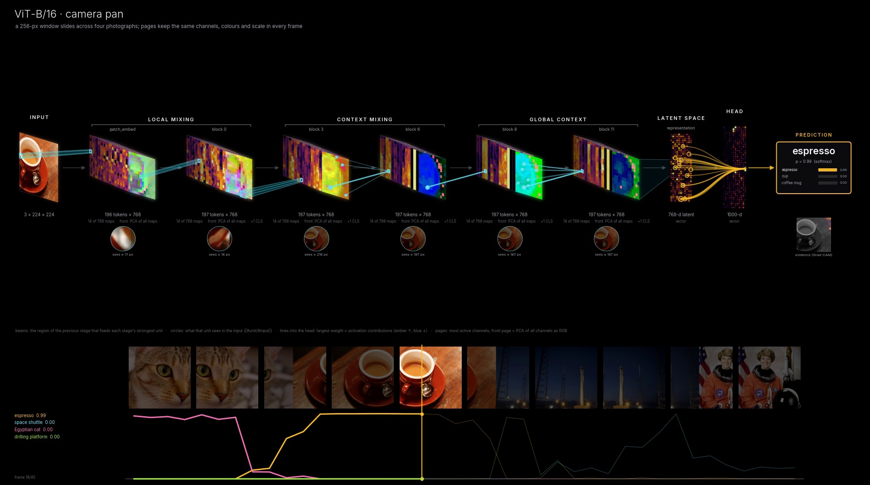
MOVIES OVER CHANGING INPUTS
A camera pans across four photographs
ResNet-50
ViT-B/16
Egyptian cat → espresso → drilling platform / crane → go-kart (the astronaut). The timeline and film strip track the top classes.
The same pan through a transformer: rays gather from across the image, and predictions switch more sharply.
Notes:
Movies hold stages, channels, per-channel scale and the PCA colour basis fixed across frames, so any change you see is a change in activation. Beams, receptive fields, contributions and Grad-CAM move with the input.

Slide 13
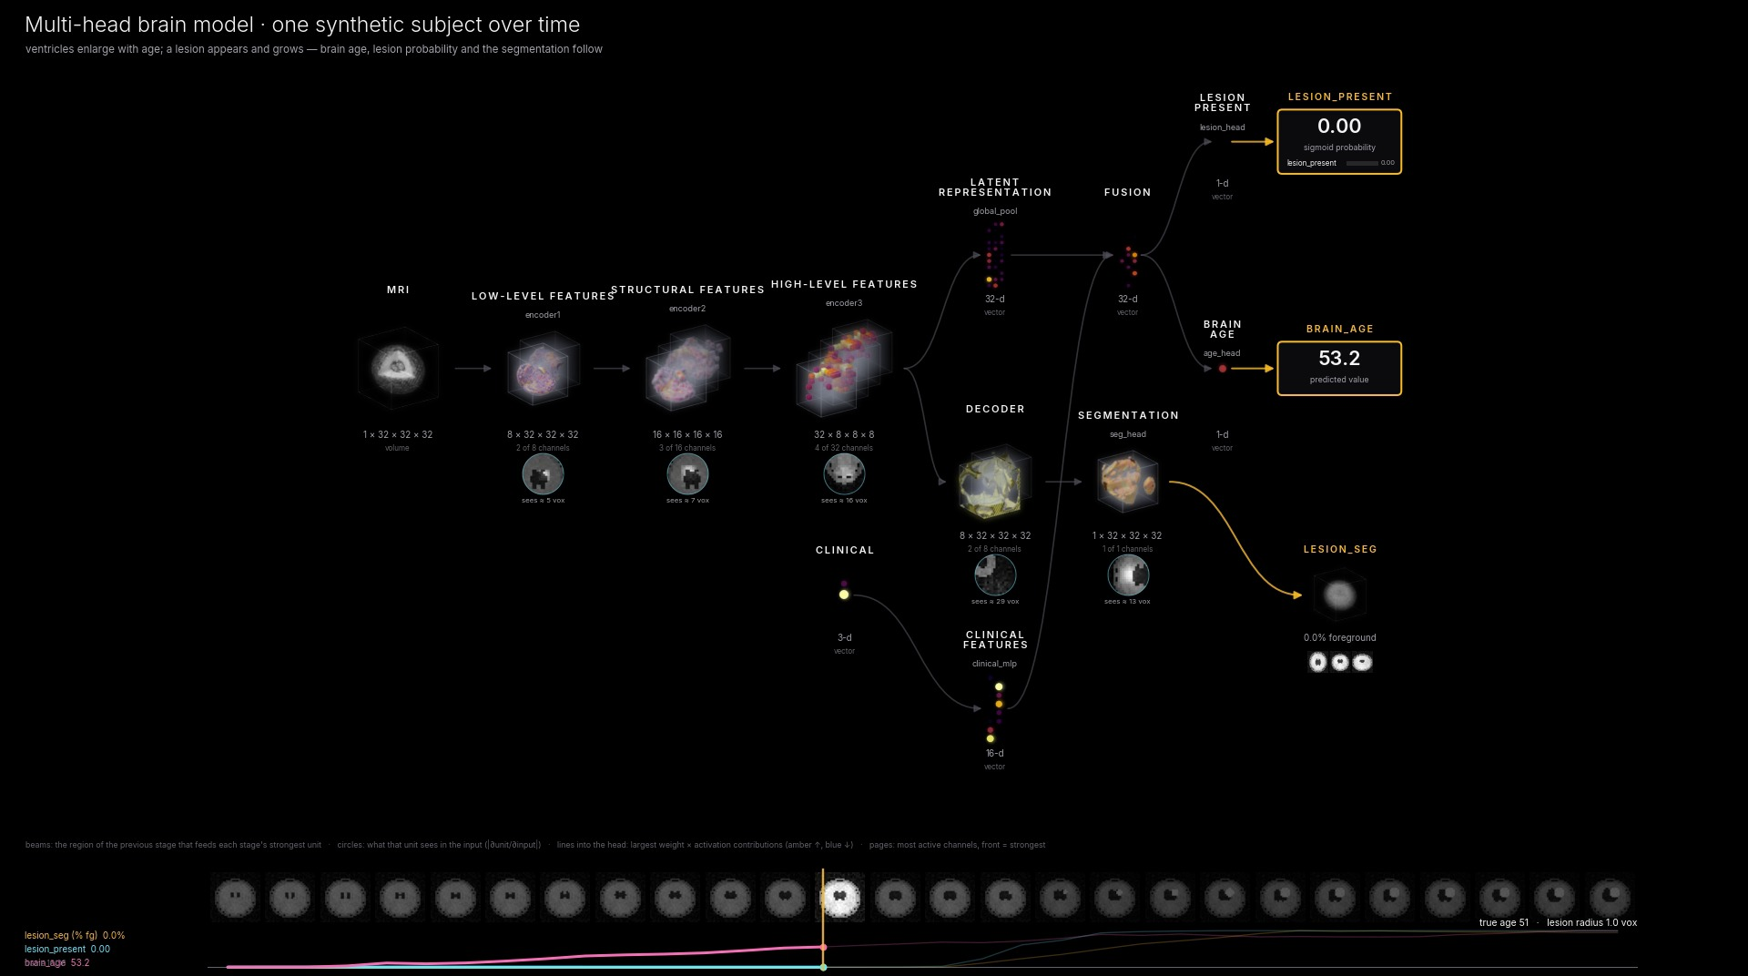
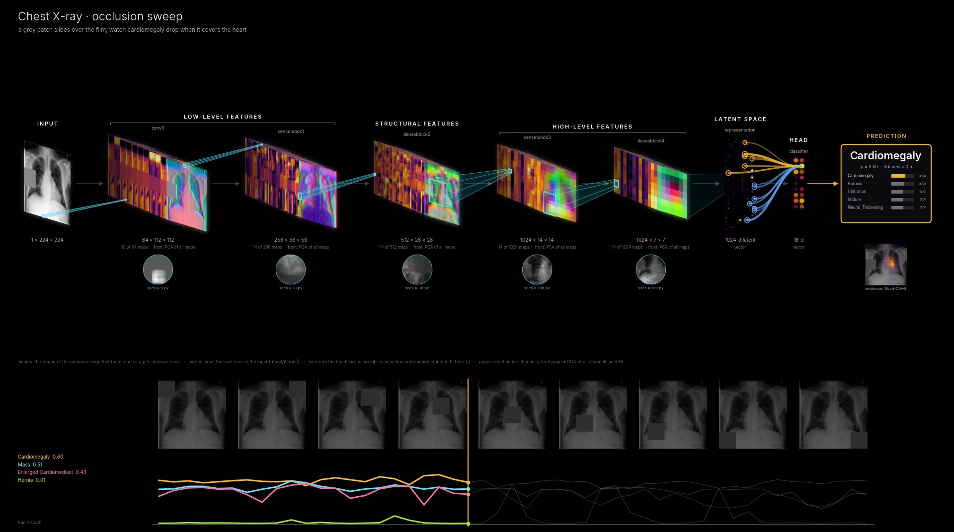
MOVIES WHERE THE NETWORK MAKES SENSE
A subject ages; a patch hides the heart
One synthetic subject over time (3-D)
Occlusion sweep on a chest X-ray
Ventricles enlarge while a lesion appears and grows. Predicted brain age rises (29 → 72), lesion probability switches 0 → 1, and the segmented volume grows.
A grey patch slides over the film. Cardiomegaly falls when the heart is covered (and the model then prefers Hernia), a direct test of reliance.
Notes:
Both movies are in-distribution sweeps where the expected behaviour is known, so the movie checks the model rather than just decorating it.

Slide 14
USER INSTRUCTIONS
Install, render, explore, animate
Install
One figure
cd ~/dev/pymodelvis
python -m venv .venv && source .venv/bin/activate
pip install -e ".[all]"
pytest -q # 50 tests
from neural_flow import visualize_model
visualize_model(model, x, output="flow.png",
style="cinematic") # black
# style="technical" | "story"; theme="light"
# figsize=(16, 9); output="flow.svg" | ".html"
A movie
Examples and real models
from neural_flow import animate_inputs
from neural_flow.sequences import pan
frames = pan(img, window=256, steps=48)
animate_inputs(model, frames,
output="pan.mp4", class_names=names)
bash examples/run_all.sh # every figure + movie
python tools/checkout_real_models.py
python examples/monai_bundle.py # MASI UNesT
python examples/monai_bundle.py --movie
Notes:
Outputs land in examples/outputs. The checkout script fetches the UNesT MONAI bundle, the MNI152 template and torchvision weights into real_models/. monai_bundle.py builds any MONAI bundle from its own config.

Slide 15
CITATIONS AND REFERENCES
References
He K, et al. Deep residual learning for image recognition. CVPR 2016.
Dosovitskiy A, et al. An image is worth 16×16 words: Transformers for image recognition at scale. ICLR 2021.
Ronneberger O, et al. U-Net: Convolutional networks for biomedical image segmentation. MICCAI 2015.
Çiçek Ö, et al. 3D U-Net: Learning dense volumetric segmentation from sparse annotation. MICCAI 2016.
Selvaraju RR, et al. Grad-CAM: Visual explanations from deep networks via gradient-based localization. ICCV 2017.
Luo W, et al. Understanding the effective receptive field in deep convolutional neural networks. NeurIPS 2016.
Abnar S, Zuidema W. Quantifying attention flow in transformers. ACL 2020.
Zeiler MD, Fergus R. Visualizing and understanding convolutional networks. ECCV 2014.
Olah C, Mordvintsev A, Schubert L. Feature visualization. Distill 2017.
Cohen JP, et al. TorchXRayVision: A library of chest X-ray datasets and models. MIDL 2022.
Wang X, et al. ChestX-ray8: Hospital-scale chest X-ray database and benchmarks. CVPR 2017.
Yu X, et al. UNesT: Local spatial representation learning with hierarchical transformer for efficient medical segmentation. Medical Image Analysis 2023.
Cardoso MJ, et al. MONAI: An open-source framework for deep learning in healthcare. arXiv 2211.02701, 2022.
Wightman R. PyTorch Image Models (timm). GitHub, 2019.
Fonov V, et al. Unbiased average age-appropriate atlases for pediatric studies (MNI152 2009). NeuroImage 2011.
van der Walt S, et al. scikit-image: Image processing in Python. PeerJ 2014.
Roeder L. Netron: visualizer for neural network models. GitHub.
Notes:
Primary references for the architectures, the explanation methods (Grad-CAM, effective receptive field, attention rollout), the real models and data, and the tooling.

