Slide 1
Book_B
File created on: 2026/11/06 1:06:48

Slide 2
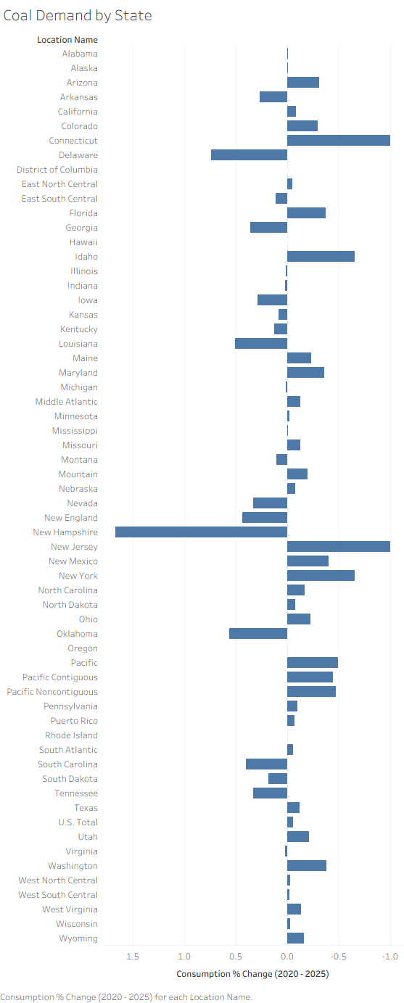

Slide 3
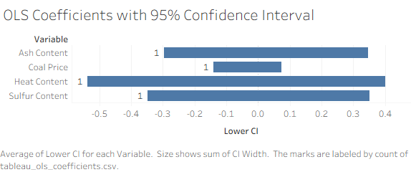

Slide 4


