Slide 1
SWENG 861 Bennett Schoonerman

Slide 2
INSTRUCTIONS
Develop a program implementing a REST API client that will provide the end-user with the functionality to inquire about real time flight prices.

Slide 3
REQUIREMENTS
Visit a mobile friendly public website
Search airports (with predictive text)
Select the date you want to fly
Enter the desired number of passengers
Get prices for the flights matching your search
Understand if the the prices are a good deal

Slide 4
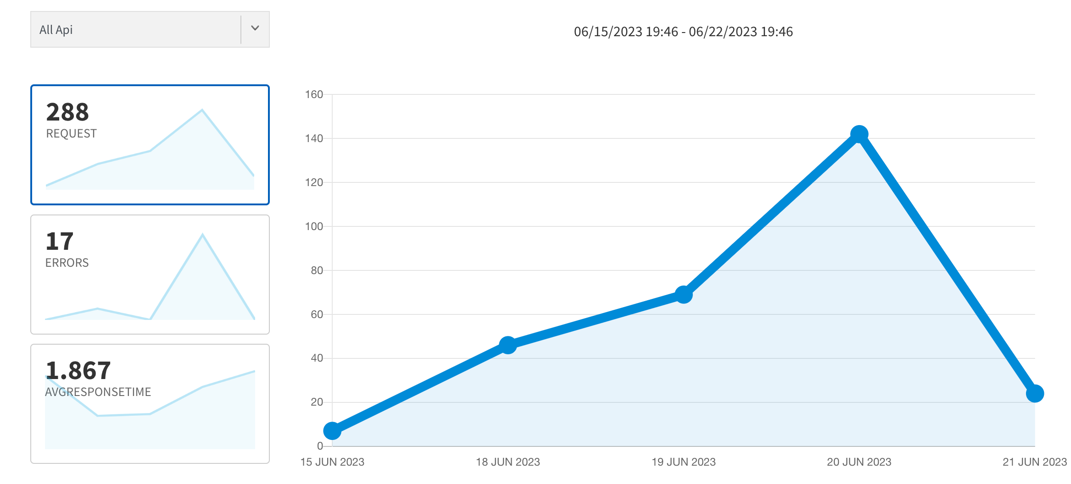
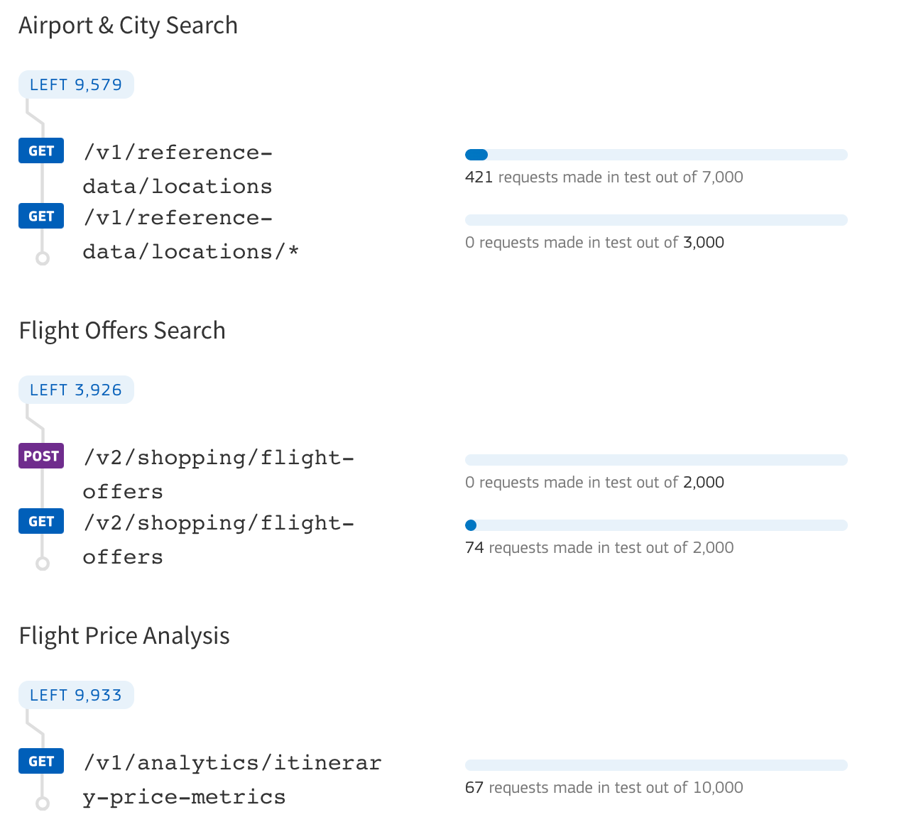
API selection
Amadeus
Robust API selection
Great documentation
Great developer tools
Easy App insights
Node.js SDK for ease of implementation

Slide 5
Basic REST overview
React App
Node.js Server
Amadeus Servers

Slide 6
Project structure
Node Express Server
React App
Src
Components
Router
No middleware
Serves up Build from React App
Utils
Build
Public

Slide 7
Technology Used
ESlint
A pluggable linter that encourages code best practices and integrates with many IDE’s.
Express.js
Express.js is a popular Node.js server framework that powers several web apps.
Jest Testing
Jest is a BDD/TDD assertion library for Node and the browser that can be delightfully paired with any testing framework.
Render.io
A unified cloud for apps and websites with free TLS certificates, a global CDN, DDOS protection, and auto deploys from Git.
Amadeus Node SDK
Makes it easy to integrate with your code without worrying about basic overhead tasks associated with RESTful services.
React
React.js is a popular UI framework that was created by Jordan Walke at Facebook.

Slide 8
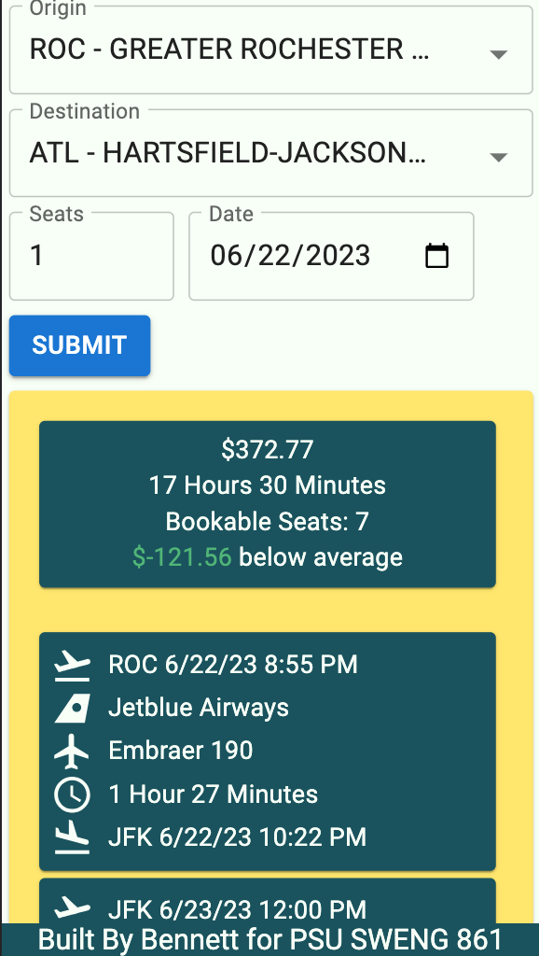
MOBILE PROJECT
Xs breakpoints are used to define styles at the smallest screen sizes.

Slide 9
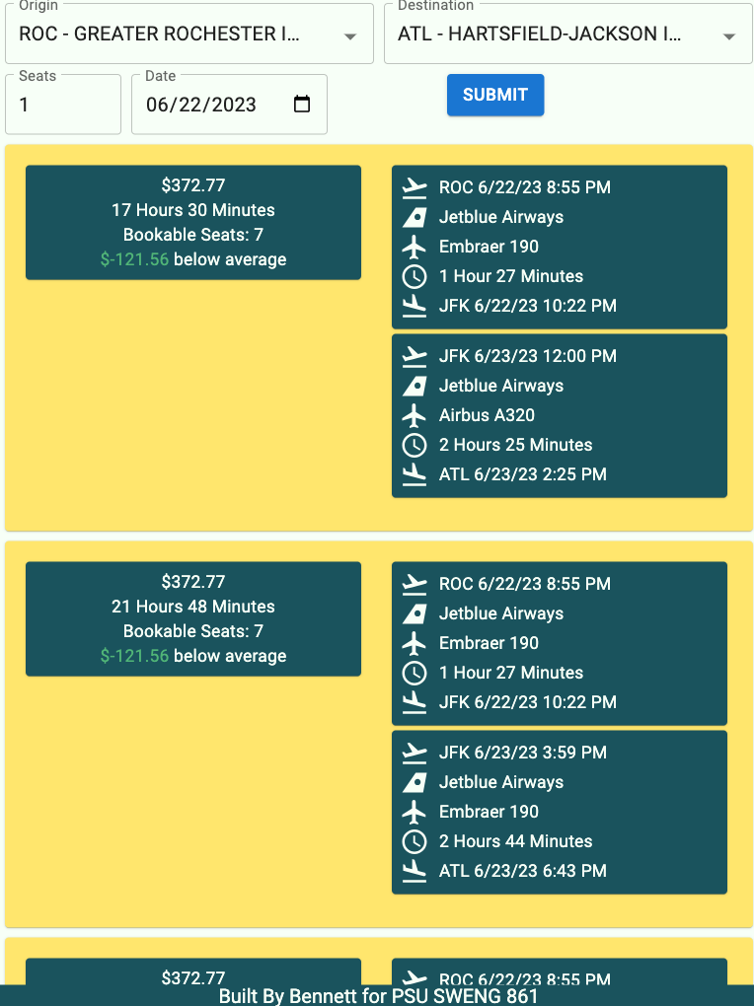
TABLET PROJECT
The mobile view is the same as the desktop view as far as breakpoints.

Slide 10
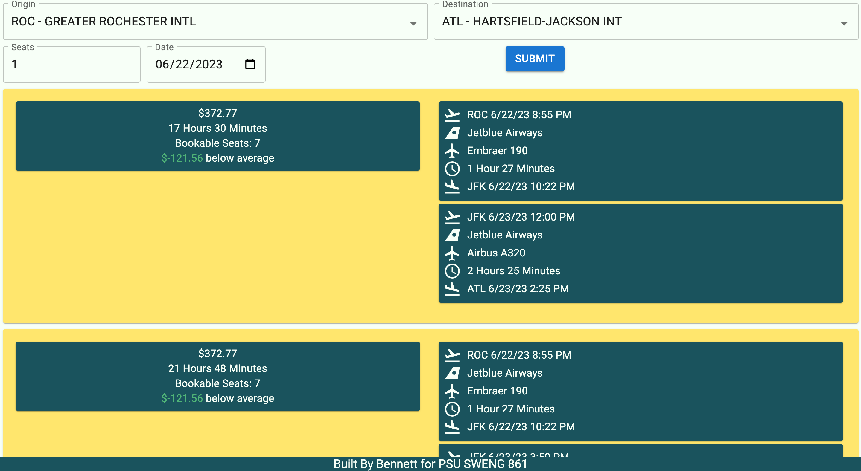
DESKTOP PROJECT

Slide 11
Thanks!
ANY QUESTIONS?
You can find me at: bas6849@psu.edu

