Slide 1
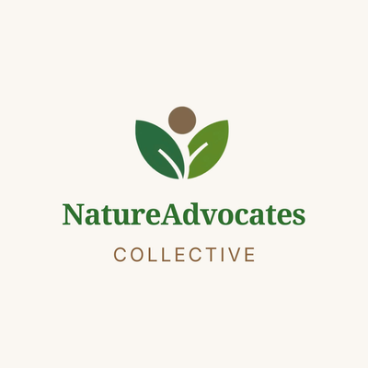


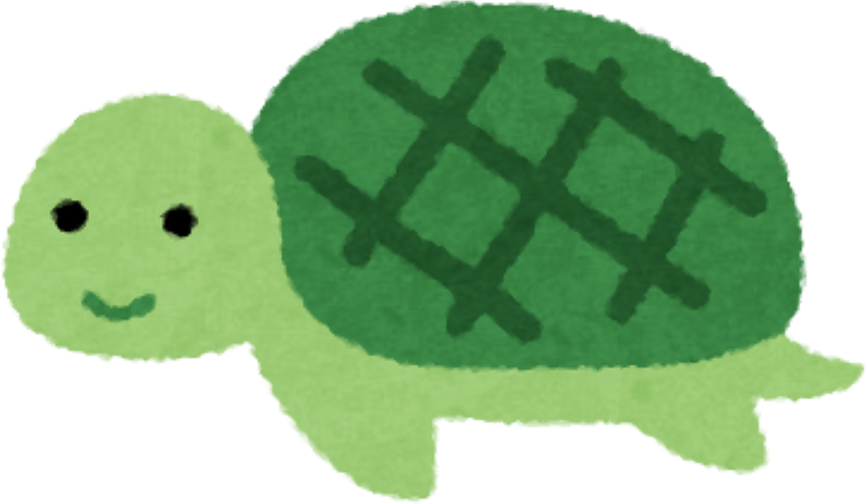









ALM216 · SOCIAL MEDIA STRATEGY
Social Media Content Strategy
Nature Advocates Collective (NAC)
Presented by Ben Nguyen
Student ID 225443664
Assessment Task 2
Notes:
Replace this cover with your own title, name and student ID. Remember to Save As before editing. This is a 5-minute video presentation — rehearse and keep to time.
1

Slide 2




Contents
01
Audit Recap
Key strengths and gaps from your AT1 findings
02
Content Strategy
Objectives · Audience alignment · Platform rationale
03
Creative Content
Sample mock-up content across at least three platforms
04
Content Calendar
One-month plan across your chosen platforms
05
Conclusion
Summary, NAC alignment and next steps
—
References
Notes:
Optional agenda slide. Keep it if it helps your client follow the flow.
3

Slide 3




SECTION
01
Audit Recap
Notes:
Section 1 — brief recap of AT1 findings. Do not repeat the full audit. Pull out the 2–3 most important findings that directly inform the strategy.
4

Slide 4
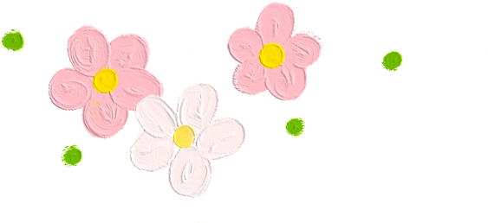
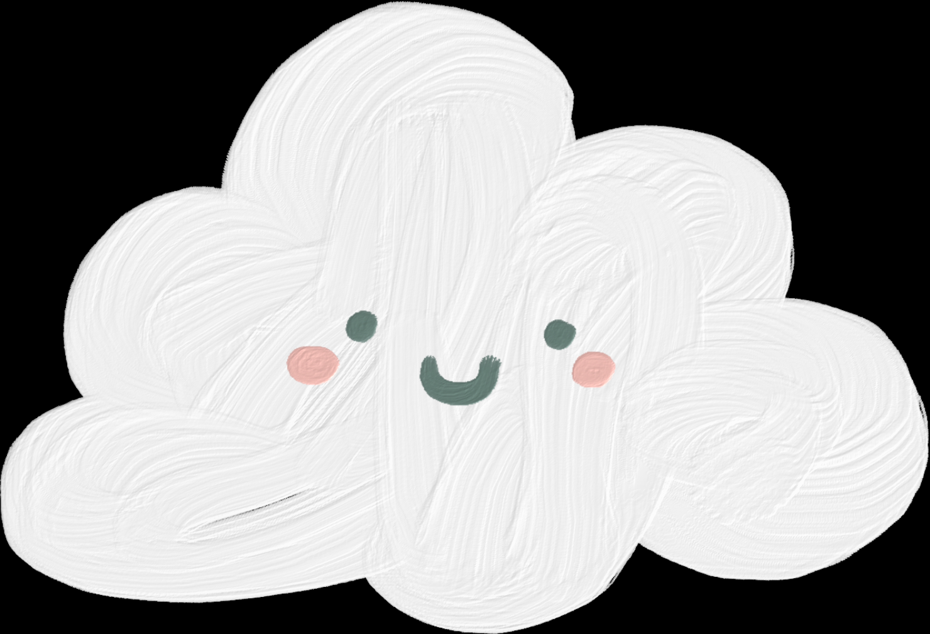
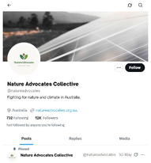
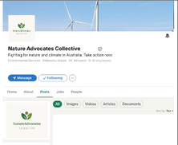
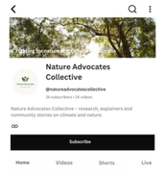
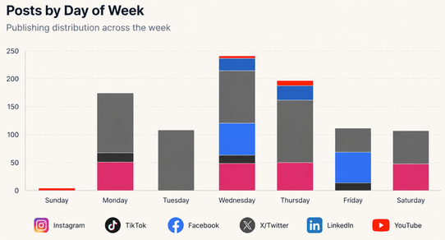
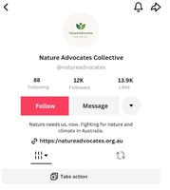
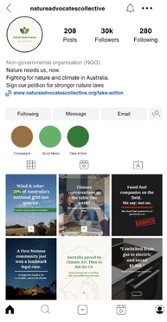
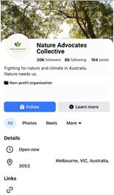
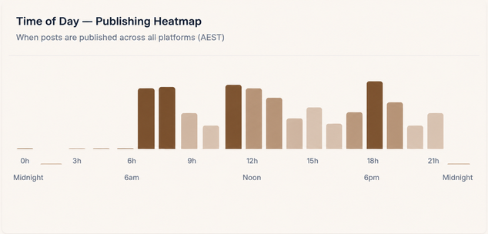
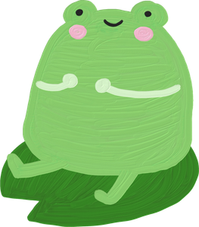



01 · AUDIT RECAP
Key findings from AT1
Strengths to build on
Gaps & opportunities to address
  Posting activity does not consistently align with audience peak times.
  Inconsistent bio copy and link strategy across platforms
  Community storytelling and short-form video generated the strongest engagement across key platforms. (NAC Social Media Dashboard, 2026)
Posts by Day of Week
X/Twitter
LinkedIn
YouTube
  Instagram achieved 0.98% ER, more than double the 0.48% benchmark (NAC Social Media Dashboard, 2026).
TikTok
Instagram
Facebook
  YouTube achieved a 4.90% average ER, above the 3.87% benchmark (NAC Social Media Dashboard, 2026).
Publishing Heatmap
  No YouTube Shorts despite strong existing video performance.
NAC demonstrates strong engagement across social media platforms, and the potential to expand its social media impact, particularly through YouTube Shorts. However, inconsistent platform linking and misaligned posting times may limit audience engagement and action. A more audience focused and consistent content strategy can address these gaps (Clampit, 2017; Quesenberry, 2020).
Source: NAC Social Media Profiles (2026).
Notes:
Draw directly from your AT1 findings here. Keep this to 1–2 slides maximum — your audience already knows the organisation. The purpose is to frame the strategy, not repeat the audit.
5

Slide 5

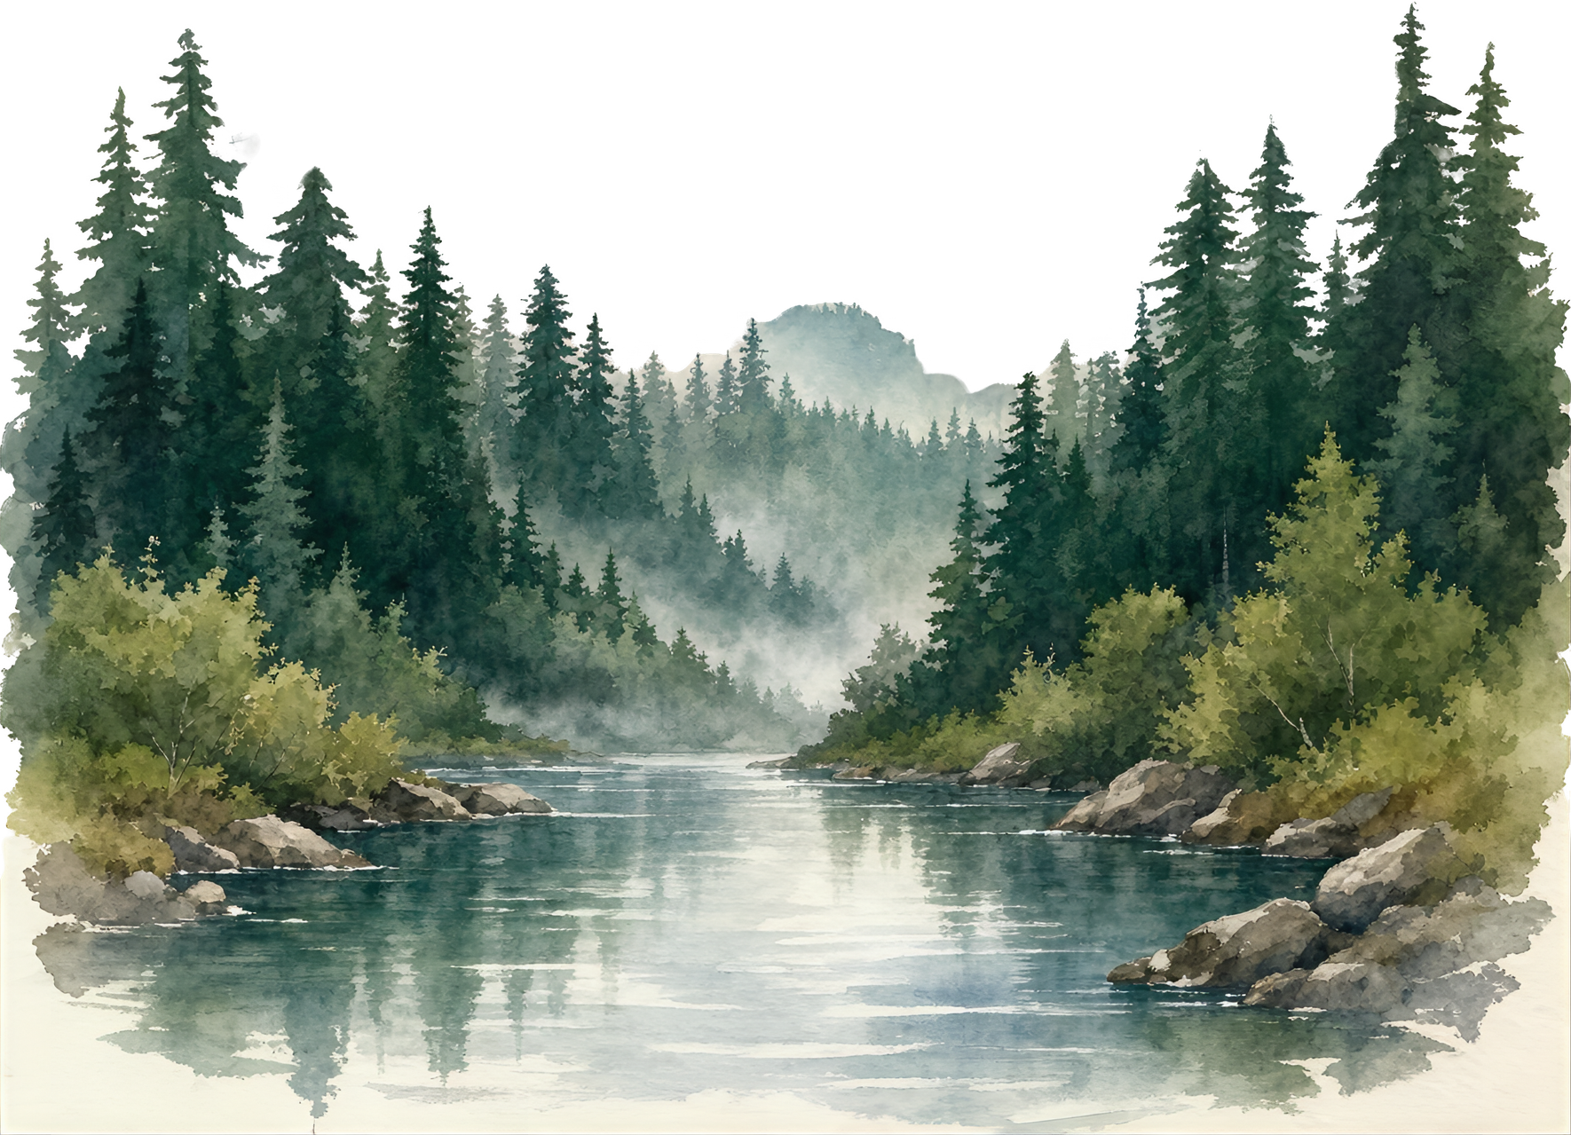
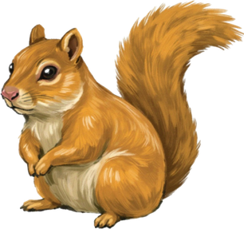

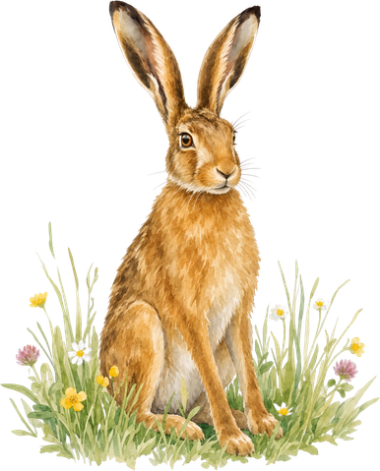
SECTION
02
Content Strategy
Notes:
Section 2 — the strategic thinking. Cover objectives, audience, platform selection, and creative rationale.
6

Slide 6



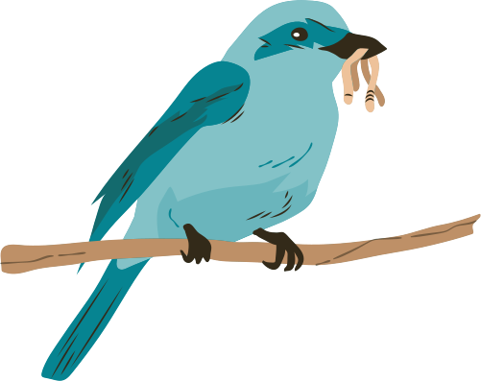


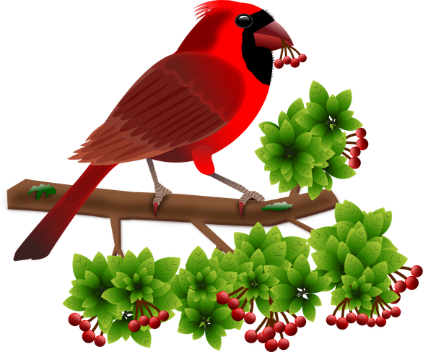

02 · CONTENT STRATEGY
YouTube — content strategy
Objectives for this platform
Establish YouTube Shorts as a consistent content format by publishing 2 - 3 Shorts per week for six months.
Achieve a 6% average engagement rate on YouTube Shorts within six months.
Increase awareness of NAC among climate-engaged Australians aged 25 - 44 by achieving 80K total YouTube Shorts reach within six months.
Notes:
Students should duplicate this slide for each platform they have chosen (minimum three platforms). Encourage them to think about whether their platforms share an audience segment — if so, one shared persona may be more logical than three near-identical ones. The NOTE on the slide gives them permission to adapt the structure.
Each slide should show: 1–3 specific objectives for that platform, rationale linked to AT1 audit findings, and an original audience persona graphic they have designed themselves.
7

Slide 7



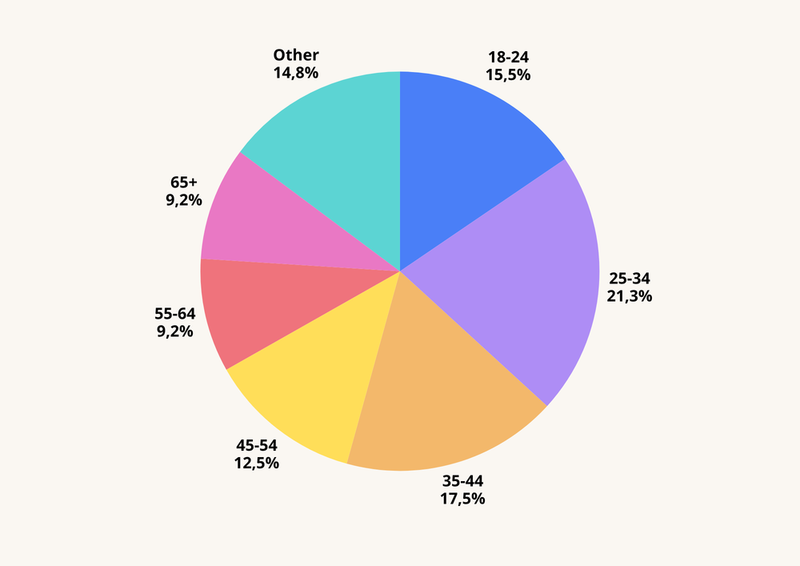


02 · CONTENT STRATEGY
YouTube — content strategy
Why this platform?
YouTube Age Demographic
Audience fit
Millennials are highly active across social media, including YouTube (Sprout Social, 2026). Adults aged 25–44 account for nearly 40% of YouTube users (Chaves, 2026).
NAC’s existing long-form YouTube content achieved a 4.90% average ER, above the 3.87% benchmark, demonstrating an established foundation for audience engagement on the platform (NAC Social Media Dashboard, 2026).
Performance evidence
NAC currently publishes no YouTube Shorts, while Shorts average 200 billion daily views globally, presenting an opportunity to expand NAC’s established video persence into short-from content (NAC Social Media Dashboard, 2026; Chaves, 2026).
Strategic opportunity
Chart created by Ben Nguyen using Canva, based on data from Ispirli (2025).
Notes:
Students should duplicate this slide for each platform they have chosen (minimum three platforms). Encourage them to think about whether their platforms share an audience segment — if so, one shared persona may be more logical than three near-identical ones. The NOTE on the slide gives them permission to adapt the structure.
Each slide should show: 1–3 specific objectives for that platform, rationale linked to AT1 audit findings, and an original audience persona graphic they have designed themselves.
7

Slide 8
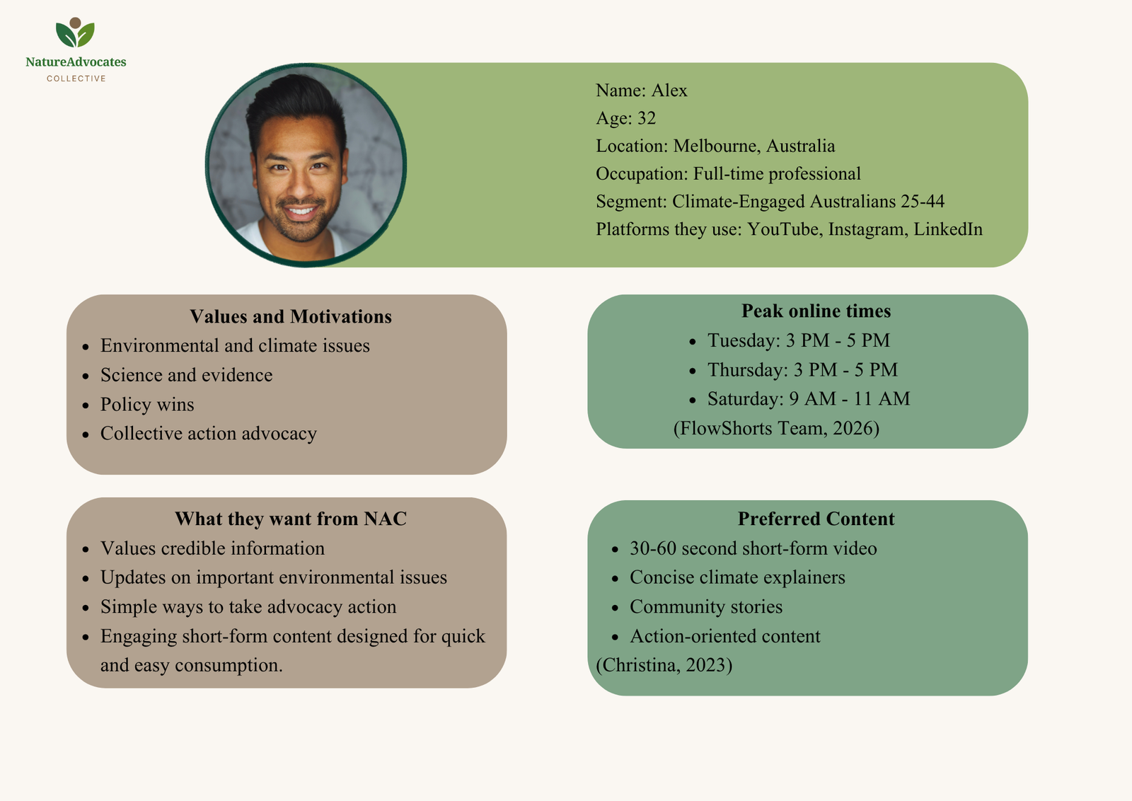
02 · CONTENT STRATEGY
YouTube — content strategy
Audience persona
Source: Persona created by Ben Nguyen using Canva, based on NAC Social Media Dashboard audience data (2026).
Photo by Joseph Gonzalez on Unsplash
Notes:
Students should duplicate this slide for each platform they have chosen (minimum three platforms). Encourage them to think about whether their platforms share an audience segment — if so, one shared persona may be more logical than three near-identical ones. The NOTE on the slide gives them permission to adapt the structure.
Each slide should show: 1–3 specific objectives for that platform, rationale linked to AT1 audit findings, and an original audience persona graphic they have designed themselves.
7

Slide 9





02 · CONTENT STRATEGY
Instagram — content strategy
Objectives for this platform
Establish a consistent Instagram link-in-bio strategy using trackable UTM links within the first month and maintain it for six months.
Schedule at least 80% of Instagram posts within the identified 7 - 9 AM and 5 - 8 PM peak windows, prioritising Wednesday and Thursday, over six months (NAC Social Media Dashboard, 2026).
Increase Instagram’s average engagement rate from 0.98% to 1.5% within six months through audience-tailored content and optimised posting times.
Notes:
Students should duplicate this slide for each platform they have chosen (minimum three platforms). Encourage them to think about whether their platforms share an audience segment — if so, one shared persona may be more logical than three near-identical ones. The NOTE on the slide gives them permission to adapt the structure.
Each slide should show: 1–3 specific objectives for that platform, rationale linked to AT1 audit findings, and an original audience persona graphic they have designed themselves.
7

Slide 10





02 · CONTENT STRATEGY
Instagram — content strategy
Why this platform?
Young Advocates aged 18–24 primarily engage through short-form, shareable content (NAC Social Media Dashboard, 2026). Instagram strongly aligns with this segment, with 41% of Gen Z consumers planning to spend more time on the platform than any other social network (Sprout Social, 2026).
Audience fit
Instagram is NAC’s strongest social platform with 30.0K followers, 885.9K reach with a 0.98% average ER, more than double the 0.48% benchmark (NAC Social Media Dashboard ,2026).
Performance evidence
Consistent UTM-tracked links and peak-time posting can strengthen NAC’s pathway from engagement to action and maximise content exposure (Clampitt, 2017; Landers, 2017).
Strategic opportunity
Notes:
Students should duplicate this slide for each platform they have chosen (minimum three platforms). Encourage them to think about whether their platforms share an audience segment — if so, one shared persona may be more logical than three near-identical ones. The NOTE on the slide gives them permission to adapt the structure.
Each slide should show: 1–3 specific objectives for that platform, rationale linked to AT1 audit findings, and an original audience persona graphic they have designed themselves.
7

Slide 11
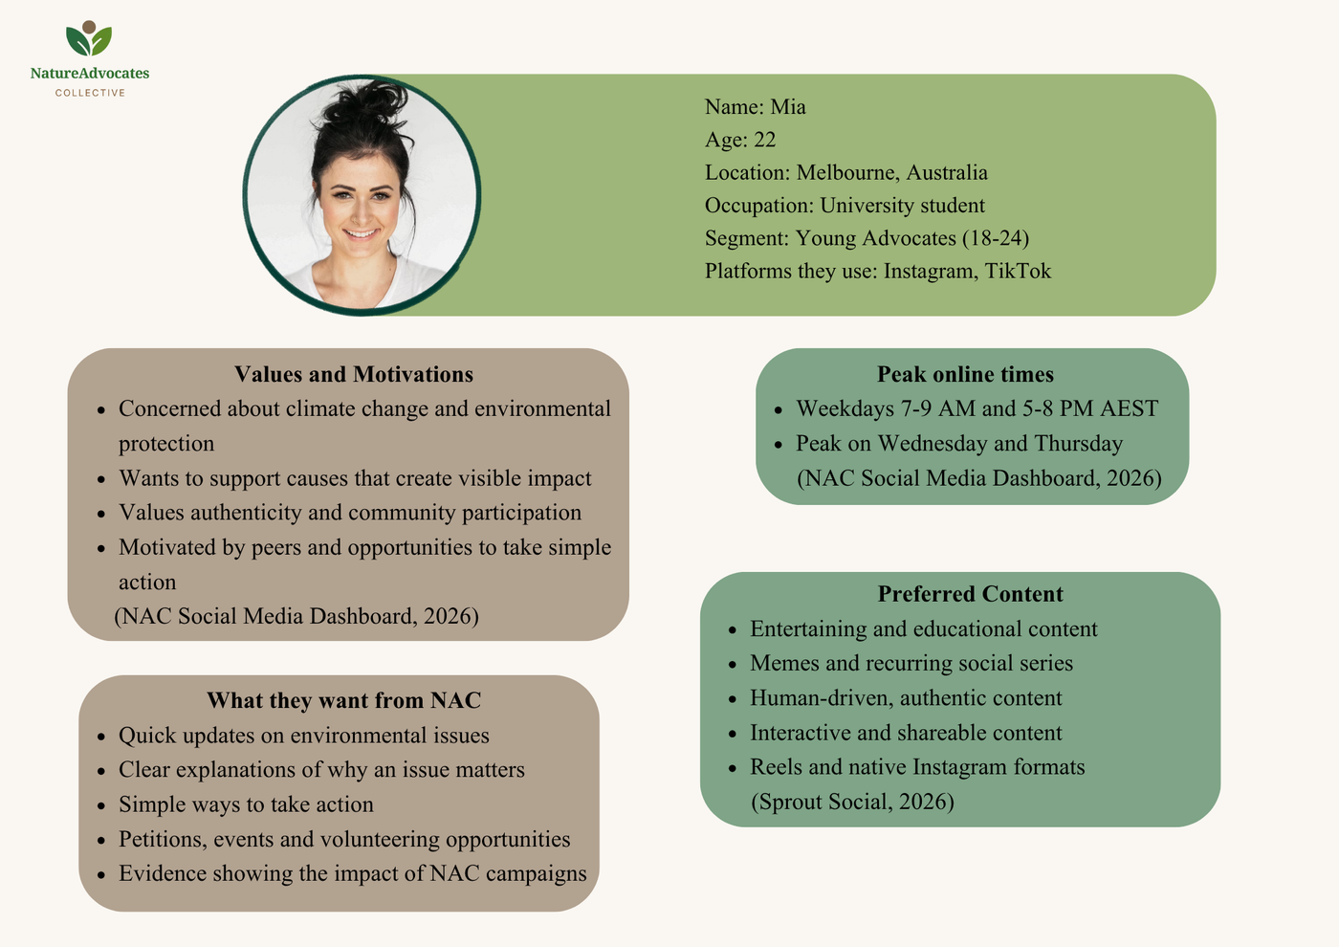
02 · CONTENT STRATEGY
Instagram — content strategy
Audience persona
Source: Persona created by Ben Nguyen using Canva, based on NAC Social Media Dashboard audience data (2026).
Photo by Jake Nackos on Unsplash
Notes:
Students should duplicate this slide for each platform they have chosen (minimum three platforms). Encourage them to think about whether their platforms share an audience segment — if so, one shared persona may be more logical than three near-identical ones. The NOTE on the slide gives them permission to adapt the structure.
Each slide should show: 1–3 specific objectives for that platform, rationale linked to AT1 audit findings, and an original audience persona graphic they have designed themselves.
7

Slide 12





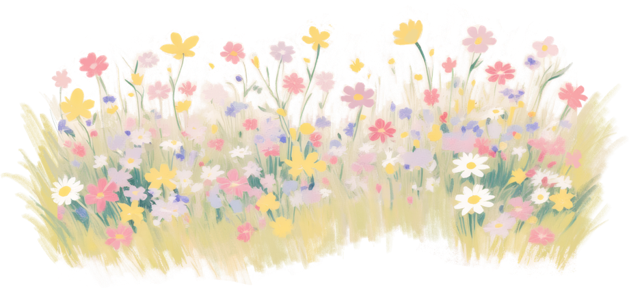
02 · CONTENT STRATEGY
LinkedIn — content strategy
Objectives for this platform
Increase LinkedIn posting frequency to at least two posts per week and maintain this consistently for six months, as posting 2–5 times weekly is associated with higher engagement rates (Lang, 2026).
Schedule LinkedIn posts within NAC’s identified peak windows of 8 - 10 AM and 12 - 1 PM AEST,
Tuesday–Thursday, prioritising Wednesday, for six months (NAC Social Media Dashboard, 2026; Sprout Social, 2026).
Establish consistent UTM-tracked profile links within the first month and maintain them for six months to measure LinkedIn-driven traffic and conversions.
Notes:
Students should duplicate this slide for each platform they have chosen (minimum three platforms). Encourage them to think about whether their platforms share an audience segment — if so, one shared persona may be more logical than three near-identical ones. The NOTE on the slide gives them permission to adapt the structure.
Each slide should show: 1–3 specific objectives for that platform, rationale linked to AT1 audit findings, and an original audience persona graphic they have designed themselves.
7

Slide 13


02 · CONTENT STRATEGY
LinkedIn — content strategy
Why this platform?
NAC’s LinkedIn targets Climate-Engaged Australians aged 25 - 44, a professional audience with potential to support environmental causes. Younger Australians show strong environmental giving intentions, with 41% of Gen Z and 34% of Gen Y likely to support environmentally focused organisations (McCrindle, 2020; NAC Social Media Dashboard, 2026)
Audience fit
LinkedIn achieved a 5.27% engagement rate above the 5.20% benchmark, while top-performing posts reach 12% ER. Community Story is the strongest campaign theme at approximately 7.5% ER, demonstrating strong audience responsiveness (NAC Social Media Dashboard, 2026)
Performance evidence
Strengthen LinkedIn’s engagement by increasing posting frequency to twice weekly, publishing during NAC’s peak audience times, and using UTM links to convert engagement into measurable action (Lang, 2026; NAC Social Media Dashboard, 2026).
Strategic opportunity
Notes:
Students should duplicate this slide for each platform they have chosen (minimum three platforms). Encourage them to think about whether their platforms share an audience segment — if so, one shared persona may be more logical than three near-identical ones. The NOTE on the slide gives them permission to adapt the structure.
Each slide should show: 1–3 specific objectives for that platform, rationale linked to AT1 audit findings, and an original audience persona graphic they have designed themselves.
7

Slide 14
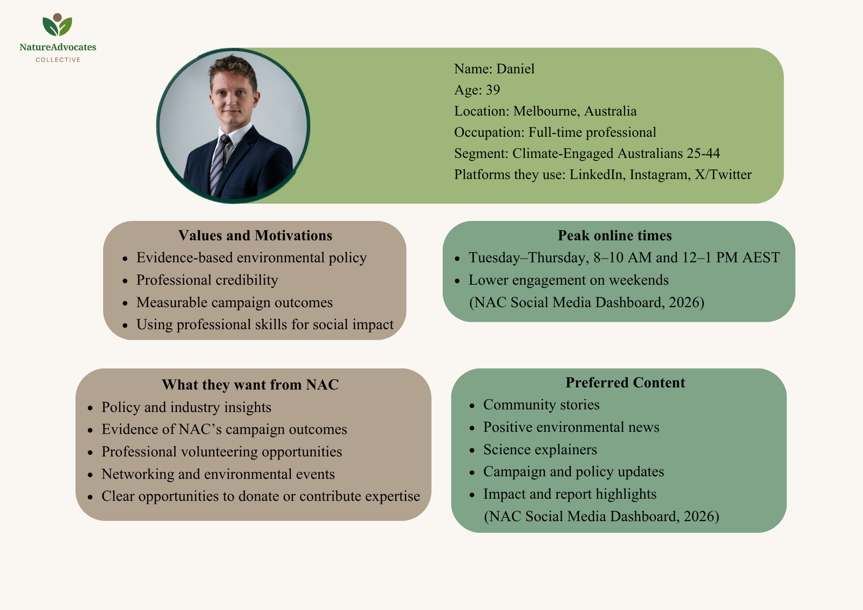
02 · CONTENT STRATEGY
LinkedIn — content strategy
Audience persona
Source: Persona created by Ben Nguyen using Canva, based on NAC Social Media Dashboard audience data (2026).
Photo by Jeppe Mønster on Unsplash
Notes:
Students should duplicate this slide for each platform they have chosen (minimum three platforms). Encourage them to think about whether their platforms share an audience segment — if so, one shared persona may be more logical than three near-identical ones. The NOTE on the slide gives them permission to adapt the structure.
Each slide should show: 1–3 specific objectives for that platform, rationale linked to AT1 audit findings, and an original audience persona graphic they have designed themselves.
7

Slide 15
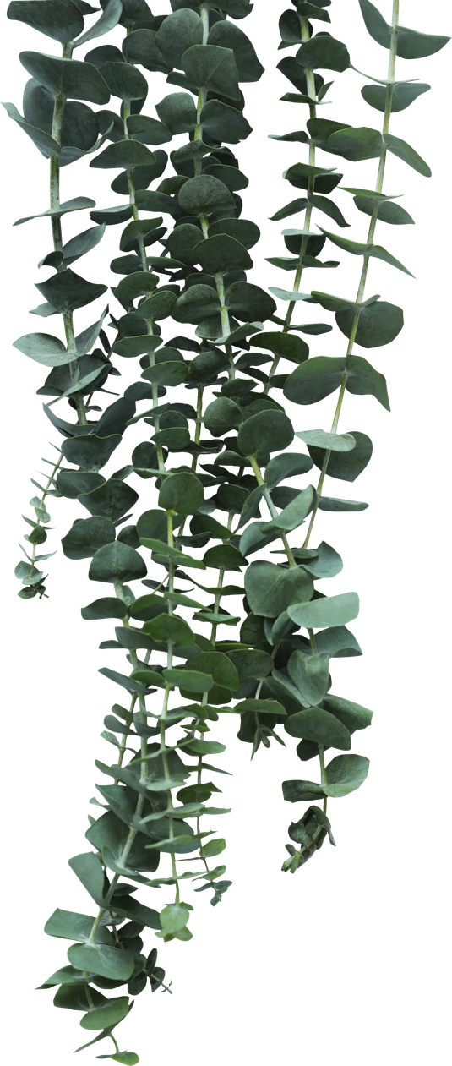
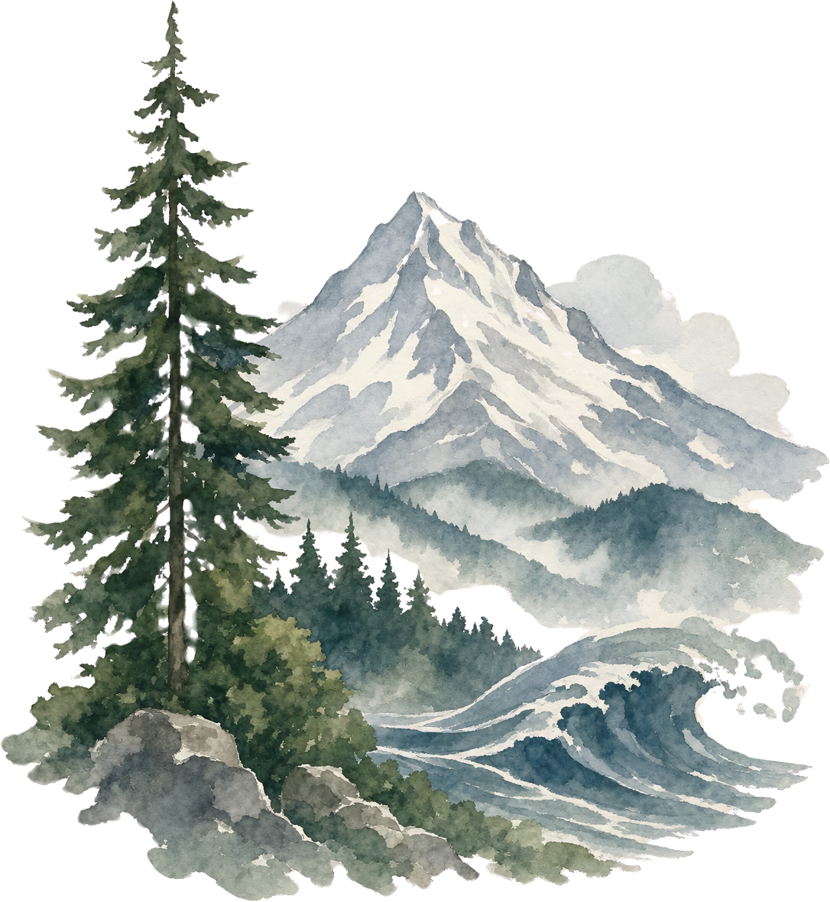



SECTION
03
Creative Content
Notes:
Section 3 — original mock-up content. At least one piece per platform. Aim for a variety of formats (Reel, carousel, infographic, static post). Design these yourself — do not use generative AI to create complete assets.
8

Slide 16
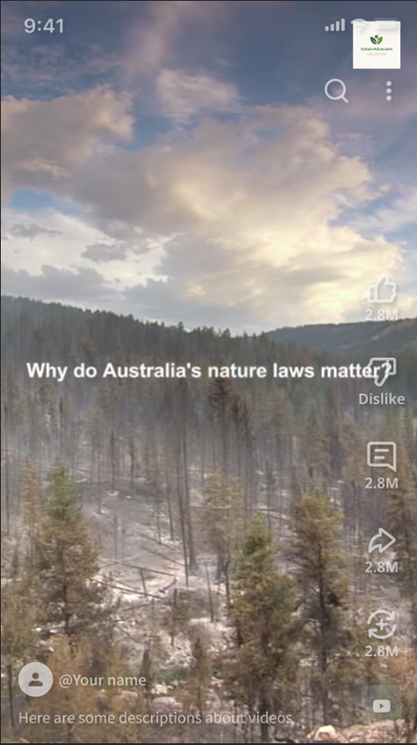

03 · CREATIVE CONTENT
YouTube — 30-Second Climate Explainer
Rationale
Platform choice
YouTube supports content discovery through search, while optimising video topics around audience search intent can improve discoverability (Enge et al., 2023).
Format
30-second video using a strong hook, fast-paced visuals, on-screen captions and a clear CTA.
Theme / campaign
Theme: Nature Laws
Caption / copy
Why do Australia’s nature laws matter? Here’s what they mean for our environment and wildlife.
Learn more. Take action.
Tone & voice
Informative, credible and accessible. Complex environmental information is communicated using simple, audience-friendly language.
Posting time
  Tuesday: 3 PM - 5 PM
  Thursday: 3 PM - 5 PM
  Saturday: 9 AM - 11 AM
(FlowShorts Team, 2026)
Video edited by Ben Nguyen using Capcut and footage from BBC Earth and Top Fives.
https://drive.google.com/file/d/1JRGSSTjqVbYTlq0TlDAk1uOGBflbKKUv/view?usp=sharing
Notes:
Duplicate this slide for each piece of sample content — one slide per mock-up. At least one per platform, at least three platforms total. Aim for a variety of formats: do not submit three static image posts.
9

Slide 17
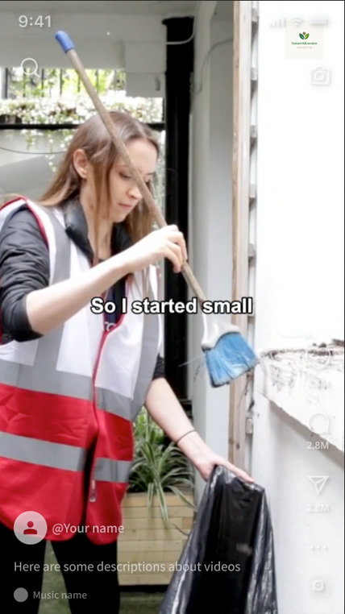


03 · CREATIVE CONTENT
Instagram — Community Story Reel
Rationale
Platform choice
Instagram enables NAC to use visual, human-led storytelling to connect environmental issues with relatable community experiences. Community Story was NAC’s highest-engagement Instagram campaign theme at 1.37% ER (NAC Social Media Dashboard, 2026). Gen Z also prefers human-driven, authentic brand content (Sprout Social, 2026).
Format
20–30 second Reel using human-led storytelling, on-screen captions, authentic footage and a clear CTA.
Theme / campaign
Theme: Community Story
Caption / copy
Meet the people turning climate concern into action. 🌱 Small actions can contribute to collective change. Ready to get involved? Join the NAC community through the link in our bio.
Tone & voice
Personal, authentic, encouraging and community-focused.
Posting time
  Weekdays 7-9 AM and 5-8 PM AEST
  Peak on Wednesday and Thursday
(NAC Social Media Dashboard, 2026)
Video edited by Ben Nguyen using Capcut and footage from Fitzrovia Youth In Action
https://drive.google.com/file/d/1BJIe6mVfnObmC22xMiF0QDSXrY5T8ajk/view?usp=sharing
Notes:
Duplicate this slide for each piece of sample content — one slide per mock-up. At least one per platform, at least three platforms total. Aim for a variety of formats: do not submit three static image posts.
9

Slide 18
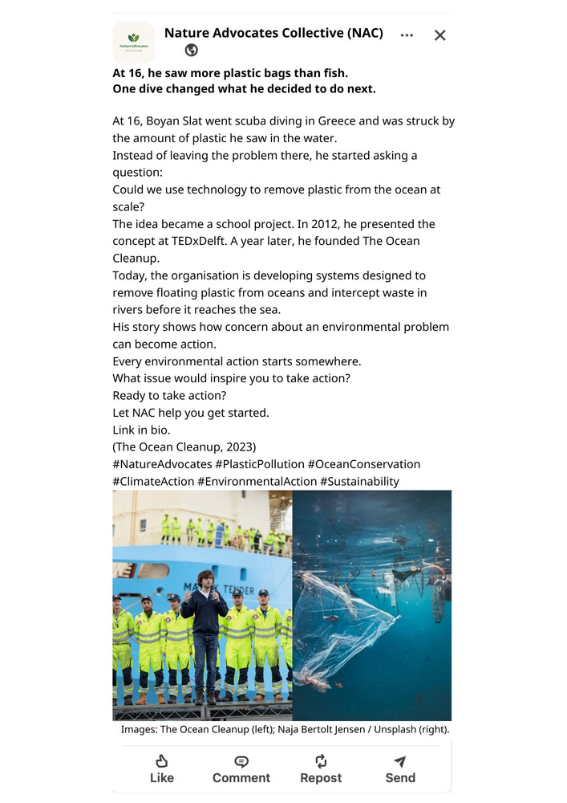


03 · CREATIVE CONTENT
LinkedIn — Community Story Post
Rationale
Platform choice
LinkedIn enables NAC to connect environmental issues with human-led stories for its professional climate audience. Community Story is NAC’s highest-performing LinkedIn campaign theme at approximately 7.5% ER (NAC Social Media Dashboard, 2026).
Format
Curated, image-led LinkedIn post using a strong human hook, concise storytelling, environmental evidence and a clear CTA.
Theme / campaign
Theme: Community Story
Caption / copy
At 16, he saw more plastic bags than fish. One dive changed what he decided to do next.
Tone & voice
Inspiring, credible and informative, connecting individual action with wider environmental impact.
Posting time
  Tuesday–Thursday: 8–10 AM and 12–1 PM AEST
  Prioritise Wednesday
(NAC Social Media Dashboard, 2026; Sprout Social, 2026)
LinkedIn mock-up created by Ben Nguyen using Canva. Images sourced from The Ocean Cleanup and Naja Bertolt Jensen via Unsplash.
Notes:
Duplicate this slide for each piece of sample content — one slide per mock-up. At least one per platform, at least three platforms total. Aim for a variety of formats: do not submit three static image posts.
9

Slide 19


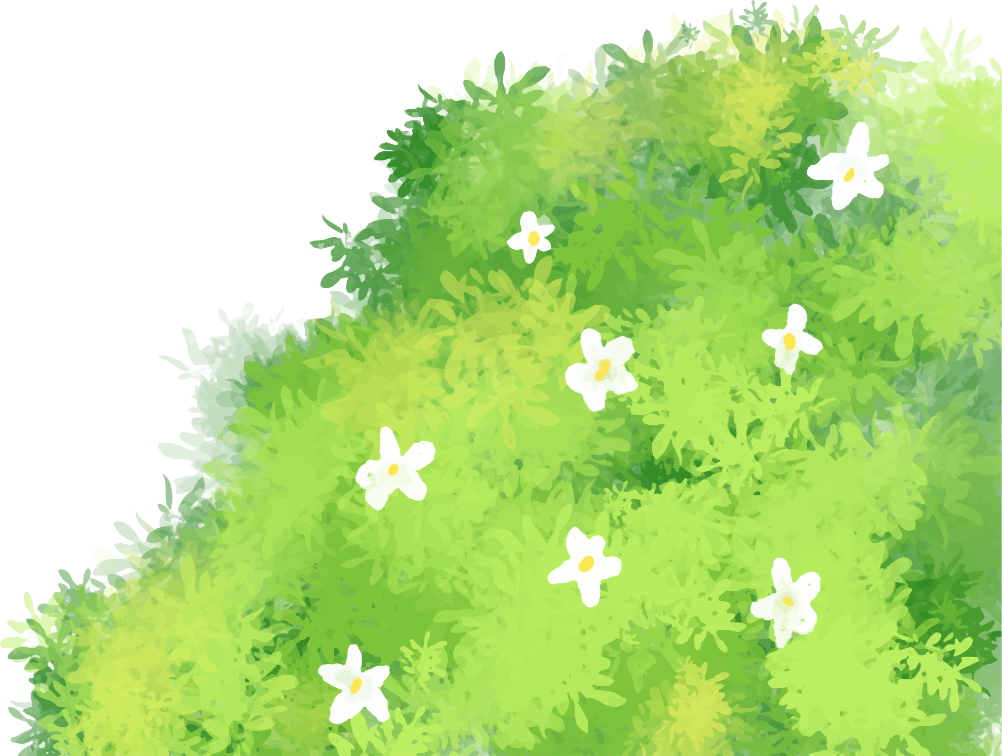

SECTION
04
Content Calendar
Notes:
Section 4 — the one-month content calendar. This must be included in the presentation. Make sure to account for relevant key dates, events and seasons.
10

Slide 20
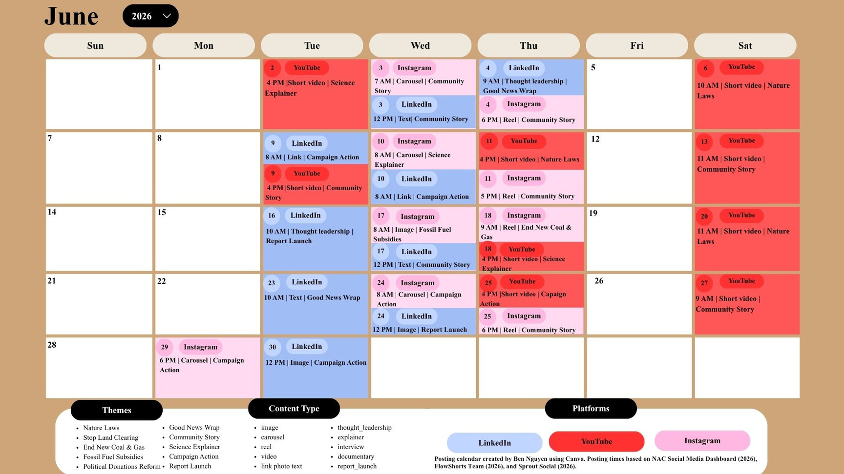
04 · CONTENT CALENDAR
One-month content calendar
Notes:
Design this calendar to reflect realistic publishing frequency. Use the dashboard audience peak times data to justify when content is scheduled. If the table is too small, insert a designed calendar as an image instead.
11

Slide 21




SECTION
05
Conclusion
Notes:
Section 5 — synthesise the strategy and leave the client with clear priorities. Do not simply list the recommendations again.
12

Slide 22




05 · CONCLUSION
Conclusion
  Key audit findings showed strong engagement but several opportunities for improvement: underused YouTube Shorts, limited LinkedIn posting frequency, misaligned posting times, and inconsistent profile linking across Instagram and LinkedIn.
  The content strategy strengthens NAC’s social media presence through consistent, platform-specific content designed to increase audience engagement and convert that engagement into measurable action.
  The recommendations support NAC’s mission through evidence-led content that educates audiences, strengthens community participation, and encourages action to protect Australia’s nature and climate.
  Next step: Establish YouTube Shorts, optimise Instagram and LinkedIn profile links and posting times, increase LinkedIn posting to twice weekly, and implement these recommendations through the content calendar.
By building on what already engages audiences and addressing key content gaps, NAC can create a more consistent, audience-focused strategy that strengthens engagement and encourages meaningful environmental action.
Notes:
Briefly tie your strategy back to NAC's objectives and leave the client energised. This is your last impression — make it confident and forward-looking.
13

Slide 23
References
BBC Earth. (2024, April 14). Forest regenerates after devastating fires | Yellowstone | BBC Earth [Video]. YouTube. https://www.youtube.com/watch?v=45dT2qdG6IE
Chaves, L. (2026, June 27). 50 YouTube Marketing Statistics & Data to know (2026). Vidico. https://vidico.com/news/youtube-marketing-statistics/
Christina. (2023, December 13). Working with millennial video: How to capture millennials’ attention. Bluecarrot.Io. https://bluecarrot.io/blog/working-with-millennial-video-how-to-capture-millennials-attention/
Clampitt, P. G. (2017). Social media strategy: Tools for professionals and organizations. SAGE Publications. https://ebookcentral.proquest.com/lib/deakin/detail.action?docID=5945501
Enge, E., Spencer, S., & Stricchiola, J. (2023). The art of SEO: Mastering search engine optimization (4th ed.). O’Reilly Media. https://learning.oreilly.com/library/view/the-art-of/9781098102609/ch03.html#conclusion-id00020
Fitzrovia Youth In Action. (2019b, June 25). Community planting and clean-up [Video]. YouTube. https://www.youtube.com/watch?v=pbTbqLh1FWs
Fletcher, G., & Adolphus, N. (2021). Creating a successful digital presence: Objectives, strategies and tactics. Taylor & Francis Group. https://ebookcentral.proquest.com/lib/deakin/detail.action?docID=6637038
FlowShorts Team. (2026, March 10). Best time to post YouTube shorts (2026). FlowShorts. Flowshorts.App. https://flowshorts.app/blog/best-time-to-post-youtube-shorts
Ispirli, S. C. (2025). YouTube demographics: The definitive guide for marketers & creators in 2025 - transcribetube. Transcribetube.Com. https://www.transcribetube.com/blog/youtube-demographics
Jeppe Mønster. (2022, March 28). A man in a suit and tie posing for a picture. Unsplash. Unsplash. https://unsplash.com/photos/a-man-in-a-suit-and-tie-posing-for-a-picture-qIZNyuZe638
Landers, J. R. (2017). Crafting the social media assessment report. In P. G. Clampitt, Social media strategy: Tools for professionals and organizations. SAGE Publications. https://ebookcentral.proquest.com/lib/deakin/reader.action?docID=5945501&ppg=187&c=RVBVQg
Notes:
Deakin APA7. Minimum 10 references, at least 5 from unit readings. Include a citation for every visual, graphic and piece of creative content used in the deck — even your own work ("Image created by [Your Name] using Canva").
14

Slide 24
References
Lang, K. (2026). The best time to post on LinkedIn in 2026 (+heatmap graph). Buffer: All-You-Need Social Media Toolkit for Small Businesses. https://buffer.com/resources/best-time-to-post-on-linkedin/
McCrindle. (2020, July 21). Charitable giving behaviour in Australia - McCrindle. Mccrindle.Com.Au. https://mccrindle.com.au/article/charitable-giving-behaviour-in-australia/
Naja Bertolt Jensen. (2024b, February 25). A plastic bag floating on top of a body of water. Unsplash. Unsplash.Com. https://unsplash.com/photos/a-plastic-bag-floating-on-top-of-a-body-of-water-gcLItQZgHYM
Quesenberry, K. A. (2020). Social media strategy: Marketing, advertising, and public relations in the consumer revolution. Rowman & Littlefield Publishers, Blue Ridge Summit. https://ebookcentral.proquest.com/lib/deakin/detail.action?docID=6361196
Social Media Strategy Unit Materials. (2026). NAC Social Media Profiles Dashboard. School of Communication and Creative Arts, Deakin University. https://d2l.deakin.edu.au/d2l/le/content/1691429/viewContent/8800749/View
Social Media Strategy Unit Materials. (2026). Nature Advocates Collective Social Media Profiles. School of Communication and Creative Arts, Deakin University. https://d2l.deakin.edu.au/d2l/le/content/1691429/viewContent/8800749/View
Sprout Social. (2026). The generational marketing playbook: How to engage every age group on social. Sprout Social. https://sproutsocial.com/insights/guides/generational-marketing/#what-is-generational-marketing
The Ocean Cleanup. (2023). Boyan slat • the ocean cleanup. The Ocean Cleanup. https://theoceancleanup.com/boyan-slat/
Top Fives. (2020, June 13). 15 LARGEST trees ever cut down [Video]. YouTube. https://www.youtube.com/watch?v=kFHVnJjIysM
Unsplash. (2017, October 3). Photo by Joseph Gonzalez on Unsplash. Unsplash.Com. https://unsplash.com/photos/man-wearing-white-v-neck-shirt-iFgRcqHznqg
Unsplash. (2020, January 31). Photo by Jake NACKOS on UNSPLASH. Unsplash.Com. https://unsplash.com/photos/woman-in-white-crew-neck-shirt-smiling-IF9TK5Uy-KI
Notes:
Deakin APA7. Minimum 10 references, at least 5 from unit readings. Include a citation for every visual, graphic and piece of creative content used in the deck — even your own work ("Image created by [Your Name] using Canva").
14

